Slide 1
Interviewing for TB Contact Investigation
Notes:
Explain to participants that this session will focus on applying all of the previously learned information on the CI process, communication, and effective interviewing skills to the actual TB contact investigation interview

Slide 2
Learning Objectives
After this session, participants will be able to:
  Describe the objectives of the initial case interview
  List the steps of the interview format
  Describe ways to confront and solve problems that may arise during the interview
Notes:
Review slide content
State that these objectives are an important part of the interview process

Slide 3
Difference Between STD Interview and TB Interview
STD Interview
Usually only 1 interview conducted
Rapport building not so much a priority
Only have to ask about one specific type of contact (sexual) so much less people you will need to follow up with
Transmission period specific
TB Interview
Multiple interviews required
Building rapport is key since you need to ensure patient returns to clinic…and you will have multiple opportunities to re-interview
Have to ask about multiple types of contacts (e.g., all sex partners, family, friends, co-workers, classmates)
Transmission period may be vague, and for a long period of time
Notes:
Before going over components of a TB interview, it is important to point out that there are differences between conducting a CI interview for STD and TB especially for those health care workers who worked in STDs before working in TB
Ask participants if they have worked in STD
If you have participants that have worked in STD, review slide content
If there are no participants that have worked in STDs, there is no need to review the slide

Slide 4

What is the Main Goal of a
TB Interview?
The main goal of a TB interview is to
identify contacts.
Why?
So you can assess them for TB disease and infection and get them on appropriate treatment.
Notes:
**Animated slide**
Review slide content
Click to display “Why” question and answer

Slide 5
When Should the TB Interview Be Conducted?
Initial interview should be conducted
  Within 1 business day of reporting for infectious cases
  Within 3 business days for others
Second interview (re-interview) should be conducted 1 to 2 weeks later
Additional interviews may be needed to gather more information and to build trust
Notes:
Review slide content
Stress that this an ideal situation and may not always be possible to interview the case so quickly

Slide 6

Where Should the Interview Take Place?
Interview should be conducted in person
  Hospital
  TB clinic
  Case's home or living space
  Other location convenient for the case
At least one interview should be conducted in the case’s home or living space
6
Notes:
Review slide content
Clarify that the initial interview should be done wherever the case is during that time frame
Explain to participants that it is important to conduct an interview in the case’s home or living space because it can help them to identify clues that may suggest there are more contacts (e.g., pictures of children, toys laying around)

Slide 7
What are the Objectives of the
Initial Interview?
Establish rapport
Educate the case about TB and the CI process
Verify and expand on information collected in the pre-interview phase
Identify
  Places WHERE they spent time
  Persons with WHOM they spent time
  Participation in activities and events (WHAT and WHEN)
Notes:
Review slide content
Remind participants that they need to focus on the infectious period when identifying people, places, and activities

Slide 8
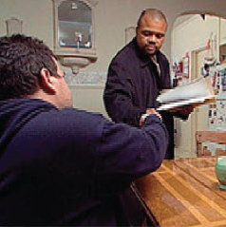
What are the Objectives of the
Re-Interview?
Identify gaps in information
Identify additional contacts
Review/refine the infectious period
Continue to build trust and rapport
Notes:
Review slide content

Slide 9
Effective Interviewer Musts
Build rapport
Maintain confidentiality
Arrange for privacy
Listen actively
Be objective and nonjudgmental
Be creative
Develop a style that works for you
9
Notes:
Review slide content
Explain that everyone has different interviewing styles

Slide 10
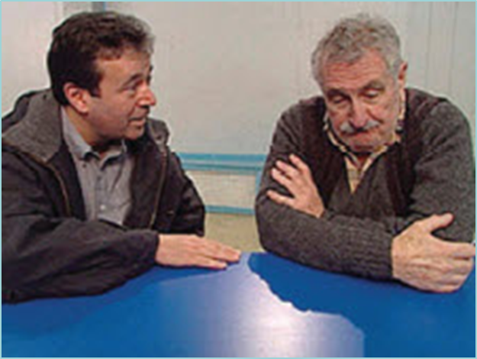
The TB Interview: Video
Notes:
Introduce the CDC “Effective TB Interviewing for Contact Investigations” DVD
Mention that different video interview scenarios will be shown during the session, so participants can observe a variety of interviews and discuss
Note that the interviews were developed to demonstrate correct and incorrect methods.
Show the Introduction section (1:49 minutes) and the first scenario with Jerry (22:09 minutes)
Ask participants
How do you feel about the way Pete continued to ask for Jerry’s contacts?
What communication and interviewing techniques did Pete use effectively in this interview?
How did Pete handle the issue of confidentiality?
Is there anything you would have done differently in this situation?
Note to facilitator: Ensure DVD equipment is working prior to training. View and become familiar with all interview scenarios prior to the course. This will allow flexibility to decide which interview clips to show participants if time becomes an issue.

Slide 11
Interview Format

Slide 12
Interview Format
Introduction
Education
Information collection and confirmation
Contact identification
Conclusion of the interview
Notes:
Review slide content
Explain that this is a suggested guide – interviews don’t always follow this format

Slide 13
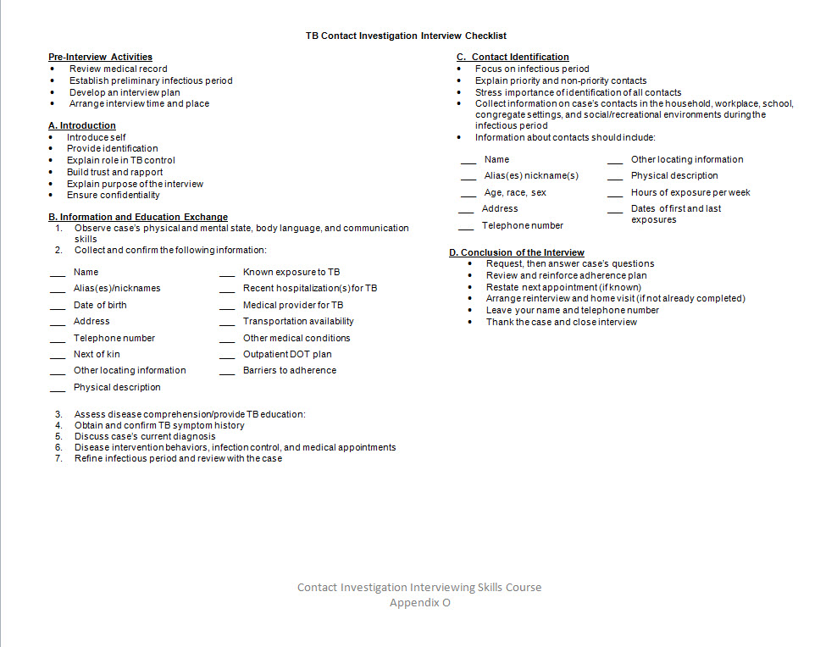
TB Interview Checklist
Refer to Appendix O
Notes:
Explain to participants that it can be helpful to have an interview checklist to make sure everything is covered during the interview
Refer participants to sample checklist in Appendix O

Slide 14
Interview Format
Introduction

Slide 15
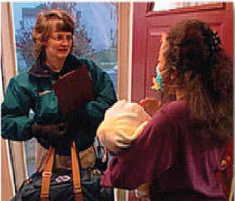
Interview Introduction (1)
The first interaction with the case can influence the remainder of the interview
Building trust and rapport early in the interview process is essential
Notes:
Review slide content
State that this was discussed earlier in the course

Slide 16

Interview Introduction (2)
Introduce yourself and shake hands if appropriate
Provide a business card or other identification
Explain your role in the TB program
Ask the case how they are feeling
Demonstrate respect towards the case
Notes:
Review slide content

Slide 17
Explain the Purpose of the Interview
Explain the purpose of the interview to the case
  To identify contacts at risk of infection and refer them for medical assessment
  To provide TB education
17
Notes:
Review slide content
State that if possible, interviewers should set the expectations for the interview. For example, explain to the case how long the interview will last, what information you hope to collect, etc.

Slide 18
Discuss Confidentiality
    Explain that information will only be shared with persons who need to know
      Health care providers who provide direct care
      Public health authorities for the purpose of TB control
    Stress that confidentiality is reinforced by local program policies and state regulations
18
Notes:
Review slide content
Stress that the protection of private information is essential in TB contact investigations and that public health workers must be familiar with established confidentiality policies and procedures for their jurisdiction and adhere to these at all times
State that emphasizing confidentiality should not take more than a few minutes unless the client has specific concerns. If you spend too much time on confidentiality, the case may become frightened.
Ask participants if they have any additional questions on confidentiality
Let participant’s know that maintaining the confidentiality of the case when assessing contacts will be discussed on Day 4

Slide 19
Interview Format
Education

Slide 20

Importance of Education
Increases knowledge of TB
Influences desired behavior
  Identification of contacts
  Treatment adherence
  Infection control activities
Helps the case make informed decisions
Notes:
Review slide content
State that education should not be the main focus of the interview. If a significant amount of time is spent on health education, the case may get exhausted before the end of the interview and not be willing to share additional information when the time comes to name contacts. The interviewer should learn how to balance between providing necessary information and focusing on obtaining contact information

Slide 21
What Education Should be
Provided to the Case?
The case should be educated about the following:
Components of treatment and care plan
Infection control measures
Importance of maintaining medical care
Importance of the contact investigation
Notes:
Review slide content
Explain that some of these activities depend on how the TB program is set up – not every investigator will do this
Explain that it is important to assess the case’s knowledge before discussing education
Note to facilitator: These 4 topics are discussed in more detail on the following slides

Slide 22
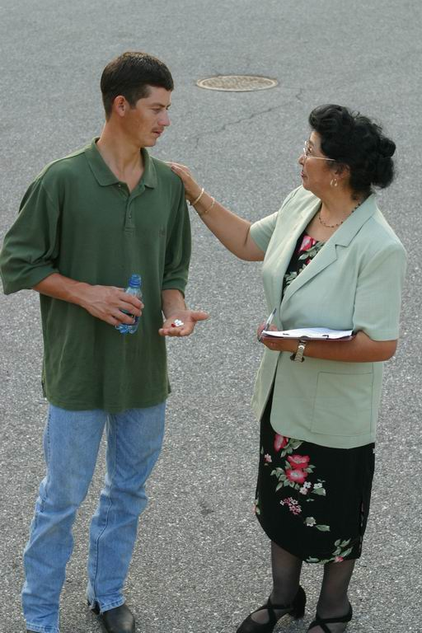
1. Treatment and Care Plan
Explain that medications kill TB germs when taken properly
Stress the importance of treatment adherence and follow-up medical care
Establish a specific schedule for treatment
Notes:
Review slide content

Slide 23
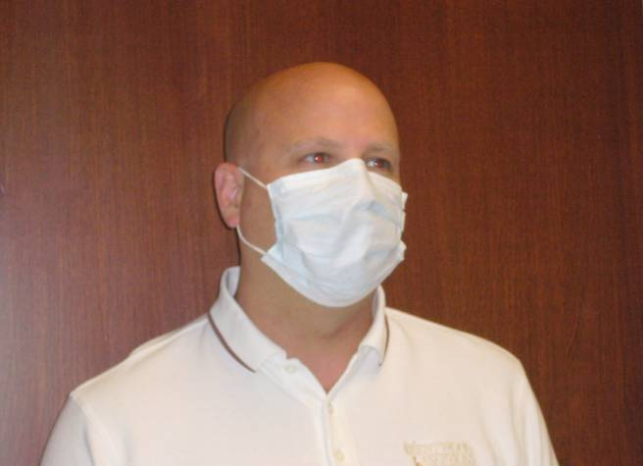
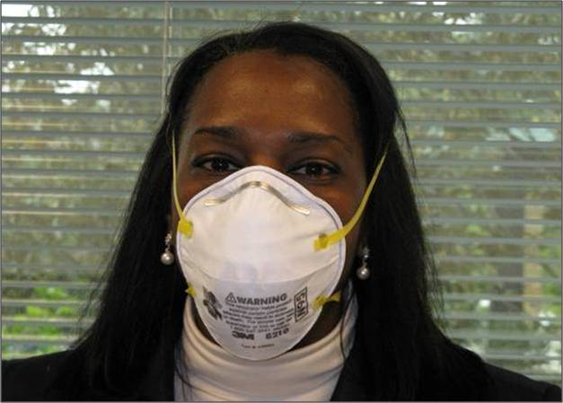
2. Infection Control Measures
  Review the importance of the case using a mask or tissue to cover cough
  In some situations, the interviewer may need to wear a respirator to protect themselves from inhaling TB germs/bacteria
  Discuss the importance of ventilation
  Describe other topics as appropriate
    Home isolation
    Visitors to the home
    Return to work or school
23
Notes:
Review slide content

Slide 24
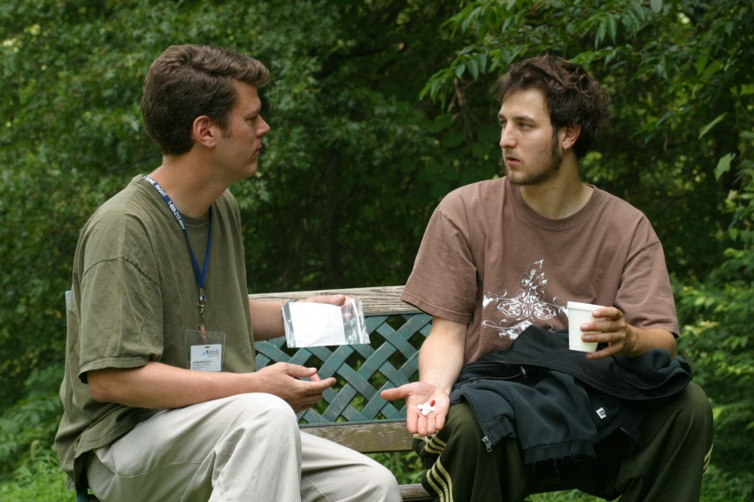
3. Importance of
Maintaining Medical Care
Discuss the importance of:
Adhering to all medical appointments and directly observed therapy (DOT)
Sputum collection, chest x-rays, and medical evaluations
24
Notes:
Review slide content

Slide 25
4. Importance of Contact Investigation
Stress the importance and urgency of identification of all contacts
Emphasize the role of the case in helping to protect family and friends from TB
Notes:
Review slide content

Slide 26
What is Effective Education?
Listening carefully
Asking questions
Understanding the case’s needs and concerns
Demonstrating a caring attitude
Helping to solve problems
Clarifying misinformation
Notes:
Explain that effective education is more than just providing information
Review slide content
State that a balance is needed between educating the case on TB and eliciting information about contacts
An example of demonstrating a caring attitude – If the case is getting tired, the interviewer can say that they will come back later for the information

Slide 27
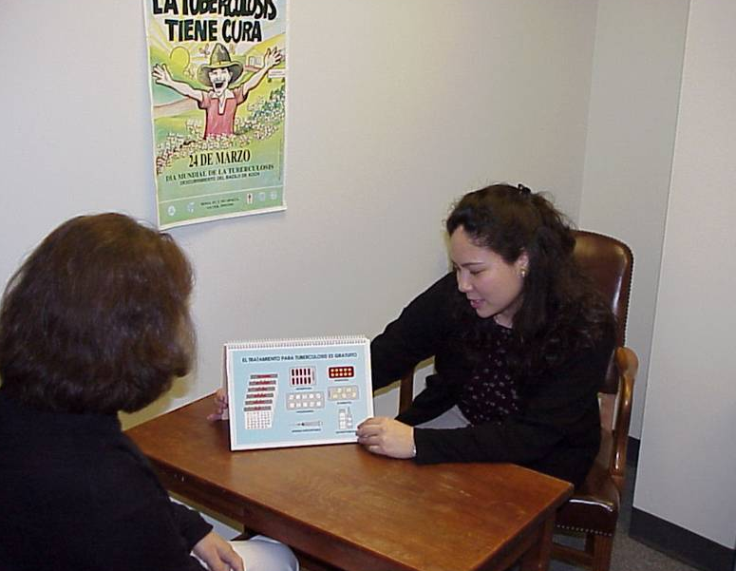
Tips for Providing Effective Education (1)
Use visuals
Visuals can complement verbal and written information
  Pictures
  Calendars
  Flipbooks
Real-life examples
  Pills
Notes:
Review slide content

Slide 28






Tips for Providing Effective Education (2)
Use culturally appropriate materials
28
Notes:
Mention culturally appropriate educational materials available through the CDC Division of TB Elimination Website (www.cdc.gov/tb)
Point out a brochure specifically about CI (highlighted in pink)

Slide 29
Tips for Providing Effective Education (3)
Speak clearly and simply
Use simple non-medical terms
Use familiar words the case will understand
  Simple: “These pills will help you get better”
  vs.
  Complex: “This drug, isoniazid, is a bactericidal agent that is highly active against Mycobacterium tuberculosis.”
Notes:
Review slide content
State that using words familiar to the case will make the information more relevant to them. Never talk down to cases. It is easy to sound condescending or preachy without meaning to.

Slide 30
Medical Terminology Exercise
Appendix P
30
Notes:
Refer participants to Appendix P
Ask participants to pair up, complete, and discuss the exercise
Discuss participant answers in a large group discussion
Note to facilitator: If time is an issue, instruct participants to complete only a portion of the exercise.
Time: 5-10 minutes

Slide 31
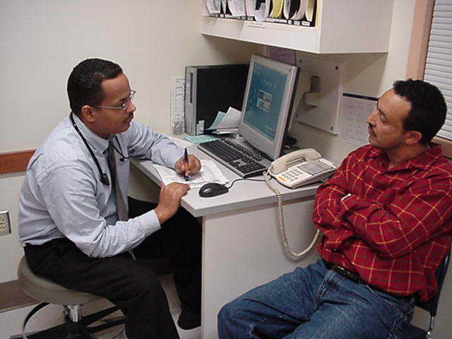
The TB Interview: Video
Notes:
Show the third scenario with Sheila (24:16 minutes)
Ask participants
How well did Marianne handle sensitive questions related to infectiousness, contacts, and HIV status?
What were some of the benefits of the home visit?
What might Marianne have done differently in this scenario?

Slide 32
Interview Format
Information Collection and Confirmation

Slide 33
Information Collection and Confirmation
During the interview, information previously collected during the pre-interview phase should be reviewed and confirmed
Personal information
Medical information
Infectious period
Notes:
Review slide content

Slide 34

Confirm Personal Information
Full name, aliases, and nicknames
Date of birth
Place of birth
If born in another country, date arrived in United States
Current address
Telephone number
Next of kin
Emergency contact information
Physical description
Other locating information
Notes:
Review slide content

Slide 35
Confirm Medical Information (1)
Obtain and/or confirm:
Known exposure to TB (who, where, when)
Recent hospitalization for TB (name of hospital, admission date, discharge date)
Other medical conditions
HIV status
Substance use (frequency, type, how long)
Medical provider for TB (private or public clinic, name, telephone number, address)
DOT plan (where, when, by whom)
Any barriers to adherence
Notes:
Review slide content
State that it is important to help the case retrieve this information as much as possible

Slide 36
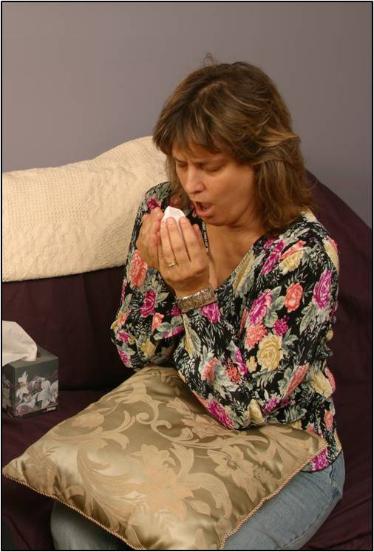
Confirm Medical Information (2)
Review the following symptoms, including onset dates and duration:
Cough
Coughing up blood
Hoarseness
Unexplained weight loss
Night sweats
Chest pain
Loss of appetite
Fever
Chills
Fatigue
Notes:
Review slide content
State that asking the case about specific holidays/events can help jog their memory of when symptoms began. For example, “Did you have any symptoms around Thanksgiving? Your birthday?” This information is needed to refine the infectious period.

Slide 37
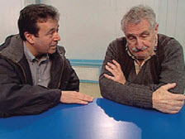
Confirm Medical Information (3)
Discuss the case’s current diagnosis
TST or IGRA results
Site of disease
Symptom history
Radiographic and bacteriologic results
Notes:
Review slide content
Emphasize the importance of reviewing the case’s current diagnosis

Slide 38
Review the Infectious Period
Refine the previously established infectious period based on a medical record review
Review the significance of the infectious period with the case and discuss its role in the contact identification
Notes:
Review slide content
Point out that the infectious period may be revised several times during the investigation depending on the information gathered

Slide 39
Interview Process
Contact Identification

Slide 40
Contact Identification (1)
Contact identification is the most important part of the initial interview with the case
Get as much information as possible about contacts from the case during the interview
  Talk to the case as if it is the last time you will see them
40
Notes:
Review slide content
Emphasize that identifying contacts prevents future cases
Note that the case may leave the hospital against medical advice or give incorrect locating information, so it is important to gather as much information as possible

Slide 41
Contact Identification (2)
To help identify contacts, interviewers should collect and confirm information regarding:
  Places WHERE they spent time
  Persons with WHOM they spent time
  Participation in activities and events (WHAT and WHEN)
Notes:
Review slide content

Slide 42
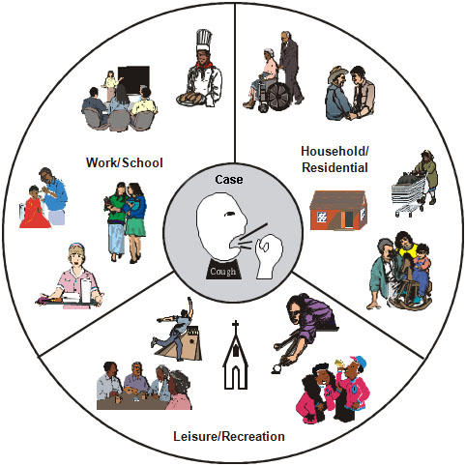
  Identify Places WHERE Case
  Spent Time (1)
Ask the case where they spent time during the infectious period
Residence
Work, school, or volunteer sites
Social, leisure, religious, or recreation sites
Sites where illicit activities might have occurred
Homeless shelters or jails
Notes:
Review slide content
Stress the importance of asking the case where they spent time

Slide 43

  Identify Places WHERE the Case
  Spent Time (2)
After getting the list of places, ask the case about
Amount of time spent at each
Environmental characteristics
  Number of rooms
  Room size/square footage
  Crowding
  Ventilation
    Windows open or closed
    HVAC systems
Notes:
Review slide content
Note to facilitator: HVAC stands for heating, ventilation, and air conditioning

Slide 44
Identify Places WHERE the Case
Spent Time (3) - Residence
Residence can include:
  House
  Apartment
  Congregate settings
    Nursing home
    Assisted living facilities
    Dormitory
    Correctional facility
    Shelters
Notes:
Review slide content

Slide 45


  Identify Places WHERE the Case
  Spent Time (4) - School
If attending school, collect information regarding:
Name of school, address, telephone number
Grade in school
Hours per day/week
Transportation type to and from school, length of commute
45
Notes:
Review slide content
Explain that this is the type of information an interviewer should collect if the case is attending school
Ask participants if there is any other information that should be collected

Slide 46
Identify Places WHERE the Case
Spent Time (5) - Workplace
If employed, collect information regarding:
  Employer name, address, telephone number
  Full or part-time, hours worked per day/week
  How long employed
  Transportation type to and from work, length of commute
  Occupation/type of work
  Indoor or outdoor work space, enclosed or open work space
If unemployed
  Source of income
Notes:
Review slide content

Slide 47
  Identify WHO the Case Spent Time With (1)
Ask the case who they spent time with during the infectious period, for example:
Wife, husband, or partner
Children
Household members
Other family members
Friends
Roommates
Cellmates
Coworkers
Notes:
Review slide content
Explain to the participants the importance of asking about contacts who may have TB or would rapidly progress to TB disease if infected (e.g., contacts who have HIV, children)

Slide 48

Identify WHO the Case Spent Time With (2)
Ask for names and aliases of contacts
Ask if contacts
  Have TB symptoms
  Have weakened immune systems
  Are children younger than 5 years of age
Notes:
Review slide content
Emphasize infectious period

Slide 49

  Identify WHEN and WHAT Activities or Events the Case Participated In (1)
Ask about activities during infectious period
  Travel, vacations
  Social events
  Holidays
Ask the case to review calendar or appointment book
Review cell phone logs and social networking sites (e.g., Facebook)
Notes:
Review slide content

Slide 50


  Identify WHEN and WHAT Activities or Events the Case Participated In (2)
Examples of social/recreational places and activities
  Hangouts, bars, clubs
  Team sports
  Community centers
  Bands, choir
  Places of worship
Ask about the number of hours per day/week, and means of transportation
Notes:
Review slide content

Slide 51
What Information Should Be Collected About Contacts?
Name/aliases/nicknames
Relationship to the case
Address, telephone number, and other locating information
Hours of exposure per week and date of first and last exposure
Setting in which exposure took place
Age, sex, race, and physical description
Notes:
Review slide content
Note that each of these topics will be discussed in greater detail on the next few slides

Slide 52
Process for Collecting Contact Information (1)
Contact and place information can be gathered using the following format:
1. Name | 2. Relationship | 3. Locating | 4. Exposure Time | 5. Setting Size | 6.Description
Notes:
Explain that this strategy is helpful because it emphasizes gathering all of the names of the contacts first. Sometimes cases may become fatigued if they need to respond to all of the information about each contact upfront, therefore they may leave out additional contacts.

Slide 53
Process for Collecting Contact Information (2)
1. Name
Get a name and/or alias
Ask the case to list as many contact names as possible before moving on
Notes:
Review slide content

Slide 54
Process for Collecting Contact Information (3)
1. Name | 2. Relationship
Ask the case what their relationship is to the contact
  Spouse
  Boyfriend/Girlfriend
  Child
  Friend
  Co-worker
  Classmate
  Roommate
  Teammate
  Any other “mate”
Notes:
Review slide content
Note that this step can be combined with the previous step

Slide 55
Process for Collecting Contact Information (4)
1. Name | 2. Relationship | 3. Locating
Collect information on how to get in touch with the contact:
Address or map to home/living space
Phone number
Best time to contact
Email address
Notes:
Review slide content

Slide 56
Process for Collecting Contact Information (5)
1. Name | 2. Relationship | 3. Locating | 4. Exposure Time
Gather exposure information for each contact:
  First and last time the case saw the contact
  Frequency of interaction
Use significant dates (birthdays, holidays, etc.) to jog case’s memory
Notes:
Review slide content

Slide 57
Process for Collecting Contact Information (6)
1. Name | 2. Relationship | 3. Locating | 4. Exposure Time | 5. Setting Size
Determine the size of the setting in which exposure took place:
Size of a bedroom?
Size of a car/van?
Size of a house?
Notes:
Review slide content
Explain to participants that asking the case about the setting size in terms of well-known items (e.g., a car) could help provide information about the likelihood that transmission may have occurred (for example, if the setting was small like a car, it is more likely that TB was transmitted vs. if the setting was very large, like a house)

Slide 58
Process for Collecting Contact Information (7)
1. Name | 2. Relationship | 3. Locating | 4. Exposure Time | 5. Setting Size | 6.Description
Obtain a detailed physical description for each contact
Age
Hair color and length
Height
Weight
Complexion
Identifying features (e.g., tattoos, piercings)
Notes:
Review slide content
Explain that this information is especially useful if you do not have the full name of the contact

Slide 59

Contact Identification Exercise
Refer to Appendix Q
Notes:
Refer participants to Appendix Q
Ask participants to pair up, complete, and discuss the exercise
Time: 10 minutes

Slide 60
Interview Process
Conclusion of the Interview

Slide 61
Conclusion of the Interview (1)
Answer the case’s questions.
Review and reinforce all components of the adherence plan.
Evaluate the case’s remaining needs or potential adherence problems.
Confirm the date of the next medical appointment, if known.
Notes:
Review slide content

Slide 62
Conclusion of the Interview (2)
Arrange for both a re-interview and home visit, if not already completed.
Confirm referral procedure of each contact.
Leave information on how the case can contact you.
If appropriate, shake the case’s hand, express appreciation, and close the interview.
Notes:
Review slide content

Slide 63
Problem Solving During the Interview

Slide 64
Potential Interview Problems
The case:
Does not believe or trust the health care worker
Will not talk
Is distracted or not paying attention
Is hostile, abusive, or aggressive
64
Notes:
Review slide content
Ask participants for examples of other problems they have encountered

Slide 65
Methods to Confront and Solve Problems
Provide Information
Direct Challenge
Self-Involvement
Withdrawal of Reinforcement
65
Notes:
Review slide content

Slide 66
1. Provide Information
Use a factual statement to challenge what a case has told you.
For example:
If the case says: “I knew I shouldn’t have shaken my neighbor’s hand when he offered it.”
How would you confront this statement by providing information?
66
Notes:
** Animated slide**
Review slide content
Click to display example of case statement
Ask participants how they can confront the statement using the “providing information” method
State that one way to confront the statement by providing information is to say: “Seems like you believe you got TB from shaking someone’s hand. From what we know about the disease, that isn’t possible.”

Slide 67
2. Direct Challenge
A direct challenge is confronting a statement that is false. Use when the case says something which can lead to greater problems if not addressed.
For example:
A case denies any contact with children. However, there are toys in the front yard and a picture of the case and a baby hanging on the wall.
How would you directly challenge this statement?
67
Notes:
** Animated slide**
Review slide content
Click to display example of case statement
Ask participants how they can confront the statement using the “direct challenge” method
State that one way to directly challenge the statement is to say: “You know TB is very dangerous for young children. Who plays with those toys in the front yard?”

Slide 68
3. Self Involvement
Used to challenge information or commitments a case has made in interviewer’s presence.
For example:
A case states that they don’t have a phone number for a contact. When looking through their cell phone address book, with permission, you notice a number for that contact.
How would you use self-involvement
to address this statement?
68
Notes:
** Animated slide**
Click to display example of case statement
Ask participants how they can confront the statement using the “self involvement” method
State that one way to use self-involvement is to say: “Let’s try calling that phone number right now to see if it is still current.”

Slide 69
4. Withdrawal of Reinforcement
Designed to appeal to a case’s need for positive reinforcement: the interviewer expresses disappointment with the case’s present behavior and/or withdraws positive feedback previously given.
For example:
“You know, I thought you acted responsibly by coming into the clinic so quickly; however, by saying that you don’t care if your co-workers get examined for TB, that’s demonstrating little concern for their health.”
69
Notes:
Review slide content
State that this technique should be used with care

Slide 70
If You Continue to Have Challenges…
Recognize the need to stop and reschedule a stalled interview.
Assign another team member to conduct the interview at a later time if you are unable to gather necessary information.
Notes:
Review slide content
Explain that it is ok to switch interviewers

Slide 71
The TB Interview: Video
Notes:
Show the second scenario with Javier (17:03 minutes)
Ask participants
What they thought of the way Khalil dealt with Javier’s home remedy (tea)?
What might they have done differently in this scenario?
Any other things that could have been improved upon – cultural issues, building rapport, etc.?

Slide 72
Review
  What are the objectives of the initial case interview?
  What are the steps of a TB interview?
  What are some ways in which to confront and solve problems that may arise during the interview?
Notes:
Ask participants to answers to the review questions
Note to facilitator: Answers to review questions:
Objectives of the initial case interview are to:
Identify contacts
Establish rapport
Educate the case about TB and the CI process
Verify and expand on information collected in the pre-interview phase
Identify: Places case spent time (WHERE), persons case spent time with (WHO), and activities/events where case participated (WHEN and WHAT)
The steps of the TB interview format are:
Introduction
Education
Information collection and confirmation
Contact identification
Conclusion of the interview
Ways to confront and solve problems include:
Provide Information
Direct Challenge
Self-Involvement
Withdrawal of Reinforcement

