Slide 1
STEADI Our Staff for Fall Prevention
Name, Title
Affiliation
Date
Disclaimer: Slide content developed by the Centers for Disease Control and Prevention

Slide 2
How to Use These Slides
Purpose: Train staff on using the STEADI initiative to prevent falls
Target audience: Healthcare providers and clinic staff
Slide order can be modified to fit your presentation
Slides 4, 38, and 39 can be customized
Some slide notes include suggested talking points
Resource gallery showcases referenced STEADI resources
References are listed at the end of presentation by slide number

Slide 3
Presentation Overview
This presentation will highlight:
The burden of falls
Risk factors for falls
How we can prevent falls
Tips for implementing a fall prevention program
Screening for fall risk
Assessment of fall risk factors
Effective strategies to reduce fall risk
Follow-up with patients
Available tools and resources

Slide 4
Your Thoughts and Experiences with Falls
How have falls among older adults (age 65+) affected you?
Have you or someone you know fallen?
What kind of life-changing events occurred because of the fall?
How could the fall have been prevented?
Notes:
Ask your audience about their experiences with falls among older adults living in the community. We define older adults as anyone aged 65 years and over.

Slide 5
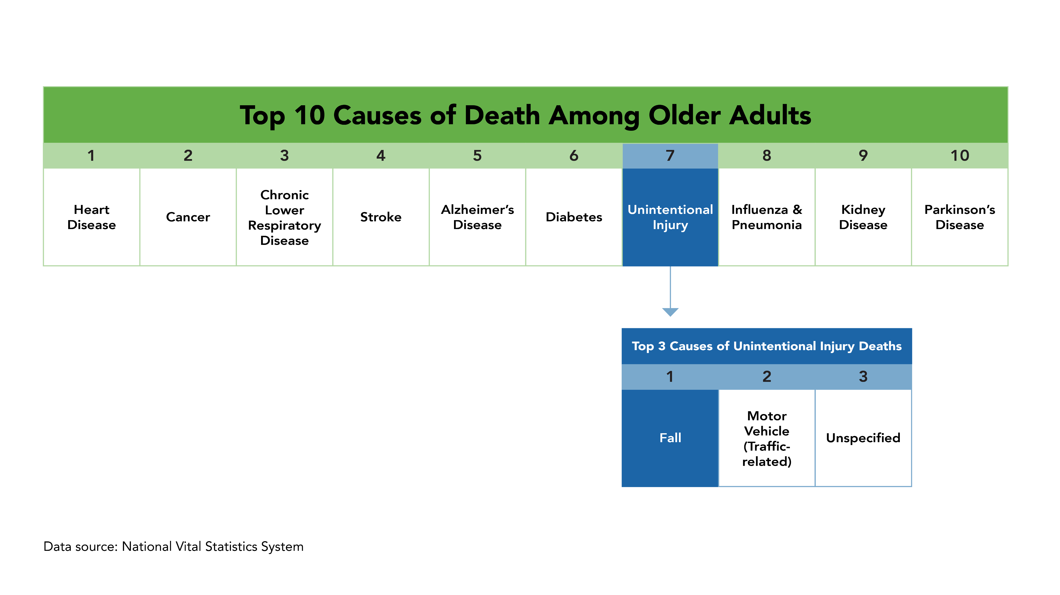
Leading Causes of Death
Reference: (1)
Notes:
Unintentional injuries are the 7th leading cause of death among older adults. Falls are the number one cause of those unintentional injury deaths.

Slide 6
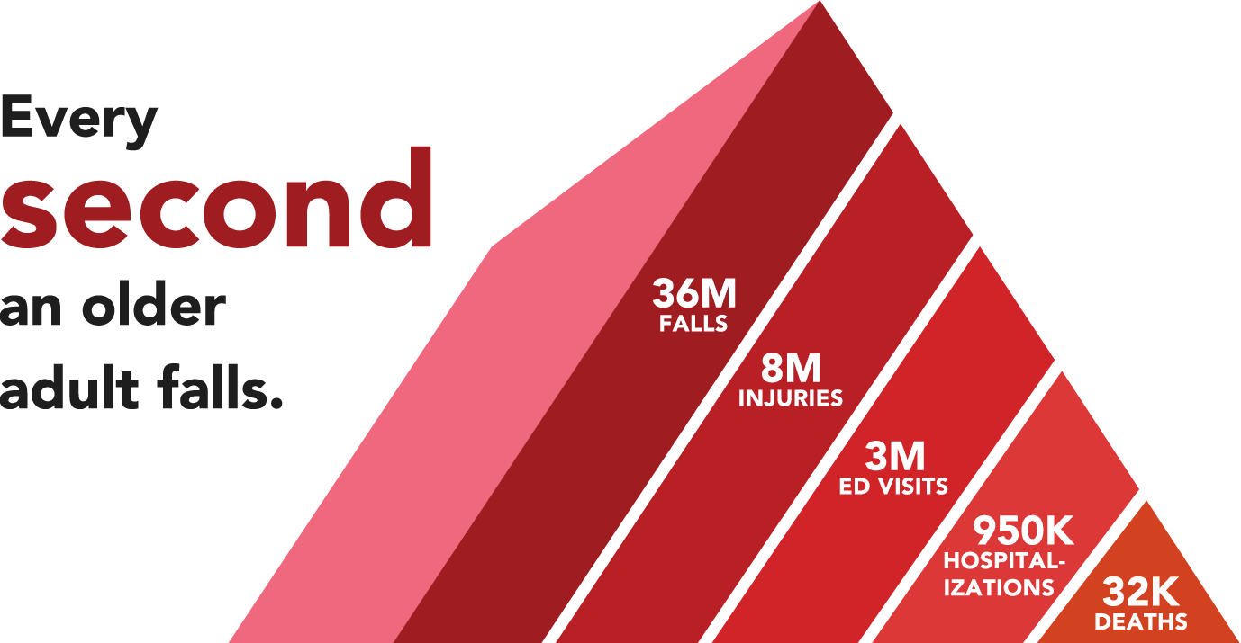
Falls Are Common
Data sources: National Vital Statistics System, National Electronic Injury Surveillance System–All Injury Program, and Behavioral Risk Factor Surveillance System.
References: (1,2)
Notes:
Every second an older adult falls. This adds up to approximately 36 million falls every year. Of those who fall, more than 8 million older adults are injured. These falls and fall injuries lead to about 3 million emergency department visits, more than 950,000 hospitalizations, and more than 32,000 deaths every year.

Slide 7
Falls Might Not Be a Priority for Patients
Less than half of older adults who fall talk to their doctor about falls
Reasons patients do not talk to their doctor:
  Belief that falls are a normal part of aging
  Fear that a fall may lead to loss of independence
  Not aware of common fall risk factors
References: (3-5)
Notes:
Although falls are common, older patients might not tell you about their falls for several reasons. They might think that falls are a normal part of aging and therefore there is nothing they can do about it. They may also fear that talking about their falls can place them in a nursing home and threaten their independence. Another reason could be that older patients are unaware of common risk factors that could put them at risk of falling. For example, more than two-thirds of older adults with reported use of medications do not know that as they age their bodies will metabolize medications differently leading to side effects that could increase their chances of falling.

Slide 8
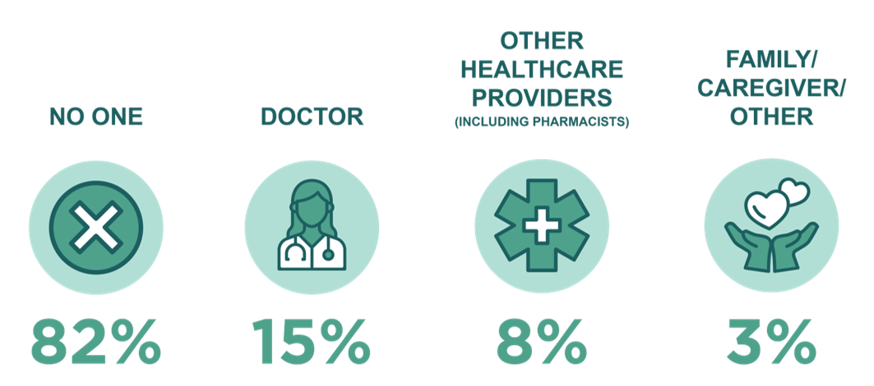
Falls Might Not Be a Priority for Patients
Few older adults speak to someone about medications and fall risk
Example:
In the past 12 months, who has talked to you about medications that might make you fall?*
*Percentage does not add up to 100 because participants could select more than one response option.
Source: ConsumerStyles survey 2016
Reference: (5)
Notes:
Here is an example: Over 80% of older adults taking medications reported that no one talked to them about medications that might increase their chances of falling. The same study also reported that older adults are willing to discuss and change medications to reduce fall risk when recommended by a healthcare provider. So, due to lack of awareness, patients might not initiate fall prevention conversations, which makes it especially important for providers to be proactive in talking with their older patients.

Slide 9
Falls Might Not Be a Priority for Providers
Providers also face many barriers to addressing falls with older patients
Competing healthcare priorities
Lack of time during office visits
Limited fall prevention knowledge
Limited communication between providers from different disciplines
Limited reimbursement strategies
References: (6,7)
Notes:
In addition to the knowledge and communication gap, studies show that healthcare providers also face many barriers to addressing falls with their older patients. Some of these barriers are listed on the slide.

Slide 10
Consequences of Falls Among Older Adults
More than 95% of hip fractures are due to falls
Falls are the leading cause of traumatic brain injuries
Falls and fall injuries increase the risk of nursing home placement
Fall death rates increased about 30% between 2009
and 2018
References: (8-11)
Notes:
It is important to prioritize falls because consequences of falls can be serious. Falls can result in debilitating injuries such as hip fractures and traumatic brain injury, loss of independence, and even deaths. Fall death rates have increased about 30% between 2009 and 2018 even after adjusting for the aging population.

Slide 11
Falls Are Costly
Average hospitalization cost due to a fall injury is $30,000
  Fall-related injuries are a leading cause of hospital readmission
Average cost per fall injury:
  Emergency Department visits = $4,829
  Office-based and outpatient visits = $5,813
References: (12-14)
Notes:
Injuries due to falls could result in hospitalizations costing an average of $30,000. Such injuries can also lead to hospital readmissions, which can further drive up healthcare and personal expenses. These are the average costs of emergency department visits, and office-based and outpatient visits for fall injuries.

Slide 12
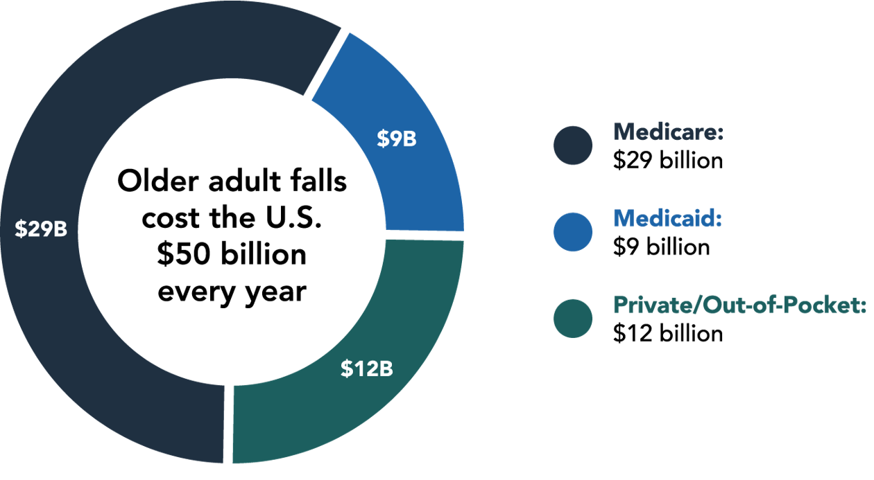
Falls Are Costly
Florence C., et al. (2018). Medical costs of fatal and nonfatal falls in older adults. Journal of the American Geriatrics Society, 66(4), 693-698.
Reference: (15)
Notes:
Overall in the United States, $50 billion is spent for medical care due to falls every year. Programs like Medicare and Medicaid pay for more than 75% of these costs.

Slide 13
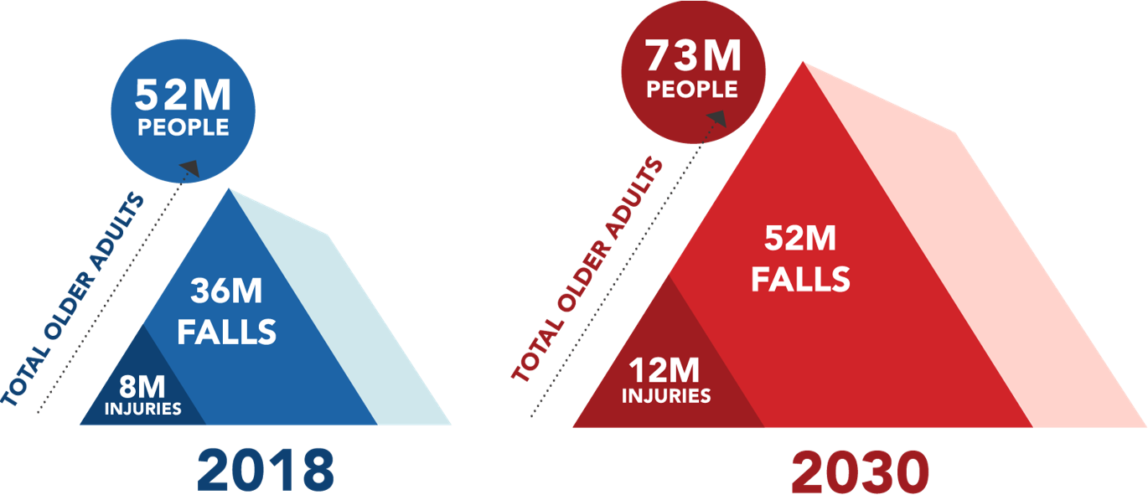
Falls Are a Growing Burden
Data sources: Behavioral Risk Factor Surveillance System and United States Census Bureau
References: (2,16)
Notes:
The number of falls and their consequences are expected to rise if more fall prevention efforts are not in place. By 2030, 1 in 5 Americans will be aged 65 and older, and we can anticipate 52 million falls and 12 million fall injuries.

Slide 14
Common Fall Risk Factors
Modifiable Risk Factors | Non-modifiable Risk Factors
Gait, strength, and balance deficits Medications that increase fall risk Home hazards Orthostatic hypotension Vision problems Foot issues/inappropriate footwear Vitamin D deficiency Comorbidities | Age Sex Race/ethnicity History of falls
Fall risk increases as the number of risk factors increases.
References: (2,17-19)
Notes:
Falls are common, costly, and can result in serious consequences. The good news is that falls are preventable. Let’s look at the risk factors for falls to understand how falls can be prevented.
As you can see here, most risk factors for falls are modifiable. These include difficulties with gait and balance, lower extremity weakness, use of medications with fall-related side effects, use of multiple medications, home hazards, orthostatic hypotension, poor vision, problems with feet and improper footwear, and vitamin D deficiency. Presence of conditions such as depression, incontinence, and dementia can also increase fall risk.
Non-modifiable risk factors include age, sex, race/ethnicity, and history of falls. Fall rates increase as we age. Women are more likely to fall and incur fall injuries compared to men, but more men tend to die from a fall. In looking at differences among race and ethnicity, there are more American Indian and Alaska Natives who fall compared to others. Having fallen once also increases the chance of falling again.
Risk of falling increases as the number of risk factors increase.
Being able to identify modifiable risk factors for falls and intervening with appropriate evidence-based strategies can help reduce the risk of falling.

Slide 15
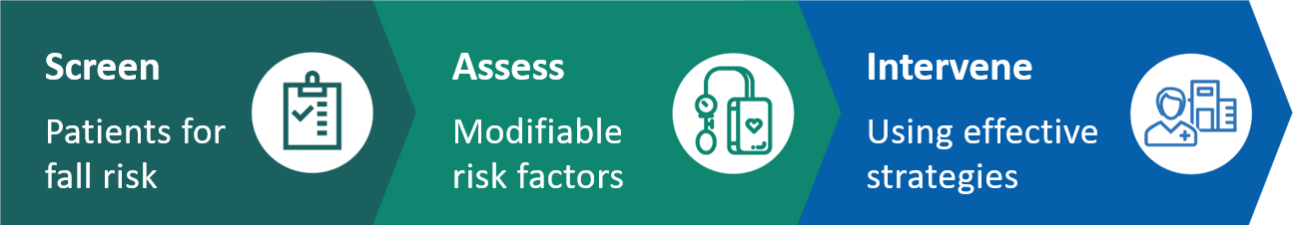
Falls Are Preventable
The Stopping Elderly Accidents, Deaths, and Injuries (STEADI)
initiative was developed by the U.S. Centers for Disease Control
and Prevention (CDC)
  STEADI is based on the American and British Geriatrics Societies’ Clinical Practice Guideline for Prevention of Falls in Older Persons and designed with input from healthcare providers
  STEADI offers tools and resources to help healthcare providers
  Screen, Assess, and Intervene to reduce fall risk
References: (20,21)
Notes:
To assist healthcare providers, CDC developed a fall prevention initiative called STEADI. STEADI is based on the American and British Geriatrics Societies’ Clinical Practice Guideline for fall prevention and designed with input from healthcare providers.
STEADI provides tools and resources to manage fall risk in clinical practice. It is comprised of three components: Screen, Assess, and Intervene. Using STEADI, providers can screen older patients for fall risk, assess at-risk patient’s modifiable risk factors, and intervene to reduce the identified risks by using effective strategies.

Slide 16
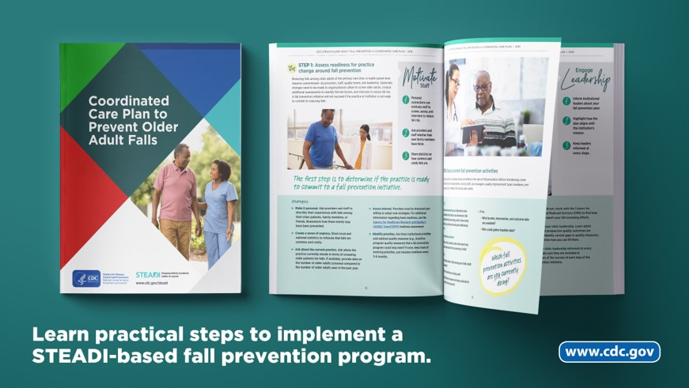
Overcoming Implementation Barriers
Use existing incentives to screen and assess for fall risk
  Welcome to Medicare Visit
  Annual Medicare Wellness Visit
Adapt STEADI tools to fit priorities and clinical workflow
Reference: (22)
Notes:
Earlier we talked about some barriers that clinics face to practice fall prevention, such as lack of time and knowledge. But there are several ways we can integrate fall prevention activities into our workflow. The CDC’s Coordinated Care Plan to Prevent Older Adult Falls provides suggestions on ways to implement a fall prevention program based on the STEADI initiative. Two examples from the Coordinated Care Plan are included on this slide. We will be looking at some more of those examples as the presentation continues.

Slide 17
Successful Implementations
Oregon Health & Science University, Oregon
64% of patients screened for fall risk
At-risk patients with modifiable risk factors, such as gait impairment and orthostatic hypotension, received interventions
United Health Services Hospitals, New York
79% of patients screened for fall risk
At-risk patients with a fall prevention care plan were 40% less likely to have a fall-related hospitalization, compared to at-risk patients without a plan
References: (23-25)
Notes:
It’s encouraging to know that STEADI has been successfully integrated in several practices. Oregon Health & Science University and the United Health Services Hospitals are two of the first practices to implement STEADI in 2012. Their experience with implementation helped inform the 12 Steps described in CDC’s Coordinated Care Plan to Prevent Older Adult Falls. Practices have the flexibility of using the 12 steps in a way that best fits their practice. Both organizations developed their own strategies to implement STEADI (refer to publications) and saw positive practice changes such as screening older adults for fall risk. For example, before implementing STEADI, providers at United Health Services Hospitals did not routinely screen for fall risk, but within a year of implementation they screened 79% of their older patients. STEADI implementation has also led to meaningful outcomes such as lower fall-related hospitalizations.

Slide 18

Benefits of a STEADI-based Fall Prevention Program
Use STEADI to:
Prevent fall-related hospitalizations
Reduce healthcare costs
Improve the lives and independence of older patients
References: (25,26)
Notes:
Integrating STEADI into clinical practice can help prevent hospitalization due to falls, reduce healthcare costs, and improve the lives and independence of older patients.

Slide 19
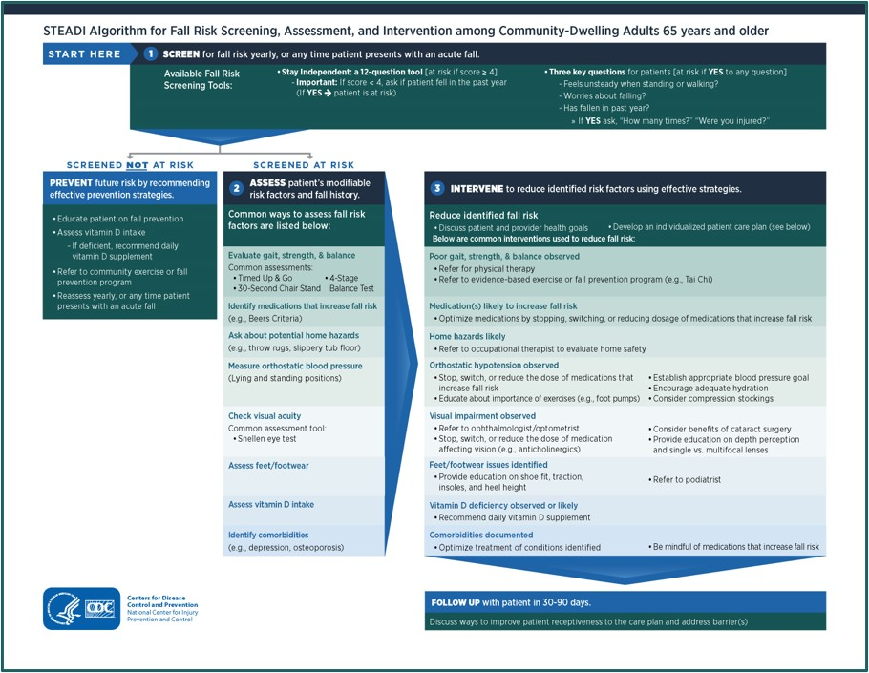
STEADI Algorithm
STEADI Resource
STEADI Algorithm: Algorithm for Fall Risk Screening, Assessment, and Intervention
Reference: (27)
Notes:
STEADI algorithm helps clinicians with the fall prevention steps of screening, assessing, and intervening. STEADI resources support the activities outlined in the algorithm.
“Algorithm for Fall Risk Screening, Assessment, and Intervention” available at:
www.cdc.gov/steadi/pdf/STEADI-Algorithm-508.pdf

Slide 20
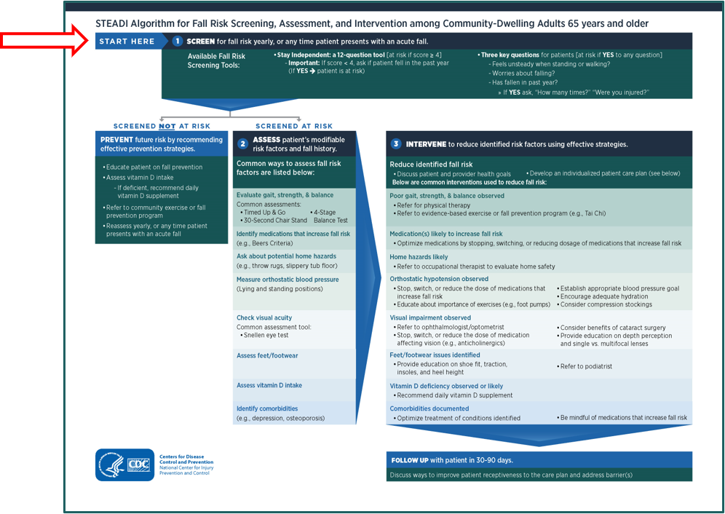
STEADI: Screening
If your patient is
65 or older, screen
  Once a year for
  fall risk or
  If they present with an acute fall
Two validated screening tools include
  The Three Key Questions
  CDC’s Stay Independent questionnaire
References: (20,24,28)
Notes:
The first component of the algorithm is screening. Fall screening is a simple process that any member of your healthcare team can conduct.
For all patients aged 65 and over, screen for fall risk annually or if patient presents with an acute fall.
Many tools are available to screen for fall risk. The STEADI initiative includes two tools shown on the screen. Practices can choose which tool to use keeping in mind that screening tools have different sensitivity and specificity.

Slide 21
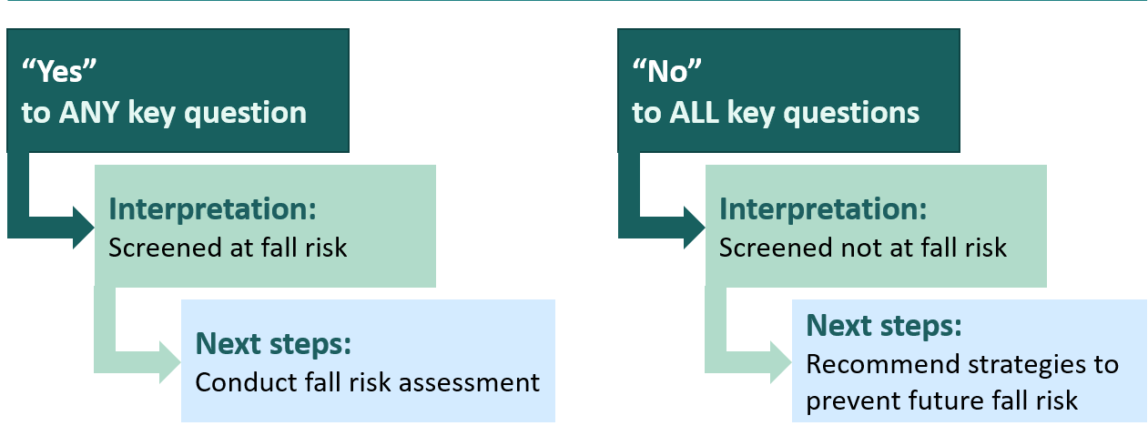
Screening Tool: The Three Key Questions
Ask your patient these questions:
  Have you fallen in the past year?
  Do you feel unsteady when standing or walking?
  Do you worry about falling?
RESULTS
Reference: (24)

Slide 22
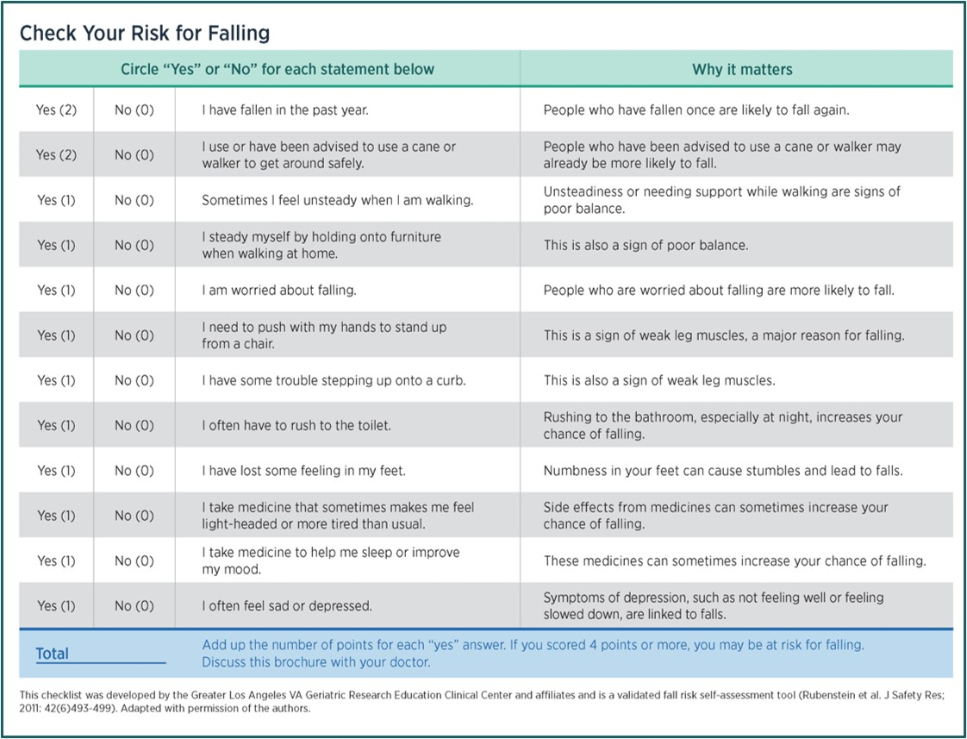
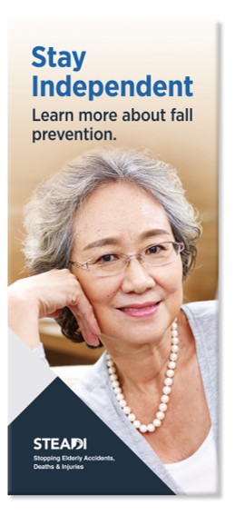
Screening Tool: Stay Independent Questionnaire
References: (28,29)
Notes:
The CDC’s Stay Independent brochure has 12 questions that offers insight into patients’ specific fall risk factors. This can be self-administered.
“Stay Independent” available at:
www.cdc.gov/steadi/patient.html#tabs-1-1

Slide 23
Screening Tool: Stay Independent Questionnaire
RESULTS
Score of 4 or more
Interpretation: Screened at fall risk
Next steps: Conduct fall risk assessment
Score less than 4 and patient fell in the past year
Interpretation: Screened at fall risk
Next steps: Conduct fall risk assessment
Score less than 4
Interpretation: Screened not at fall risk
Next steps: Recommend strategies to prevent future fall risk
References: (28,29)

Slide 24
Tips to Implement Fall Screening
Integrate screening tools to fit your clinic workflow
  Example: Add to usual patient intake forms
Find an optimal time to ask screening questions
  Before an office visit—by phone or online portal
  During routine office visit—in the waiting room or the exam room
  During Welcome to Medicare Examination or Medicare Annual Wellness Visit
Set screening goals and monitor progress
  Example:
    Goal: We will screen 50% of our older adult patients in 30 days
    Monitor: Percent of older patients screened for fall risk in the past 30 days
    Share progress with team members
Reference: (22)
Notes:
Here are some tips to incorporate fall screening in your practice. Question to discuss: How and when should we screen for fall risk?

Slide 25
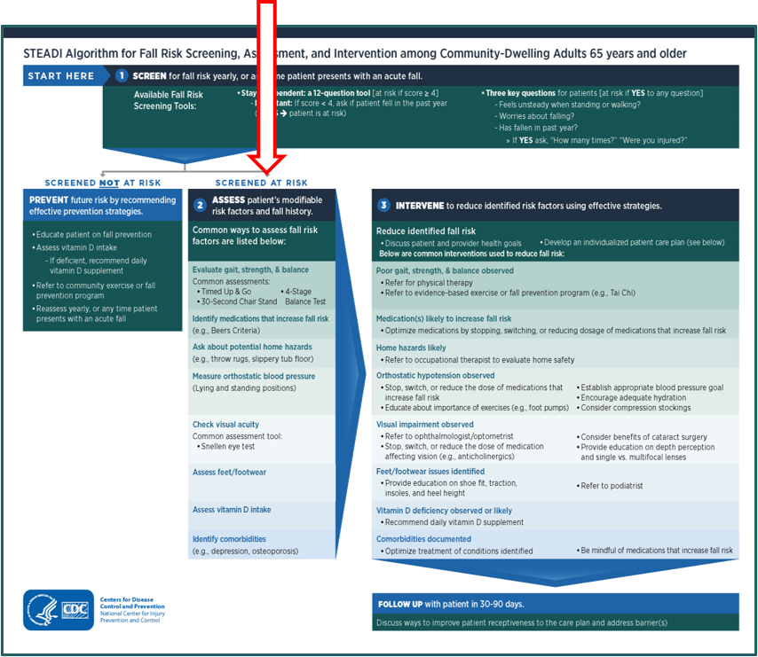
STEADI: Assessment
To identify modifiable fall risk factors in
at-risk patients:
Conduct a falls history. Example questions:
  How many times have you fallen?
  Did you have any symptoms prior to your fall?
  Where and when did you fall?
References: (20,27)
Notes:
Many older adults have multiple fall risk factors. Here is a list of common assessments to identify those risk factors. Conduct as many of these assessments as possible considering what is feasible for you, your practice setting, or your patient. Often addressing different risk factors can be done over several office visits.

Slide 26
STEADI: Assessment
To identify modifiable fall risk factors in
at-risk patients:
Conduct assessments:
  Evaluate gait, strength, and balance
  Identify medications that increase fall risk
  Ask about potential home hazards
  Measure orthostatic blood pressure
  Check visual acuity
  Assess feet and footwear
  Assess vitamin D intake
  Identify comorbidities
References: (20,27)
Notes:
Many older adults have multiple fall risk factors. Here is a list of common assessments to identify those risk factors. Conduct as many of these assessments as possible considering what is feasible for you, your practice setting, or your patient. Often addressing different risk factors can be done over several office visits.

Slide 27
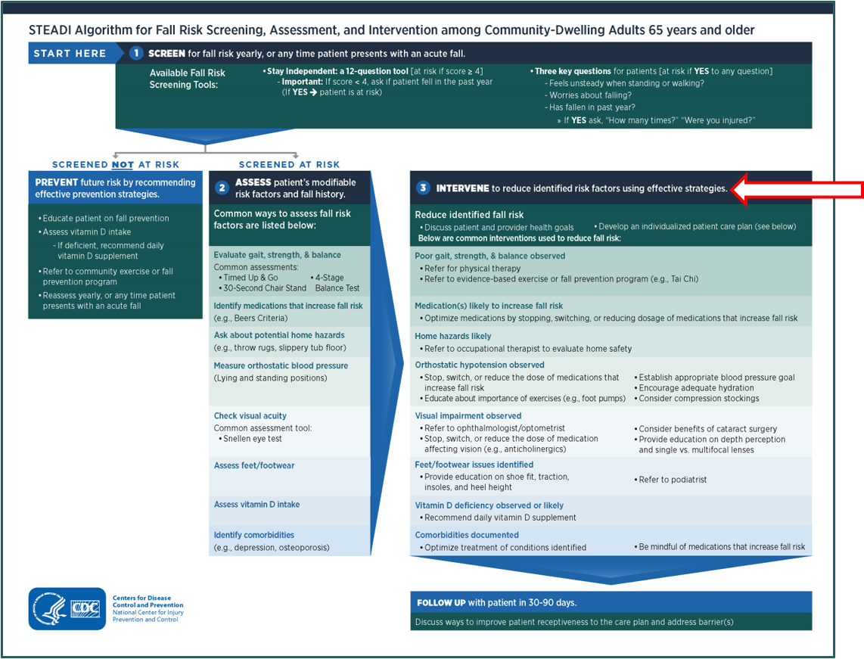
STEADI: Intervention
Reference: (27)
Notes:
Once all modifiable risk factors are identified, work with the patient to develop a tailored fall prevention care plan that includes evidence-based interventions. The algorithm provides an overview of the evidence-based strategies for each of the risk factors. We will go into these examples in the next slides.

Slide 28
Components of STEADI: Examples
Fall Risk Factor | Assessment | Intervention
Gait, strength, and balance deficits | Conduct tests: - Timed Up and Go (TUG) - 30-second chair stand - 4-stage balance | Physical therapy Evidence-based fall prevention program
STEADI Resource
Handouts: TUG, 30-second chair stand, and 4-stage balance tests
Instructional videos: TUG, 30-second chair stand, and 4 stage balance tests
References: (20,22)
Notes:
We will now go over examples to explain the components of STEADI in greater detail. Let’s say we used the 12-item questionnaire in the Stay Independent brochure to screen for fall risk and found that the patient’s score was above 4. We know that a score higher than 4 means that the patient is at risk of falling. So, our next step will be to identify factors that put the patient at risk of falling and provide evidence-based interventions to reduce that risk. There are many ways to do this.
Let’s begin with examples to identify gait, strength, and balance deficits and some available interventions. Tests such as TUG, 30-second chair stand, and 4-stage balance are available to assess mobility, leg strength and endurance, and balance, respectively. And if deficits are identified, providers can refer to physical therapy or evidence-based exercises such as Tai Chi or fall prevention programs such as Stepping On.

Slide 29
Components of STEADI: Examples
Fall Risk Factor | Assessment | Intervention
Medications that increase fall risk | Conduct a comprehensive medication review | Medication management - Stop medications when possible - Switch to safer alternatives - Reduce to lowest effective dose
STEADI Resource
Fact sheets: Medications Linked to Falls, SAFE Medication Review Framework, STEADI-Rx Pharmacist Flyer
References: (20,22)
Notes:
Conduct a comprehensive medication review to identify polypharmacy and medications that can increase fall risk such as psychoactive medications. Some interventions include stopping, switching, or reducing medication use, lowering the total number of medications, and using non-pharmacologic interventions. It is important to use clinical judgment when making these changes.

Slide 30
Components of STEADI: Examples
Fall Risk Factor | Assessment | Intervention
Home hazards | Ask patients and their family members about home safety | Refer to occupational therapy Recommend tips to improve home safety
STEADI Resource
Educational material: Check for Safety
References: (20,22)
Notes:
Engage patients and family members in conversations regarding home safety, and refer to occupational therapy if needed. Also, recommend tips to improve home safety, such as keeping paths clear of clutter, removing rugs, improving lighting, installing handrails on stairs, etc.

Slide 31
Components of STEADI: Examples
Fall Risk Factor | Assessment | Intervention
Orthostatic hypotension The patient has orthostatic hypotension if systolic blood pressure drops by at least 20 mm Hg or diastolic by at least 10 mm Hg | Measure orthostatic blood pressure Have the patient lie down for 5 minutes Check blood pressure Have the patient stand Check blood pressure within 3 minutes | Treat underlying cause Adjust medications if warranted
STEADI Resource
Handout: Measuring Orthostatic Blood Pressure
Educational material: Postural Hypotension
References: (20,22)
Notes:
To identify orthostatic hypotension, measure orthostatic blood pressure using the steps shown on the slide. If patient has orthostatic hypotension, strategies such as treating the underlying cause and adjusting medications can be undertaken. Additionally, recommendations such as adequate hydration, foot pumping before standing, and standing slowly and waiting to walk can be provided.

Slide 32
Components of STEADI: Examples
Fall Risk Factor | Assessment | Intervention
Vision impairment | Ask patients about vision problems Use Snellen eye chart to assess visual acuity Ask if patient uses bifocal lenses when outdoors | Refer to ophthalmology or optometry Recommend single distance lenses for walking outside
STEADI Resource
Guide: Coordinated Care Plan to Prevent Older Adult Falls
Educational materials: Family Caregivers: Protect your Loved Ones from Falling, What You Can Do to Prevent Falls
References: (20,22)
Notes:
To assess vision impairment, ask patients about vision problems, use Snellen eye chart to assess visual acuity, and ask if they use bifocal lenses when outdoors. Some interventions include referring to ophthalmology or optometry, and recommending single distance lenses for walking outside. A simple reminder to keep glasses clean can also be helpful.

Slide 33
Components of STEADI: Examples
Fall Risk Factor | Assessment | Intervention
Feet or footwear issues | Look for foot deformities, deficits in sensation, or pain Assess for inappropriate footwear | Counsel on shoe fit, insoles, and heel height Refer to podiatry
STEADI Resource
Guide: Coordinated Care Plan to Prevent Older Adult Falls
Educational materials: Family Caregivers: Protect your Loved Ones from Falling, What You Can Do to Prevent Falls
References: (20,22)
Notes:
For feet issues, check for deformities, deficits in sensation, or pain. Assess for inappropriate footwear use such as flip flops.
If risk factors are identified, provide advice on shoe fit, insoles, and heel height, and refer to podiatry.

Slide 34
Components of STEADI: Examples
Fall Risk Factor | Assessment | Intervention
Vitamin D deficiency | Ask about patient’s dietary vitamin D intake, use of vitamin D supplements, and sun exposure | Consider increasing dietary vitamin D or daily vitamin D supplements if the patient has a vitamin D deficiency
STEADI Resource
Guide: Coordinated Care Plan to Prevent Older Adult Falls
Educational materials: Family Caregivers: Protect your Loved Ones from Falling, What You Can Do to Prevent Falls
References: (20,22)
Notes:
For vitamin D deficiency, consider asking about patient’s dietary intake, use of supplements, and sun exposure. And if deficiency is identified, consider increasing dietary intake or daily supplements of vitamin D.

Slide 35
Components of STEADI: Examples
Fall Risk Factor | Assessment | Intervention
Comorbidities | Screen for comorbidities such as osteoporosis, depression, dementia, incontinence | Optimize treatments of identified conditions
STEADI Resource
Guide: Coordinated Care Plan to Prevent Older Adult Falls
Educational materials: Family Caregivers: Protect your Loved Ones from Falling, What You Can Do to Prevent Falls
References: (20,22)
Notes:
Fall risk assessment also includes identifying if the patient has comorbidities such as osteoporosis, depression, dementia, and incontinence. Providers can optimize treatment of the conditions present to address the patient’s risk of falling.

Slide 36
Follow-Up
Follow up with patients within 30–90 days
Review plan of care
Encourage adherence to recommendations
Discuss barriers to adherence
STEADI Resource
Fact sheet: Talking with Patients about Fall Prevention
Educational materials: Family Caregivers: Protect your Loved Ones from Falling
References: (20,22)
Notes:
STEADI resources such as Talking with Patients about Fall Prevention and the Family Caregivers’ brochure can help communicate with patients and their families the importance of implementing their fall prevention plan.

Slide 37
Tips to Implement Fall Assessment & Intervention
Divide tasks among clinic staff, including follow-up
Pilot the fall prevention program before expanding
Seek feedback from staff on progress and barriers
Provide refresher training at regular intervals
Engage patient and caregivers
STEADI Resource
Wall chart: Practice Fall Prevention Wall Chart
Reference: (22)
Notes:
These are some tips to implement fall assessment and intervention in your practice. Questions to discuss:
Which risk factors should we consider and assess routinely?
How do we intervene to reduce the identified risk?

Slide 38
Our Fall Prevention Program
Which fall risk factors will we focus on?
How will our clinic workflow adapt STEADI’s screen, assess, and intervene steps?
How will the electronic health record incorporate fall prevention?
How will the practice bill for fall prevention?
How will the practice monitor and evaluate the program?
Describe how members of the practice can play a role in fall prevention.
STEADI Resource
Guides: Coordinated Care Plan to Prevent Older Adult Falls, STEADI: Evaluation Guide for Older Adult Clinical Fall Prevention Programs
References: (22,30)
Notes:
How will your practice implement a fall prevention program? Discuss or describe your fall prevention activities using questions on this slide.
To prepare responses specific to your practice, refer to www.cdc.gov/steadi and CDC resources such as Coordinated Care Plan to Prevent Older Adult Falls and Evaluation Guide for Older Adult Clinical Fall Prevention Programs.

Slide 39
Team and Roles
Every member can play an important role in fall prevention
Our team will include
  Front office staff
  Office manager
  Medical assistants
  Care coordinator
  Nurses
  Physician, physician assistants, or nurse practitioners
  Pharmacists
  Physical therapists
  Occupational therapists
Notes:
Revise the list of team members to best represent the team at your practice.

Slide 40
Let’s Do Our Part to Prevent Falls
Learn about older adult fall prevention and STEADI resources
  Available at www.cdc.gov/steadi
Earn continuing education with an online training on fall prevention
  STEADI: Empowering Healthcare Providers to Reduce Fall Risk
  Available at www.cdc.gov/steadi/training.html
Hear from other healthcare providers on their STEADI experience
  Available at www.cdc.gov/steadi/about/success-stories.html

Slide 41
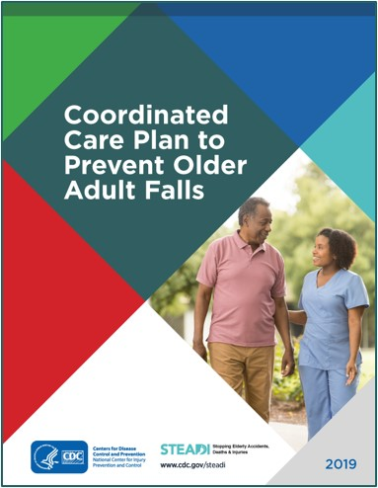
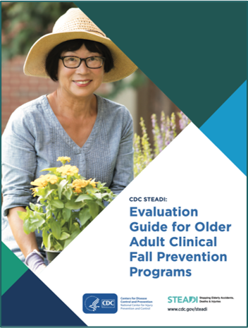
Appendix: Resource Gallery
STEADI Guides
Coordinated Care Plan to Prevent Older Adult Falls
Evaluation Guide for Older Adult Clinical Fall Prevention Programs
Notes:
STEADI guides available at:
www.cdc.gov/steadi/materials/implementation_evaluation.html

Slide 42
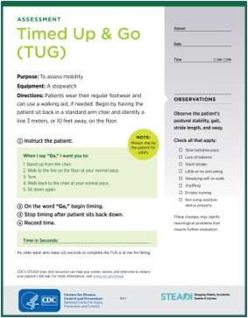
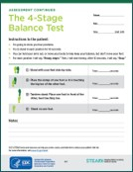
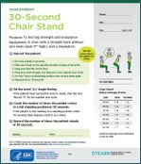
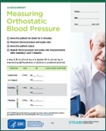
Appendix: Resource Gallery
STEADI Assessment Handouts
Timed Up & Go (TUG)
4-Stage Balance
30-Second Chair Stand
Measuring Orthostatic Blood Pressure
Notes:
STEADI assessment handouts available at:
www.cdc.gov/steadi/materials.html#tabs-1-3

Slide 43
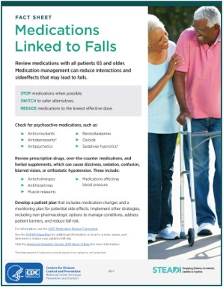
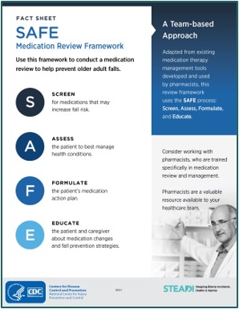
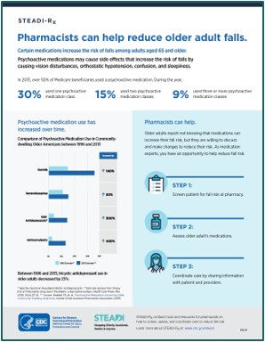
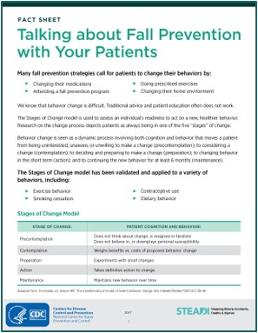
Appendix: Resource Gallery
STEADI Fact Sheets
Medications Linked to Falls
SAFE Medication Review Framework
STEADI-Rx Pharmacist Flyer
Talking about Fall Prevention with Your Patients
Notes:
“Medications Linked to Falls” and “SAFE Medication Review Framework” available at:
www.cdc.gov/steadi/materials.html#tabs-1-4
“STEADI-Rx Pharmacist Flyer” available at:
www.cdc.gov/steadi/pdf/provider/steadi-rx/STEADIRx_Medication_flyer-508.pdf
“Talking about Fall Prevention with Your Patients” available at:
www.cdc.gov/steadi/pdf/STEADI-FactSheet-TalkingWPatients-508.pdf

Slide 44
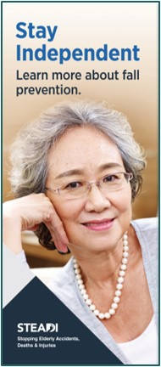
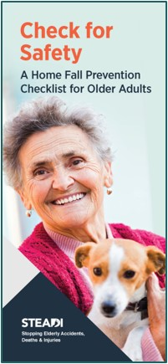


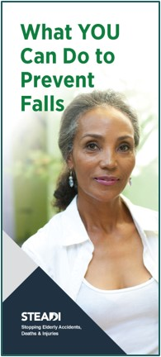
Appendix: Resource Gallery
STEADI Educational Materials
Notes:
STEADI educational materials available at:
www.cdc.gov/steadi/patient.html#tabs-1-1

Slide 45
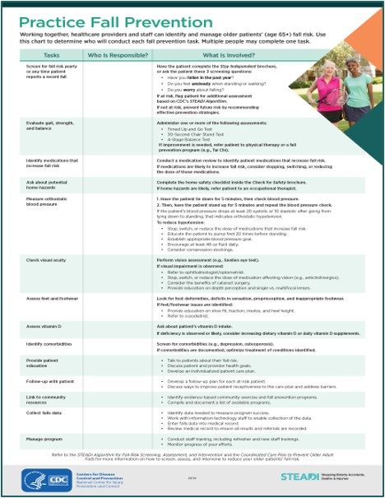
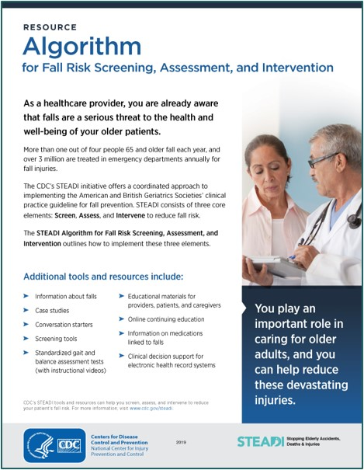
Appendix: Resource Gallery
Wall Chart and Algorithm
Practice Fall Prevention Wall Chart
Algorithm for Fall Risk Screening, Assessment, and Intervention (front page)
Notes:
“Practice Fall Prevention Wall Chart” available at:
www.cdc.gov/steadi/pdf/STEADI-Poster-Integrating-508-2019.pdf
“Algorithm for Fall Risk Screening, Assessment, and Intervention” available at:
www.cdc.gov/steadi/pdf/STEADI-Algorithm-508.pdf

Slide 46
References
Slide 5
CDC. Web-based Injury Statistics Query and Reporting System (WISQARS) [online]. [cited 2021 January 19]. Available from URL: www.cdc.gov/injury/wisqars. Atlanta, GA: National Center for Injury Prevention and Control.
Slide 6
CDC. Web-based Injury Statistics Query and Reporting System (WISQARS) [online]. [cited 2021 January 19]. Available from URL: www.cdc.gov/injury/wisqars. Atlanta, GA: National Center for Injury Prevention and Control.
Moreland B, Kakara R, Henry A. Trends in Nonfatal Falls and Fall-Related Injuries Among Adults Aged ≥65 years—United States, 2012-2018. MMWR Morb Mortal Wkly Rep 2020;69(27):875-881. DOI: 10.15585/mmwr.mm6927a5

Slide 47
References
Slide 7
Stevens JA, Ballesteros MF, Mack KA, Rudd RA, DeCaro E, Adler G. Gender Differences in Seeking Care for Falls in the Aged Medicare Population. Am J Prev Med 2012;43(1):59-62. DOI: 10.1016/j.amepre.2012.03.008
Stevens JA, Noonan RK, Rubenstein LZ. Older Adult Fall Prevention: Perceptions, Beliefs and Behaviors. Am J Lifestyle Med 2010;1:16-20. DOI: 10.1177/1559827609348350
Haddad YK, Karani MV, Bergen G, Marcum ZA. Willingness to Change Medications Linked to Increased Fall Risk: A Comparison between Age Groups. J Am Geriatr Soc 2019;67(3):527-533. DOI: 10.1111/jgs.15696
Slide 8
Haddad YK, Karani MV, Bergen G, Marcum ZA. Willingness to Change Medications Linked to Increased Fall Risk: A Comparison between Age Groups. J Am Geriatr Soc 2019;67(3):527-533. DOI: 10.1111/jgs.15696
Slide 9
Jones TS, Ghosh TS, Horn K, Smith J, Vogt RL. Primary Care Physicians Perceptions and Practices Regarding Fall Prevention in Adults 65 Years and Over. Accid Anal Prev 2011;43:1605-1609. DOI: 10.1016/j.aap.2011.03.013
Van Rhyn B, Barwick A. Health Practitioners’ Perceptions of Falls and Fall Prevention in Older People: A Metasynthesis. Qual Health Res 2019;29(1):69-79. DOI: 10.1177/1049732318805753

Slide 48
References
Slide 10
Parkkari J, Kannus P, Palvanen M, Natri A, Vainio J, Aho H, et al. Majority of Hip Fractures Occur as a Result of a Fall and Impact on the Greater Trochanter of the Femur: A Prospective Controlled Hip Fracture Study with 206 Consecutive Patients. Calcif Tissue Int 1999;65(3):183-7. DOI: 10.1007/s002239900679
Taylor CA, Bell JM, Breiding MJ, Xu L. Traumatic Brain Injury–Related Emergency Department Visits, Hospitalizations, and Deaths—United States, 2007 and 2013. MMWR Surveill Summ 2017;66(No. SS-9):1–16. DOI: 10.15585/mmwr.ss6609a1
Gill TM, Murphy TE, Gahbauer EA, Allore HG. Association of Injurious Falls With Disability Outcomes and Nursing Home Admissions in Community-Living Older Persons. Am J Epidemiol 2013;178(3):418–25. DOI: 10.1093/aje/kws554
CDC. Wide-ranging OnLine Data for Epidemiologic Research (WONDER) [online]. [cited 2021 January 19]. Available from URL: https://wonder.cdc.gov. Atlanta, GA: Centers for Disease Control and Prevention.

Slide 49
References
Slide 11
Burns ER, Stevens JA, Lee R. The Direct Costs of Fatal and Non-fatal Falls Among Older adults—United States. J Safety Res 2016;58:99-103. DOI: 10.1016/j.jsr.2016.05.001
Bohl AA, Fishman PA, Ciol MA, Williams B, Logerfo J, Phelan EA. A Longitudinal Analysis of Total 3-Year Healthcare Costs for Older Adults Who Experience a Fall Requiring Medical Care. J Am Geriatr Soc 2010;58(5):853-60. DOI: 10.1111/j.1532-5415.2010.02816.x
Hoffman GJ, Liu H, Alexander NB, Tinetti M, Braun TM, Min LC. Posthospital Fall Injuries and 30-Day Readmissions in Adults 65 Years and Older. JAMA Netw Open 2019;2(5):e194276. DOI: 10.1001/jamanetworkopen.2019.4276
Slide 12
Florence CS, Bergen G, Atherly A, Burns E, Stevens J, Drake C. Medical Costs of Fatal and Nonfatal Falls in Older Adults. J Am Geriatr Soc 2018;66(4):693-8. DOI: 10.1111/jgs.15304
Slide 13
Moreland B, Kakara R, Henry A. Trends in Nonfatal Falls and Fall-Related Injuries Among Adults Aged ≥65 years—United States, 2012-2018. MMWR Morb Mortal Wkly Rep 2020;69(27):875-881. DOI: 10.15585/mmwr.mm6927a5
Ortman JM, Velkoff VA, Hogan H. An Aging Nation: The Older Population in the United States, Current Population Reports, P25-1140. Washington, DC: U.S. Census Bureau. 2014.

Slide 50
References
Slide 14
Moreland B, Kakara R, Henry A. Trends in Nonfatal Falls and Fall-Related Injuries Among Adults Aged ≥65 years—United States, 2012-2018. MMWR Morb Mortal Wkly Rep 2020;69(27):875-881. DOI: 10.15585/mmwr.mm6927a5
Ambrose AE, Paul G, Haudorff JM. Risk Factors for Falls Among Older Adults: A Review of the Literature. Maturitas 2013;75:51-61. DOI: 10.1016/j.maturitas.2013.02.009
Tinetti ME, Speechley M, Ginter SF. Risk Factors for Falls Among Elderly Persons Living in the Community. New Engl J Med 1988;319(26):1701–7. DOI: 10.1056/NEJM198812293192604
Burns E, Kakara R. Deaths from Falls Among Persons Aged ≥65 Years—United States, 2007–2016. MMWR Morb Mortal Wkly Rep 2018;67:509-514. DOI: 10.15585/mmwr.mm6718a1
Slide 15
AGS/BGS. Summary of the Updated American Geriatrics Society/British Geriatrics Society Clinical Practice Guideline for Prevention of Falls in Older Persons. J Am Geriatr Soc 2011;59(1):148–57. DOI: 10.1111/j.1532-5415.2010.03234.x
Lee R. The CDC’s STEADI Initiative: Promoting Older Adult Health and Independence Through Fall Prevention. Am Fam Physician 2017;96(4):220–1.
Slide 16
Eckstrom E, Parker EM, Shakya I, Lee R. Coordinated Care Plan to Prevent Older Adult Falls. Atlanta, GA: National Center for Injury Prevention and Control, Centers for Disease Control and Prevention. 2021. Available at: https://www.cdc.gov/steadi/pdf/Steadi-Coordinated-Care-Plan.pdf

Slide 51
References
Slide 17
Casey CM, Parker EM, Winkler G, Liu X, Lambert GH, Eckstrom E. Lessons Learned From Implementing CDC's STEADI Falls Prevention Algorithm in Primary Care. Gerontologist 2017;57(4):787–96. DOI: 10.1093/geront/gnw074
Eckstrom E, Parker EM, Lambert GH, Winkler G, Dowler D, Casey CM. Implementing STEADI in Academic Primary Care to Address Older Adult Fall Risk. Innov Aging 2017;1(2). DOI: 10.1093/geroni/igx028
Johnston YA, Bergen G, Bauer M, Parker EM, Wentworth L, McFadden M, et al. Implementation of the Stopping Elderly Accidents, Deaths, and Injuries Initiative in Primary Care: An Outcome Evaluation. Gerontologist 2019;59(6):1182-91. DOI: 10.1093/geront/gny101
Slide 18
Johnston YA, Bergen G, Bauer M, Parker EM, Wentworth L, McFadden M, et al. Implementation of the Stopping Elderly Accidents, Deaths, and Injuries Initiative in Primary Care: An Outcome Evaluation. Gerontologist 2019;59(6):1182-91. DOI: 10.1093/geront/gny101
Stevens JA, Lee R. The Potential to Reduce Falls and Avert Costs by Clinically Managing Fall Risk. Am J Prev Med 2018;55(3):290–7. DOI: 10.1016/j.amepre.2018.04.035
Slide 19
CDC. Algorithm for Fall Risk Screening, Assessment, and Intervention [online]. [cited 2021 January 19]. Available from URL: www.cdc.gov/steadi/pdf/STEADI-Algorithm-508.pdf. Atlanta, GA: Centers for Disease Control and Prevention.

Slide 52
References
Slide 20
AGS/BGS. Summary of the Updated American Geriatrics Society/British Geriatrics Society Clinical Practice Guideline for Prevention of Falls in Older Persons. J Am Geriatr Soc 2011;59(1):148-57. DOI: 10.1111/j.1532-5415.2010.03234.x
Eckstrom E, Parker EM, Lambert GH, Winkler G, Dowler D, Casey CM. Implementing STEADI in Academic Primary Care to Address Older Adult Fall Risk. Innov Aging 2017;1(2). DOI: 10.1093/geroni/igx028
Rubenstein LZ, Vivrette R, Harker JO, Stevens JA, Kramer BJ. Validating an Evidence-based, Self-rated Fall Risk Questionnaire (FRQ) for Older Adults. J Safety Res 2011;42(6):493-499. DOI: 10.1016/j.jsr.2011.08.006
Slide 21
Eckstrom E, Parker EM, Lambert GH, Winkler G, Dowler D, Casey CM. Implementing STEADI in Academic Primary Care to Address Older Adult Fall Risk. Innov Aging 2017;1(2). DOI: 10.1093/geroni/igx028
Slide 22–23
Rubenstein LZ, Vivrette R, Harker JO, Stevens JA, Kramer BJ. Validating an Evidence-based, Self-rated Fall Risk Questionnaire (FRQ) for Older Adults. J Safety Res 2011;42(6):493-499. DOI: 10.1016/j.jsr.2011.08.006
CDC. STEADI—Older Adult Fall Prevention [online]. [cited 2021 January 19]. Available from URL: www.cdc.gov/steadi. Atlanta, GA: National Center for Injury Prevention and Control.

Slide 53
References
Slide 24
Eckstrom E, Parker EM, Shakya I, Lee R. Coordinated Care Plan to Prevent Older Adult Falls. Atlanta, GA: National Center for Injury Prevention and Control, Centers for Disease Control and Prevention. 2021. Available at: https://www.cdc.gov/steadi/pdf/Steadi-Coordinated-Care-Plan.pdf
Slide 25–26
AGS/BGS. Summary of the Updated American Geriatrics Society/British Geriatrics Society Clinical Practice Guideline for Prevention of Falls in Older Persons. J Am Geriatr Soc 2011;59(1):148-57. DOI: 10.1111/j.1532-5415.2010.03234.x
CDC. Algorithm for Fall Risk Screening, Assessment, and Intervention [online]. [cited 2021 January 19]. Available from URL: www.cdc.gov/steadi/pdf/STEADI-Algorithm-508.pdf. Atlanta, GA: Centers for Disease Control and Prevention.
Slide 27
CDC. Algorithm for Fall Risk Screening, Assessment, and Intervention [online]. [cited 2021 January 19]. Available from URL: www.cdc.gov/steadi/pdf/STEADI-Algorithm-508.pdf. Atlanta, GA: Centers for Disease Control and Prevention.

Slide 54
References
Slides 28–36
AGS/BGS. Summary of the Updated American Geriatrics Society/British Geriatrics Society Clinical Practice Guideline for Prevention of Falls in Older Persons. J Am Geriatr Soc 2011;59(1):148-57. DOI: 10.1111/j.1532-5415.2010.03234.x
Eckstrom E, Parker EM, Shakya I, Lee R. Coordinated Care Plan to Prevent Older Adult Falls. Atlanta, GA: National Center for Injury Prevention and Control, Centers for Disease Control and Prevention. 2021. Available at: https://www.cdc.gov/steadi/pdf/Steadi-Coordinated-Care-Plan.pdf
Slide 37
Eckstrom E, Parker EM, Shakya I, Lee R. Coordinated Care Plan to Prevent Older Adult Falls. Atlanta, GA: National Center for Injury Prevention and Control, Centers for Disease Control and Prevention. 2021. Available at: https://www.cdc.gov/steadi/pdf/Steadi-Coordinated-Care-Plan.pdf
Slide 38
Eckstrom E, Parker EM, Shakya I, Lee R. Coordinated Care Plan to Prevent Older Adult Falls. Atlanta, GA: National Center for Injury Prevention and Control, Centers for Disease Control and Prevention. 2021. Available at: https://www.cdc.gov/steadi/pdf/Steadi-Coordinated-Care-Plan.pdf
Bergen G, Shakya, I. Evaluation Guide for Older Adult Clinical Fall Prevention Programs. Atlanta, GA: National Center for Injury Prevention and Control, Centers for Disease Control and Prevention. 2019. Available at: https://www.cdc.gov/steadi/pdf/Steadi-Evaluation-Guide_Final_4_30_19.pdf

