Slide 1
Prevalence of Obesity Based on Self-Reported Weight and Height Among US Adults by Race/Ethnicity, State and Territory, BRFSS
Definitions
Obesity: Body mass index (BMI) of 30 kg/m² or higher.
Body mass index (BMI): A calculated measure of weight relative to height, defined as body weight in kilograms divided by height in meters squared.

Slide 2
Prevalence of Obesity Based on Self-Reported Weight and Height Among US Adults by Race/Ethnicity, State and Territory, BRFSS
Method
The data were collected through the Behavioral Risk Factor Surveillance System (BRFSS), an ongoing, state-based, telephone interview survey conducted by state health departments with assistance from CDC.
Height and weight data used in the BMI calculations were self-reported.
Three years of data were combined to ensure sufficient sample size.

Slide 3
Prevalence of Obesity Based on Self-Reported Weight and Height Among US Adults by Race/Ethnicity, State and Territory, BRFSS
Exclusion Criteria
Records with the following were excluded:
Height: <3 feet or ≥8 feet
Weight: <50 pounds or ≥650 pounds
BMI: <12 kg/m² or ≥100 kg/m²
Pregnant women

Slide 4
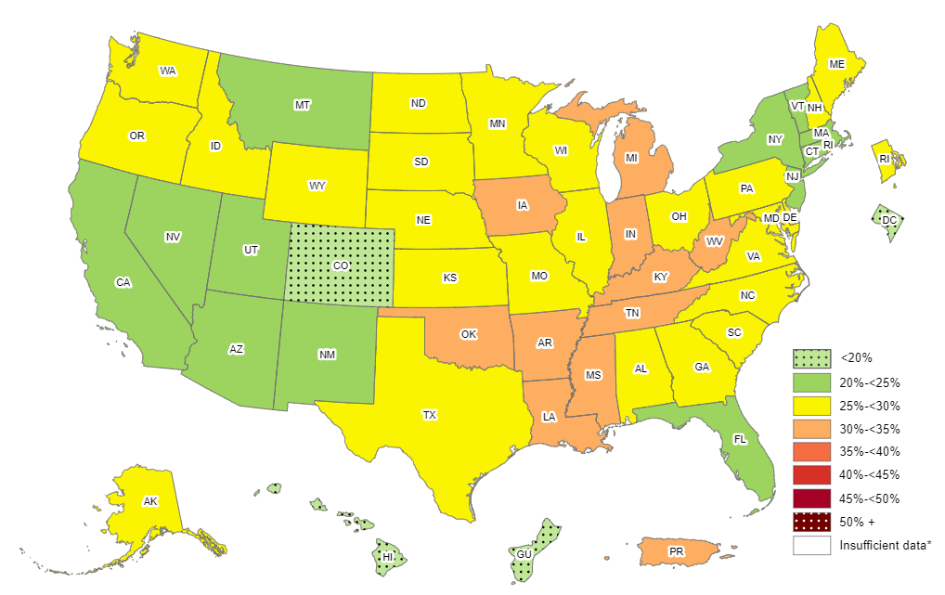
Prevalence of Self-Reported Obesity Among Non-Hispanic White Adults, by State and Territory, BRFSS, 2011-2013
*Sample size <50 or the relative standard error (dividing the standard error by the prevalence) ≥30%.

Slide 5
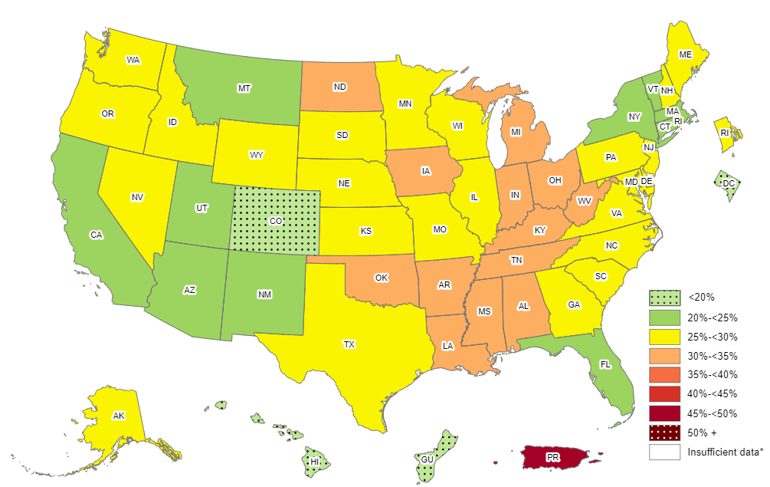
Prevalence of Self-Reported Obesity Among Non-Hispanic White Adults, by State and Territory, BRFSS, 2012-2014
*Sample size <50 or the relative standard error (dividing the standard error by the prevalence) ≥30%.

Slide 6
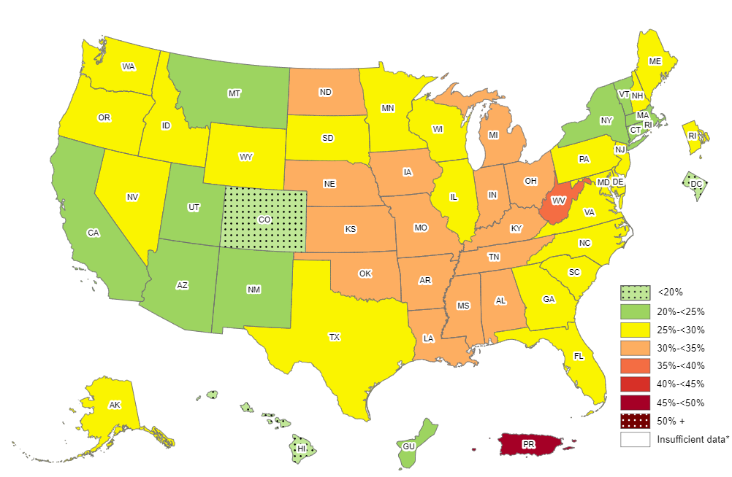
Prevalence of Self-Reported Obesity Among Non-Hispanic White Adults, by State and Territory, BRFSS, 2013-2015
*Sample size <50 or the relative standard error (dividing the standard error by the prevalence) ≥30%.

Slide 7
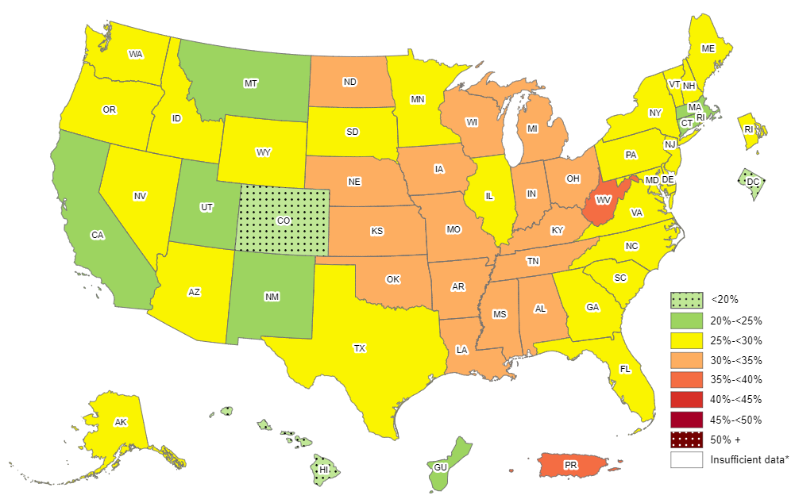
Prevalence of Self-Reported Obesity Among Non-Hispanic White Adults, by State and Territory, BRFSS, 2014-2016
*Sample size <50 or the relative standard error (dividing the standard error by the prevalence) ≥30%.

Slide 8
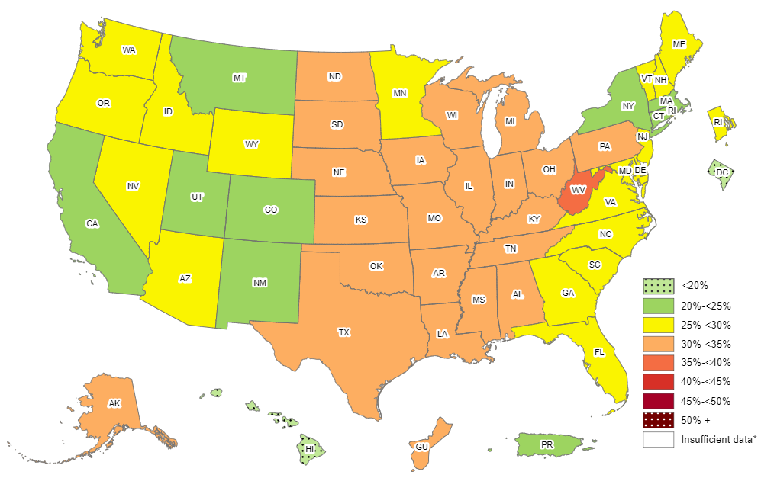
Prevalence of Self-Reported Obesity Among Non-Hispanic White Adults, by State and Territory, BRFSS, 2015-2017
*Sample size <50 or the relative standard error (dividing the standard error by the prevalence) ≥30%.

Slide 9
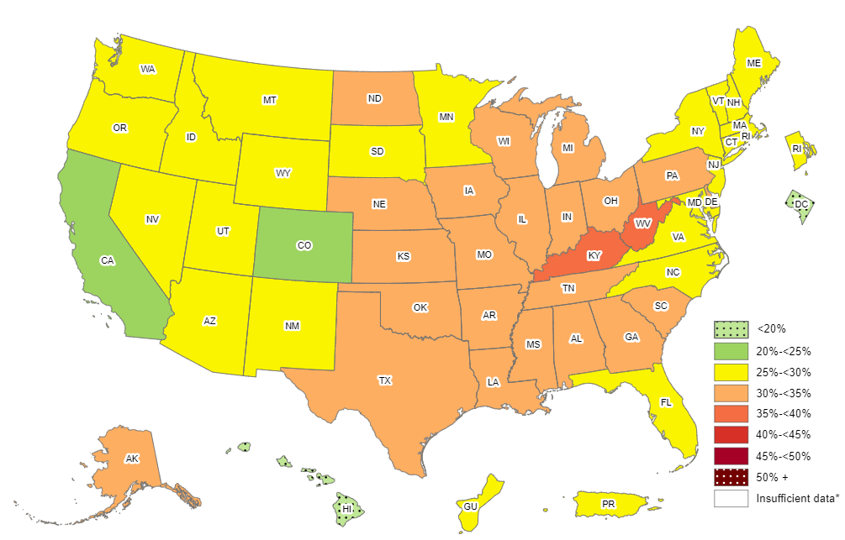
Prevalence of Self-Reported Obesity Among Non-Hispanic White Adults, by State and Territory, BRFSS, 2016-2018
*Sample size <50 or the relative standard error (dividing the standard error by the prevalence) ≥30%.

Slide 10
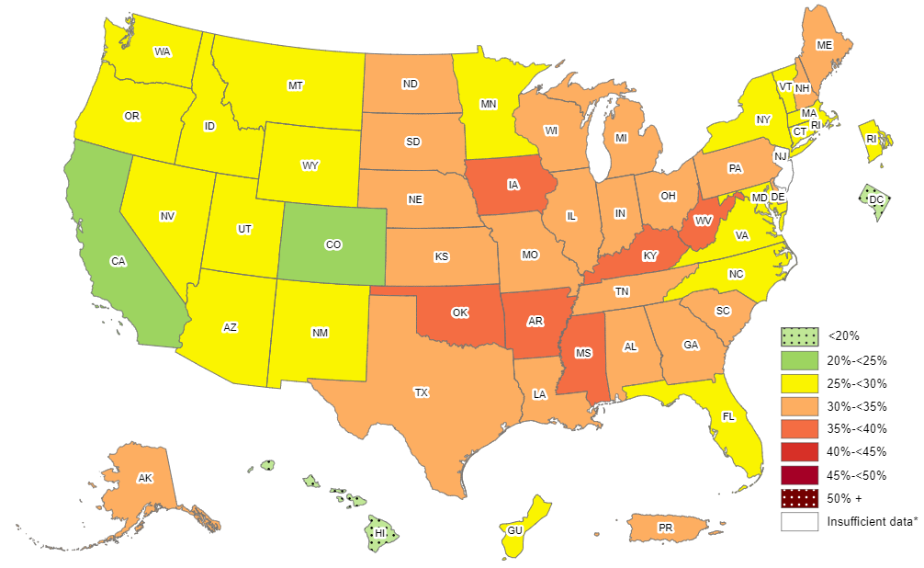
Prevalence of Self-Reported Obesity Among Non-Hispanic White Adults, by State and Territory, BRFSS, 2017-2019
*Sample size <50, the relative standard error (dividing the standard error by the prevalence) ≥30%, or no data in a specific year.

Slide 11
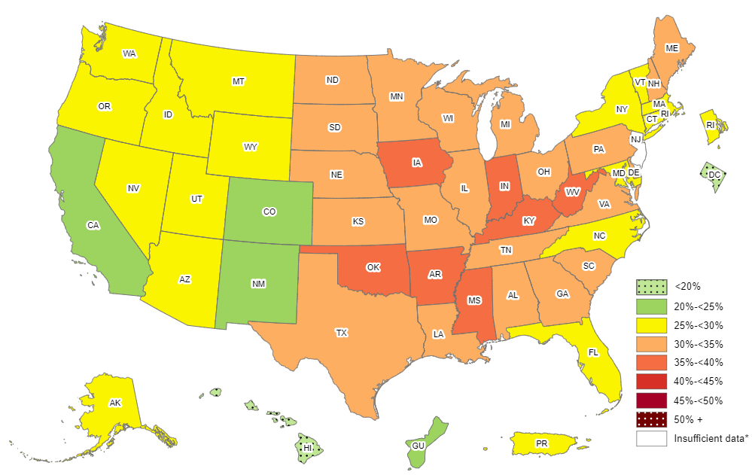
Prevalence of Self-Reported Obesity Among Non-Hispanic White Adults, by State and Territory, BRFSS, 2018-2020
*Sample size <50, the relative standard error (dividing the standard error by the prevalence) ≥30%, or no data in a specific year.

Slide 12
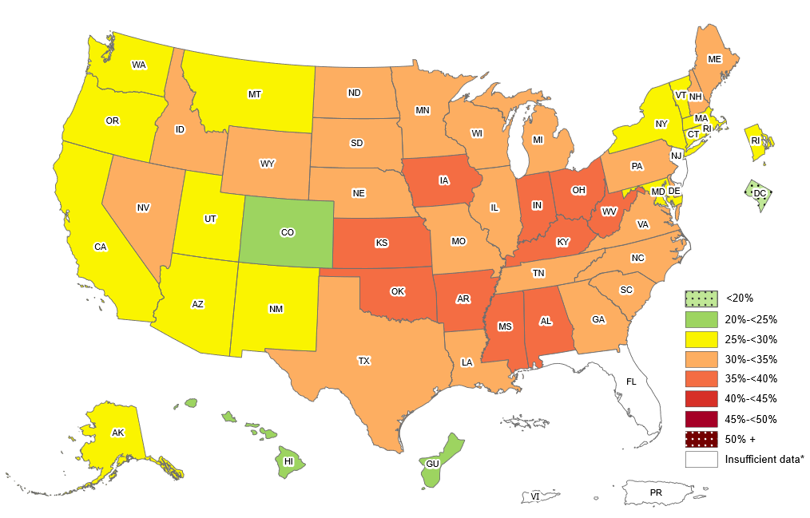
Prevalence of Self-Reported Obesity Among Non-Hispanic White Adults, by State and Territory, BRFSS, 2019-2021
*Sample size <50, the relative standard error (dividing the standard error by the prevalence) ≥30%, or no data in a specific year.

Slide 13
Prevalence of Self-Reported Obesity Among Non-Hispanic White Adults, by State and Territory, BRFSS, 2011-2013
State | Prevalence | 95% Confidence Interval
Alabama | 29.8 | (28.8, 30.9)
Alaska | 26.1 | (24.9, 27.4)
Arizona | 22.0 | (20.8, 23.3)
Arkansas | 32.0 | (30.7, 33.2)
California | 22.4 | (21.7, 23.1)
Colorado | 18.8 | (18.2, 19.4)
Connecticut | 23.5 | (22.6, 24.4)
Delaware | 27.4 | (26.3, 28.5)
District of Columbia | 10.0 | (8.8, 11.3)
Florida | 24.5 | (23.7, 25.3)
Georgia | 26.2 | (25.2, 27.2)
Guam | 18.8 | (15.1, 23.2)
Hawaii | 19.3 | (17.8, 20.8)
Idaho | 26.8 | (25.7, 27.9)
Illinois | 27.0 | (26.0, 28.1)
Indiana | 30.1 | (29.3, 30.9)
Iowa | 30.1 | (29.3, 30.9)
Kansas | 29.2 | (28.6, 29.7)
Kentucky | 31.0 | (30.2, 31.8)
Louisiana | 30.4 | (29.3, 31.6)
Maine | 28.5 | (27.8, 29.2)
Maryland | 25.3 | (24.5, 26.2)
Massachusetts | 22.4 | (21.8, 23.1)
Michigan | 30.1 | (29.3, 30.8)
Minnesota | 25.5 | (24.8, 26.2)
Mississippi | 30.7 | (29.6, 31.8)
State | Prevalence | 95% Confidence Interval
Missouri | 28.8 | (27.8, 29.9)
Montana | 23.4 | (22.7, 24.2)
Nebraska | 28.6 | (28.0, 29.2)
Nevada | 24.7 | (23.4, 26.0)
New Hampshire | 27.1 | (26.3, 28.0)
New Jersey | 24.4 | (23.7, 25.2)
New Mexico | 22.2 | (21.2, 23.1)
New York | 23.6 | (22.7, 24.5)
North Carolina | 26.6 | (25.8, 27.5)
North Dakota | 29.1 | (28.2, 30.0)
Ohio | 29.4 | (28.7, 30.2)
Oklahoma | 31.0 | (30.1, 31.9)
Oregon | 26.2 | (25.3, 27.1)
Pennsylvania | 28.7 | (28.0, 29.4)
Puerto Rico | 32.6 | (24.2, 42.2)
Rhode Island | 25.9 | (24.9, 26.9)
South Carolina | 27.5 | (26.6, 28.3)
South Dakota | 28.1 | (27.0, 29.2)
Tennessee | 30.2 | (28.9, 31.4)
Texas | 26.5 | (25.5, 27.4)
Utah | 24.1 | (23.5, 24.7)
Vermont | 24.5 | (23.7, 25.4)
Virginia | 26.3 | (25.4, 27.3)
Washington | 27.5 | (26.8, 28.2)
West Virginia | 33.8 | (32.9, 34.7)
Wisconsin | 28.6 | (27.5, 29.7)
Wyoming | 25.5 | (24.5, 26.5)
Source: Behavioral Risk Factor Surveillance System, CDC.

Slide 14
Prevalence of Self-Reported Obesity Among Non-Hispanic White Adults, by State and Territory, BRFSS, 2012-2014
State | Prevalence | 95% Confidence Interval
Alabama | 30.4 | (29.4, 31.4)
Alaska | 27.0 | (25.8, 28.2)
Arizona | 23.7 | (22.6, 24.8)
Arkansas | 32.9 | (31.7, 34.2)
California | 22.6 | (21.8, 23.4)
Colorado | 19.1 | (18.6, 19.7)
Connecticut | 24.2 | (23.3, 25.1)
Delaware | 28.2 | (27.0, 29.4)
District of Columbia | 9.9 | (8.7, 11.3)
Florida | 24.3 | (23.5, 25.2)
Georgia | 27.5 | (26.5, 28.6)
Guam | 18.2 | (14.6, 22.6)
Hawaii | 18.8 | (17.3, 20.3)
Idaho | 27.4 | (26.3, 28.5)
Illinois | 27.5 | (26.5, 28.6)
Indiana | 31.1 | (30.3, 31.9)
Iowa | 30.9 | (30.1, 31.7)
Kansas | 29.6 | (29.1, 30.2)
Kentucky | 31.6 | (30.7, 32.4)
Louisiana | 30.5 | (29.3, 31.7)
Maine | 28.5 | (27.8, 29.3)
Maryland | 26.0 | (25.1, 26.9)
Massachusetts | 22.6 | (22.0, 23.3)
Michigan | 30.2 | (29.5, 31.0)
Minnesota | 26.1 | (25.4, 26.7)
Mississippi | 31.3 | (30.0, 32.5)
State | Prevalence | 95% Confidence Interval
Missouri | 28.9 | (27.8, 29.9)
Montana | 23.9 | (23.1, 24.7)
Nebraska | 29.0 | (28.4, 29.6)
Nevada | 26.4 | (25.0, 27.8)
New Hampshire | 27.5 | (26.6, 28.5)
New Jersey | 25.4 | (24.6, 26.2)
New Mexico | 22.5 | (21.5, 23.5)
New York | 24.5 | (23.6, 25.4)
North Carolina | 26.8 | (26.0, 27.7)
North Dakota | 30.7 | (29.7, 31.7)
Ohio | 30.4 | (29.6, 31.1)
Oklahoma | 31.9 | (31.0, 32.7)
Oregon | 27.0 | (26.1, 28.0)
Pennsylvania | 29.2 | (28.5, 29.9)
Puerto Rico | 46.7 | (35.4, 58.3)
Rhode Island | 26.6 | (25.6, 27.6)
South Carolina | 28.1 | (27.2, 28.9)
South Dakota | 28.9 | (27.8, 30.0)
Tennessee | 30.7 | (29.6, 31.8)
Texas | 26.7 | (25.8, 27.7)
Utah | 24.5 | (24.0, 25.1)
Vermont | 24.3 | (23.5, 25.1)
Virginia | 26.1 | (25.2, 26.9)
Washington | 27.8 | (27.1, 28.5)
West Virginia | 34.7 | (33.8, 35.6)
Wisconsin | 29.6 | (28.6, 30.7)
Wyoming | 26.8 | (25.7, 27.9)
Source: Behavioral Risk Factor Surveillance System, CDC.

Slide 15
Prevalence of Self-Reported Obesity Among Non-Hispanic White Adults, by State and Territory, BRFSS, 2013-2015
State | Prevalence | 95% Confidence Interval
Alabama | 31.1 | (30.1, 32.1)
Alaska | 27.7 | (26.4, 29.0)
Arizona | 24.4 | (23.4, 25.5)
Arkansas | 33.2 | (31.9, 34.6)
California | 22.2 | (21.4, 23.1)
Colorado | 19.1 | (18.5, 19.7)
Connecticut | 24.0 | (23.2, 24.9)
Delaware | 29.4 | (28.1, 30.8)
District of Columbia | 9.9 | (8.6, 11.4)
Florida | 25.2 | (24.4, 26.0)
Georgia | 28.0 | (27.0, 29.2)
Guam | 21.1 | (16.7, 26.2)
Hawaii | 17.9 | (16.6, 19.4)
Idaho | 28.1 | (27.0, 29.2)
Illinois | 28.3 | (27.2, 29.3)
Indiana | 31.3 | (30.4, 32.2)
Iowa | 31.6 | (30.8, 32.5)
Kansas | 31.0 | (30.5, 31.6)
Kentucky | 32.9 | (32.0, 33.8)
Louisiana | 31.9 | (30.7, 33.2)
Maine | 29.2 | (28.4, 30.0)
Maryland | 26.7 | (25.8, 27.8)
Massachusetts | 23.0 | (22.3, 23.8)
Michigan | 30.2 | (29.5, 31.0)
Minnesota | 26.5 | (25.8, 27.1)
Mississippi | 31.5 | (30.2, 32.8)
State | Prevalence | 95% Confidence Interval
Missouri | 30.4 | (29.4, 31.4)
Montana | 23.8 | (22.9, 24.6)
Nebraska | 30.0 | (29.3, 30.6)
Nevada | 26.3 | (24.7, 27.9)
New Hampshire | 27.3 | (26.4, 28.2)
New Jersey | 25.6 | (24.8, 26.5)
New Mexico | 22.8 | (21.7, 24.0)
New York | 24.9 | (24.1, 25.8)
North Carolina | 27.2 | (26.3, 28.1)
North Dakota | 31.3 | (30.4, 32.3)
Ohio | 30.5 | (29.7, 31.4)
Oklahoma | 32.5 | (31.5, 33.4)
Oregon | 28.1 | (27.1, 29.1)
Pennsylvania | 29.5 | (28.6, 30.3)
Puerto Rico | 45.4 | (33.4, 58.0)
Rhode Island | 26.4 | (25.4, 27.4)
South Carolina | 28.3 | (27.5, 29.2)
South Dakota | 29.6 | (28.5, 30.8)
Tennessee | 31.5 | (30.3, 32.6)
Texas | 27.9 | (26.9, 28.9)
Utah | 24.5 | (23.9, 25.1)
Vermont | 24.8 | (24.0, 25.6)
Virginia | 26.7 | (25.9, 27.5)
Washington | 27.7 | (27.0, 28.5)
West Virginia | 35.2 | (34.3, 36.1)
Wisconsin | 29.8 | (28.9, 30.8)
Wyoming | 28.0 | (26.9, 29.1)
Source: Behavioral Risk Factor Surveillance System, CDC.

Slide 16
Prevalence of Self-Reported Obesity Among Non-Hispanic White Adults, by State and Territory, BRFSS, 2014-2016
State | Prevalence | 95% Confidence Interval
Alabama | 32.4 | (31.4, 33.4)
Alaska | 28.7 | (27.2, 30.2)
Arizona | 26.0 | (25.1, 26.9)
Arkansas | 34.0 | (32.5, 35.4)
California | 22.7 | (21.9, 23.6)
Colorado | 19.8 | (19.2, 20.4)
Connecticut | 24.3 | (23.5, 25.1)
Delaware | 29.4 | (28.0, 30.9)
District of Columbia | 9.7 | (8.5, 11.2)
Florida | 25.7 | (24.9, 26.5)
Georgia | 28.9 | (27.7, 30.1)
Guam | 24.8 | (19.9, 30.5)
Hawaii | 17.6 | (16.3, 19.0)
Idaho | 27.6 | (26.6, 28.7)
Illinois | 29.2 | (28.1, 30.3)
Indiana | 31.8 | (30.9, 32.7)
Iowa | 31.9 | (31.1, 32.8)
Kansas | 31.5 | (30.9, 32.1)
Kentucky | 33.4 | (32.4, 34.3)
Louisiana | 32.6 | (31.4, 33.9)
Maine | 29.5 | (28.7, 30.3)
Maryland | 27.8 | (26.8, 28.8)
Massachusetts | 22.9 | (22.2, 23.7)
Michigan | 30.7 | (29.9, 31.4)
Minnesota | 27.3 | (26.8, 27.8)
Mississippi | 31.9 | (30.6, 33.3)
State | Prevalence | 95% Confidence Interval
Missouri | 30.7 | (29.7, 31.8)
Montana | 24.4 | (23.5, 25.4)
Nebraska | 30.8 | (30.1, 31.5)
Nevada | 26.2 | (24.7, 27.9)
New Hampshire | 27.2 | (26.3, 28.2)
New Jersey | 25.4 | (24.5, 26.4)
New Mexico | 23.9 | (22.7, 25.2)
New York | 25.1 | (24.3, 25.9)
North Carolina | 28.1 | (27.2, 29.1)
North Dakota | 31.5 | (30.5, 32.6)
Ohio | 30.8 | (30.0, 31.7)
Oklahoma | 32.3 | (31.3, 33.2)
Oregon | 29.0 | (28.1, 30.0)
Pennsylvania | 29.5 | (28.6, 30.4)
Puerto Rico | 36.0 | (24.8, 49.0)
Rhode Island | 26.0 | (24.9, 27.1)
South Carolina | 28.9 | (28.1, 29.8)
South Dakota | 29.5 | (28.4, 30.7)
Tennessee | 31.3 | (30.2, 32.4)
Texas | 29.2 | (28.1, 30.3)
Utah | 24.9 | (24.3, 25.6)
Vermont | 25.7 | (24.9, 26.6)
Virginia | 27.3 | (26.5, 28.2)
Washington | 28.2 | (27.5, 28.8)
West Virginia | 36.0 | (35.2, 36.9)
Wisconsin | 30.5 | (29.5, 31.5)
Wyoming | 27.9 | (26.8, 29.2)
Source: Behavioral Risk Factor Surveillance System, CDC.

Slide 17
Prevalence of Self-Reported Obesity Among Non-Hispanic White Adults, by State and Territory, BRFSS, 2015-2017
State | Prevalence | 95% Confidence Interval
Alabama | 33.1 | (32.1, 34.2)
Alaska | 30.0 | (28.3, 31.7)
Arizona | 26.1 | (25.3, 27.0)
Arkansas | 34.0 | (32.5, 35.5)
California | 23.1 | (22.2, 24.0)
Colorado | 20.3 | (19.6, 20.9)
Connecticut | 24.4 | (23.7, 25.2)
Delaware | 29.7 | (28.3, 31.1)
District of Columbia | 10.3 | (9.0, 11.8)
Florida | 26.2 | (25.4, 27.0)
Georgia | 29.5 | (28.3, 30.8)
Guam | 30.2 | (24.8, 36.2)
Hawaii | 17.5 | (16.2, 18.9)
Idaho | 27.8 | (26.7, 28.9)
Illinois | 30.3 | (29.3, 31.5)
Indiana | 32.1 | (31.2, 32.9)
Iowa | 33.6 | (32.8, 34.5)
Kansas | 32.0 | (31.4, 32.5)
Kentucky | 34.4 | (33.4, 35.4)
Louisiana | 33.4 | (32.1, 34.7)
Maine | 29.8 | (29.0, 30.7)
Maryland | 28.1 | (27.1, 29.0)
Massachusetts | 24.0 | (23.1, 25.0)
Michigan | 30.9 | (30.2, 31.7)
Minnesota | 27.5 | (27.0, 28.1)
Mississippi | 32.1 | (30.8, 33.5)
Missouri | 31.6 | (30.6, 32.6)
State | Prevalence | 95% Confidence Interval
Montana | 24.0 | (23.0, 25.0)
Nebraska | 31.7 | (31.0, 32.4)
Nevada | 25.7 | (24.1, 27.3)
New Hampshire | 27.4 | (26.5, 28.5)
New Jersey | 25.7 | (24.6, 26.7)
New Mexico | 24.3 | (23.1, 25.6)
New York | 24.7 | (24.0, 25.5)
North Carolina | 29.3 | (28.3, 30.4)
North Dakota | 31.9 | (30.9, 32.9)
Ohio | 31.2 | (30.3, 32.0)
Oklahoma | 33.4 | (32.3, 34.4)
Oregon | 29.3 | (28.3, 30.3)
Pennsylvania | 30.1 | (29.2, 31.1)
Puerto Rico | 24.1 | (15.1, 36.0)
Rhode Island | 26.9 | (25.8, 28.0)
South Carolina | 29.6 | (28.8, 30.5)
South Dakota | 30.0 | (28.8, 31.3)
Tennessee | 31.8 | (30.7, 32.9)
Texas | 30.1 | (28.8, 31.3)
Utah | 24.7 | (24.1, 25.4)
Vermont | 26.7 | (25.8, 27.7)
Virginia | 27.9 | (27.0, 28.8)
Washington | 28.3 | (27.7, 29.0)
West Virginia | 37.0 | (36.1, 37.9)
Wisconsin | 31.0 | (30.0, 32.0)
Wyoming | 27.9 | (26.8, 29.1)
Source: Behavioral Risk Factor Surveillance System, CDC.

Slide 18
Prevalence of Self-Reported Obesity Among Non-Hispanic White Adults, by State and Territory, BRFSS, 2016-2018
State | Prevalence | 95% Confidence Interval
Alabama | 33.8 | (32.7, 34.9)
Alaska | 30.4 | (28.6, 32.1)
Arizona | 26.8 | (25.9, 27.7)
Arkansas | 34.8 | (33.4, 36.2)
California | 23.3 | (22.4, 24.2)
Colorado | 21.1 | (20.5, 21.8)
Connecticut | 25.2 | (24.5, 26.0)
Delaware | 30.7 | (29.4, 32.1)
District of Columbia | 11.2 | (10.0, 12.6)
Florida | 26.9 | (26.1, 27.7)
Georgia | 30.1 | (29.0, 31.3)
Guam | 29.2 | (24.0, 35.0)
Hawaii | 17.8 | (16.6, 19.2)
Idaho | 27.7 | (26.6, 28.9)
Illinois | 30.8 | (29.7, 31.9)
Indiana | 33.0 | (32.2, 33.8)
Iowa | 34.5 | (33.7, 35.3)
Kansas | 32.1 | (31.5, 32.8)
Kentucky | 35.2 | (34.2, 36.2)
Louisiana | 32.9 | (31.7, 34.2)
Maine | 29.8 | (28.9, 30.6)
Maryland | 28.7 | (27.9, 29.5)
Massachusetts | 25.0 | (24.0, 26.0)
Michigan | 31.8 | (31.0, 32.5)
Minnesota | 28.7 | (28.2, 29.2)
Mississippi | 33.9 | (32.6, 35.2)
Missouri | 32.0 | (30.9, 33.0)
State | Prevalence | 95% Confidence Interval
Montana | 25.1 | (24.1, 26.1)
Nebraska | 32.6 | (31.9, 33.3)
Nevada | 26.4 | (24.9, 27.9)
New Hampshire | 28.5 | (27.5, 29.5)
New Jersey | 26.1 | (24.8, 27.5)
New Mexico | 25.1 | (23.9, 26.4)
New York | 25.7 | (25.0, 26.4)
North Carolina | 29.9 | (28.7, 31.1)
North Dakota | 33.1 | (32.2, 34.1)
Ohio | 32.6 | (31.8, 33.4)
Oklahoma | 33.9 | (32.9, 35.0)
Oregon | 29.2 | (28.2, 30.1)
Pennsylvania | 30.4 | (29.4, 31.3)
Puerto Rico | 29.9 | (17.9, 45.5)
Rhode Island | 27.1 | (26.0, 28.3)
South Carolina | 30.8 | (29.9, 31.7)
South Dakota | 29.7 | (28.5, 31.0)
Tennessee | 32.3 | (31.2, 33.4)
Texas | 31.5 | (30.2, 32.9)
Utah | 25.7 | (25.0, 26.4)
Vermont | 27.7 | (26.7, 28.6)
Virginia | 28.4 | (27.6, 29.2)
Washington | 29.0 | (28.4, 29.7)
West Virginia | 38.5 | (37.6, 39.5)
Wisconsin | 31.4 | (30.4, 32.5)
Wyoming | 28.0 | (26.9, 29.2)
Source: Behavioral Risk Factor Surveillance System, CDC.

Slide 19
Prevalence of Self-Reported Obesity Among Non-Hispanic White Adults, by State and Territory, BRFSS, 2017-2019
State | Prevalence | 95% Confidence Interval
Alabama | 33.5 | (32.4, 34.5)
Alaska | 30.1 | (28.5, 31.9)
Arizona | 27.6 | (26.6, 28.6)
Arkansas | 35.6 | (34.2, 36.9)
California | 23.9 | (23.0, 24.9)
Colorado | 21.6 | (20.9, 22.3)
Connecticut | 26.1 | (25.2, 26.9)
Delaware | 32.3 | (31.0, 33.7)
District of Columbia | 11.4 | (10.1, 12.8)
Florida | 26.5 | (25.6, 27.3)
Georgia | 30.1 | (29.0, 31.2)
Guam | 27.7 | (23.1, 32.9)
Hawaii | 18.3 | (17.1, 19.6)
Idaho | 28.4 | (27.2, 29.6)
Illinois | 30.9 | (29.8, 32.0)
Indiana | 33.9 | (33.1, 34.7)
Iowa | 35.3 | (34.5, 36.0)
Kansas | 33.7 | (33.0, 34.3)
Kentucky | 35.8 | (34.8, 36.9)
Louisiana | 33.0 | (31.8, 34.3)
Maine | 30.4 | (29.5, 31.2)
Maryland | 28.9 | (28.1, 29.7)
Massachusetts | 25.8 | (24.8, 26.9)
Michigan | 32.8 | (32.0, 33.5)
Minnesota | 29.5 | (29.0, 30.0)
Mississippi | 35.7 | (34.4, 37.0)
Missouri | 33.1 | (32.0, 34.1)
State | Prevalence | 95% Confidence Interval
Montana | 25.8 | (24.9, 26.8)
Nebraska | 33.3 | (32.6, 34.0)
Nevada | 26.9 | (25.3, 28.6)
New Hampshire | 30.2 | (29.1, 31.3)
New Jersey | Insufficient data* | Insufficient data*
New Mexico | 25.1 | (23.9, 26.4)
New York | 26.4 | (25.6, 27.1)
North Carolina | 29.9 | (28.7, 31.2)
North Dakota | 34.1 | (33.0, 35.1)
Ohio | 33.6 | (32.8, 34.5)
Oklahoma | 35.3 | (34.3, 36.4)
Oregon | 29.0 | (28.1, 30.0)
Pennsylvania | 31.3 | (30.3, 32.3)
Puerto Rico | 31.3 | (18.9, 47.0)
Rhode Island | 28.2 | (27.1, 29.4)
South Carolina | 31.7 | (30.8, 32.7)
South Dakota | 30.2 | (29.0, 31.6)
Tennessee | 33.0 | (31.9, 34.1)
Texas | 31.5 | (30.2, 32.9)
Utah | 27.0 | (26.3, 27.6)
Vermont | 27.6 | (26.7, 28.6)
Virginia | 29.4 | (28.5, 30.2)
Washington | 29.0 | (28.3, 29.7)
West Virginia | 39.0 | (38.0, 40.0)
Wisconsin | 31.9 | (30.8, 32.9)
Wyoming | 28.9 | (27.9, 30.1)
*Sample size <50, the relative standard error (dividing the standard error by the prevalence) ≥30%, or no data in a specific year.
Source: Behavioral Risk Factor Surveillance System, CDC.

Slide 20
Prevalence of Self-Reported Obesity Among Non-Hispanic White Adults, by State and Territory, BRFSS, 2018-2020
State | Prevalence | 95% Confidence Interval
Alabama | 34.3 | (33.2, 35.5)
Alaska | 29.0 | (27.3, 30.6)
Arizona | 27.6 | (26.6, 28.7)
Arkansas | 36.1 | (34.9, 37.4)
California | 24.4 | (23.3, 25.5)
Colorado | 21.8 | (21.2, 22.5)
Connecticut | 26.6 | (25.7, 27.5)
Delaware | 33.3 | (32.0, 34.7)
District of Columbia | 11.2 | (10.1, 12.5)
Florida | 27.4 | (26.4, 28.3)
Georgia | 30.7 | (29.6, 31.8)
Guam | 24.9 | (20.8, 29.6)
Hawaii | 18.8 | (17.6, 20.1)
Idaho | 29.2 | (28.0, 30.3)
Illinois | 31.1 | (29.9, 32.3)
Indiana | 35.1 | (34.2, 35.9)
Iowa | 35.3 | (34.6, 36.0)
Kansas | 34.5 | (33.7, 35.2)
Kentucky | 36.5 | (35.4, 37.6)
Louisiana | 33.3 | (32.1, 34.5)
Maine | 31.1 | (30.3, 32.0)
Maryland | 28.9 | (28.2, 29.7)
Massachusetts | 25.3 | (24.3, 26.2)
Michigan | 33.9 | (33.0, 34.7)
Minnesota | 30.3 | (29.7, 30.8)
Mississippi | 36.2 | (34.9, 37.4)
Missouri | 33.6 | (32.6, 34.6)
State | Prevalence | 95% Confidence Interval
Montana | 26.9 | (26.0, 27.8)
Nebraska | 33.9 | (33.1, 34.6)
Nevada | 28.9 | (27.2, 30.6)
New Hampshire | 30.7 | (29.6, 31.7)
New Jersey | Insufficient data* | Insufficient data*
New Mexico | 24.8 | (23.6, 26.1)
New York | 26.6 | (25.9, 27.3)
North Carolina | 29.9 | (28.8, 31.1)
North Dakota | 33.9 | (32.8, 35.1)
Ohio | 34.2 | (33.5, 35.0)
Oklahoma | 35.1 | (34.0, 36.2)
Oregon | 28.3 | (27.4, 29.2)
Pennsylvania | 31.3 | (30.3, 32.3)
Puerto Rico | 29.2 | (17.1, 45.0)
Rhode Island | 28.3 | (27.1, 29.5)
South Carolina | 32.4 | (31.3, 33.5)
South Dakota | 30.9 | (29.5, 32.3)
Tennessee | 34.1 | (32.9, 35.2)
Texas | 32.2 | (30.9, 33.5)
Utah | 28.0 | (27.3, 28.6)
Vermont | 27.1 | (26.1, 28.1)
Virginia | 30.3 | (29.4, 31.2)
Washington | 29.3 | (28.6, 30.0)
West Virginia | 39.4 | (38.4, 40.5)
Wisconsin | 31.9 | (30.8, 33.0)
Wyoming | 29.5 | (28.4, 30.7)
*Sample size <50, the relative standard error (dividing the standard error by the prevalence) ≥30%, or no data in a specific year.
Source: Behavioral Risk Factor Surveillance System, CDC.

Slide 21
Prevalence of Self-Reported Obesity Among Non-Hispanic White Adults, by State and Territory, BRFSS, 2019–2021
State | Prevalence | 95% Confidence Interval
Alabama | 35.2 | (34.0, 36.4)
Alaska | 29.7 | (28.2, 31.3)
Arizona | 27.9 | (26.9, 28.8)
Arkansas | 36.7 | (35.5, 38.0)
California | 25.6 | (24.4, 26.8)
Colorado | 22.6 | (21.9, 23.3)
Connecticut | 27.5 | (26.5, 28.5)
Delaware | 33.1 | (31.6, 34.6)
District of Columbia | 11.4 | (10.2, 12.8)
Florida | Insufficient data* | Insufficient data*
Georgia | 31.0 | (29.8, 32.2)
Guam | 22.3 | (18.3, 26.9)
Hawaii | 20.2 | (18.9, 21.5)
Idaho | 30.2 | (29.2, 31.2)
Illinois | 31.9 | (30.6, 33.2)
Indiana | 35.7 | (34.8, 36.5)
Iowa | 35.9 | (35.1, 36.6)
Kansas | 35.1 | (34.4, 35.8)
Kentucky | 37.6 | (36.4, 38.7)
Louisiana | 34.6 | (33.3, 35.8)
Maine | 31.7 | (30.8, 32.5)
Maryland | 29.7 | (28.9, 30.5)
Massachusetts | 25.4 | (24.5, 26.4)
Michigan | 34.5 | (33.6, 35.3)
Minnesota | 31.1 | (30.5, 31.7)
Mississippi | 35.7 | (34.4, 37.0)
Missouri | 34.8 | (33.9, 35.7)
State | Prevalence | 95% Confidence Interval
Montana | 28.6 | (27.7, 29.5)
Nebraska | 34.5 | (33.8, 35.2)
Nevada | 30.0 | (28.3, 31.8)
New Hampshire | 31.0 | (30.0, 32.1)
New Jersey | Insufficient data* | Insufficient data*
New Mexico | 25.5 | (24.2, 26.8)
New York | 26.9 | (26.2, 27.6)
North Carolina | 31.0 | (29.8, 32.2)
North Dakota | 33.9 | (32.8, 35.0)
Ohio | 35.4 | (34.7, 36.2)
Oklahoma | 36.3 | (35.2, 37.5)
Oregon | 28.6 | (27.7, 29.6)
Pennsylvania | 32.2 | (31.2, 33.3)
Puerto Rico | Insufficient data* | Insufficient data*
Rhode Island | 29.1 | (28.0, 30.3)
South Carolina | 32.7 | (31.6, 33.8)
South Dakota | 33.5 | (32.0, 35.2)
Tennessee | 34.0 | (32.8, 35.1)
Texas | 31.6 | (30.4, 32.9)
Utah | 29.0 | (28.4, 29.7)
Vermont | 27.5 | (26.5, 28.5)
Virgin Islands | Insufficient data* | Insufficient data*
Virginia | 31.6 | (30.7, 32.5)
Washington | 29.3 | (28.6, 30.0)
West Virginia | 39.7 | (38.7, 40.7)
Wisconsin | 32.5 | (31.4, 33.6)
Wyoming | 30.5 | (29.3, 31.7)
*Sample size <50, the relative standard error (dividing the standard error by the prevalence) ≥30%, or no data in a specific year.
Source: Behavioral Risk Factor Surveillance System, CDC.

Slide 22
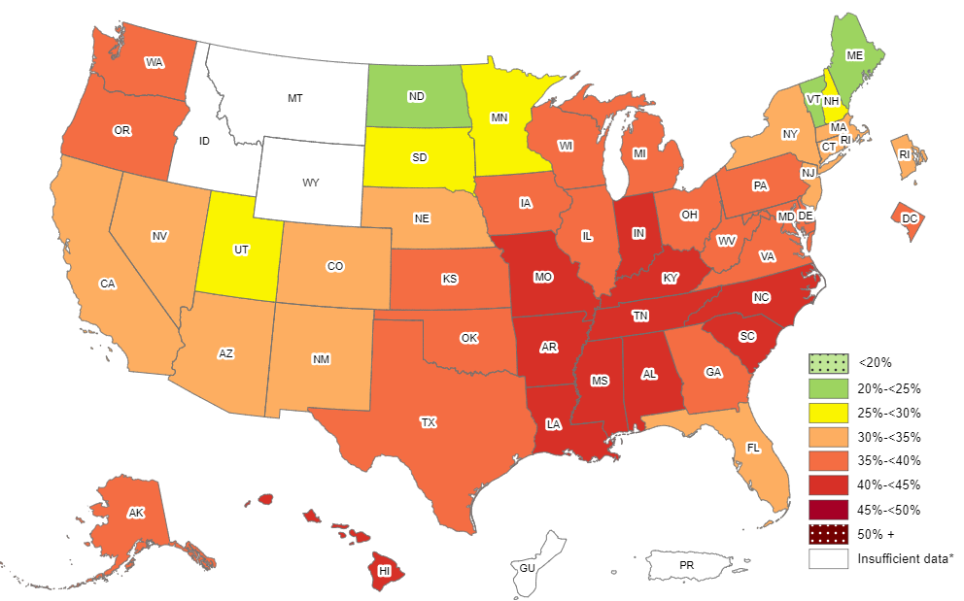
Prevalence of Self-Reported Obesity Among Non-Hispanic Black Adults, by State and Territory, BRFSS, 2011-2013
*Sample size <50 or the relative standard error (dividing the standard error by the prevalence) ≥30%.

Slide 23
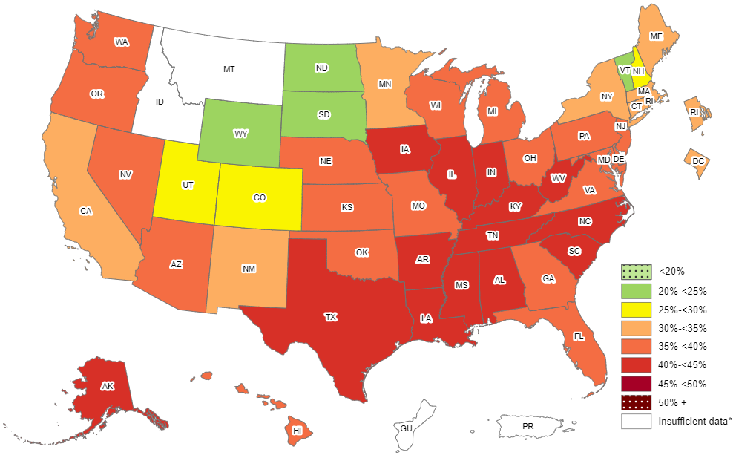
Prevalence of Self-Reported Obesity Among Non-Hispanic Black Adults, by State and Territory, BRFSS, 2012-2014
*Sample size <50 or the relative standard error (dividing the standard error by the prevalence) ≥30%.

Slide 24
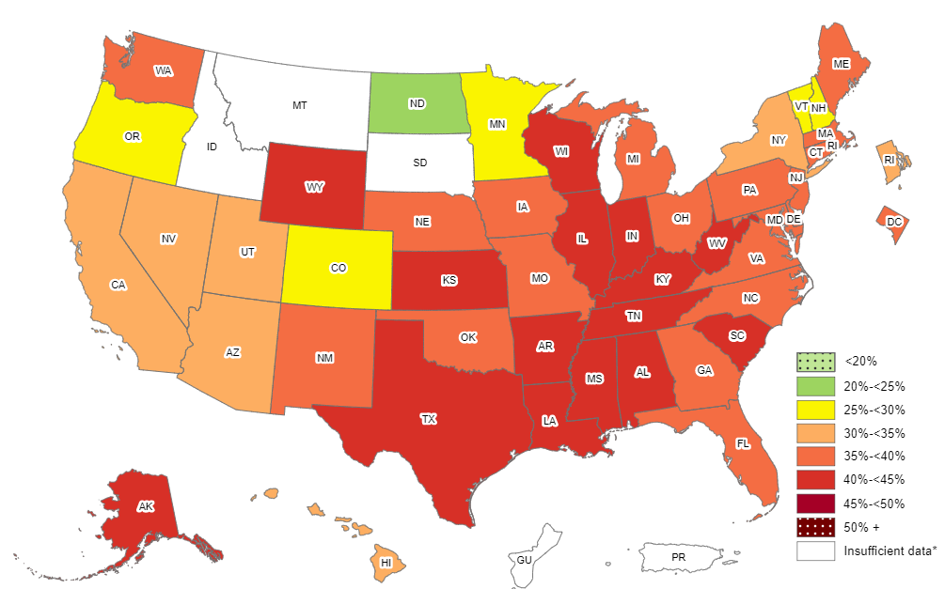
Prevalence of Self-Reported Obesity Among Non-Hispanic Black Adults, by State and Territory, BRFSS, 2013-2015
*Sample size <50 or the relative standard error (dividing the standard error by the prevalence) ≥30%.

Slide 25
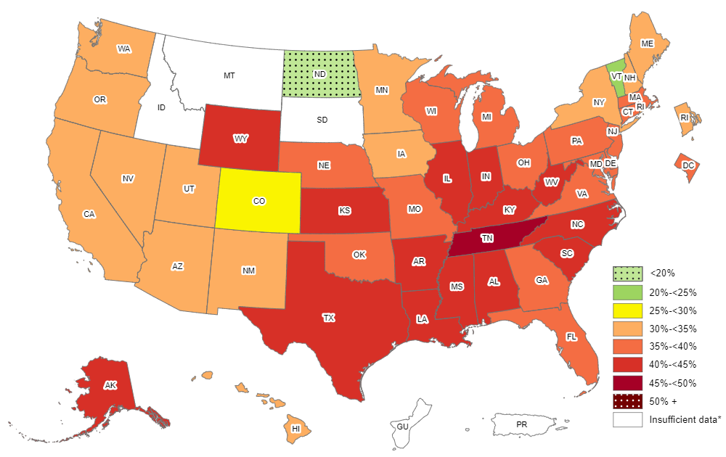
Prevalence of Self-Reported Obesity Among Non-Hispanic Black Adults, by State and Territory, BRFSS, 2014-2016
*Sample size <50 or the relative standard error (dividing the standard error by the prevalence) ≥30%.

Slide 26
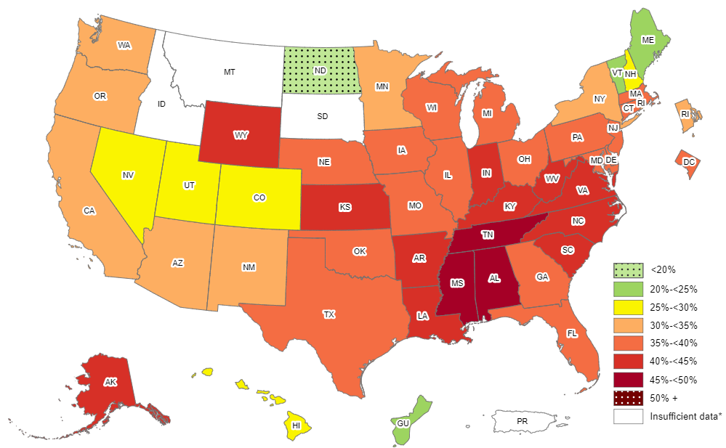
Prevalence of Self-Reported Obesity Among Non-Hispanic Black Adults, by State and Territory, BRFSS, 2015-2017
*Sample size <50 or the relative standard error (dividing the standard error by the prevalence) ≥30%.

Slide 27
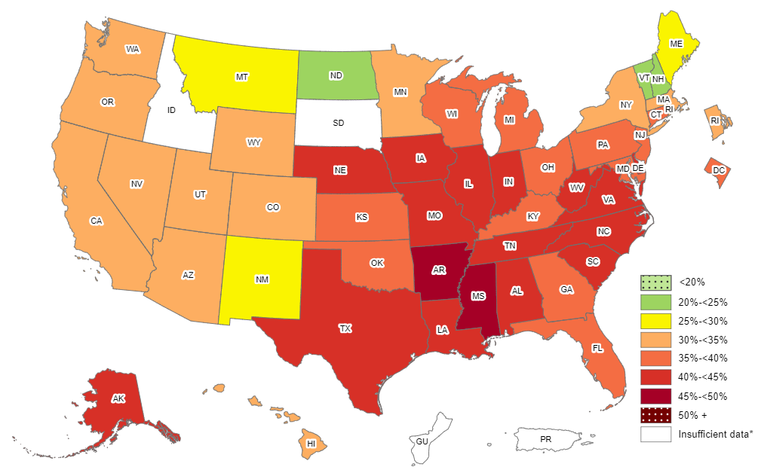
Prevalence of Self-Reported Obesity Among Non-Hispanic Black Adults, by State and Territory, BRFSS, 2016-2018
*Sample size <50 or the relative standard error (dividing the standard error by the prevalence) ≥30%.

Slide 28
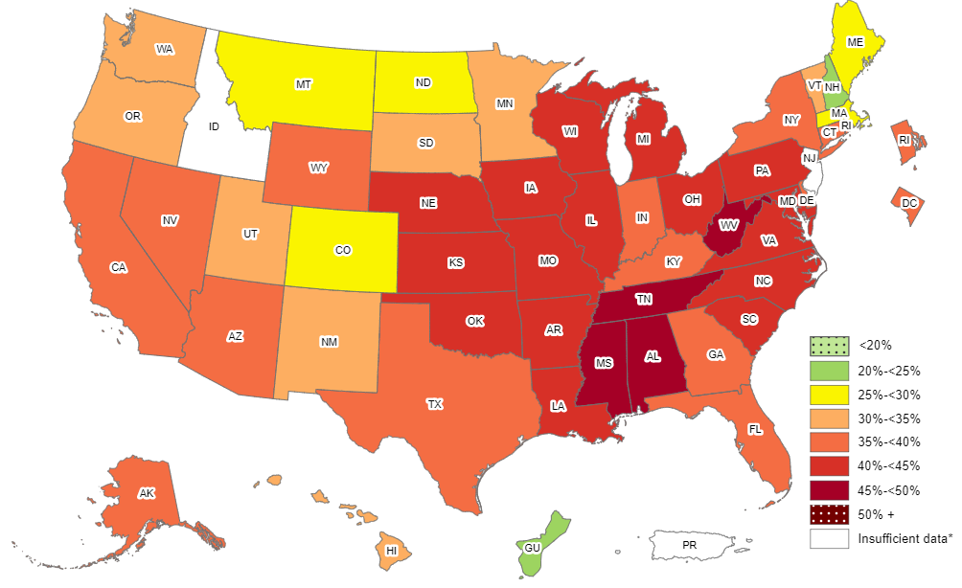
Prevalence of Self-Reported Obesity Among Non-Hispanic Black Adults, by State and Territory, BRFSS, 2017-2019
*Sample size <50, the relative standard error (dividing the standard error by the prevalence) ≥30%, or no data in a specific year.

Slide 29
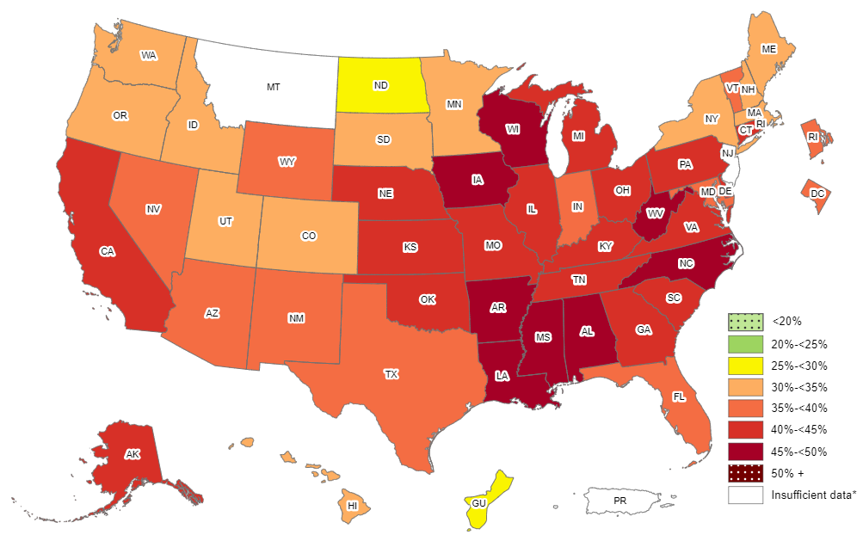
Prevalence of Self-Reported Obesity Among Non-Hispanic Black Adults, by State and Territory, BRFSS, 2018-2020
*Sample size <50, the relative standard error (dividing the standard error by the prevalence) ≥30%, or no data in a specific year.

Slide 30
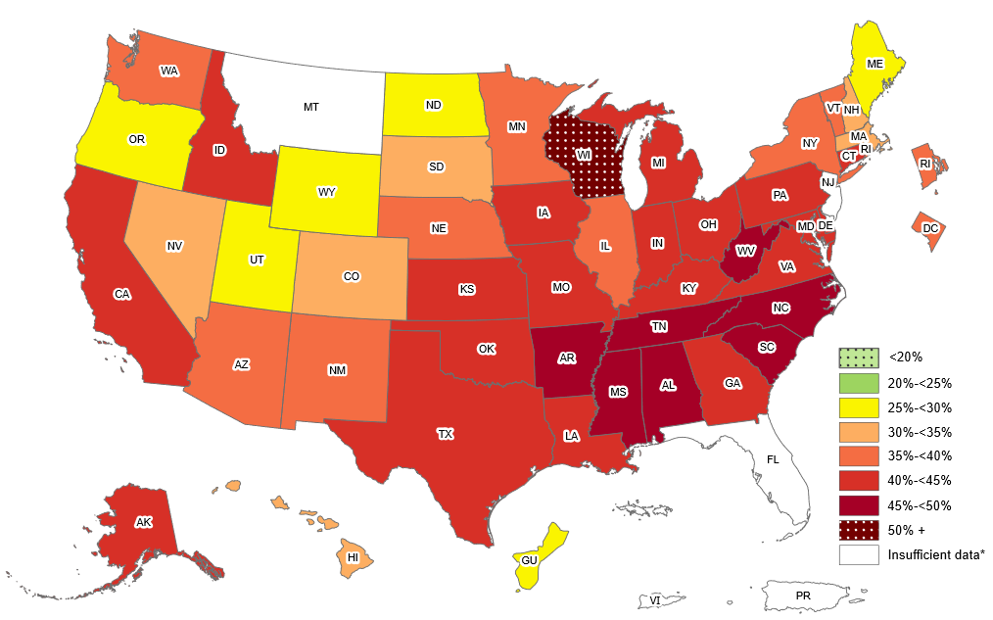
Prevalence of Self-Reported Obesity Among Non-Hispanic Black Adults, by State and Territory, BRFSS, 2019–2021
*Sample size <50, the relative standard error (dividing the standard error by the prevalence) ≥30%, or no data in a specific year.

Slide 31
Prevalence of Self-Reported Obesity Among Non-Hispanic Black Adults, by State and Territory, BRFSS, 2011-2013
State | Prevalence | 95% Confidence Interval
Alabama | 41.8 | (39.9, 43.8)
Alaska | 37.9 | (29.1, 47.6)
Arizona | 32.5 | (25.7, 40.2)
Arkansas | 42.2 | (38.7, 45.7)
California | 34.8 | (31.8, 38.0)
Colorado | 30.5 | (26.6, 34.7)
Connecticut | 33.2 | (30.1, 36.5)
Delaware | 37.3 | (34.6, 40.1)
District of Columbia | 35.6 | (33.7, 37.6)
Florida | 34.8 | (32.2, 37.5)
Georgia | 37.2 | (35.3, 39.0)
Guam | Insufficient data* | Insufficient data*
Hawaii | 41.1 | (30.6, 52.4)
Idaho | Insufficient data* | Insufficient data*
Illinois | 38.7 | (35.3, 42.3)
Indiana | 42.5 | (39.4, 45.7)
Iowa | 39.5 | (32.7, 46.7)
Kansas | 39.2 | (36.2, 42.2)
Kentucky | 42.0 | (38.1, 46.0)
Louisiana | 41.9 | (39.9, 44.0)
Maine | 22.6 | (13.0, 36.3)
Maryland | 37.5 | (35.8, 39.2)
Massachusetts | 33.6 | (30.8, 36.5)
Michigan | 39.3 | (37.0, 41.7)
Minnesota | 29.8 | (26.1, 33.7)
Mississippi | 42.9 | (41.2, 44.5)
State | Prevalence | 95% Confidence Interval
Missouri | 40.0 | (36.5, 43.5)
Montana | Insufficient data* | Insufficient data*
Nebraska | 33.7 | (30.0, 37.6)
Nevada | 34.9 | (29.7, 40.4)
New Hampshire | 27.7 | (18.7, 39.0)
New Jersey | 34.5 | (32.6, 36.5)
New Mexico | 30.1 | (24.1, 36.9)
New York | 32.7 | (30.1, 35.4)
North Carolina | 40.4 | (38.6, 42.4)
North Dakota | 24.7 | (15.5, 36.9)
Ohio | 36.0 | (33.5, 38.5)
Oklahoma | 38.7 | (35.2, 42.3)
Oregon | 39.5 | (29.3, 50.6)
Pennsylvania | 35.6 | (33.2, 38.0)
Puerto Rico | Insufficient data* | Insufficient data*
Rhode Island | 31.4 | (26.7, 36.6)
South Carolina | 42.6 | (41.1, 44.2)
South Dakota | 26.1 | (15.6, 40.3)
Tennessee | 40.4 | (37.0, 43.9)
Texas | 38.2 | (35.4, 41.1)
Utah | 26.0 | (18.8, 34.7)
Vermont | 20.2 | (11.2, 33.7)
Virginia | 38.5 | (36.2, 41.0)
Washington | 37.6 | (32.8, 42.7)
West Virginia | 36.5 | (30.4, 43.0)
Wisconsin | 38.5 | (33.0, 44.3)
Wyoming | Insufficient data* | Insufficient data*
*Sample size <50 or the relative standard error (dividing the standard error by the prevalence) ≥30%.
Source: Behavioral Risk Factor Surveillance System, CDC.

Slide 32
Prevalence of Self-Reported Obesity Among Non-Hispanic Black Adults, by State and Territory, BRFSS, 2012-2014
State | Prevalence | 95% Confidence Interval
Alabama | 42.4 | (40.5, 44.3)
Alaska | 40.4 | (32.0, 49.4)
Arizona | 35.5 | (29.3, 42.2)
Arkansas | 44.4 | (41.2, 47.8)
California | 34.7 | (31.6, 38.0)
Colorado | 29.3 | (25.7, 33.2)
Connecticut | 34.7 | (31.7, 37.8)
Delaware | 37.2 | (34.4, 40.1)
District of Columbia | 34.7 | (32.7, 36.7)
Florida | 35.0 | (32.4, 37.6)
Georgia | 37.5 | (35.6, 39.4)
Guam | Insufficient data* | Insufficient data*
Hawaii | 36.0 | (26.5, 46.7)
Idaho | Insufficient data* | Insufficient data*
Illinois | 40.2 | (36.8, 43.7)
Indiana | 42.5 | (39.4, 45.6)
Iowa | 40.0 | (33.2, 47.3)
Kansas | 39.5 | (36.5, 42.7)
Kentucky | 41.9 | (38.0, 45.9)
Louisiana | 43.2 | (41.1, 45.3)
Maine | 32.2 | (21.1, 45.7)
Maryland | 37.9 | (36.2, 39.7)
Massachusetts | 34.6 | (31.6, 37.7)
Michigan | 36.9 | (34.6, 39.2)
Minnesota | 31.2 | (27.7, 35.0)
Mississippi | 43.0 | (41.2, 44.9)
State | Prevalence | 95% Confidence Interval
Missouri | 39.9 | (36.5, 43.5)
Montana | Insufficient data* | Insufficient data*
Nebraska | 35.2 | (31.2, 39.4)
Nevada | 37.1 | (31.7, 42.8)
New Hampshire | 25.3 | (16.0, 37.7)
New Jersey | 36.7 | (34.7, 38.8)
New Mexico | 34.9 | (28.1, 42.5)
New York | 32.5 | (29.9, 35.1)
North Carolina | 40.0 | (38.2, 41.8)
North Dakota | 24.9 | (16.0, 36.7)
Ohio | 38.6 | (35.9, 41.4)
Oklahoma | 38.3 | (34.9, 41.7)
Oregon | 35.3 | (25.9, 46.1)
Pennsylvania | 36.0 | (33.6, 38.4)
Puerto Rico | Insufficient data* | Insufficient data*
Rhode Island | 31.3 | (26.8, 36.2)
South Carolina | 42.7 | (41.2, 44.2)
South Dakota | 24.3 | (14.4, 37.9)
Tennessee | 40.6 | (37.6, 43.6)
Texas | 40.7 | (37.8, 43.6)
Utah | 25.6 | (18.7, 34.0)
Vermont | 23.2 | (13.5, 37.0)
Virginia | 38.9 | (36.8, 41.0)
Washington | 35.7 | (31.1, 40.6)
West Virginia | 40.9 | (34.8, 47.3)
Wisconsin | 38.8 | (33.2, 44.7)
Wyoming | 24.3 | (14.3, 38.2)
*Sample size <50 or the relative standard error (dividing the standard error by the prevalence) ≥30%.
Source: Behavioral Risk Factor Surveillance System, CDC.

Slide 33
Prevalence of Self-Reported Obesity Among Non-Hispanic Black Adults, by State and Territory, BRFSS, 2013-2015
State | Prevalence | 95% Confidence Interval
Alabama | 43.2 | (41.3, 45.2)
Alaska | 40.5 | (31.7, 49.9)
Arizona | 34.2 | (28.4, 40.5)
Arkansas | 43.9 | (40.4, 47.6)
California | 32.8 | (29.7, 36.0)
Colorado | 27.7 | (24.1, 31.6)
Connecticut | 35.5 | (32.5, 38.6)
Delaware | 36.6 | (33.7, 39.7)
District of Columbia | 35.2 | (33.1, 37.4)
Florida | 35.3 | (32.9, 37.7)
Georgia | 37.8 | (35.8, 39.8)
Guam | Insufficient data* | Insufficient data*
Hawaii | 33.6 | (23.7, 45.1)
Idaho | Insufficient data* | Insufficient data*
Illinois | 40.7 | (37.5, 44.0)
Indiana | 41.5 | (38.0, 45.2)
Iowa | 35.4 | (28.8, 42.6)
Kansas | 42.7 | (39.9, 45.5)
Kentucky | 42.7 | (38.6, 46.9)
Louisiana | 42.5 | (40.3, 44.7)
Maine | 35.9 | (24.2, 49.6)
Maryland | 38.0 | (36.1, 40.0)
Massachusetts | 35.9 | (32.5, 39.4)
Michigan | 37.6 | (35.3, 40.0)
Minnesota | 29.9 | (26.6, 33.5)
Mississippi | 43.2 | (41.3, 45.2)
State | Prevalence | 95% Confidence Interval
Missouri | 38.4 | (35.0, 41.9)
Montana | Insufficient data* | Insufficient data*
Nebraska | 36.3 | (32.0, 40.8)
Nevada | 34.5 | (28.9, 40.6)
New Hampshire | 27.6 | (17.6, 40.5)
New Jersey | 36.6 | (34.4, 38.8)
New Mexico | 37.5 | (30.0, 45.6)
New York | 32.3 | (30.1, 34.6)
North Carolina | 39.9 | (37.9, 41.8)
North Dakota | 20.0 | (12.4, 30.6)
Ohio | 37.1 | (34.3, 40.1)
Oklahoma | 35.4 | (32.1, 38.8)
Oregon | 29.4 | (20.4, 40.4)
Pennsylvania | 35.7 | (33.0, 38.5)
Puerto Rico | Insufficient data* | Insufficient data*
Rhode Island | 34.5 | (29.8, 39.4)
South Carolina | 42.2 | (40.7, 43.7)
South Dakota | Insufficient data* | Insufficient data*
Tennessee | 43.0 | (39.8, 46.4)
Texas | 41.5 | (38.5, 44.6)
Utah | 30.9 | (23.2, 39.8)
Vermont | 29.0 | (17.7, 43.7)
Virginia | 39.2 | (37.1, 41.3)
Washington | 35.4 | (30.8, 40.2)
West Virginia | 41.5 | (35.8, 47.4)
Wisconsin | 41.6 | (35.5, 48.0)
Wyoming | 43.0 | (28.7, 58.5)
*Sample size <50 or the relative standard error (dividing the standard error by the prevalence) ≥30%.
Source: Behavioral Risk Factor Surveillance System, CDC.

Slide 34
Prevalence of Self-Reported Obesity Among Non-Hispanic Black Adults, by State and Territory, BRFSS, 2014-2016
State | Prevalence | 95% Confidence Interval
Alabama | 44.1 | (42.3, 46.0)
Alaska | 43.6 | (32.6, 55.1)
Arizona | 33.1 | (28.6, 38.0)
Arkansas | 44.2 | (40.3, 48.3)
California | 31.0 | (28.2, 34.0)
Colorado | 29.1 | (25.4, 33.0)
Connecticut | 37.7 | (34.8, 40.8)
Delaware | 36.5 | (33.4, 39.8)
District of Columbia | 35.5 | (33.4, 37.6)
Florida | 35.2 | (32.8, 37.6)
Georgia | 37.7 | (35.6, 39.9)
Guam | Insufficient data* | Insufficient data*
Hawaii | 31.3 | (22.3, 41.9)
Idaho | Insufficient data* | Insufficient data*
Illinois | 41.3 | (38.2, 44.4)
Indiana | 41.7 | (38.2, 45.3)
Iowa | 32.1 | (25.9, 38.9)
Kansas | 43.1 | (40.0, 46.3)
Kentucky | 42.4 | (38.5, 46.4)
Louisiana | 42.9 | (40.7, 45.2)
Maine | 34.3 | (23.2, 47.4)
Maryland | 38.1 | (36.3, 40.0)
Massachusetts | 36.6 | (33.0, 40.4)
Michigan | 37.4 | (35.1, 39.7)
Minnesota | 30.4 | (27.4, 33.5)
Mississippi | 44.6 | (42.7, 46.6)
State | Prevalence | 95% Confidence Interval
Missouri | 38.6 | (35.2, 42.1)
Montana | Insufficient data* | Insufficient data*
Nebraska | 37.2 | (32.8, 41.9)
Nevada | 30.8 | (25.8, 36.2)
New Hampshire | 30.3 | (19.2, 44.2)
New Jersey | 37.2 | (34.7, 39.8)
New Mexico | 34.4 | (26.2, 43.7)
New York | 32.1 | (30.1, 34.3)
North Carolina | 40.2 | (38.3, 42.2)
North Dakota | 15.9 | (9.6, 25.2)
Ohio | 37.6 | (34.7, 40.5)
Oklahoma | 36.6 | (33.0, 40.4)
Oregon | 30.2 | (21.4, 40.6)
Pennsylvania | 36.4 | (33.5, 39.5)
Puerto Rico | Insufficient data* | Insufficient data*
Rhode Island | 31.9 | (27.2, 37.1)
South Carolina | 41.7 | (40.2, 43.3)
South Dakota | Insufficient data* | Insufficient data*
Tennessee | 45.1 | (41.7, 48.6)
Texas | 42.4 | (39.2, 45.7)
Utah | 30.1 | (22.3, 39.1)
Vermont | 21.9 | (13.3, 33.9)
Virginia | 39.4 | (37.4, 41.4)
Washington | 34.2 | (29.9, 38.7)
West Virginia | 44.6 | (39.3, 50.1)
Wisconsin | 39.9 | (34.0, 46.1)
Wyoming | 43.8 | (29.3, 59.4)
*Sample size <50 or the relative standard error (dividing the standard error by the prevalence) ≥30%.
Source: Behavioral Risk Factor Surveillance System, CDC.

Slide 35
Prevalence of Self-Reported Obesity Among Non-Hispanic Black Adults, by State and Territory, BRFSS, 2015-2017
State | Prevalence | 95% Confidence Interval
Alabama | 45.0 | (43.1, 46.9)
Alaska | 44.7 | (33.3, 56.8)
Arizona | 32.4 | (28.1, 36.9)
Arkansas | 44.2 | (39.9, 48.5)
California | 31.4 | (28.3, 34.7)
Colorado | 28.9 | (25.1, 33.1)
Connecticut | 37.1 | (34.3, 40.0)
Delaware | 37.4 | (34.2, 40.7)
District of Columbia | 36.3 | (34.4, 38.2)
Florida | 35.4 | (33.0, 37.8)
Georgia | 37.1 | (35.0, 39.2)
Guam | 22.8 | (12.3, 38.4)
Hawaii | 29.8 | (21.0, 40.6)
Idaho | Insufficient data* | Insufficient data*
Illinois | 39.5 | (36.6, 42.5)
Indiana | 42.2 | (38.8, 45.7)
Iowa | 36.3 | (30.1, 43.0)
Kansas | 41.2 | (38.3, 44.2)
Kentucky | 40.2 | (36.2, 44.3)
Louisiana | 42.6 | (40.1, 45.0)
Maine | 24.8 | (16.2, 36.0)
Maryland | 39.1 | (37.4, 40.9)
Massachusetts | 35.1 | (30.8, 39.6)
Michigan | 39.9 | (37.7, 42.1)
Minnesota | 30.4 | (27.5, 33.5)
Mississippi | 45.4 | (43.4, 47.4)
Missouri | 39.1 | (35.8, 42.5)
State | Prevalence | 95% Confidence Interval
Montana | Insufficient data* | Insufficient data*
Nebraska | 39.9 | (35.3, 44.7)
Nevada | 29.2 | (24.5, 34.5)
New Hampshire | 25.9 | (15.7, 39.7)
New Jersey | 36.4 | (33.8, 39.1)
New Mexico | 31.2 | (22.9, 40.8)
New York | 33.4 | (31.5, 35.4)
North Carolina | 41.1 | (38.9, 43.3)
North Dakota | 19.6 | (13.3, 28.1)
Ohio | 37.5 | (34.9, 40.3)
Oklahoma | 37.6 | (33.8, 41.6)
Oregon | 30.8 | (22.7, 40.4)
Pennsylvania | 36.8 | (33.7, 40.0)
Puerto Rico | Insufficient data* | Insufficient data*
Rhode Island | 31.8 | (27.0, 37.1)
South Carolina | 42.0 | (40.5, 43.6)
South Dakota | Insufficient data* | Insufficient data*
Tennessee | 46.4 | (43.1, 49.8)
Texas | 39.8 | (36.4, 43.3)
Utah | 26.3 | (18.9, 35.4)
Vermont | 22.8 | (13.4, 36.1)
Virginia | 41.0 | (39.0, 43.0)
Washington | 33.7 | (29.8, 37.9)
West Virginia | 43.6 | (38.2, 49.3)
Wisconsin | 38.1 | (32.2, 44.4)
Wyoming | 44.8 | (30.8, 59.7)
*Sample size <50 or the relative standard error (dividing the standard error by the prevalence) ≥30%.
Source: Behavioral Risk Factor Surveillance System, CDC.

Slide 36
Prevalence of Self-Reported Obesity Among Non-Hispanic Black Adults, by State and Territory, BRFSS, 2016-2018
State | Prevalence | 95% Confidence Interval
Alabama | 44.1 | (42.2, 46.0)
Alaska | 42.4 | (30.9, 54.8)
Arizona | 32.8 | (28.4, 37.5)
Arkansas | 45.4 | (41.4, 49.5)
California | 34.5 | (31.3, 37.9)
Colorado | 31.4 | (27.4, 35.8)
Connecticut | 37.0 | (34.3, 39.9)
Delaware | 40.1 | (37.0, 43.3)
District of Columbia | 37.0 | (35.5, 38.6)
Florida | 36.3 | (33.8, 38.8)
Georgia | 38.3 | (36.5, 40.1)
Guam | Insufficient data* | Insufficient data*
Hawaii | 31.0 | (22.8, 40.7)
Idaho | Insufficient data* | Insufficient data*
Illinois | 40.1 | (37.3, 43.0)
Indiana | 41.7 | (38.8, 44.6)
Iowa | 41.7 | (35.8, 47.8)
Kansas | 39.7 | (36.5, 43.0)
Kentucky | 39.3 | (35.3, 43.5)
Louisiana | 43.5 | (41.1, 46.0)
Maine | 28.2 | (17.5, 42.2)
Maryland | 39.5 | (38.0, 40.9)
Massachusetts | 30.9 | (26.8, 35.3)
Michigan | 39.9 | (37.8, 42.1)
Minnesota | 32.7 | (29.8, 35.7)
Mississippi | 46.1 | (44.1, 48.1)
Missouri | 41.9 | (38.4, 45.5)
State | Prevalence | 95% Confidence Interval
Montana | 25.5 | (13.6, 42.5)
Nebraska | 41.9 | (37.2, 46.8)
Nevada | 34.8 | (29.8, 40.0)
New Hampshire | 23.1 | (13.4, 36.7)
New Jersey | 36.0 | (32.5, 39.5)
New Mexico | 27.6 | (19.7, 37.2)
New York | 34.1 | (32.3, 36.0)
North Carolina | 42.7 | (40.3, 45.1)
North Dakota | 23.5 | (16.9, 31.6)
Ohio | 37.9 | (35.3, 40.6)
Oklahoma | 39.8 | (35.8, 43.9)
Oregon | 33.8 | (25.7, 43.1)
Pennsylvania | 39.5 | (36.5, 42.6)
Puerto Rico | Insufficient data* | Insufficient data*
Rhode Island | 33.2 | (28.3, 38.6)
South Carolina | 42.3 | (40.7, 44.0)
South Dakota | Insufficient data* | Insufficient data*
Tennessee | 44.7 | (41.4, 48.0)
Texas | 40.0 | (36.4, 43.6)
Utah | 30.5 | (22.7, 39.6)
Vermont | 24.9 | (15.4, 37.7)
Virginia | 41.3 | (39.3, 43.3)
Washington | 34.3 | (30.2, 38.7)
West Virginia | 43.4 | (37.4, 49.6)
Wisconsin | 35.3 | (29.7, 41.3)
Wyoming | 34.0 | (20.9, 50.1)
*Sample size <50 or the relative standard error (dividing the standard error by the prevalence) ≥30%.
Source: Behavioral Risk Factor Surveillance System, CDC.

Slide 37
Prevalence of Self-Reported Obesity Among Non-Hispanic Black Adults, by State and Territory, BRFSS, 2017-2019
State | Prevalence | 95% Confidence Interval
Alabama | 45.0 | (43.0, 46.9)
Alaska | 39.8 | (29.1, 51.5)
Arizona | 35.0 | (30.3, 40.0)
Arkansas | 44.7 | (40.9, 48.5)
California | 35.6 | (32.4, 39.0)
Colorado | 29.4 | (25.3, 33.9)
Connecticut | 38.6 | (35.9, 41.5)
Delaware | 39.8 | (36.6, 43.1)
District of Columbia | 38.0 | (36.3, 39.8)
Florida | 36.6 | (34.0, 39.4)
Georgia | 39.2 | (37.2, 41.2)
Guam | 22.8 | (13.2, 36.4)
Hawaii | 31.5 | (23.2, 41.1)
Idaho | Insufficient data* | Insufficient data*
Illinois | 40.5 | (37.8, 43.4)
Indiana | 39.9 | (37.0, 42.8)
Iowa | 43.4 | (38.0, 48.9)
Kansas | 41.0 | (37.9, 44.2)
Kentucky | 39.9 | (35.4, 44.5)
Louisiana | 43.6 | (41.4, 45.9)
Maine | 29.0 | (18.1, 42.9)
Maryland | 41.0 | (39.5, 42.5)
Massachusetts | 29.7 | (25.8, 33.9)
Michigan | 41.8 | (39.5, 44.1)
Minnesota | 32.9 | (30.0, 35.9)
Mississippi | 46.0 | (44.0, 48.0)
Missouri | 42.0 | (38.7, 45.4)
State | Prevalence | 95% Confidence Interval
Montana | 25.0 | (13.6, 41.3)
Nebraska | 42.6 | (38.3, 47.1)
Nevada | 38.3 | (33.2, 43.7)
New Hampshire | 24.7 | (14.9, 38.2)
New Jersey | Insufficient data* | Insufficient data*
New Mexico | 33.5 | (25.2, 43.1)
New York | 35.0 | (33.1, 36.9)
North Carolina | 44.8 | (42.3, 47.3)
North Dakota | 27.7 | (20.5, 36.2)
Ohio | 40.1 | (37.4, 42.8)
Oklahoma | 41.7 | (37.8, 45.8)
Oregon | 30.8 | (23.4, 39.3)
Pennsylvania | 41.5 | (38.5, 44.5)
Puerto Rico | Insufficient data* | Insufficient data*
Rhode Island | 36.2 | (31.3, 41.5)
South Carolina | 43.7 | (41.8, 45.5)
South Dakota | 30.8 | (17.3, 48.7)
Tennessee | 45.0 | (41.8, 48.2)
Texas | 38.3 | (34.9, 41.8)
Utah | 32.2 | (24.8, 40.7)
Vermont | 34.5 | (22.0, 49.7)
Virginia | 42.8 | (40.7, 44.8)
Washington | 32.4 | (28.3, 36.7)
West Virginia | 47.4 | (40.2, 54.6)
Wisconsin | 42.9 | (36.7, 49.3)
Wyoming | 35.0 | (20.7, 52.6)
*Sample size <50, the relative standard error (dividing the standard error by the prevalence) ≥30%, or no data in a specific year.
Source: Behavioral Risk Factor Surveillance System, CDC.

Slide 38
Prevalence of Self-Reported Obesity Among Non-Hispanic Black Adults, by State and Territory, BRFSS, 2018-2020
State | Prevalence | 95% Confidence Interval
Alabama | 46.2 | (44.2, 48.2)
Alaska | 41.6 | (30.5, 53.6)
Arizona | 35.7 | (30.9, 40.9)
Arkansas | 45.0 | (41.4, 48.5)
California | 41.7 | (37.6, 45.8)
Colorado | 31.0 | (26.9, 35.5)
Connecticut | 40.3 | (37.3, 43.4)
Delaware | 43.0 | (39.7, 46.3)
District of Columbia | 39.1 | (37.1, 41.1)
Florida | 35.7 | (32.6, 38.9)
Georgia | 40.5 | (38.5, 42.6)
Guam | 27.0 | (16.3, 41.2)
Hawaii | 33.1 | (25.0, 42.4)
Idaho | 30.7 | (16.6, 49.6)
Illinois | 41.0 | (38.0, 44.1)
Indiana | 39.7 | (36.8, 42.7)
Iowa | 45.4 | (40.3, 50.7)
Kansas | 43.3 | (39.8, 46.9)
Kentucky | 43.0 | (38.4, 47.8)
Louisiana | 45.2 | (42.9, 47.6)
Maine | 34.8 | (22.3, 49.8)
Maryland | 39.9 | (38.5, 41.3)
Massachusetts | 30.9 | (27.2, 35.0)
Michigan | 42.3 | (39.8, 44.8)
Minnesota | 33.7 | (30.9, 36.6)
Mississippi | 46.7 | (45.0, 48.4)
Missouri | 42.2 | (39.1, 45.5)
State | Prevalence | 95% Confidence Interval
Montana | Insufficient data* | Insufficient data*
Nebraska | 41.1 | (36.8, 45.5)
Nevada | 37.3 | (32.0, 43.0)
New Hampshire | 31.3 | (20.6, 44.4)
New Jersey | Insufficient data* | Insufficient data*
New Mexico | 37.9 | (29.0, 47.6)
New York | 34.8 | (32.9, 36.7)
North Carolina | 46.5 | (44.1, 48.9)
North Dakota | 25.8 | (18.5, 34.8)
Ohio | 40.5 | (37.9, 43.2)
Oklahoma | 43.4 | (39.2, 47.7)
Oregon | 33.0 | (25.5, 41.4)
Pennsylvania | 41.8 | (38.8, 44.9)
Puerto Rico | Insufficient data* | Insufficient data*
Rhode Island | 35.8 | (30.8, 41.1)
South Carolina | 43.9 | (41.8, 46.1)
South Dakota | 34.3 | (19.8, 52.5)
Tennessee | 44.3 | (40.9, 47.6)
Texas | 39.2 | (35.8, 42.7)
Utah | 34.7 | (27.1, 43.1)
Vermont | 37.2 | (24.2, 52.4)
Virginia | 42.6 | (40.6, 44.7)
Washington | 34.2 | (30.1, 38.5)
West Virginia | 46.3 | (39.0, 53.6)
Wisconsin | 45.6 | (39.3, 52.0)
Wyoming | 35.0 | (20.2, 53.4)
*Sample size <50, the relative standard error (dividing the standard error by the prevalence) ≥30%, or no data in a specific year.
Source: Behavioral Risk Factor Surveillance System, CDC.

Slide 39
Prevalence of Self-Reported Obesity Among Non-Hispanic Black Adults, by State and Territory, BRFSS, 2019–2021
State | Prevalence | 95% Confidence Interval
Alabama | 48.1 | (46.0, 50.3)
Alaska | 43.7 | (33.2, 54.7)
Arizona | 38.9 | (34.4, 43.7)
Arkansas | 47.0 | (43.1, 50.8)
California | 40.6 | (36.3, 45.1)
Colorado | 30.9 | (27.1, 35.0)
Connecticut | 42.9 | (39.6, 46.4)
Delaware | 42.6 | (39.3, 46.1)
District of Columbia | 38.7 | (36.6, 41.0)
Florida | Insufficient data* | Insufficient data*
Georgia | 41.2 | (39.0, 43.4)
Guam | 28.1 | (17.0, 42.7)
Hawaii | 30.2 | (23.0, 38.6)
Idaho | 44.5 | (30.0, 60.1)
Illinois | 39.5 | (36.2, 43.0)
Indiana | 42.1 | (39.3, 45.0)
Iowa | 44.0 | (39.0, 49.2)
Kansas | 42.4 | (39.1, 45.8)
Kentucky | 44.7 | (40.0, 49.6)
Louisiana | 44.9 | (42.5, 47.3)
Maine | 29.2 | (19.7, 40.9)
Maryland | 41.7 | (40.3, 43.1)
Massachusetts | 33.9 | (30.1, 37.9)
Michigan | 42.5 | (39.9, 45.1)
Minnesota | 35.1 | (32.4, 37.9)
Mississippi | 47.1 | (45.3, 49.0)
Missouri | 41.8 | (39.0, 44.8)
State | Prevalence | 95% Confidence Interval
Montana | Insufficient data* | Insufficient data*
Nebraska | 39.9 | (35.7, 44.3)
Nevada | 33.8 | (28.6, 39.4)
New Hampshire | 30.1 | (19.4, 43.5)
New Jersey | Insufficient data* | Insufficient data*
New Mexico | 39.5 | (31.0, 48.6)
New York | 36.1 | (34.2, 38.0)
North Carolina | 48.8 | (46.4, 51.2)
North Dakota | 25.2 | (17.9, 34.3)
Ohio | 42.7 | (40.1, 45.4)
Oklahoma | 43.9 | (39.7, 48.1)
Oregon | 29.8 | (23.0, 37.7)
Pennsylvania | 42.8 | (39.8, 45.8)
Puerto Rico | Insufficient data* | Insufficient data*
Rhode Island | 37.8 | (33.0, 42.9)
South Carolina | 45.2 | (42.9, 47.6)
South Dakota | 34.0 | (20.0, 51.4)
Tennessee | 45.8 | (42.4, 49.3)
Texas | 40.5 | (37.2, 43.8)
Utah | 28.9 | (22.2, 36.8)
Vermont | 38.4 | (26.3, 52.2)
Virgin Islands | Insufficient data* | Insufficient data*
Virginia | 44.8 | (42.7, 46.9)
Washington | 35.4 | (31.5, 39.5)
West Virginia | 45.4 | (38.8, 52.2)
Wisconsin | 51.8 | (45.4, 58.1)
Wyoming | 29.3 | (16.0, 47.5)
*Sample size <50, the relative standard error (dividing the standard error by the prevalence) ≥30%, or no data in a specific year.
Source: Behavioral Risk Factor Surveillance System, CDC.

Slide 40
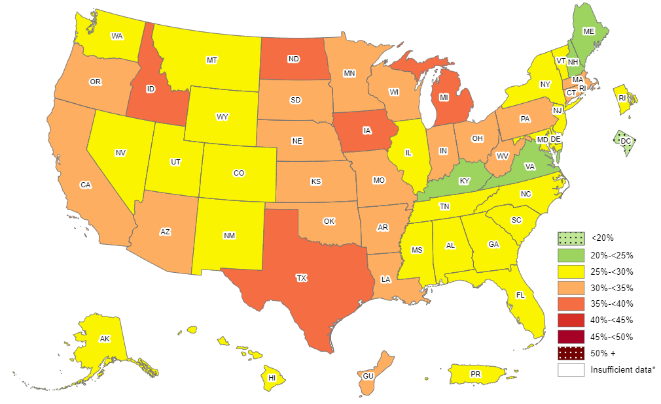
Prevalence of Self-Reported Obesity Among Hispanic Adults, by State and Territory, BRFSS, 2011-2013
*Sample size <50 or the relative standard error (dividing the standard error by the prevalence) ≥30%.

Slide 41
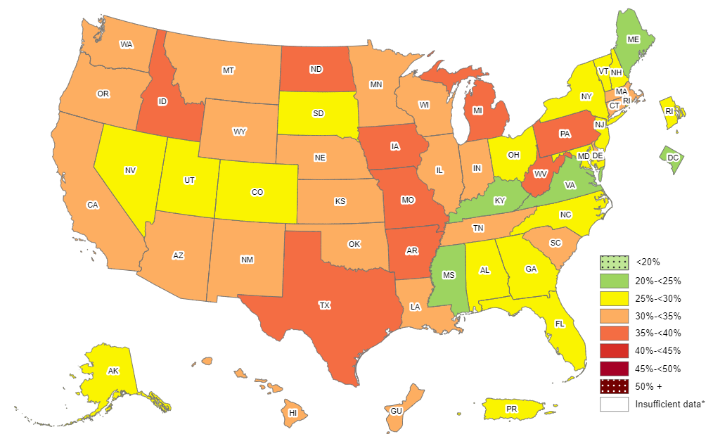
Prevalence of Self-Reported Obesity Among Hispanic Adults, by State and Territory, BRFSS, 2012-2014
*Sample size <50 or the relative standard error (dividing the standard error by the prevalence) ≥30%.

Slide 42
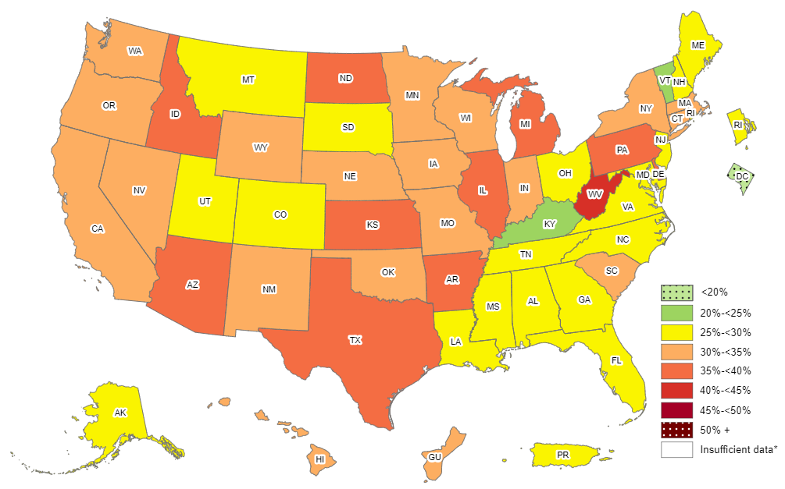
Prevalence of Self-Reported Obesity Among Hispanic Adults, by State and Territory, BRFSS, 2013-2015
*Sample size <50 or the relative standard error (dividing the standard error by the prevalence) ≥30%.

Slide 43
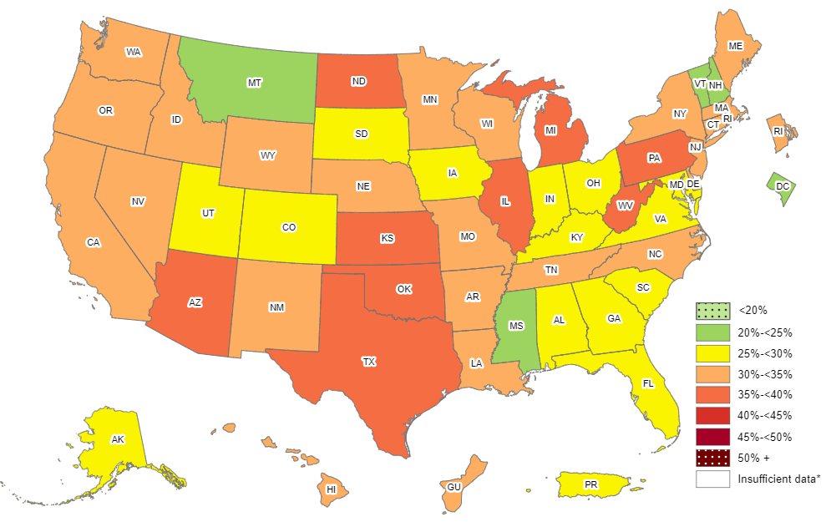
Prevalence of Self-Reported Obesity Among Hispanic Adults, by State and Territory, BRFSS, 2014-2016
*Sample size <50 or the relative standard error (dividing the standard error by the prevalence) ≥30%.

Slide 44
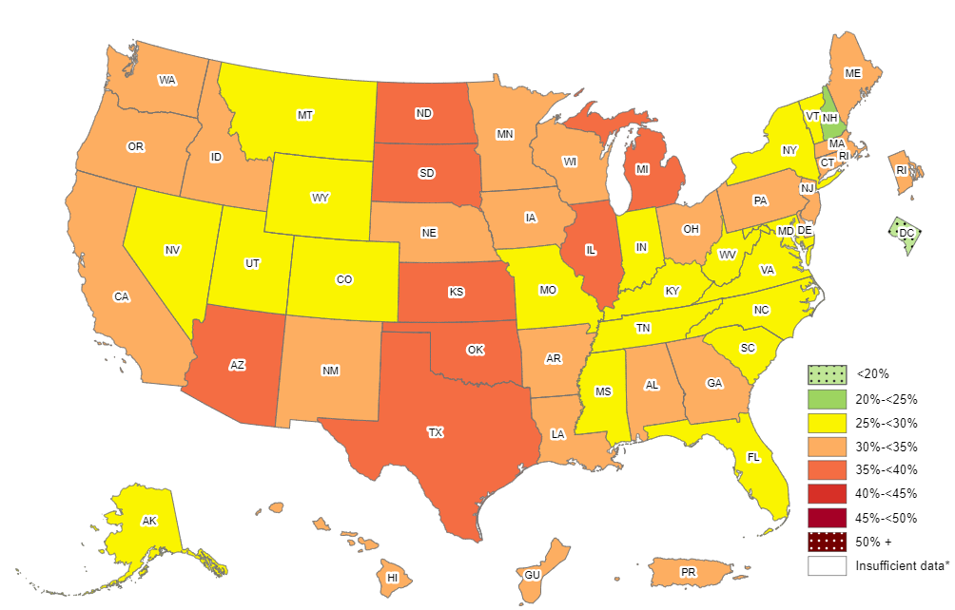
Prevalence of Self-Reported Obesity Among Hispanic Adults, by State and Territory, BRFSS, 2015-2017
*Sample size <50 or the relative standard error (dividing the standard error by the prevalence) ≥30%.

Slide 45
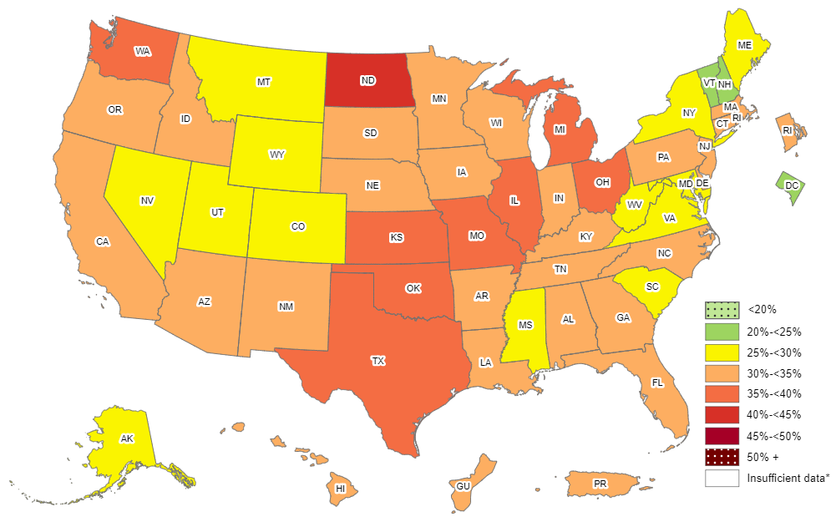
Prevalence of Self-Reported Obesity Among Hispanic Adults, by State and Territory, BRFSS, 2016-2018
*Sample size <50 or the relative standard error (dividing the standard error by the prevalence) ≥30%.

Slide 46
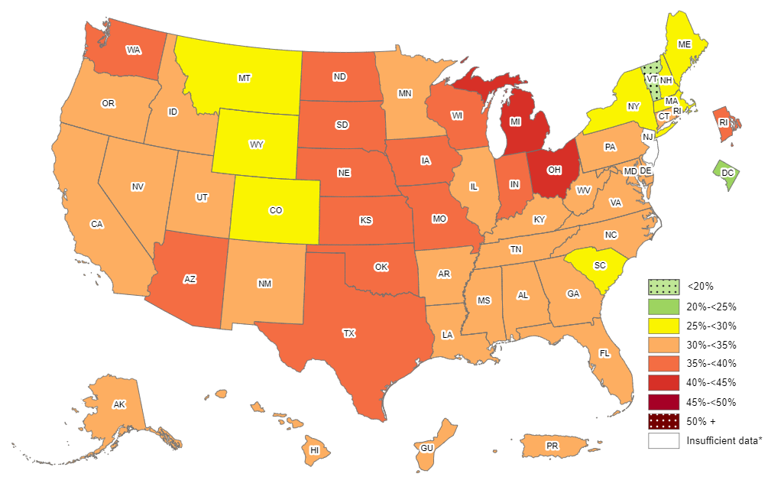
Prevalence of Self-Reported Obesity Among Hispanic Adults, by State and Territory, BRFSS, 2017-2019
*Sample size <50 or the relative standard error (dividing the standard error by the prevalence) ≥30%,
or no data in a specific year.

Slide 47
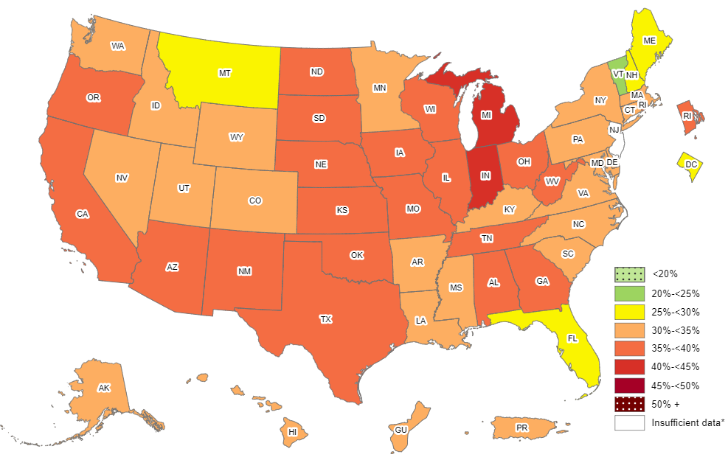
Prevalence of Self-Reported Obesity Among Hispanic Adults, by State and Territory, BRFSS, 2018-2020
*Sample size <50, the relative standard error (dividing the standard error by the prevalence) ≥30%,
or no data in a specific year.

Slide 48
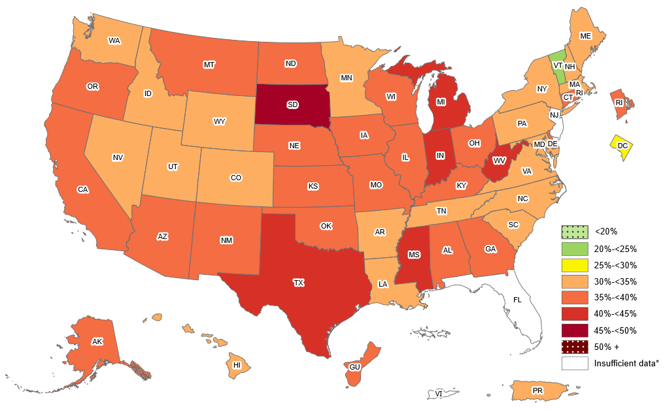
Prevalence of Self-Reported Obesity Among Hispanic Adults, by State and Territory, BRFSS, 2019–2021
*Sample size <50, the relative standard error (dividing the standard error by the prevalence) ≥30%,
or no data in a specific year.

Slide 49
Prevalence of Self-Reported Obesity Among Hispanic Adults, by State and Territory, BRFSS, 2011-2013
State | Prevalence | 95% Confidence Interval
Alabama | 27.3 | (19.6, 36.6)
Alaska | 28.4 | (22.1, 35.5)
Arizona | 33.8 | (30.5, 37.3)
Arkansas | 34.3 | (28.3, 40.9)
California | 30.7 | (29.5, 31.9)
Colorado | 28.0 | (26.2, 29.8)
Connecticut | 32.5 | (29.5, 35.7)
Delaware | 29.2 | (24.2, 34.8)
District of Columbia | 18.5 | (14.1, 24.0)
Florida | 26.4 | (24.4, 28.5)
Georgia | 28.1 | (24.3, 32.3)
Guam | 31.7 | (25.7, 38.5)
Hawaii | 29.4 | (26.0, 33.1)
Idaho | 35.3 | (30.5, 40.3)
Illinois | 29.9 | (26.3, 33.7)
Indiana | 33.2 | (29.1, 37.6)
Iowa | 37.6 | (32.5, 42.9)
Kansas | 33.5 | (30.8, 36.2)
Kentucky | 24.5 | (18.5, 31.6)
Louisiana | 32.6 | (26.0, 40.0)
Maine | 24.2 | (18.1, 31.6)
Maryland | 25.9 | (22.2, 29.9)
Massachusetts | 31.0 | (28.8, 33.3)
Michigan | 35.4 | (30.9, 40.3)
Minnesota | 30.5 | (26.1, 35.3)
Mississippi | 28.2 | (21.8, 35.6)
State | Prevalence | 95% Confidence Interval
Missouri | 33.6 | (26.7, 41.2)
Montana | 29.6 | (23.9, 36.0)
Nebraska | 30.4 | (27.7, 33.1)
Nevada | 27.3 | (24.3, 30.6)
New Hampshire | 24.7 | (17.4, 33.6)
New Jersey | 27.5 | (25.7, 29.3)
New Mexico | 29.8 | (28.5, 31.0)
New York | 27.3 | (25.1, 29.6)
North Carolina | 27.0 | (24.0, 30.2)
North Dakota | 36.2 | (27.8, 45.5)
Ohio | 30.9 | (25.7, 36.6)
Oklahoma | 31.3 | (27.9, 34.9)
Oregon | 31.2 | (26.8, 36.0)
Pennsylvania | 34.8 | (31.0, 38.8)
Puerto Rico | 27.5 | (26.7, 28.3)
Rhode Island | 27.5 | (24.5, 30.9)
South Carolina | 29.7 | (24.7, 35.1)
South Dakota | 31.5 | (24.4, 39.6)
Tennessee | 25.6 | (17.5, 36.0)
Texas | 35.4 | (33.8, 37.0)
Utah | 26.1 | (23.9, 28.4)
Vermont | 27.1 | (19.6, 36.3)
Virginia | 24.1 | (20.3, 28.3)
Washington | 29.7 | (27.0, 32.6)
West Virginia | 32.1 | (24.3, 41.1)
Wisconsin | 32.4 | (24.9, 40.9)
Wyoming | 29.2 | (24.9, 33.9)
Source: Behavioral Risk Factor Surveillance System, CDC.

Slide 50
Prevalence of Self-Reported Obesity Among Hispanic Adults, by State and Territory, BRFSS, 2012-2014
State | Prevalence | 95% Confidence Interval
Alabama | 25.4 | (18.2, 34.3)
Alaska | 27.7 | (22.0, 34.2)
Arizona | 33.9 | (30.9, 36.9)
Arkansas | 39.5 | (33.1, 46.3)
California | 31.3 | (30.0, 32.6)
Colorado | 28.1 | (26.4, 29.8)
Connecticut | 30.9 | (28.0, 33.8)
Delaware | 31.9 | (27.1, 37.1)
District of Columbia | 20.5 | (15.5, 26.7)
Florida | 26.2 | (24.3, 28.3)
Georgia | 27.0 | (23.1, 31.2)
Guam | 34.8 | (28.8, 41.3)
Hawaii | 31.3 | (28.0, 34.8)
Idaho | 35.9 | (31.2, 40.9)
Illinois | 33.0 | (29.5, 36.7)
Indiana | 32.0 | (28.3, 35.9)
Iowa | 35.5 | (30.6, 40.8)
Kansas | 34.2 | (31.5, 37.0)
Kentucky | 23.2 | (17.2, 30.5)
Louisiana | 31.3 | (24.9, 38.6)
Maine | 24.2 | (17.6, 32.4)
Maryland | 26.0 | (22.4, 29.9)
Massachusetts | 31.4 | (29.1, 33.9)
Michigan | 35.5 | (30.7, 40.6)
Minnesota | 31.7 | (27.6, 36.0)
Mississippi | 21.1 | (14.8, 29.2)
State | Prevalence | 95% Confidence Interval
Missouri | 35.5 | (28.5, 43.1)
Montana | 30.1 | (24.4, 36.5)
Nebraska | 31.0 | (28.2, 33.8)
Nevada | 27.8 | (24.7, 31.1)
New Hampshire | 29.3 | (21.7, 38.3)
New Jersey | 28.8 | (26.9, 30.7)
New Mexico | 30.1 | (28.8, 31.5)
New York | 29.3 | (27.0, 31.6)
North Carolina | 29.7 | (26.9, 32.7)
North Dakota | 37.9 | (29.1, 47.7)
Ohio | 29.1 | (24.2, 34.4)
Oklahoma | 33.4 | (30.0, 37.0)
Oregon | 30.2 | (26.0, 34.8)
Pennsylvania | 36.7 | (32.6, 40.9)
Puerto Rico | 28.1 | (27.3, 28.9)
Rhode Island | 28.0 | (24.9, 31.3)
South Carolina | 32.2 | (27.3, 37.5)
South Dakota | 27.1 | (19.0, 37.1)
Tennessee | 31.7 | (23.4, 41.2)
Texas | 35.8 | (34.3, 37.3)
Utah | 27.5 | (25.4, 29.7)
Vermont | 25.5 | (17.9, 35.0)
Virginia | 24.5 | (21.2, 28.2)
Washington | 31.8 | (29.0, 34.9)
West Virginia | 37.1 | (28.8, 46.3)
Wisconsin | 33.9 | (27.5, 41.0)
Wyoming | 32.7 | (27.7, 38.0)
Source: Behavioral Risk Factor Surveillance System, CDC.

Slide 51
Prevalence of Self-Reported Obesity Among Hispanic Adults, by State and Territory, BRFSS, 2013-2015
State | Prevalence | 95% Confidence Interval
Alabama | 27.6 | (20.5, 36.0)
Alaska | 28.3 | (22.3, 35.1)
Arizona | 35.5 | (32.6, 38.4)
Arkansas | 36.9 | (30.1, 44.4)
California | 31.3 | (30.1, 32.6)
Colorado | 28.3 | (26.6, 30.1)
Connecticut | 30.3 | (27.6, 33.0)
Delaware | 35.3 | (30.5, 40.3)
District of Columbia | 18.5 | (13.2, 25.1)
Florida | 26.5 | (24.7, 28.4)
Georgia | 27.1 | (23.0, 31.8)
Guam | 32.9 | (27.3, 38.9)
Hawaii | 31.8 | (28.6, 35.1)
Idaho | 36.3 | (31.8, 41.0)
Illinois | 36.0 | (32.6, 39.6)
Indiana | 31.4 | (27.4, 35.7)
Iowa | 34.0 | (28.6, 39.8)
Kansas | 35.4 | (33.3, 37.5)
Kentucky | 24.3 | (17.9, 32.2)
Louisiana | 29.9 | (23.5, 37.3)
Maine | 25.3 | (18.5, 33.5)
Maryland | 25.1 | (21.2, 29.4)
Massachusetts | 32.4 | (29.9, 35.1)
Michigan | 36.9 | (32.2, 41.8)
Minnesota | 31.2 | (27.5, 35.2)
Mississippi | 25.4 | (16.7, 36.6)
State | Prevalence | 95% Confidence Interval
Missouri | 31.5 | (25.0, 38.8)
Montana | 26.8 | (21.2, 33.2)
Nebraska | 30.8 | (27.9, 33.8)
Nevada | 30.5 | (26.9, 34.3)
New Hampshire | 27.8 | (20.2, 36.8)
New Jersey | 28.8 | (26.8, 30.9)
New Mexico | 31.2 | (29.7, 32.8)
New York | 30.6 | (28.6, 32.7)
North Carolina | 28.1 | (25.2, 31.2)
North Dakota | 35.1 | (26.7, 44.6)
Ohio | 26.3 | (21.4, 31.8)
Oklahoma | 33.9 | (30.2, 37.8)
Oregon | 31.4 | (27.1, 36.1)
Pennsylvania | 39.1 | (34.1, 44.3)
Puerto Rico | 28.5 | (27.6, 29.4)
Rhode Island | 28.9 | (25.7, 32.3)
South Carolina | 32.1 | (27.3, 37.3)
South Dakota | 28.8 | (20.0, 39.5)
Tennessee | 27.6 | (19.7, 37.3)
Texas | 36.9 | (35.4, 38.5)
Utah | 27.7 | (25.7, 29.9)
Vermont | 22.4 | (15.4, 31.5)
Virginia | 27.9 | (24.3, 31.7)
Washington | 31.5 | (28.7, 34.5)
West Virginia | 40.2 | (31.4, 49.6)
Wisconsin | 33.4 | (27.6, 39.8)
Wyoming | 33.4 | (28.4, 38.8)
Source: Behavioral Risk Factor Surveillance System, CDC.

Slide 52
Prevalence of Self-Reported Obesity Among Hispanic Adults, by State and Territory, BRFSS, 2014-2016
State | Prevalence | 95% Confidence Interval
Alabama | 28.1 | (21.7, 35.6)
Alaska | 27.9 | (21.3, 35.5)
Arizona | 35.0 | (32.8, 37.2)
Arkansas | 32.4 | (25.4, 40.3)
California | 32.3 | (31.1, 33.5)
Colorado | 27.1 | (25.5, 28.8)
Connecticut | 30.3 | (28.0, 32.8)
Delaware | 32.1 | (27.6, 37.1)
District of Columbia | 20.0 | (15.0, 26.1)
Florida | 26.8 | (25.1, 28.6)
Georgia | 28.4 | (23.9, 33.4)
Guam | 32.6 | (27.0, 38.7)
Hawaii | 31.4 | (28.3, 34.6)
Idaho | 33.6 | (29.3, 38.2)
Illinois | 36.3 | (33.2, 39.6)
Indiana | 28.7 | (24.9, 32.9)
Iowa | 29.9 | (24.9, 35.5)
Kansas | 35.2 | (32.8, 37.6)
Kentucky | 25.0 | (18.4, 33.0)
Louisiana | 32.2 | (25.9, 39.2)
Maine | 30.5 | (22.5, 39.9)
Maryland | 25.4 | (21.6, 29.5)
Massachusetts | 31.4 | (28.8, 34.2)
Michigan | 38.4 | (33.8, 43.3)
Minnesota | 33.1 | (30.0, 36.3)
Mississippi | 22.3 | (14.2, 33.4)
State | Prevalence | 95% Confidence Interval
Missouri | 32.7 | (26.1, 40.2)
Montana | 24.8 | (19.1, 31.7)
Nebraska | 31.8 | (29.1, 34.7)
Nevada | 30.6 | (27.3, 34.1)
New Hampshire | 24.7 | (17.7, 33.4)
New Jersey | 31.4 | (29.1, 33.7)
New Mexico | 31.3 | (29.7, 33.0)
New York | 30.6 | (28.7, 32.5)
North Carolina | 31.2 | (28.1, 34.4)
North Dakota | 37.2 | (28.8, 46.5)
Ohio | 27.8 | (22.7, 33.5)
Oklahoma | 36.7 | (32.7, 41.0)
Oregon | 32.4 | (28.6, 36.6)
Pennsylvania | 39.5 | (34.3, 45.0)
Puerto Rico | 29.4 | (28.5, 30.4)
Rhode Island | 30.8 | (27.4, 34.4)
South Carolina | 28.2 | (23.9, 33.0)
South Dakota | 29.5 | (20.0, 41.3)
Tennessee | 33.0 | (25.1, 42.0)
Texas | 37.4 | (35.7, 39.1)
Utah | 28.1 | (26.0, 30.4)
Vermont | 24.3 | (16.7, 34.1)
Virginia | 29.6 | (26.1, 33.3)
Washington | 34.4 | (31.7, 37.1)
West Virginia | 37.7 | (28.7, 47.6)
Wisconsin | 31.2 | (25.7, 37.1)
Wyoming | 32.4 | (27.2, 38.1)
Source: Behavioral Risk Factor Surveillance System, CDC.

Slide 53
Prevalence of Self-Reported Obesity Among Hispanic Adults, by State and Territory, BRFSS, 2015-2017
State | Prevalence | 95% Confidence Interval
Alabama | 31.9 | (25.1, 39.6)
Alaska | 28.8 | (21.7, 37.1)
Arizona | 35.5 | (33.5, 37.5)
Arkansas | 30.1 | (22.6, 38.8)
California | 32.1 | (30.9, 33.3)
Colorado | 27.4 | (25.7, 29.1)
Connecticut | 31.8 | (29.5, 34.1)
Delaware | 31.9 | (27.4, 36.8)
District of Columbia | 19.7 | (15.1, 25.3)
Florida | 28.1 | (26.1, 30.2)
Georgia | 30.1 | (25.7, 34.9)
Guam | 33.0 | (27.3, 39.3)
Hawaii | 31.9 | (28.9, 35.1)
Idaho | 33.7 | (29.5, 38.1)
Illinois | 35.9 | (33.0, 38.9)
Indiana | 28.2 | (24.6, 32.1)
Iowa | 33.4 | (28.5, 38.8)
Kansas | 36.8 | (34.5, 39.2)
Kentucky | 28.5 | (21.6, 36.6)
Louisiana | 32.3 | (25.8, 39.6)
Maine | 32.2 | (23.4, 42.5)
Maryland | 27.6 | (23.8, 31.8)
Massachusetts | 31.0 | (28.2, 34.0)
Michigan | 38.6 | (34.4, 43.0)
Minnesota | 33.3 | (30.2, 36.5)
Mississippi | 29.2 | (20.1, 40.4)
Missouri | 29.9 | (23.8, 36.8)
State | Prevalence | 95% Confidence Interval
Montana | 26.0 | (20.0, 33.2)
Nebraska | 32.8 | (30.0, 35.7)
Nevada | 29.2 | (26.1, 32.4)
New Hampshire | 24.1 | (16.7, 33.4)
New Jersey | 31.9 | (29.4, 34.5)
New Mexico | 31.2 | (29.6, 33.0)
New York | 28.7 | (27.1, 30.4)
North Carolina | 28.3 | (25.0, 31.8)
North Dakota | 36.5 | (28.6, 45.1)
Ohio | 31.9 | (26.7, 37.6)
Oklahoma | 36.8 | (32.6, 41.3)
Oregon | 34.9 | (31.1, 38.9)
Pennsylvania | 34.7 | (29.9, 39.9)
Puerto Rico | 31.0 | (30.0, 32.1)
Rhode Island | 33.1 | (29.6, 36.9)
South Carolina | 27.8 | (23.6, 32.4)
South Dakota | 35.0 | (25.0, 46.5)
Tennessee | 29.6 | (22.6, 37.6)
Texas | 37.9 | (36.1, 39.8)
Utah | 27.9 | (25.6, 30.4)
Vermont | 26.4 | (18.7, 35.9)
Virginia | 29.9 | (26.3, 33.7)
Washington | 33.9 | (31.6, 36.2)
West Virginia | 29.0 | (21.0, 38.6)
Wisconsin | 31.5 | (26.0, 37.5)
Wyoming | 28.8 | (24.2, 33.9)
Source: Behavioral Risk Factor Surveillance System, CDC.
.

Slide 54
Prevalence of Self-Reported Obesity Among Hispanic Adults, by State and Territory, BRFSS, 2016-2018
State | Prevalence | 95% Confidence Interval
Alabama | 31.7 | (24.6, 39.8)
Alaska | 29.8 | (22.6, 38.2)
Arizona | 34.8 | (32.7, 36.9)
Arkansas | 32.0 | (24.7, 40.4)
California | 32.8 | (31.6, 34.0)
Colorado | 28.1 | (26.5, 29.8)
Connecticut | 32.0 | (29.7, 34.4)
Delaware | 30.2 | (26.2, 34.5)
District of Columbia | 23.4 | (19.0, 28.5)
Florida | 30.7 | (28.4, 33.1)
Georgia | 30.1 | (26.6, 33.9)
Guam | 32.4 | (26.8, 38.6)
Hawaii | 33.2 | (30.3, 36.3)
Idaho | 33.3 | (29.1, 37.9)
Illinois | 35.6 | (32.9, 38.4)
Indiana | 31.7 | (28.1, 35.4)
Iowa | 34.4 | (30.5, 38.6)
Kansas | 36.3 | (33.7, 39.1)
Kentucky | 30.9 | (24.2, 38.6)
Louisiana | 31.7 | (25.6, 38.6)
Maine | 29.0 | (20.4, 39.4)
Maryland | 29.7 | (26.6, 33.1)
Massachusetts | 30.0 | (27.1, 33.1)
Michigan | 36.9 | (32.8, 41.1)
Minnesota | 34.5 | (31.6, 37.5)
Mississippi | 28.2 | (20.1, 38.0)
Missouri | 37.1 | (30.3, 44.5)
State | Prevalence | 95% Confidence Interval
Montana | 26.8 | (20.7, 33.9)
Nebraska | 34.0 | (31.4, 36.7)
Nevada | 28.9 | (26.1, 31.8)
New Hampshire | 24.2 | (17.0, 33.1)
New Jersey | 31.9 | (28.9, 35.0)
New Mexico | 32.8 | (31.2, 34.5)
New York | 29.4 | (27.9, 31.0)
North Carolina | 30.0 | (26.5, 33.7)
North Dakota | 40.2 | (32.1, 49.0)
Ohio | 39.8 | (34.3, 45.5)
Oklahoma | 36.9 | (32.8, 41.3)
Oregon | 34.5 | (31.2, 37.9)
Pennsylvania | 32.2 | (28.1, 36.7)
Puerto Rico | 32.1 | (31.1, 33.2)
Rhode Island | 34.3 | (30.8, 38.1)
South Carolina | 27.6 | (23.6, 31.9)
South Dakota | 32.9 | (23.6, 43.7)
Tennessee | 33.6 | (26.7, 41.4)
Texas | 37.9 | (35.8, 40.0)
Utah | 28.9 | (26.6, 31.3)
Vermont | 24.9 | (17.1, 34.6)
Virginia | 29.2 | (25.9, 32.8)
Washington | 35.9 | (33.5, 38.2)
West Virginia | 26.7 | (18.9, 36.2)
Wisconsin | 34.9 | (29.4, 40.9)
Wyoming | 29.7 | (25.5, 34.2)
Source: Behavioral Risk Factor Surveillance System, CDC.
.

Slide 55
Prevalence of Self-Reported Obesity Among Hispanic Adults, by State and Territory, BRFSS, 2017-2019
State | Prevalence | 95% Confidence Interval
Alabama | 33.6 | (26.2, 41.8)
Alaska | 33.6 | (26.0, 42.3)
Arizona | 35.2 | (33.0, 37.4)
Arkansas | 32.5 | (25.7, 40.2)
California | 32.9 | (31.8, 34.1)
Colorado | 29.8 | (28.1, 31.5)
Connecticut | 32.9 | (30.4, 35.3)
Delaware | 33.6 | (29.1, 38.5)
District of Columbia | 24.6 | (20.1, 29.7)
Florida | 31.0 | (28.5, 33.6)
Georgia | 32.9 | (29.3, 36.8)
Guam | 34.0 | (28.2, 40.4)
Hawaii | 34.0 | (31.0, 37.0)
Idaho | 32.8 | (28.6, 37.4)
Illinois | 34.6 | (32.2, 37.1)
Indiana | 38.3 | (34.5, 42.2)
Iowa | 37.1 | (33.6, 40.7)
Kansas | 36.7 | (34.0, 39.4)
Kentucky | 31.6 | (24.3, 39.8)
Louisiana | 32.7 | (26.9, 39.1)
Maine | 28.6 | (21.2, 37.4)
Maryland | 30.8 | (27.8, 34.1)
Massachusetts | 29.8 | (26.8, 32.9)
Michigan | 40.0 | (35.8, 44.4)
Minnesota | 33.5 | (30.5, 36.5)
Mississippi | 30.8 | (22.1, 41.2)
Missouri | 38.8 | (32.4, 45.7)
State | Prevalence | 95% Confidence Interval
Montana | 28.2 | (22.4, 34.9)
Nebraska | 35.1 | (32.7, 37.7)
Nevada | 31.6 | (28.7, 34.6)
New Hampshire | 27.5 | (19.7, 37.0)
New Jersey | Insufficient data* | Insufficient data*
New Mexico | 34.4 | (32.8, 36.1)
New York | 29.3 | (27.7, 30.9)
North Carolina | 30.1 | (26.5, 33.9)
North Dakota | 39.5 | (31.5, 48.0)
Ohio | 40.2 | (34.9, 45.8)
Oklahoma | 36.8 | (32.9, 40.9)
Oregon | 34.4 | (31.3, 37.7)
Pennsylvania | 30.9 | (27.0, 35.1)
Puerto Rico | 32.8 | (31.8, 33.8)
Rhode Island | 35.1 | (31.6, 38.8)
South Carolina | 29.6 | (25.2, 34.5)
South Dakota | 38.6 | (28.9, 49.2)
Tennessee | 33.0 | (26.3, 40.4)
Texas | 38.7 | (36.6, 40.9)
Utah | 30.5 | (28.3, 32.8)
Vermont | 16.7 | (10.5, 25.6)
Virginia | 31.0 | (27.4, 34.7)
Washington | 35.2 | (32.9, 37.6)
West Virginia | 33.5 | (24.6, 43.8)
Wisconsin | 39.9 | (34.2, 46.0)
Wyoming | 29.0 | (25.0, 33.4)
*Sample size <50, the relative standard error (dividing the standard error by the prevalence) ≥30%, or no data in a specific year.
Source: Behavioral Risk Factor Surveillance System, CDC.
.

Slide 56
Prevalence of Self-Reported Obesity Among Hispanic Adults, by State and Territory, BRFSS, 2018-2020
State | Prevalence | 95% Confidence Interval
Alabama | 35.3 | (27.7, 43.8)
Alaska | 34.0 | (26.8, 42.0)
Arizona | 35.9 | (33.7, 38.1)
Arkansas | 34.0 | (27.9, 40.7)
California | 36.2 | (34.7, 37.8)
Colorado | 30.9 | (29.2, 32.6)
Connecticut | 34.5 | (32.0, 37.0)
Delaware | 34.5 | (30.1, 39.2)
District of Columbia | 25.2 | (20.9, 30.1)
Florida | 29.7 | (27.2, 32.3)
Georgia | 35.7 | (31.7, 40.0)
Guam | 34.7 | (28.3, 41.7)
Hawaii | 33.0 | (30.1, 36.1)
Idaho | 33.1 | (29.0, 37.5)
Illinois | 35.4 | (32.1, 38.8)
Indiana | 40.0 | (36.0, 44.1)
Iowa | 36.4 | (33.2, 39.7)
Kansas | 38.0 | (35.1, 41.0)
Kentucky | 33.2 | (25.7, 41.8)
Louisiana | 32.2 | (26.6, 38.4)
Maine | 28.2 | (21.5, 35.9)
Maryland | 31.3 | (28.6, 34.1)
Massachusetts | 30.4 | (27.4, 33.5)
Michigan | 43.1 | (38.4, 48.0)
Minnesota | 33.9 | (31.1, 36.8)
Mississippi | 33.0 | (23.9, 43.5)
Missouri | 39.5 | (33.4, 45.9)
State | Prevalence | 95% Confidence Interval
Montana | 29.7 | (23.9, 36.2)
Nebraska | 35.8 | (33.3, 38.4)
Nevada | 33.1 | (30.0, 36.3)
New Hampshire | 25.8 | (19.1, 34.0)
New Jersey | Insufficient data* | Insufficient data*
New Mexico | 35.7 | (34.0, 37.4)
New York | 30.4 | (28.7, 32.1)
North Carolina | 31.3 | (27.9, 34.8)
North Dakota | 37.9 | (30.2, 46.2)
Ohio | 39.7 | (34.7, 44.8)
Oklahoma | 36.2 | (32.4, 40.2)
Oregon | 35.4 | (32.3, 38.6)
Pennsylvania | 32.9 | (28.8, 37.3)
Puerto Rico | 32.3 | (31.3, 33.3)
Rhode Island | 35.2 | (31.8, 38.8)
South Carolina | 30.9 | (25.4, 37.1)
South Dakota | 37.8 | (28.1, 48.5)
Tennessee | 35.0 | (28.2, 42.4)
Texas | 39.7 | (37.5, 41.9)
Utah | 32.3 | (30.1, 34.6)
Vermont | 21.7 | (14.2, 31.8)
Virginia | 31.3 | (28.1, 34.7)
Washington | 34.8 | (32.6, 37.2)
West Virginia | 39.3 | (29.9, 49.6)
Wisconsin | 39.0 | (33.4, 44.9)
Wyoming | 32.3 | (27.8, 37.1)
*Sample size <50, the relative standard error (dividing the standard error by the prevalence) ≥30%, or no data in a specific year.
Source: Behavioral Risk Factor Surveillance System, CDC.

Slide 57
Prevalence of Self-Reported Obesity Among Hispanic Adults, by State and Territory, BRFSS, 2019–2021
State | Prevalence | 95% Confidence Interval
Alabama | 37.9 | (30.1, 46.4)
Alaska | 37.7 | (30.7, 45.2)
Arizona | 36.5 | (34.5, 38.5)
Arkansas | 33.7 | (28.0, 39.9)
California | 37.0 | (35.4, 38.7)
Colorado | 31.4 | (29.8, 33.1)
Connecticut | 35.5 | (33.0, 38.0)
Delaware | 36.3 | (31.7, 41.2)
District of Columbia | 26.3 | (21.8, 31.4)
Florida | Insufficient data* | Insufficient data*
Georgia | 36.1 | (31.9, 40.4)
Guam | 36.3 | (29.4, 43.9)
Hawaii | 32.0 | (29.1, 35.1)
Idaho | 34.5 | (30.8, 38.5)
Illinois | 38.3 | (34.3, 42.5)
Indiana | 41.0 | (37.5, 44.7)
Iowa | 36.0 | (32.9, 39.3)
Kansas | 39.0 | (36.3, 41.9)
Kentucky | 35.6 | (27.8, 44.2)
Louisiana | 33.9 | (28.0, 40.4)
Maine | 31.4 | (25.0, 38.6)
Maryland | 32.8 | (30.3, 35.5)
Massachusetts | 32.5 | (29.6, 35.5)
Michigan | 43.2 | (38.4, 48.2)
Minnesota | 34.2 | (31.6, 37.0)
Mississippi | 40.0 | (28.9, 52.2)
Missouri | 37.2 | (32.1, 42.7)
State | Prevalence | 95% Confidence Interval
Montana | 35.1 | (29.3, 41.3)
Nebraska | 36.6 | (34.1, 39.2)
Nevada | 34.0 | (30.8, 37.3)
New Hampshire | 32.8 | (26.0, 40.5)
New Jersey | Insufficient data* | Insufficient data*
New Mexico | 35.9 | (34.2, 37.5)
New York | 31.0 | (29.4, 32.7)
North Carolina | 31.7 | (28.5, 35.1)
North Dakota | 36.8 | (29.7, 44.5)
Ohio | 37.1 | (32.7, 41.8)
Oklahoma | 38.6 | (34.8, 42.6)
Oregon | 36.1 | (32.9, 39.3)
Pennsylvania | 32.7 | (28.6, 37.1)
Puerto Rico | 33.4 | (32.3, 34.5)
Rhode Island | 35.7 | (32.5, 39.1)
South Carolina | 31.1 | (25.5, 37.3)
South Dakota | 45.2 | (35.2, 55.6)
Tennessee | 34.9 | (28.4, 42.0)
Texas | 41.0 | (39.0, 43.1)
Utah | 34.6 | (32.4, 36.9)
Vermont | 22.9 | (15.7, 32.0)
Virgin Islands | Insufficient data* | Insufficient data*
Virginia | 31.9 | (28.7, 35.4)
Washington | 34.4 | (32.2, 36.8)
West Virginia | 42.9 | (34.1, 52.2)
Wisconsin | 35.8 | (30.3, 41.7)
Wyoming | 34.0 | (29.2, 39.3)
*Sample size <50, the relative standard error (dividing the standard error by the prevalence) ≥30%, or no data in a specific year.
Source: Behavioral Risk Factor Surveillance System, CDC.

Slide 58
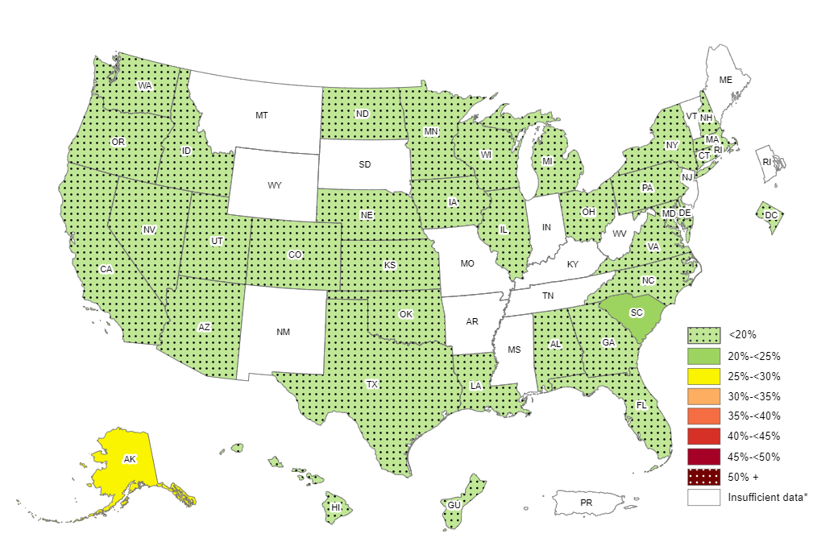
Prevalence of Self-Reported Obesity Among Non-Hispanic Asian Adults, by State and Territory, BRFSS, 2018–2020
*Sample size <50, the relative standard error (dividing the standard error by the prevalence) ≥30%,
or no data in a specific year.

Slide 59
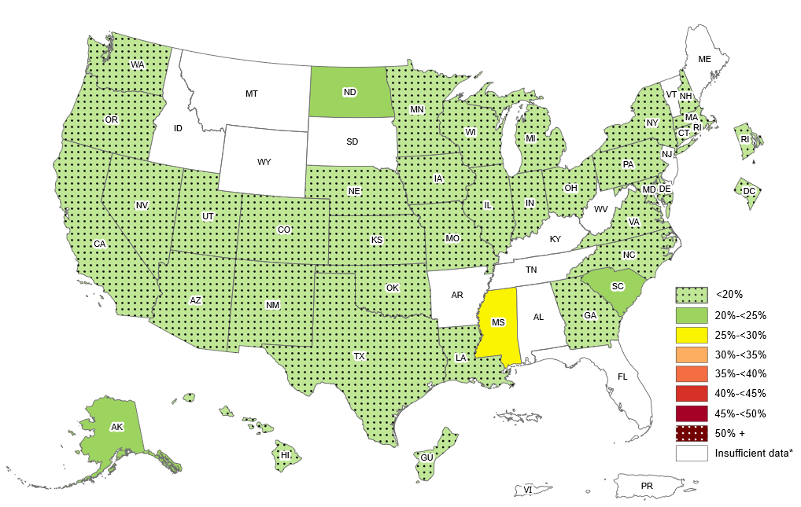
Prevalence of Self-Reported Obesity Among Non-Hispanic Asian Adults, by State and Territory, BRFSS, 2019–2021
*Sample size <50, the relative standard error (dividing the standard error by the prevalence) ≥30%,
or no data in a specific year.

Slide 60
Prevalence of Self-Reported Obesity Among Non-Hispanic Asian Adults, by State and Territory, BRFSS, 2018–2020
State | Prevalence | 95% Confidence Interval
Alabama | 15.6 | (8.7, 26.4)
Alaska | 25.5 | (17.2, 36.1)
Arizona | 12.3 | (8.1, 18.3)
Arkansas | Insufficient data* | Insufficient data*
California | 10.5 | (8.8, 12.5)
Colorado | 6.3 | (4.3, 9.3)
Connecticut | 11.6 | (8.4, 15.9)
Delaware | 13.4 | (8.2, 21.2)
District of Columbia | 7.3 | (4.3, 12.2)
Florida | 14.9 | (9.8, 22.2)
Georgia | 11.6 | (7.0, 18.7)
Guam | 15.9 | (13.5, 18.5)
Hawaii | 16.6 | (15.5, 17.8)
Idaho | 19.0 | (10.3, 32.5)
Illinois | 12.1 | (9.1, 15.8)
Indiana | Insufficient data* | Insufficient data*
Iowa | 13.4 | (9.4, 18.7)
Kansas | 11.9 | (8.5, 16.5)
Kentucky | Insufficient data* | Insufficient data*
Louisiana | 16.9 | (9.4, 28.5)
Maine | Insufficient data* | Insufficient data*
Maryland | 11.8 | (9.5, 14.5)
Massachusetts | 9.6 | (7.1, 12.8)
Michigan | 8.8 | (6.1, 12.6)
Minnesota | 18.8 | (16.0, 22.0)
Mississippi | Insufficient data* | Insufficient data*
Missouri | Insufficient data* | Insufficient data*
State | Prevalence | 95% Confidence Interval
Montana | Insufficient data* | Insufficient data*
Nebraska | 9.3 | (5.9, 14.3)
Nevada | 13.4 | (8.5, 20.7)
New Hampshire | 13.7 | (7.8, 23.1)
New Jersey | Insufficient data* | Insufficient data*
New Mexico | Insufficient data* | Insufficient data*
New York | 11.4 | (9.5, 13.5)
North Carolina | 16.9 | (11.5, 24.2)
North Dakota | 16.7 | (9.3, 28.1)
Ohio | 10.5 | (6.9, 15.5)
Oklahoma | 12.2 | (7.3, 19.8)
Oregon | 16.7 | (11.4, 23.7)
Pennsylvania | 7.2 | (4.5, 11.2)
Puerto Rico | Insufficient data* | Insufficient data*
Rhode Island | Insufficient data* | Insufficient data*
South Carolina | 23.7 | (14.3, 36.7)
South Dakota | Insufficient data* | Insufficient data*
Tennessee | Insufficient data* | Insufficient data*
Texas | 12.5 | (9.1, 16.9)
Utah | 11.6 | (8.0, 16.6)
Vermont | Insufficient data* | Insufficient data*
Virginia | 11.8 | (9.0, 15.3)
Washington | 9.9 | (8.2, 12.0)
West Virginia | Insufficient data* | Insufficient data*
Wisconsin | 18.1 | (11.8, 26.7)
Wyoming | Insufficient data* | Insufficient data*
*Sample size <50, the relative standard error (dividing the standard error by the prevalence) ≥30%, or no data in a specific year.
Source: Behavioral Risk Factor Surveillance System, CDC.

Slide 61
Prevalence of Self-Reported Obesity Among Non-Hispanic Asian Adults, by State and Territory, BRFSS, 2019–2021
State | Prevalence | 95% Confidence Interval
Alabama | Insufficient data* | Insufficient data*
Alaska | 22.9 | (15.7, 32.1)
Arizona | 14.4 | (10.1, 20.2)
Arkansas | Insufficient data* | Insufficient data*
California | 10.0 | (8.2, 12.1)
Colorado | 6.9 | (4.7, 9.8)
Connecticut | 12.5 | (9.4, 16.6)
Delaware | 15.1 | (9.4, 23.5)
District of Columbia | 6.9 | (3.9, 11.9)
Florida | Insufficient data* | Insufficient data*
Georgia | 12.6 | (7.2, 21.1)
Guam | 17.0 | (14.4, 19.9)
Hawaii | 16.1 | (15.0, 17.3)
Idaho | Insufficient data* | Insufficient data*
Illinois | 12.3 | (9.3, 16.1)
Indiana | 6.9 | (4.2, 10.9)
Iowa | 10.6 | (7.1, 15.5)
Kansas | 9.9 | (7.3, 13.4)
Kentucky | Insufficient data* | Insufficient data*
Louisiana | 18.6 | (11.2, 29.3)
Maine | Insufficient data* | Insufficient data*
Maryland | 12.9 | (10.5, 15.7)
Massachusetts | 11.2 | (8.6, 14.4)
Michigan | 9.2 | (6.5, 12.8)
Minnesota | 19.5 | (16.7, 22.6)
Mississippi | 26.9 | (14.9, 43.5)
Missouri | 12.0 | (7.6, 18.5)
State | Prevalence | 95% Confidence Interval
Montana | Insufficient data* | Insufficient data*
Nebraska | 11.9 | (8.0, 17.4)
Nevada | 13.9 | (8.9, 21.2)
New Hampshire | 11.6 | (7.2, 18.2)
New Jersey | Insufficient data* | Insufficient data*
New Mexico | 16.5 | (9.2, 27.7)
New York | 11.6 | (9.8, 13.8)
North Carolina | 18.8 | (13.3, 26.0)
North Dakota | 23.4 | (14.6, 35.3)
Ohio | 12.0 | (8.5, 16.7)
Oklahoma | 18.1 | (11.4, 27.5)
Oregon | 16.6 | (11.9, 22.8)
Pennsylvania | 8.4 | (5.5, 12.5)
Puerto Rico | Insufficient data* | Insufficient data*
Rhode Island | 9.5 | (5.7, 15.4)
South Carolina | 20.6 | (12.3, 32.5)
South Dakota | Insufficient data* | Insufficient data*
Tennessee | Insufficient data* | Insufficient data*
Texas | 13.2 | (9.7, 17.6)
Utah | 10.3 | (7.0, 14.9)
Vermont | Insufficient data* | Insufficient data*
Virgin Islands | Insufficient data* | Insufficient data*
Virginia | 12.4 | (9.6, 15.9)
Washington | 9.9 | (8.2, 11.8)
West Virginia | Insufficient data* | Insufficient data*
Wisconsin | 15.9 | (9.8, 24.8)
Wyoming | Insufficient data* | Insufficient data*
*Sample size <50, the relative standard error (dividing the standard error by the prevalence) ≥30%, or no data in a specific year.
Source: Behavioral Risk Factor Surveillance System, CDC.

Slide 62
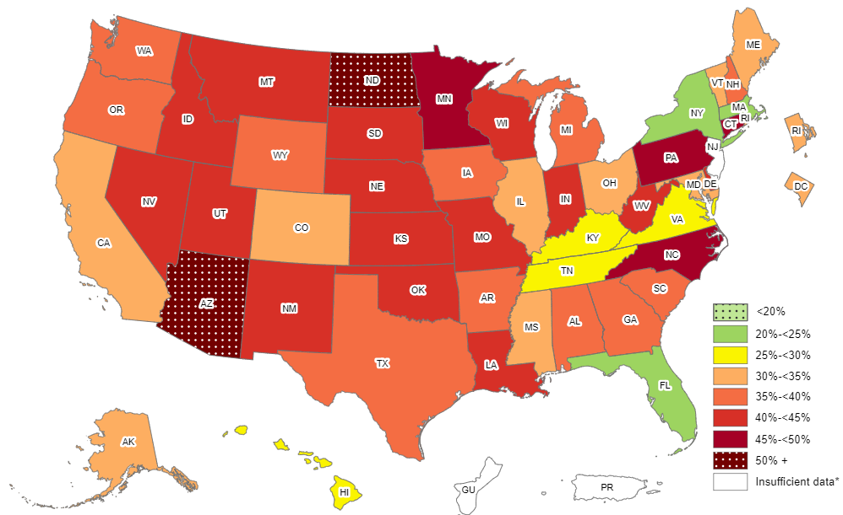
Prevalence of Self-Reported Obesity Among Non-Hispanic American Indian or Alaska Native Adults, by State and Territory, BRFSS, 2018–2020
*Sample size <50, the relative standard error (dividing the standard error by the prevalence) ≥30%,
or no data in a specific year.

Slide 63
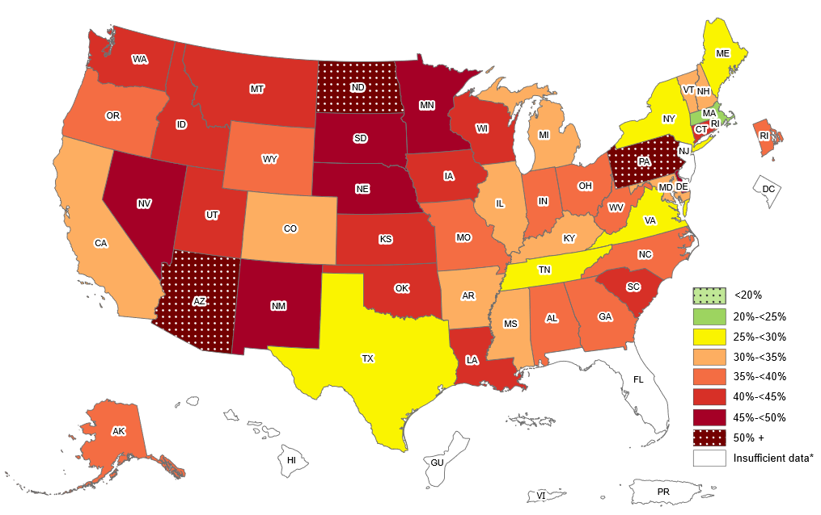
Prevalence of Self-Reported Obesity Among Non-Hispanic American Indian or Alaska Native Adults, by State and Territory, BRFSS, 2019–2021
*Sample size <50, the relative standard error (dividing the standard error by the prevalence) ≥30%,
or no data in a specific year.

Slide 64
Prevalence of Self-Reported Obesity Among Non-Hispanic American Indian or Alaska Native Adults, by State and Territory, BRFSS, 2018–2020
State | Prevalence | 95% Confidence Interval
Alabama | 35.4 | (27.3, 44.5)
Alaska | 34.0 | (30.0, 38.2)
Arizona | 50.4 | (45.7, 55.1)
Arkansas | 37.1 | (27.7, 47.6)
California | 32.6 | (22.7, 44.3)
Colorado | 30.1 | (23.3, 38.0)
Connecticut | 45.3 | (32.9, 58.3)
Delaware | 44.4 | (30.9, 58.7)
District of Columbia | 33.4 | (19.9, 50.3)
Florida | 22.5 | (16.3, 30.2)
Georgia | 36.4 | (24.4, 50.4)
Guam | Insufficient data* | Insufficient data*
Hawaii | 28.7 | (15.3, 47.3)
Idaho | 40.8 | (31.2, 51.1)
Illinois | 30.5 | (19.7, 44.1)
Indiana | 42.3 | (32.3, 53.0)
Iowa | 37.5 | (27.1, 49.2)
Kansas | 42.2 | (35.4, 49.3)
Kentucky | 28.8 | (19.3, 40.6)
Louisiana | 42.1 | (33.5, 51.2)
Maine | 33.9 | (24.2, 45.2)
Maryland | 34.9 | (27.1, 43.6)
Massachusetts | 21.2 | (11.8, 35.1)
Michigan | 35.4 | (27.3, 44.4)
Minnesota | 49.8 | (44.6, 55.0)
Mississippi | 34.8 | (24.7, 46.4)
Missouri | 41.8 | (32.5, 51.7)
State | Prevalence | 95% Confidence Interval
Montana | 43.1 | (38.9, 47.4)
Nebraska | 44.3 | (37.1, 51.8)
Nevada | 44.5 | (30.5, 59.5)
New Hampshire | 36.6 | (24.9, 50.2)
New Jersey | Insufficient data* | Insufficient data*
New Mexico | 44.0 | (40.4, 47.6)
New York | 24.1 | (16.3, 34.1)
North Carolina | 46.4 | (38.7, 54.2)
North Dakota | 51.8 | (45.8, 57.7)
Ohio | 31.2 | (20.1, 44.9)
Oklahoma | 40.9 | (37.3, 44.6)
Oregon | 37.6 | (28.8, 47.4)
Pennsylvania | 45.9 | (32.1, 60.4)
Puerto Rico | Insufficient data* | Insufficient data*
Rhode Island | 34.5 | (23.3, 47.7)
South Carolina | 39.9 | (29.0, 52.0)
South Dakota | 43.8 | (38.0, 49.9)
Tennessee | 27.5 | (19.0, 38.0)
Texas | 37.3 | (25.7, 50.5)
Utah | 41.8 | (35.0, 48.8)
Vermont | 33.7 | (24.3, 44.6)
Virginia | 27.8 | (18.9, 38.9)
Washington | 38.2 | (32.5, 44.3)
West Virginia | 40.0 | (26.7, 55.0)
Wisconsin | 44.4 | (33.3, 56.2)
Wyoming | 39.1 | (29.3, 49.8)
*Sample size <50, the relative standard error (dividing the standard error by the prevalence) ≥30%, or no data in a specific year.
Source: Behavioral Risk Factor Surveillance System, CDC.

Slide 65
Prevalence of Self-Reported Obesity Among Non-Hispanic American Indian or Alaska Native Adults, by State and Territory, BRFSS, 2019–2021
State | Prevalence | 95% Confidence Interval
Alabama | 39.6 | (30.5, 49.6)
Alaska | 37.5 | (33.6, 41.5)
Arizona | 50.5 | (46.2, 54.8)
Arkansas | 30.3 | (22.1, 40.0)
California | 31.1 | (21.0, 43.4)
Colorado | 31.3 | (24.8, 38.6)
Connecticut | 40.6 | (28.8, 53.6)
Delaware | 49.3 | (33.6, 65.1)
District of Columbia | Insufficient data* | Insufficient data*
Florida | Insufficient data* | Insufficient data*
Georgia | 35.2 | (24.2, 48.0)
Guam | Insufficient data* | Insufficient data*
Hawaii | Insufficient data* | Insufficient data*
Idaho | 41.1 | (32.4, 50.5)
Illinois | 30.6 | (18.9, 45.5)
Indiana | 38.4 | (29.7, 47.8)
Iowa | 40.0 | (29.6, 51.5)
Kansas | 43.1 | (36.7, 49.7)
Kentucky | 30.0 | (20.0, 42.3)
Louisiana | 41.2 | (32.0, 51.2)
Maine | 29.8 | (21.9, 39.1)
Maryland | 31.9 | (24.2, 40.9)
Massachusetts | 22.0 | (12.7, 35.4)
Michigan | 33.6 | (25.4, 43.0)
Minnesota | 47.2 | (41.6, 52.8)
Mississippi | 31.1 | (21.4, 42.7)
Missouri | 36.0 | (27.6, 45.4)
State | Prevalence | 95% Confidence Interval
Montana | 42.5 | (38.4, 46.7)
Nebraska | 45.8 | (38.8, 53.0)
Nevada | 49.4 | (34.9, 64.0)
New Hampshire | 33.3 | (22.0, 47.0)
New Jersey | Insufficient data* | Insufficient data*
New Mexico | 46.7 | (43.1, 50.4)
New York | 25.9 | (18.1, 35.6)
North Carolina | 37.5 | (31.1, 44.3)
North Dakota | 54.0 | (48.4, 59.6)
Ohio | 36.9 | (26.2, 49.0)
Oklahoma | 43.9 | (40.4, 47.5)
Oregon | 36.6 | (28.3, 45.7)
Pennsylvania | 53.6 | (38.6, 68.0)
Puerto Rico | Insufficient data* | Insufficient data*
Rhode Island | 38.5 | (27.2, 51.1)
South Carolina | 43.0 | (32.6, 54.0)
South Dakota | 46.4 | (39.7, 53.2)
Tennessee | 29.7 | (21.8, 39.1)
Texas | 26.3 | (17.7, 37.4)
Utah | 41.5 | (34.4, 49.0)
Vermont | 32.9 | (23.9, 43.3)
Virgin Islands | Insufficient data* | Insufficient data*
Virginia | 28.1 | (19.6, 38.4)
Washington | 42.5 | (36.3, 48.9)
West Virginia | 38.7 | (26.1, 53.1)
Wisconsin | 43.8 | (33.8, 54.4)
Wyoming | 35.5 | (25.8, 46.6)
*Sample size <50, the relative standard error (dividing the standard error by the prevalence) ≥30%, or no data in a specific year.
Source: Behavioral Risk Factor Surveillance System, CDC.

