Slide 1

NNDSS Modernization Initiative (NMI):
A Jurisdiction’s Approach to Implementing HL7 Case Notification Messages
Division of Health Informatics and Surveillance
November 19, 2019

Slide 2

Agenda
Welcome and Announcements
A Jurisdiction’s Approach to Implementing HL7 Case Notification Messages “From Zero to Five: Meeting NMI Objectives in Connecticut”
  Nancy L. Barrett, Infectious Disease Section Informatics Program Lead, Connecticut Department of Public Health
Questions and Answers

Slide 3
NMI Updates and Timeline
Sara Imholte Johnston, MPH
NNDSS Program Manager
Michele Hoover, MS
Lead, State Implementation and Technical Assistance

Slide 4
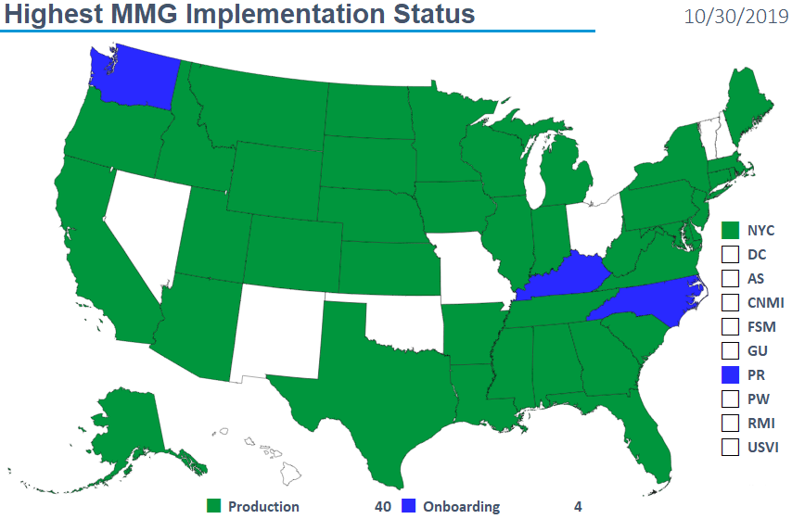
Text
11/19/2019

Slide 5
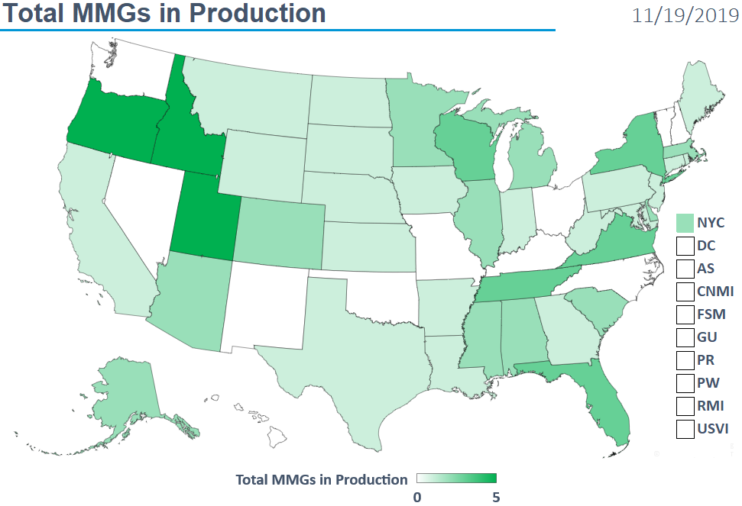
NMI Implementation Status Oct 15, 2019
11/19/2019

Slide 6
Finalized Guides
Onboarding Open to All | Onboarding For Pilots Only | Onboarding On Hold
Arboviral v1.3 | Babesiosis | Mumps
Gen v2 | CS | Pertussis
Hepatitis | FDD | Varicella
 | Lyme/TBRD
 | Malaria
 | STD
 | TB/LTBI
 | Trichinellosis
11/19/2019

Slide 7
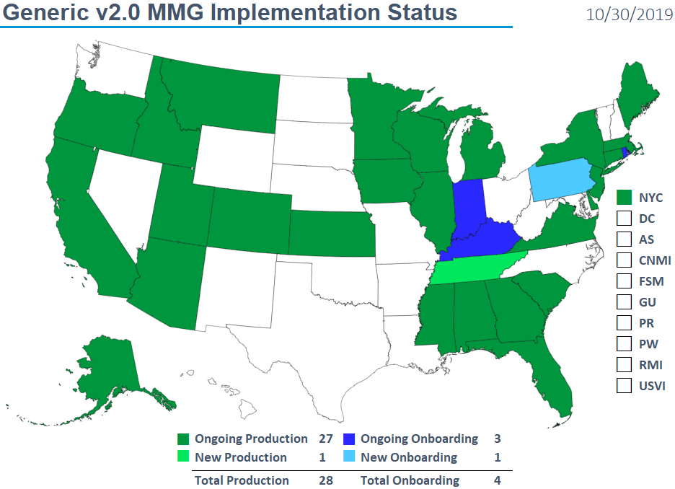
NMI Implementation Status Oct 15, 2019
11/19/2019

Slide 8
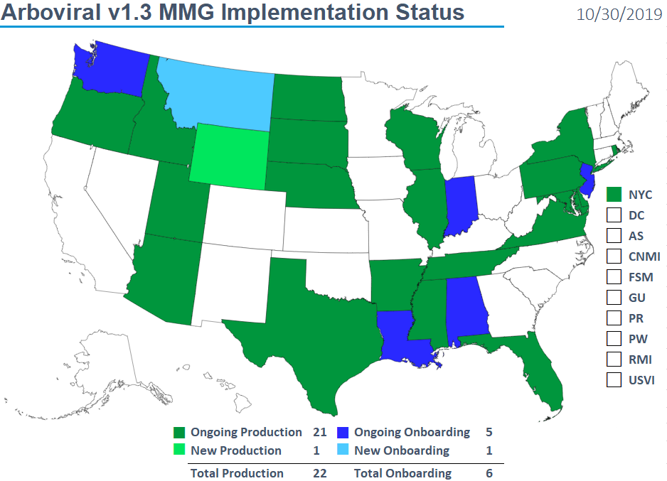
Text
11/19/2019

Slide 9
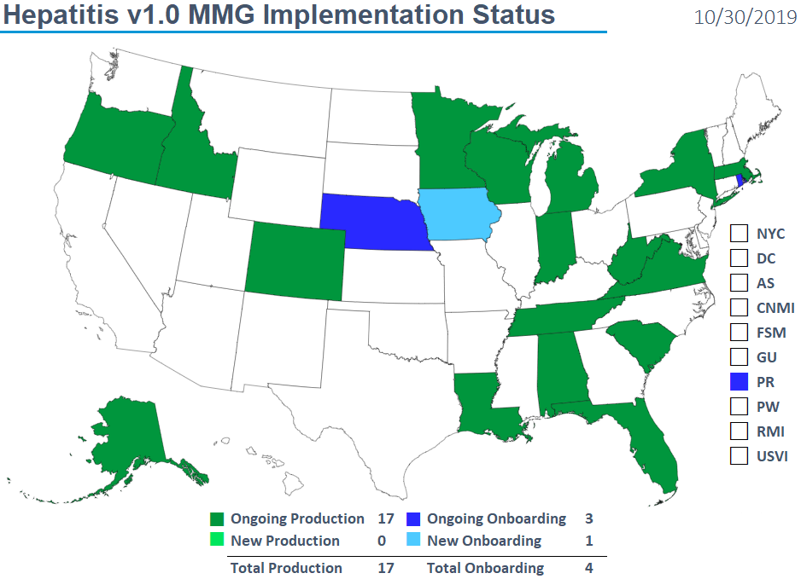
Text
11/19/2019

Slide 10
Piloting Status
Message Mapping Guides (MMGs) | Piloting | States Piloting
RIBD | 3 | GA, KS, OR
Lyme/TBRD | 5 | FL, ID, IL, MI, OR
HAI MDRO | 3 | CO, MI, OR
Measles/Rubella/CRS | 4 | AL*, AZ, FL, OR
Total # of Individual States | 10 | AL, AZ, CO, FL, GA, ID, IL, KS, MI, OR
* Measles Only
11/19/2019

Slide 11
NNDSS HL7 Message Mapping Guide Estimated Timeline

Slide 12
A Jurisdiction’s Approach to Implementing HL7 Case Notification Messages

Slide 13
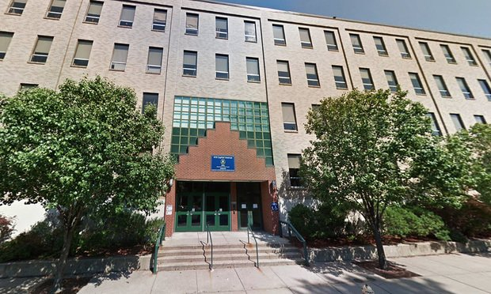
From Zero to Five
Meeting NMI Objectives in Connecticut
Nancy L Barrett, MS, MPH, Connecticut Department of Public Health
Infectious Disease Section Informatics Program Lead
November 2019 eShare Call
Notes:
Good afternoon. My name is Nancy Barrett and I am the Infectious Disease Section Informatics Program Lead at the Connecticut Department of Public Health. This presentation is updated from a presentation given at the 2019 CSTE conference in Raleigh, NC, and describes Connecticut’s journey to onboarding the new HL7 messages. I thank the eSHARE team for this invitation.

Slide 14
NMI Implementation Status May 7, 2018
Where we were
NH
WA
MT
VT
ME
AK
ND
MN
OR
NY
MA
ID
SD
WI
RI
WY
MI
CT
IA
PA
NJ
NYC
CA
NE
OH
DE
HI
NV
IL
IN
WV
UT
VA
DC
MD
CO
KS
MO
KY
NC
TN
OK
AR
SC
AZ
NM
MS
AL
GA
TX
LA
Piloting Total of 5 (states)
FL
PR
Onboarding Total of 5 (states)
Production Total of 25 (24 states + NYC)

Slide 15
NMI Implementation Status Nov 19, 2019
Where we are
NH
WA
VT
ME
AK
MT
ND
MN
MA
OR
WI
NY
RI
ID
SD
MI
WY
CT
IA
PA
NJ
NYC
CA
NE
OH
DE
HI
NV
IL
IN
WV
UT
VA
DC
MD
CO
KS
MO
KY
NC
TN
OK
AR
SC
AZ
NM
MS
AL
GA
TX
LA
FL
PR
Onboarding Total of 4 (states)
Production Total of 40 (39 states + NYC)

Slide 16

Our Strengths
Our Strengths
Strong NMI Team
Project Management Experience
A Flexible EDX Platform
Excited Program Staff SMEs
Mature Integrated Surveillance System
Test
16

Slide 17
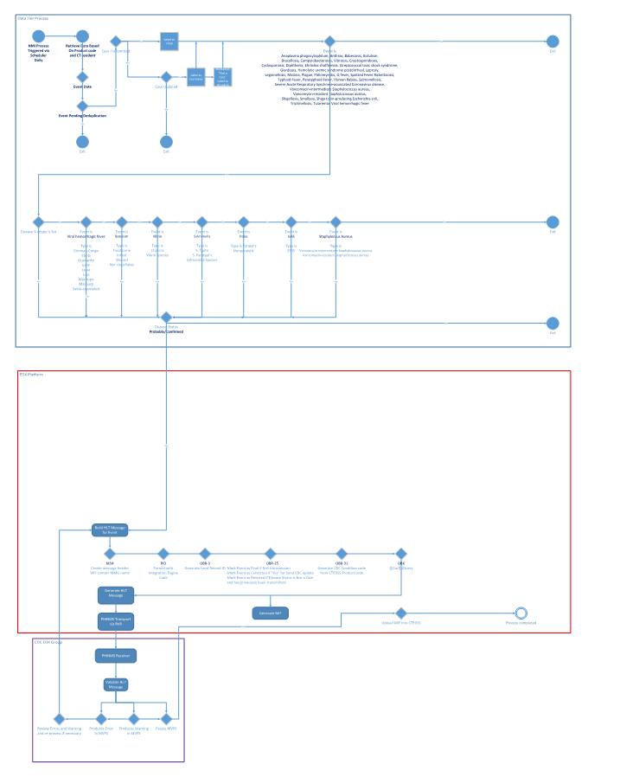
Define
Define
Surveillance System – Data Tier
Talk with other Maven states
Learn CT Reporting Criteria
Gap Analysis
Flow Diagram
EDX Platform
CDC MVPS
17

Slide 18
Design
Design
NMI Flow Diagram
Electronic Data Exchange Platform
Build HL7 Message:
  MSH (with MMG name)
  PID (format with integration engine code)
  OBR (Local Record ID) (F, C, X) (CDC Condition Code)
  OBX: Run Queries
  Generate HL7 Message → Send via PHINMS
  Generate NMI record tags uploaded into CTEDSS
Surveillance Data Tier: CTEDSS-Maven
Daily Scheduler:
Disease → CT resident → Event Date
Case not pending deduplication
Case previously transmitted:
NO → label as Final (F)
YES → Is Case Updated
YES → label Corrected (C)
Marked “not a case” → label Rescinded (R)
Further assess by
Disease Subtype (e.g. S. paratyphi) AND
Disease Status (Probable/Confirmed)
CDC MVPS
Receive message
Validate: Warnings and Errors
  Review and reprocess if needed
Still perfecting a process to mark a duplicate merged case as rescinded.
18

Slide 19
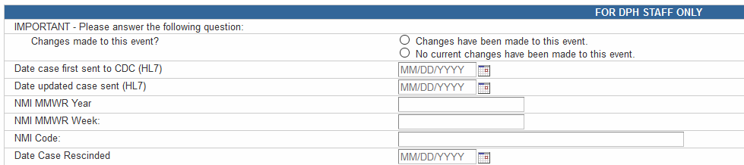
CTEDSS
CTEDSS NMI Question Package
Date case first sent to CDC – populated from output generated from the EDX system after HL7 file processed. This output file is uploaded into CTEDSS. This date is fixed and never changed.
NMI MMWR Year, Week, NMI Code are all populated the first time a case is sent.
Date updated case sent (HL7) – populated from output if a “date case first sent” is filled in and the “changes made to this event” has been selected. Currently program staff manually choose the “change made” button, but we are working to automate this process.
If a case is rescinded, the Date Case Rescinded is populated.
19

Slide 20
EDXPlatform Develop
EDX Platform:
Develop
Electronic Data Exchange
(EDX) Platform
Pilotfish Integration Console
Work in XML
Custom Java processors
Built in mechanisms for acquiring or delivering data
Base X
Used for all translations
Spreadsheet driven
Once concepts defined can re-use processes
Pilotfish to convert to XML then to HL7
20

Slide 21
t
Truncated example from spreadsheet
Code | Type | Value.1 | Value.2 | Value.3 | Value.5 | Value.24
MMGGENERIC | MMGMapping | CASE_HOSPITALIZED | 77974-4 | CWE | PHINVADS.YesNoUnknown | O
MMGGENERIC | MMGMapping | DIAGNOSIS_DATE | 77975-1 | TS |  | RE
MMGGENERIC | MMGMapping | DATE_ILLNESS_RESOLVED | 77976-9 | TS |  | O
MMGGENERIC | MMGMapping | DURATION_OF_SYMPTOMS | 77977-7 | TS |  | O
MMGGENERIC | MMGMapping | OUTCOME | 77978-5 | CWE | PHINVADS.OutcomeDeath | RE
Source MMG | (PF category) | CTEDSS Question ID | MMG LOINC | MMG Data type | PHINVADS variables | MMG Usage
Top row are the categories used in the Pilotfish process.
Bottom row are where these items come from in the MMG mapping.
t
21

Slide 22



Expectations
Expectations
What we thought we were starting
What we encountered
22
—RACHEL GILLETT, FAST COMPANY
Notes:
At the CSTE conference, we compared this journey to traveling the yellow brick road to Oz. However, like Dorothy, we quickly encountered several challenges.

Slide 23
Successes and Challenges
23

Slide 24
Gap Analysis Successes
GAP ANALYSIS
Successes
Program SMEs
  Invested in process
  - 1-2 staff max to assist
  Change in data to be collected
  - Sometimes more than expected by staff
  ↑ staff awareness of case reporting and data collected – gives them a fresh look at how they do surveillance. Move away from visualizing data as a paper form.
Surveillance system changes (CTEDSS)
  Harmonize data elements to MMG
  Add NMI tracking variables
NMI Lead
  Need the right person
  Deep cross-MMG understanding
24

Slide 25
Gap Analysis Challenge
GAP ANALYSIS
Challenges
Surveillance system changes (CTEDSS)
  Not all data elements harmonized and some configurations disease specific
  - Getting better
  Took time to come up with process to mark cases as updated or rescinded
  - Working to improve and automate
Program SMEs
  “preferred” vs. “required”
  - Addition of priority data elements lists helpful
  CDC and state program staff understanding can differ
  - Suggest initial CDC program to State program call to clarify
  Use of coded value sets
  - Improving
NMI Lead
  Initially a steep learning curve
25

Slide 26
EDX Platform Successes
EDX Platform
Successes
Surveillance system changes (CTEDSS)
  Interface with data tier
  No data warehouse needed; no purchase from vendor
  Upload of NMI tracking variables
  - Working on new ways to “Speed up process”
Tech Lead
  Developed EDX platform applications, HL7, vocabulary
  Developed extensible process
  Now a permanent state employee!
Spreadsheets
  Drive mapping and message creation
  Re-usable process
  Uses standard code sets
26

Slide 27
EDX Platform Challenges
EDX Platform
Challenges
Surveillance system changes (CTEDSS)
  Staff consistency in marking updated and rescinded cases
  - Automating process
Tech Lead
  Many modifications needed to accommodate NNDSS use of HL7
  Repeatable blocks doable but still difficult
  Issues with some GenV2 variables – inclusion and interpretation
Spreadsheets
  Lots of manual work to create initial sheets
  - Re-use of process improves with experience
  Lots of mapping to coordinate with PHIN VADs code sets
  - Need to follow up when PHIN VADS tables are modified or missing standard codes
27

Slide 28
t
Data Element Name | MMG noticed | Issue
Hospitalized, Admission and Discharge Dates | FDD | CDC program interpretation/use different from state program
Duration of Hospital Stay | FDD, STD | CDC program interpretation/use different from state program
Date of Illness Onset | FDD, TB, STD | Not always collected at state. We decided to use Symptom onset date or specimen collection depending on disease.
Case Status – NOT A CASE | FDD | Across all conditions, it took several meetings and discussions to come to a universal agreement on NOT A CASE and with CDC for FDD. We need to use NOT A CASE to define cases to be rescinded when they no longer meet case classification for reporting.
Immediate National Notifiable Condition and Date CDC was first verbally notified of case |  | Not applicable for many conditions – take out of GenV2?
Date First Reported to PHD and Date Reported | STD | CDC program interpretation/use different from state program. Not all programs use this date.
Earliest Date Reported to State | STD, TB | CDC program interpretation/use different from state program. Not all programs use this date.
Illness End Date, Duration, Duration Units | FDD, MBT, STD | Not used in MBT
Diagnosis Date | TB | Not in TB
Comments | All | We won’t send comments as that is used internally and may have PHI.
T
28

Slide 29
Onboarding Successes
Onboarding
Successes
Surveillance system changes (CTEDSS)
  Useful to have MMGs as early as possible
  - Especially helpful when making major changes in surveillance system
Technical Assistance
  Use of TA critical for success
  - Cohort process helpful
Onboarding
  Each success adds to experience
  - NMI website updates clearly outline process
29

Slide 30
Onboarding Challenges
Onboarding
Challenges
Surveillance system changes (CTEDSS)
  Use of lab data vs. epi-lab data
  - Epi/Lab still an issue, but some work-arounds are now possible
  Refining in-house process to make changes to system are working
Technical Assistance
  Challenge to be sure HL7 was correct and passed validation
  METS changes have helped, especially the highlight feature!
  You can’t test too much!
  Don’t be shy!
Onboarding
  Seemed CDC programs wanted more info even if “preferred”
  - Priority lists help greatly
  QA data issues brought up at onboarding delays process
  Readiness of CDC programs for onboarding
30

Slide 31

So How Did We Do
So How Did
We Do?
April 27, 2018 to
November 19, 2019
CSTE Abstract
CT Production: Gen V2, STD, CS, TB, Babesiosis
Onboarding: Pertussis, Mumps, Varicella, Arbo v1.3
In Process: Hepatitis, FDD
Gap Analysis: RIBD
LOL
CSTE Conference (June 2019)
CT Production: Gen V2, STD, CS
Piloting: Malaria, Babesiosis, Trichinellosis, TB
Gap Analysis: Arbo v1.3, FDD
Requirements: CO
November 2019 eShare call
CT Production: Gen V2, STD, CS
Onboarding: Malaria*, FDD**, TB**
Gap Analysis: Arbo v1.3**, RIBD (draft)**
Requirements: CO
*likely in Dev **now March 2020 **on hold by state
CSTE NMI Evaluation Workgroup
31
—RACHEL GILLETT, FAST COMPANY

Slide 32

Thanks
Thanks
Alycia McNutt – NMI Lead
Alycia.mcnutt@ct.gov
Carl Bondeson – EDX Tech Lead
Carl.Bondeson@ct.gov t
Zack Fraser and Jianxin Sun – CTEDSS admin
DPH ID program SMEs
APHL-CDC TA (Melanie, Natalie, Heather, others)
CDC Onboarding teams
32

Slide 33
QUESTIONS
Nancy L Barrett
nancy.l.barrett@ct.gov
THANK YOU
33

Slide 34
Subscribe to monthly NMI Notes news updates at
https://www.cdc.gov/nndss/trc/news/
Access the NNDSS Technical Resource Center at
https://www.cdc.gov/nndss/trc/
Request NNDSS technical assistance or onboarding at
edx@cdc.gov
Next NNDSS eSHARE is December 17, 2019 – details at
https://www.cdc.gov/nndss/trc/onboarding/eshare.html

