Slide 1
Extended eSHARE Webinar: Current Plans for State Implementation of Arboviral v1.3 Case Notification Conference Number: 800-779-9623 Participant Code: 9740330 NOTE: Adobe Connects Audio is not available. Join the Adobe Connects meeting at: https://virtualsepd.adobeconnect.com/nmieshare/. Click “Enter as a Guest,” provide your name, and click “Enter Room.” May 19, 2016

Slide 2
Update on Implementation of Arboviral v1.3 Case Notifications
Data continuity is a priority during responses.
The United States needs reliable data for Arboviral emergency responses.
Changing the Arboviral case notification introduces risk.
Complex business process and system changes are needed in many jurisdictions.
CDC expects to onboard jurisdictions on a case-by-case basis to minimize risk of data disruption.
CDC expects to be ready to accept v1.3 messages in July 2016.

Slide 3
Low-Risk Implementation of Arboviral v1.3 Case Notifications
Strategy: Case by case onboarding for v1.3
Limited migration to the v1.3 guide during the 2016 season
Prepare to migrate to the v1.3 message for the 2017 season
Evaluation of jurisdictions for 2016 onboarding based on:
Business processes
Surveillance system capabilities
Availability of Ft. Collins staff for onboarding

Slide 4
What Should Jurisdictions Do Now?
Continue to submit Arboviral case notifications by using your current process.
Everyone: Consider resources for surveillance.
ELC Cooperative Agreement
OPHPR Zika Response Funding
Direct hand entry into ArboNET: Continue entry into ArboNET.
XML upload into ArboNET: CDC Arboviral program will coordinate XML upgrade.
V1.2 message: Continue to send until contacted to convert to v1.3.

Slide 5
What Should Jurisdictions Do to Prepare for v1.3?
Begin planning for Arboviral v1.3 Case Notification implementation for 2017:
Review current business processes for Arboviral surveillance.
Plan transition of human Arboviral disease surveillance from legacy business process and systems to jurisdiction’s integrated surveillance information system.
Update integrated surveillance system to support Arboviral surveillance.
Consider technical assistance for implementation of the Arboviral v1.3 message.

Slide 6
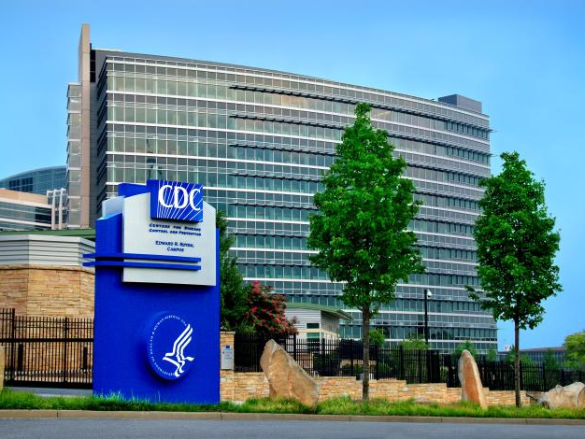
Questions? Email EDX@cdc.gov

Slide 7
The End
For more information, please contact Centers for Disease Control and Prevention
1600 Clifton Road NE, Atlanta, GA 30333
Telephone: 1-800-CDC-INFO (232-4636)/TTY: 1-888-232-6348
Visit: http://www.cdc.gov | Contact CDC at: 1-800-CDC-INFO or http://www.cdc.gov/info
The findings and conclusions in this report are those of the authors and do not necessarily represent the official position of the Centers for Disease Control and Prevention.
Center for Surveillance, Epidemiology, and Laboratory Services
Division of Health Informatics and Surveillance

