Slide 1
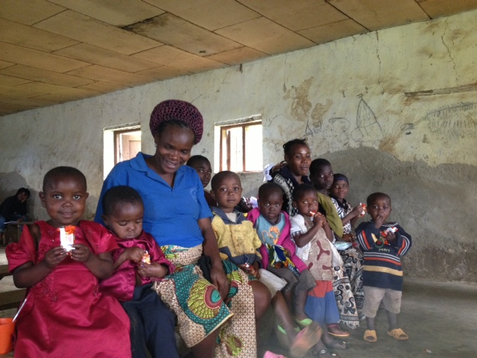
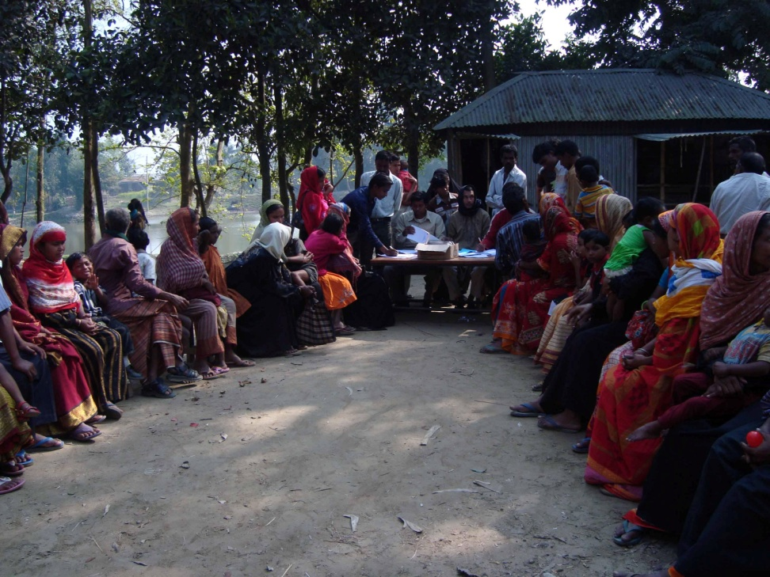
Field-testing an earlier draft of the WG/UNICEF Question Set in Cameroon and India
Islay Mactaggart
Research Fellow in Disability
International Centre for Evidence in Disability
LSHTM

Slide 2
Outline
Measuring Disability
Building Evidence study – Aims and Objectives
Building Evidence study – Methods
Field testing the WG/UNICEF ESF in Cameroon and India

Slide 3
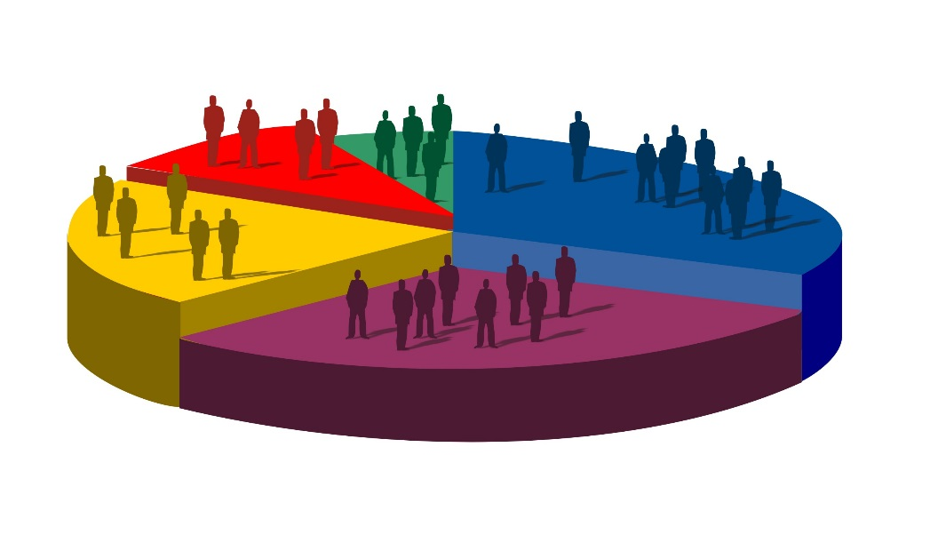
1. Measuring Disability

Slide 4
Measuring Disability
Different methods provide different information within the overall framework of the ICF
Different methods preferable depending on aims and objectives

Slide 5
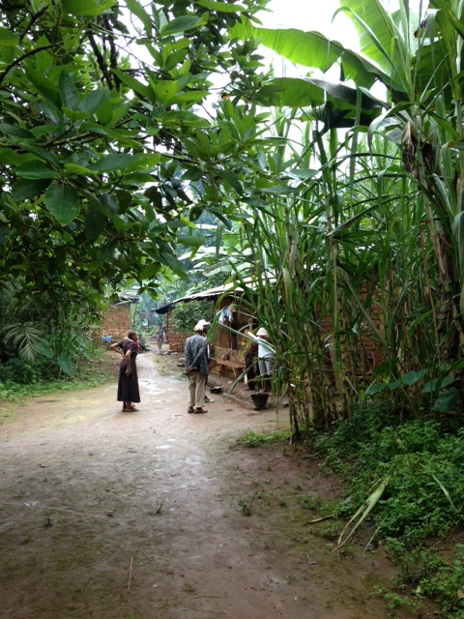
2. Building Evidence Study aims and Objectives

Slide 6
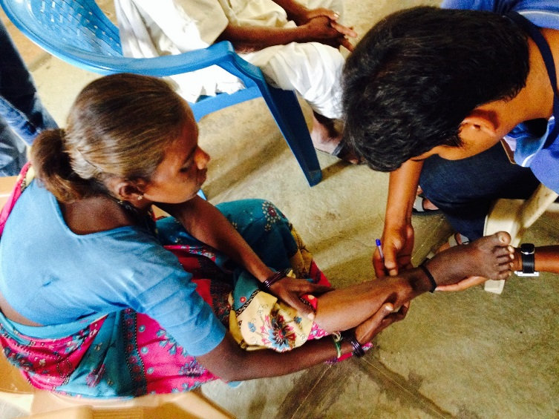
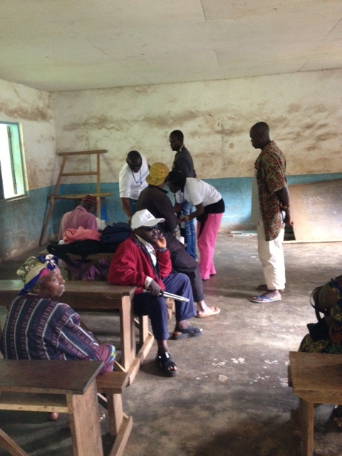
2. Study Aim
To develop a comprehensive population-based survey methodology that is compatible with the ICF, and to explore the inter-relationship between the different components of this framework.

Slide 7
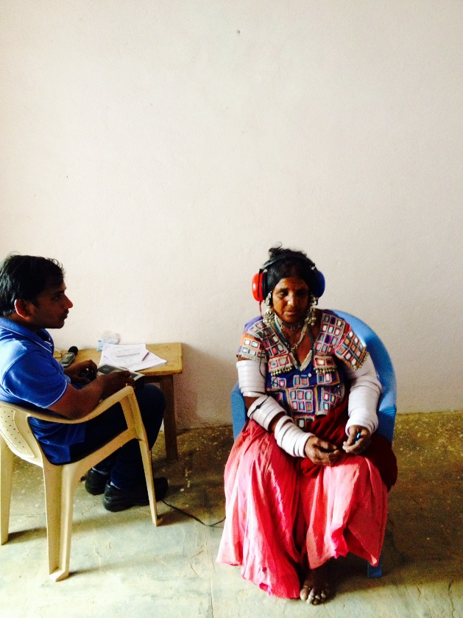
2. Study Objectives
Identify available tools for disability measurement
Develop comprehensive survey methodology to explore components of the ICF
Explore the relationship between disability measurement options within the context of the ICF

Slide 8
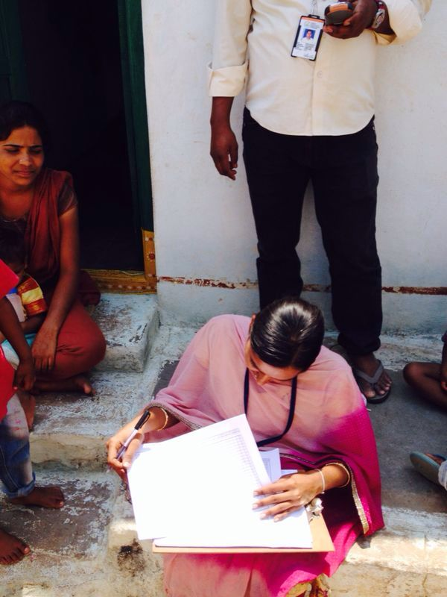
2. Study Objectives
Assess the impact of disability on access to education, livelihoods, participation and quality of life
Identify socio-demographic, economic, environmental and clinical predictors of access to health, education and employment among people with disabilities

Slide 9
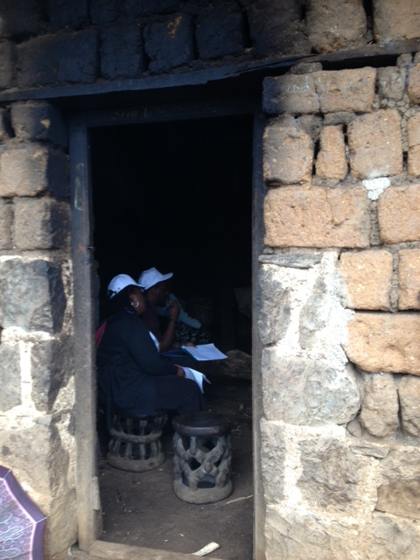
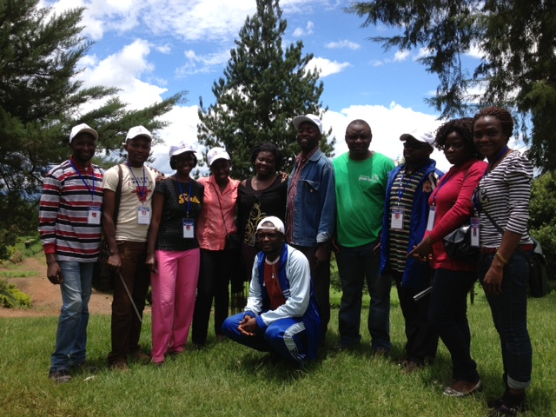
3. Building Evidence study - methods

Slide 10
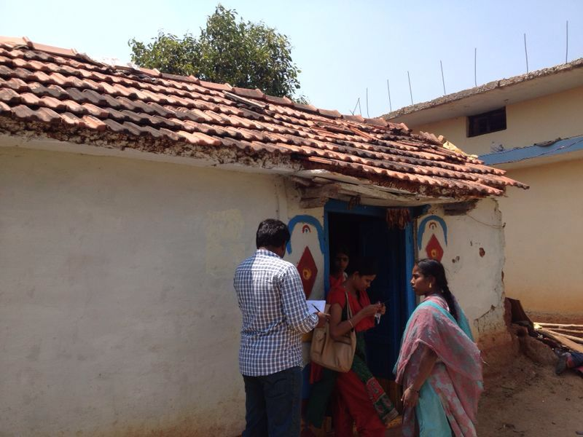
3. Methods – Study Design Overview
All age population-based survey of:
1. Self reported functional limitations
2. Clinically measured visual impairment, hearing impairment , musculoskeletal impairment and depression
2. Nested Case-control study (age 5+):
CASES: People with disabilities
CONTROLS: People without
disabilities

Slide 11
3. Methods – Study Design Overview
All age population-based survey of:
1. Self reported functional limitations
2. Clinically measured visual impairment, hearing impairment , musculoskeletal impairment and depression
2. Nested Case-control study (age 5+):
CASES: People with disabilities
CONTROLS: People without disabilities
Inc. module on participation

Slide 12
3. Methods – Study Settings
Cameroon: North West Region (July-Sept 2013)
India: Mubabnager, Andra Pradesh (Feb-April 2014)

Slide 13
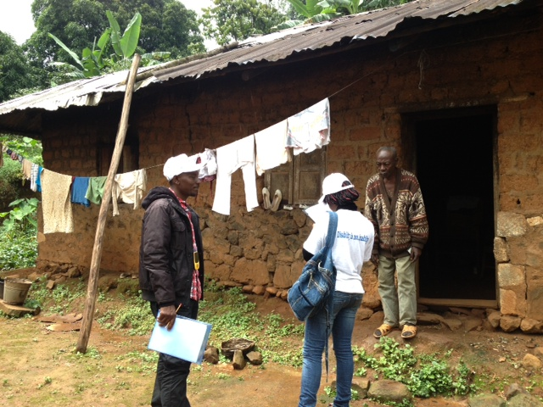
3. Methods – Sampling
Sample size
4,056 per country (precision 20%, 95% CI, design effect of 1.5 and 20% non-response)
Selection of clusters (villages): 51 clusters of 80 people per site
Probability proportionate-to-size sampling
Selection of households within clusters
Compact segment sampling
All eligible participants enumerated and asked to attend screening

Slide 14
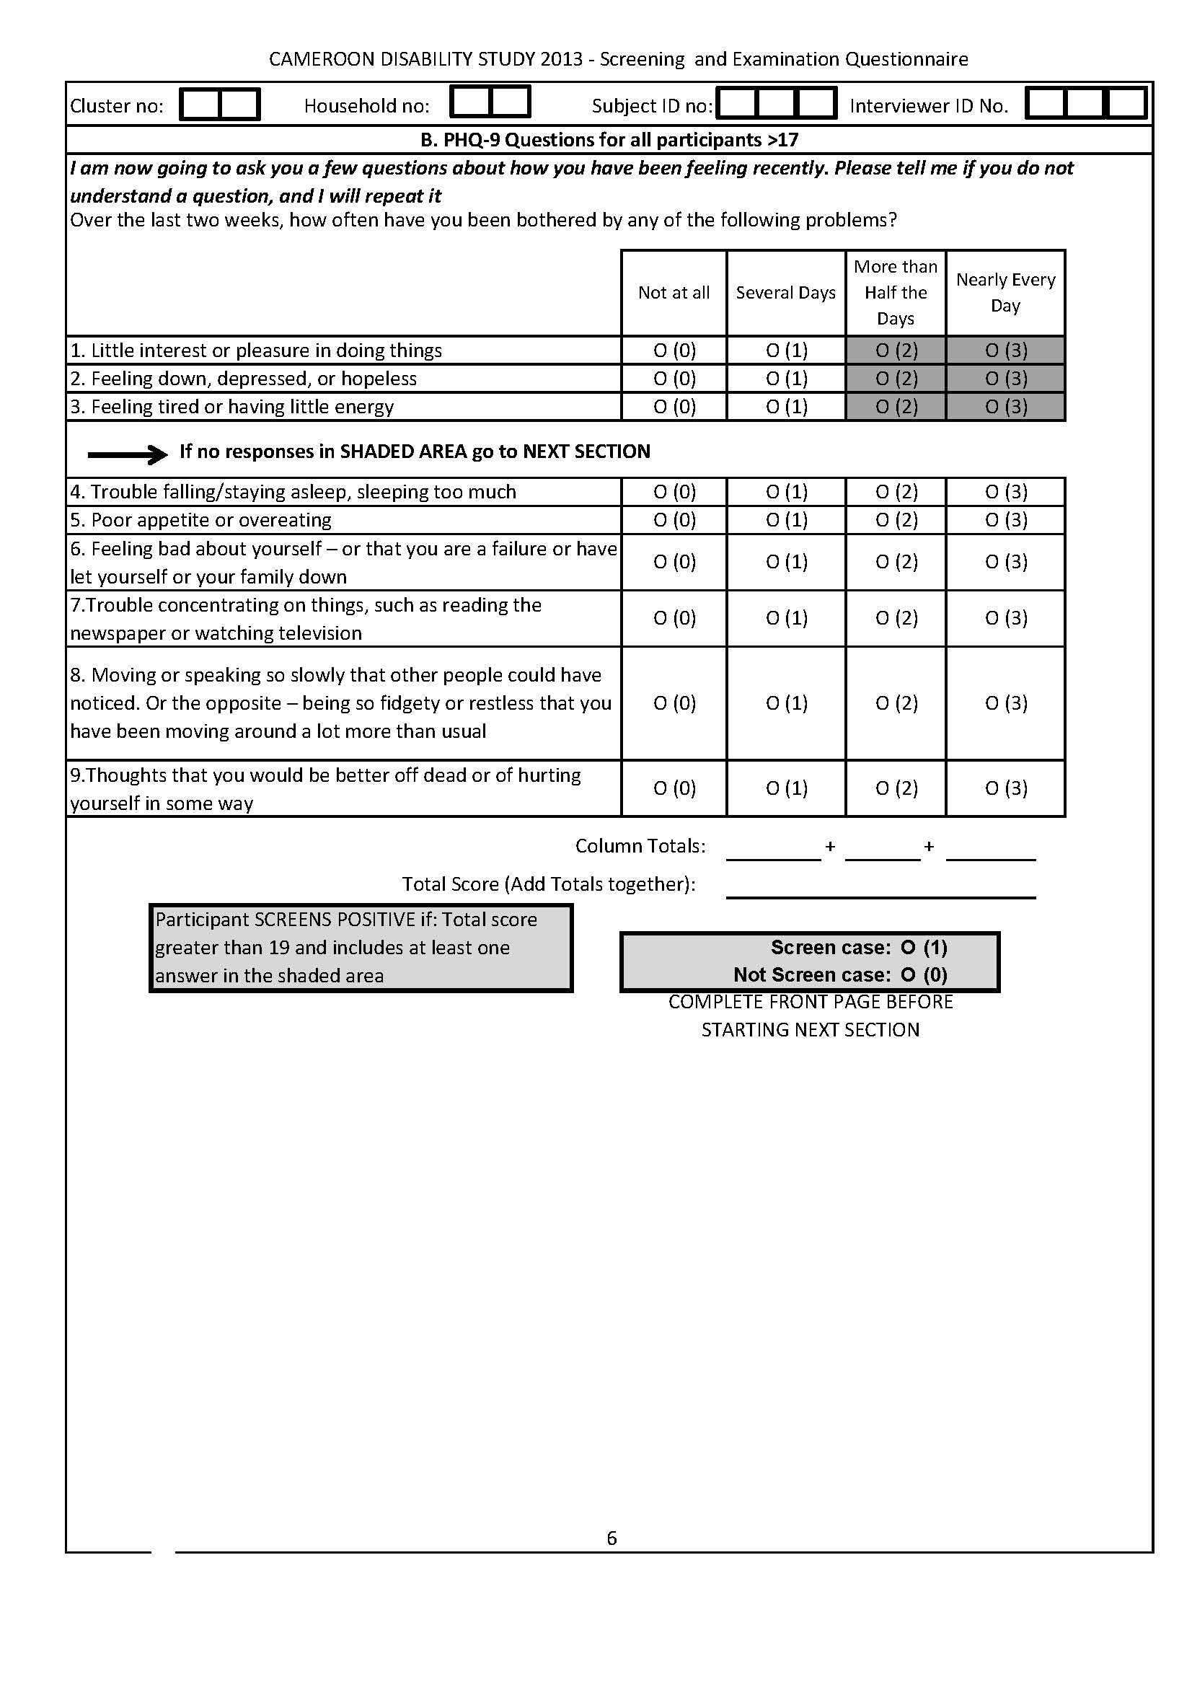
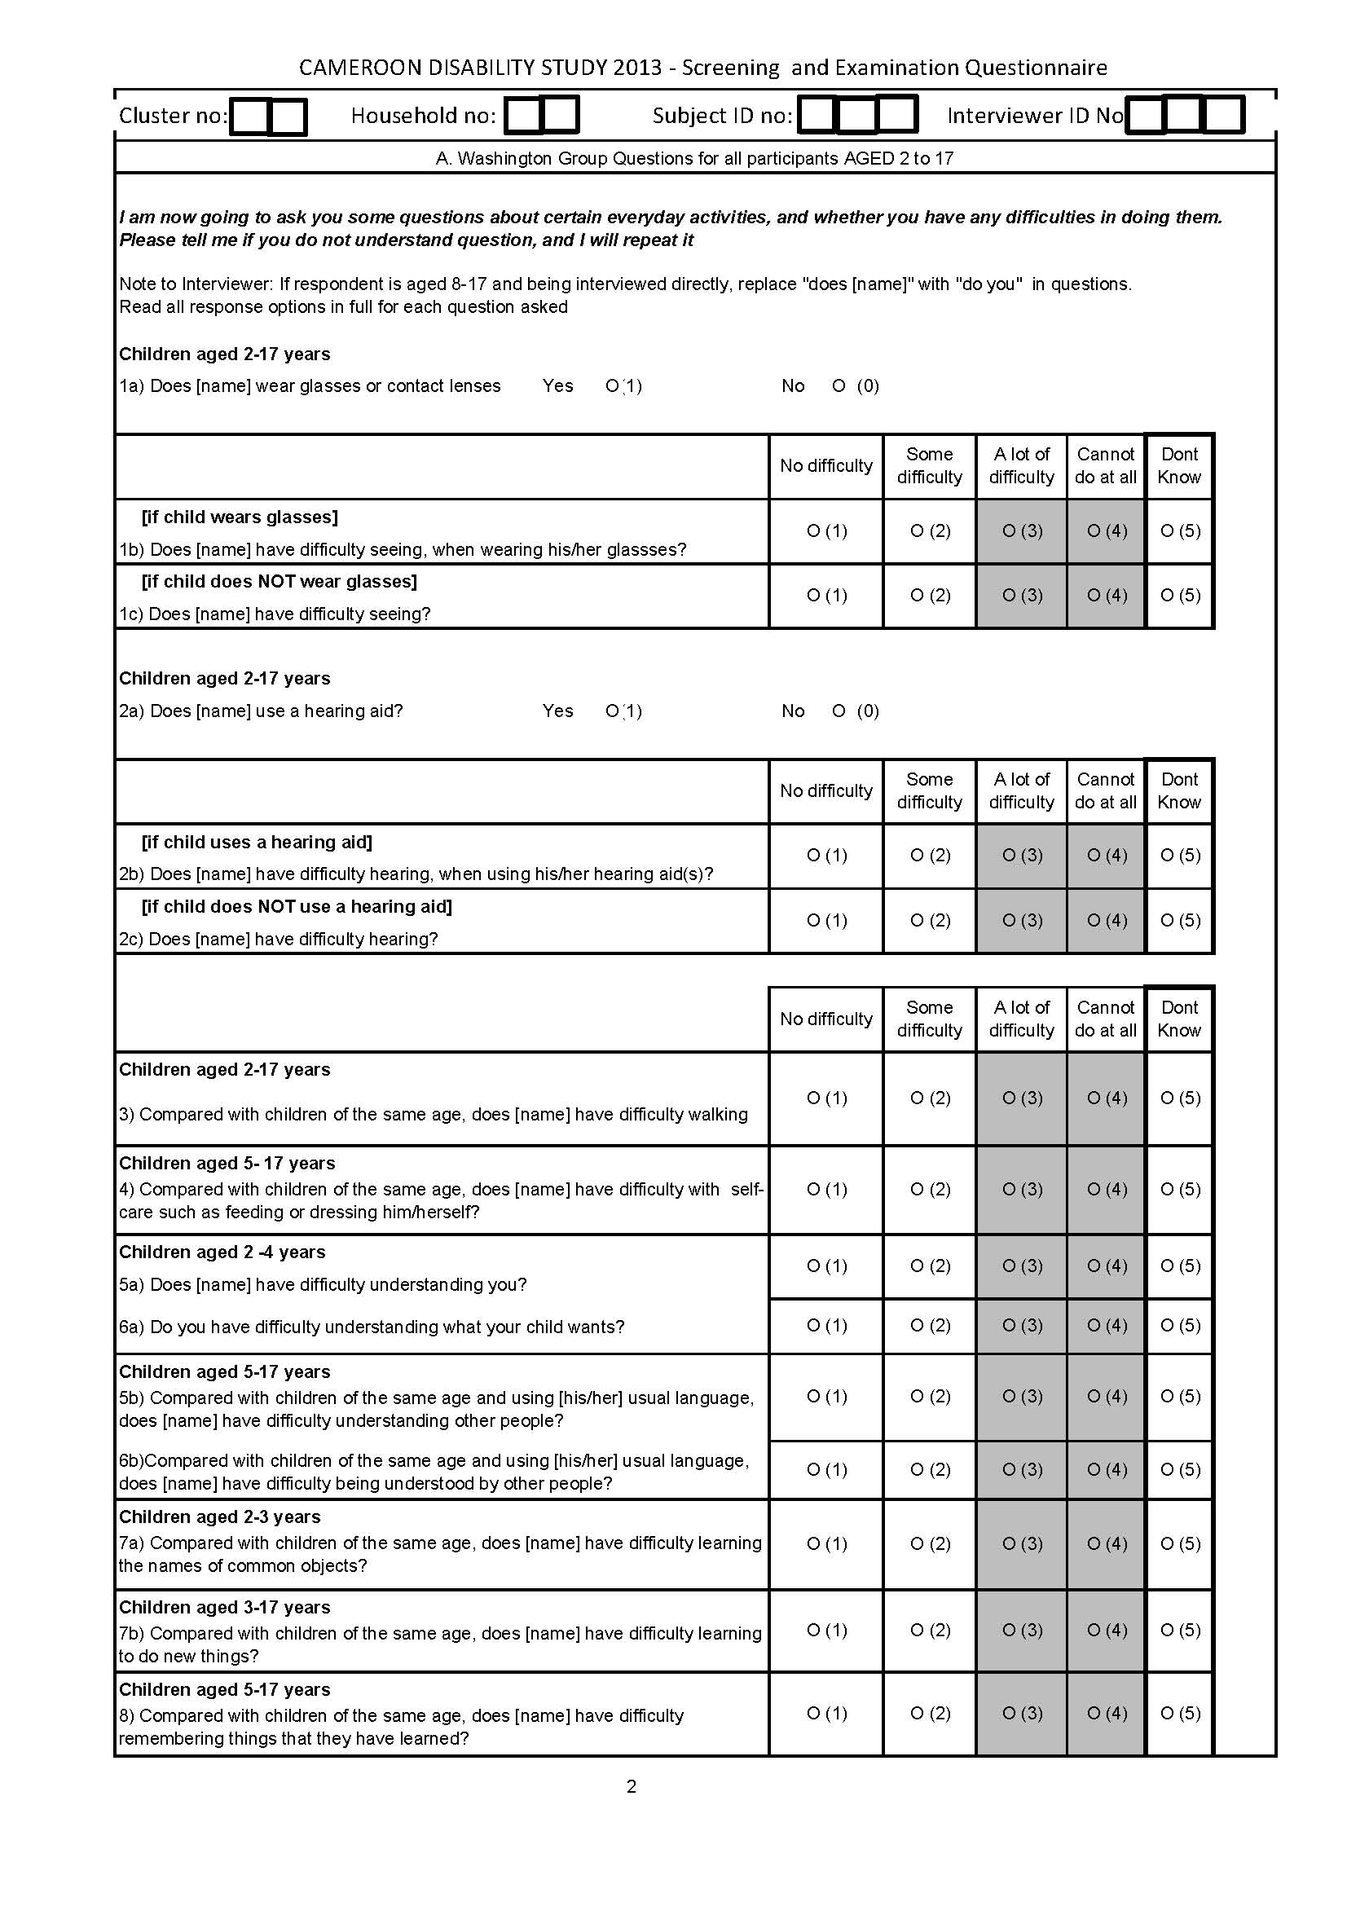
3. Methods – Screening Protocol
5. Screening tools
WG/UNICEF and WG-ESF Self-Reported Screen (2+)*
PHQ-9 Clinical Depression Screen (18+)
RAAB Vision Screen (all ages)
WHO E&H Hearing Screen (all ages)
RAM Musculoskeletal Screen (all ages)
Clinical examination, diagnosis and referral for all participants screening positive to any clinical screen
Case/Control interviews for all participants screening positive to any screen aged 5+

Slide 15
3. Methods – Screening Protocol
5. Screening tools
WG/UNICEF and WG-ESF Self-Reported Screen (2+)*
PHQ-9 Clinical Depression Screen (18+)
RAAB Vision Screen (all ages)
WHO E&H Hearing Screen (all ages)
RAM Musculoskeletal Screen (all ages)
Clinical examination, diagnosis and referral for all participants screening positive to any clinical screen
Case/Control interviews for all participants screening positive to any screen aged 5+
*NB. Children 8-17 (unless unable to communicate) respond independently (recorded)

Slide 16
3. Methods – Screening Protocol
5. Screening tools
WG/UNICEF and WG-ESF Self-Reported Screen (2+)*
PHQ-9 Clinical Depression Screen (18+)
RAAB Vision Screen (all ages)
WHO E&H Hearing Screen (all ages)
RAM Musculoskeletal Screen (all ages)
Clinical examination, diagnosis and referral for all participants screening positive to any clinical screen
Case/Control interviews for all participants screening positive to any screen aged 5+
*NB. Children 8-17 (unless unable to communicate) respond independently (recorded)

Slide 17
4. Field-testing WG-UNICEF ESF for children
DOMAIN TYPE | AGE GP | No. | DOMAIN OF FUNCTIONING |  | DOMAIN TYPE |  | AGE GP | No. | DOMAIN OF FUNCTIONING
Basic activity domains | 2-17 | D1 | Seeing |  | Complex activity/ participation domains |  | 2-17 | D9 | Controlling Behaviour
 |  | D2 | Hearing |  |  |  |  | D10 | Playing
 |  | D3 | Walking |  |  |  | 5+ only | D11 | Worry
 |  | D4 | Understanding |  |  |  |  | D12 | Completion of Task
 |  | D5 | Being Understood |  |  |  |  | D13 | Accept Change
 |  | D6 | Learning |  |  |  |  | D14 | Get along with other children
 | 5+ only | D7 | Remembering
 |  | D8 | Self Care
Draft Module Domains

Slide 18
4. Field-testing WG-UNICEF ESF for children
DOMAIN TYPE | AGE GP | No. | DOMAIN OF FUNCTIONING |  | DOMAIN TYPE |  | AGE GP | No. | DOMAIN OF FUNCTIONING
Basic activity domains | 2-17 | D1 | Seeing |  | Complex activity/ participation domains |  | 2-17 | D9 | Controlling Behaviour
 |  | D2 | Hearing |  |  |  |  | D10 | Playing
 |  | D3 | Walking |  |  |  | 5+ only | D11 | Worry
 |  | D4 | Understanding |  |  |  |  | D12 | Completion of Task
 |  | D5 | Being Understood |  |  |  |  | D13 | Accept Change
 |  | D6 | Learning |  |  |  |  | D14 | Get along with other children
 | 5+ only | D7 | Remembering
 |  | D8 | Self Care
Draft Module Domains

Slide 19
4. Field-testing WG-UNICEF ESF for children
Cohort Descriptives
 | Cameroon |  |  | India
 | Male | Female | Total | Male | Female | Total
 | n (%) | n (%) | n (100%) | n (%) | n (%) | n (100%)
2 to 5 | 237 (46.9) | 268 (53.1) | 505 | 113 (48.5) | 120 (51.5) | 233
6 to 9 | 256 (51.3) | 243 (48.7) | 499 | 163 (53.8) | 140 (46.2) | 303
10 to 13 | 230 (51.7) | 215 (48.3) | 445 | 138 (50.5) | 135 (49.5) | 273
14 to 17 | 126 (47.7) | 138 (52.3) | 264 | 161 (55.1) | 131(44.9) | 292
Total | 849 (49.6) | 864 (50.4) | 1,713 | 575 (52.2) | 526 (47.8) | 1,101

Slide 20
4. Field-testing WG-UNICEF ESF for children

Slide 21
4. Field-testing WG-UNICEF ESF for children

Slide 22
4. Proportion Endorsing Each Domain - Cameroon

Slide 23
4. Proportion Endorsing Each Domain - Cameroon

Slide 24
4. Proportion Endorsing Each Domain - Cameroon

Slide 25
4. Proportion Endorsing Each Domain - Cameroon

Slide 26
4. Proportion Endorsing Each Domain - Cameroon

Slide 27
4. Proportion endorsing each domain - India
Notes:
-Lower overall than Cameroon
-

Slide 28
4. Proportion endorsing each domain - India

Slide 29
4. Proportion endorsing each domain - India

Slide 30
4. Proportion endorsing each domain - India

Slide 31
4. Proportion endorsing each domain - India

Slide 32
4. India – Single question vs. WG

Slide 33
4. Relationship to clinical screens - Cameroon

Slide 34
4. Relationship to clinical screens - Cameroon

Slide 35
4. Relationship to clinical screens - India

Slide 36
4. Relationship to clinical screens - India

Slide 37
4. Summary of Field Test
Almost 3000 children screened
63.9% of children in Cameroon and 34.9% of children in India endorsed at least one domain with at least “some difficulty”
Much smaller percentage endorsing at least one domain with at least “a lot or can not do” – 8.9% Cameroon and 3.5% India
Similar proportions endorsing basic domains in both countries; higher proportion endorsing complex domains in Cameroon

Slide 38
4. Summary of Field Test
Reasonable relationship with clinical tools (but small sample) – more false negatives than false positives vs. clinical criteria
Draft module seen as best available during review but since updated - results as field test
No strong significant pairwise relationships between domains either country
<0.5% in Cameroon and 0.6% in India answered “Don’t Know” to any question

Slide 39
4. Summary of Field Test
Further results from study forthcoming end 2014
WG-ESF functional limitations in adults
Clinical Impairment prevalence
Case-control data on impact of disability
Relationship between self-reported functional limitations and objectively assessed impairments

Slide 40
Thank you for listening!
Islay.mactaggart@lshtm.ac.uk
Islay Mactaggart, Research Fellow in Disability
International Centre for Evidence in Disability
LSHTM
http://disabilitycentre.lshtm.ac.uk

