Slide 1
Privacy Preserving Techniques: Case Studies from the Data Linkage Program
Lisa B. Mirel
Board of Scientific Counselors
May 19, 2021

Slide 2
Introduction
Linking data is a powerful mechanism to provide policy relevant information in an efficient way
NCHS currently links data from several population-based and establishment surveys to administrative data sources, but privacy concerns impact:
Data that can be released
Sources used for linkage
Two case studies attempt to address these concerns:
Synthetic data creation for public release
Privacy preserving record linkage
Notes:
ability to link to other sources (non traditional federal data sharing--> private insurance, rx cancer registry)

Slide 3
Data Sources for Case Studies
National Hospital Care Survey (NHCS): An establishment survey that, when fully implemented, will provide nationally representative statistics, from claims and electronic health records (EHRs), on health and health care utilization from hospital inpatient stays and emergency department visits
National Death Index (NDI): A centralized database of U.S. death records gathered from states’ vital statistics offices

Slide 4
Data Sources: Linked NHCS-NDI Data (cont.)
Mortality
Patient level encounter data from hospitals
Cause of death from National Death Index

Slide 5
Case Study I: Synthetic Data

Slide 6
Synthetic Data
Explore the feasibility of developing a fully synthetic linked mortality file for public release
Model occurrence and date of death
Decision tree for cause of death
Research question: how do the estimates from a fully synthetic linked mortality file compare to the original restricted use file?

Slide 7
Synthetic Data Methodology: Occurrence of death and date of death
Occurrence of death and date of death modeled using Cox proportional hazards model:
Linear predictor of death risk
Baseline survival rates for each day

Slide 8
Synthetic Data: Major and Contributing Causes of Death
Modeled using classification tree (CART):
Contributing causes were modeled contingent on major causes
Predictors were similar to those used in survival model for date and occurrence of death
Notes:
CART:

Slide 9
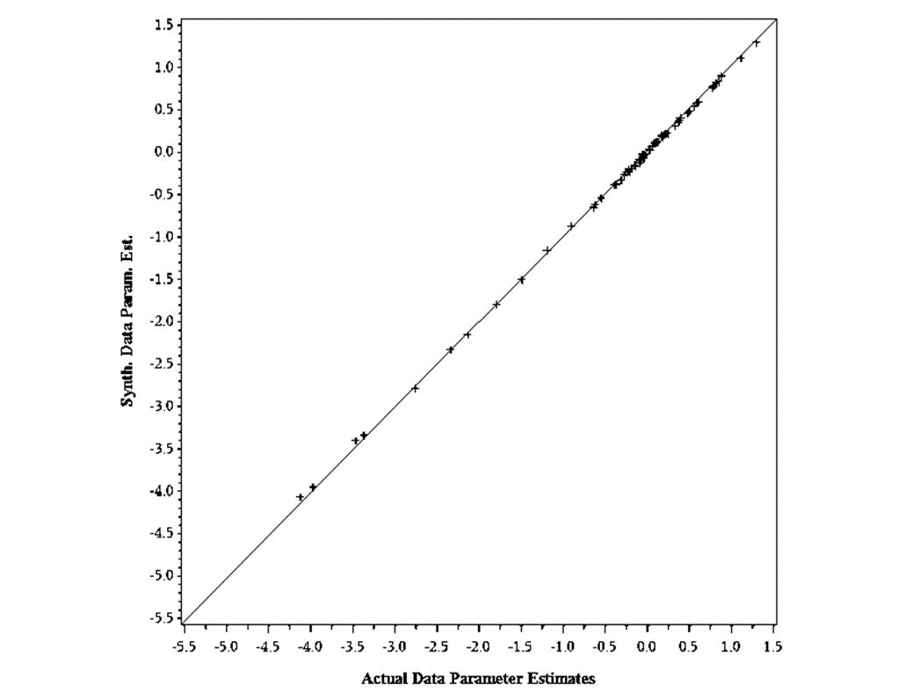
Results
Comparative analysis shows very similar results for all-cause mortality when compared to the restricted-use data
Some differences are noted in cause-specific estimates
Synthetic Data Parameter Estimates
Actual Data Parameter Estimates
Resnick, D., Cox, CS., Mirel, LB. (2021). Using synthetic data to replace linkage derived elements: a case study. Health Services and Outcomes Research Methodology. 1-18. 10.1007/s10742-021-00241-z.
Notes:
The release of synthetic linked data balances the needs of the research community while protecting against disclosure risk

Slide 10
Next Steps: Synthetic Data
PCORTF FY 21 funding to create fully synthetic linked data files
Convene stakeholders meeting
Develop a methodology and implement
Create a validation method for researchers
Notes:
Stakeholders to id variables of greatest need
Validation method to address: differences should be considered by potential users if/when a public-use file is released. Could be stated as a limitation in a paper or researchers could consider using the restricted-use file. Researchers can do analysis with synthetic data

Slide 11
Opportunities and Challenges
Opportunities:
Increase data accessibility, which could expand data user community
Support evidence-based policymaking
Balance needs of researchers while protecting against disclosure risk
Challenges:
User communication
Create statistically valid datasets with distributions similar to the true data
Create methods and processes for validation
Notes:
Supporting agencies effort to support EBP

Slide 12
Case Study II: Privacy Preserving Record Linkage

Slide 13
Privacy Preserving Record Linkage
Privacy preserving techniques have increased the potential to expand data sharing while reducing privacy concerns
Privacy preserving record linkage or “PPRL” is a method that can be used to link de-identified data using hashing algorithms and tokens
Research question: how do results from PPRL compare to results from the standard linkage algorithm?

Slide 14
Privacy Preserving Record Linkage (cont.)
NCHS case study: National Hospital Care Survey data linked to death certificate information from the National Death Index
Assess PPRL compared to “gold standard” (standard linkage algorithms)
Initial PPRL and refined PPRL
Determine the quality of PPRL linked data (sensitivity and specificity)
Compare estimates from two methods in secondary analysis
7
Notes:
Note: this work is funded in part by the Department of Health and Human Services’ Office of the Secretary Patient-Centered Outcomes Research Trust Fund (OS-PCORTF)

Slide 15
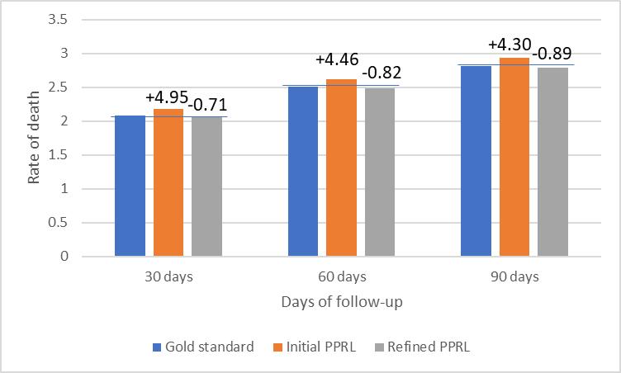
Results
Death Rates by Linkage Approach and Follow-Up Period and Percent Difference from Gold Standard
Depending on the selection of tokens from PPRL:
Sensitivity ranged from 98.7% to 97.8%
Specificity ranged from 99.7% to 99.9%
Impact of PPRL links on secondary data analysis was minimal
8

Slide 16
2016 NHCS Patients Linked to 2016-2017 NDI by Linkage Approach and Demographics
Characteristic | % Linked Gold Standard | % Linked Initial PPRL | % Linked Refined PPRL
Overall | 5.1 | 5.4 | 5.0
Age
<18 | 0.3 | 0.3 | 0.3
18-64 | 2.9 | 3.1 | 2.9
65+ | 20.0 | 20.8 | 19.9
Sex
Male | 5.9 | 6.2 | 5.8
Female | 4.5 | 4.7 | 4.4
Note: Percent with non-missing SSN is highest in the 65+ group, which also happens to be the group that is most likely to link to the NDI.
9
Notes:
The age and gender distribution of linked survey participants appears similar across the linkage approaches
Linkage rates are highest among adults aged 65 and over with approximately 20% of adults aged 65 and over matching to the NDI for all three approaches

Slide 17
Summary
PPRL can be an effective record linkage technique that produces results similar to the standard linkage algorithm
High sensitivity and specificity estimates
Age- and sex-specific linkage rates show minimal differences for these subpopulations

Slide 18
Next Steps: PPRL
Explore accuracy of PPRL when using sources with less complete PII
Evaluate the impact of PPRL on health outcomes beyond mortality
Assess the use of PPRL to expand NCHS data linkage activities

Slide 19
Opportunities and Challenges
Opportunities:
Expand linkage beyond traditional federal data sources without sharing PII
Increase opportunities for NCHS, CDC and HHS to link data to address emerging public health threats
Challenges:
Ensure PPRL methodology is safe and secure when sharing hashed tokens
Continue to evaluate and calibrate PPRL results for linkage accuracy
Notes:
Really across the federal systems

Slide 20
Discussion
Synthetic data
Are there unique considerations with public use synthetic data products from NCHS?
User communication
Validation process
Privacy concerns
PPRL
How do we extend this work to other sources (e.g., private sector, emerging public health data)?
Priority sources
Privacy concerns
Notes:
Not differential privacy- Linked SIPP synthetic data (there is a precedent for these type of data to be released)
Ongoing issue of privacy. pprl results need to be synthesized
How can we pay for it
Specific questions
What are some non-federal data sources to consider when working with PPRL?
What advice do you have for convening stakeholders for synthetic data project?

Slide 21
Thank you!

