Slide 1
Update from the Division of Analysis and Epidemiology
Irma Arispe
Board of Scientific Counselors
October 22, 2021

Slide 2
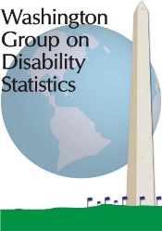
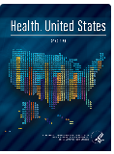
NCHS Division of Analysis and Epidemiology Major Program Areas
Division of Analysis and Epidemiology
Data Linkage Methodology and Analysis
Population Health Reporting and Dissemination
Health Promotion Statistics
Measures Research and Evaluation

Slide 3
Goal 1: Expand Relevance, External Engagement Understand user needs Improve awareness and use of products Build and maintain partnerships

Slide 4
NCHS Products Target Different Audiences in Different Ways
Citations of Healthy People 2030 and Health, United States FY2021
Healthy People 2030
Health, United States

Slide 5
Monitoring Use of Health, United States Products
COVID-19
2019 report
2017 report &
Data Finder launch
2018 report
Data Finder views
HUS Homepage views
Report downloads

Slide 6
A Health, United States Query System Informed by Users’ Needs
Health, United States redesign’s systematic approach helped us understand who was using Health US, what topics and analyses were most frequently used, and why users selected those data.
Web user survey
Literature review
Audience research
Stakeholder interviews
Web analytics

Slide 7
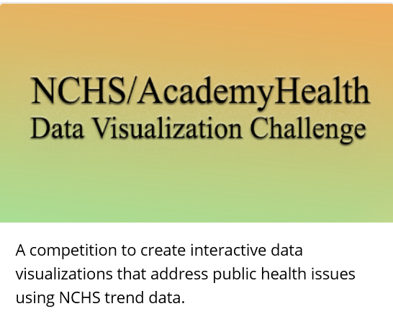
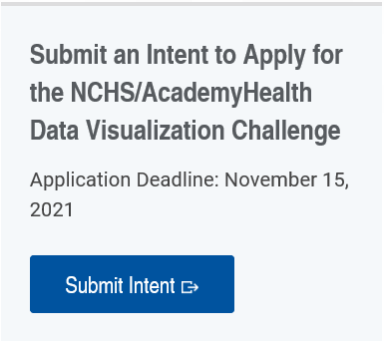
Collaboration and Engagement
Types of Partnerships
Data partners
Reviewers
Subject matter/topic
Methods development
Technical assistance
CDC and external agency business partnerships
Interagency/International analytic or reporting partnerships
Visionary partnerships
https://academyhealth.org/NCHSData

Slide 8
Goal 2: Accelerate Data Capabilities Modernize systems and infrastructure Expand data sources & collection methods Enhance analytic tools and techniques

Slide 9
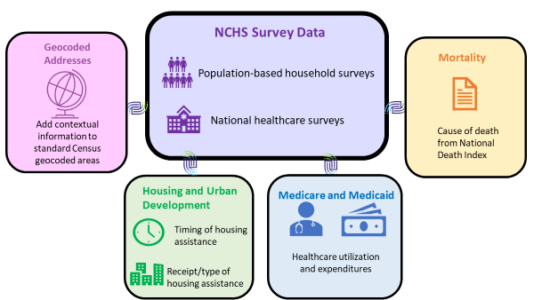
NCHS Data Linkage Program
Linking data can provide policy-relevant information in an efficient way
NCHS links its surveys to administrative data sources using personally identifiable information (PII)
NCHS also geocodes its surveys to facilitate merging of contextual variables

Slide 10
New Developments in the Data Linkage Program: Partnerships are Key
New data sources, linkages
Department of Veterans Affairs health and benefits data
CMS’ Transformed Medicaid Statistical Information System (T-MSIS)
Updated linkage with ESRD data
Methodologies for expanding access while protecting privacy
PPRL
Synthetic Data files
Leveraging data to improve administrative data on race and ethnicity
New partnership with Georgia Tech Research Institute will inform content of publicly available linked data files

Slide 11
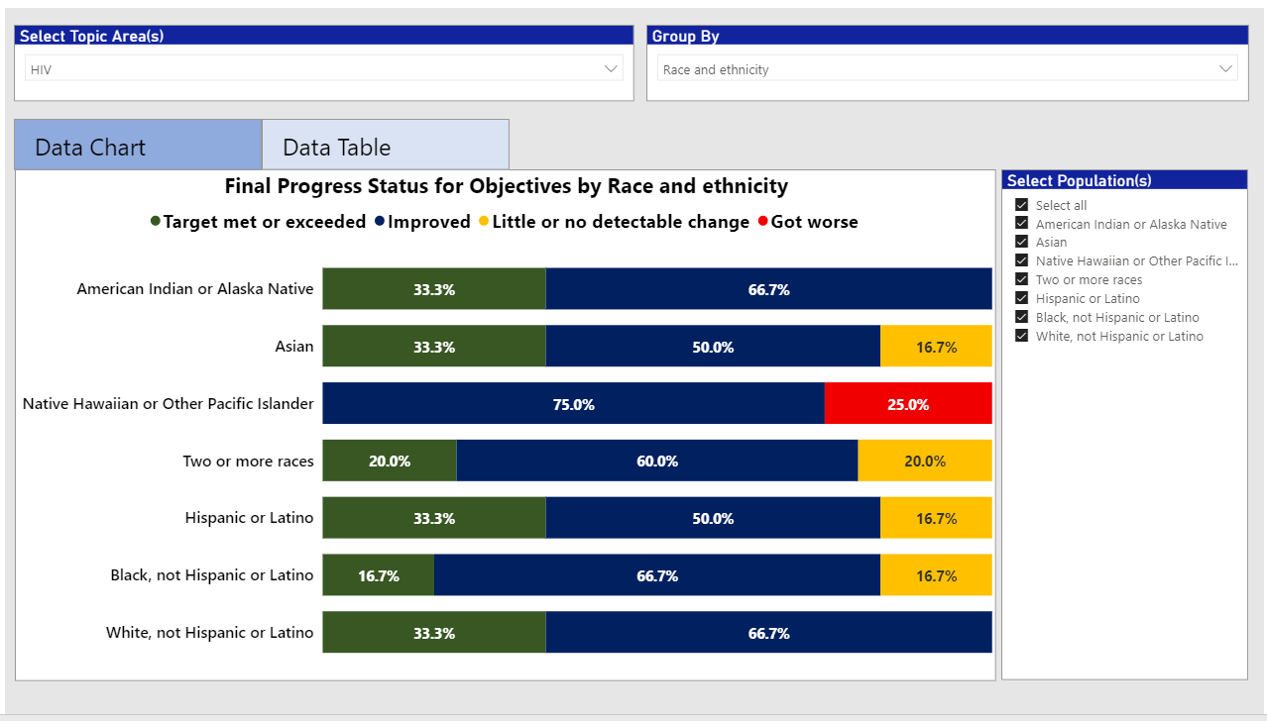
Enhancing Analytic Tools for Health Equity

Slide 12
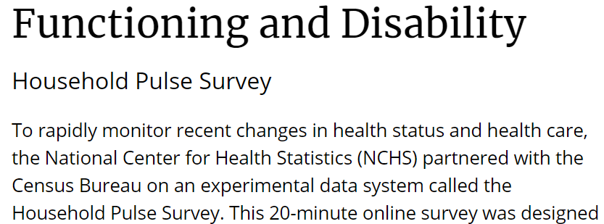
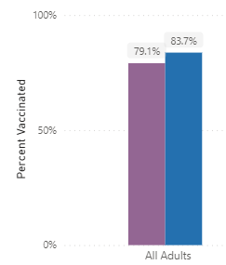
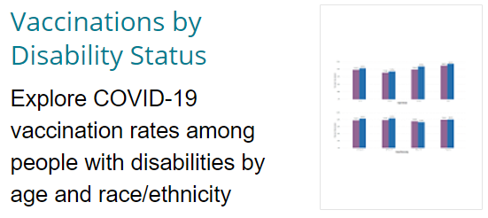
Informing Health Equity Priorities: Ensure Disability Inclusion
Washington Group Short Set measures in Pulse
NCHS and CDC web pages feature data
Disparities in vaccination, mental health, access and utilization
Anxiety and Depression
Mental Health Care
Health Insurance Coverage
Access to Health Care
Telemedicine Use

Slide 13
Goal 3: Build on Workforce, Operational Excellence Strengthen workforce management Improve professional advancement, development, leadership Improve coordination, collaboration, internal communication

Slide 14
Selected Professional Development and Collaborative Opportunities
COVID deployments
Cross coverage, cross training, developmental assignments
Mentoring programs: NCHS, ICSP, HHS
Health Communication Early Career Certificate Program
Data Science Upskilling Program
Data Science Certificate Program
Long term education
NCHS Data Visualization Group
Heath Equity and Disparities Interest Group
Invited Presentations

Slide 15
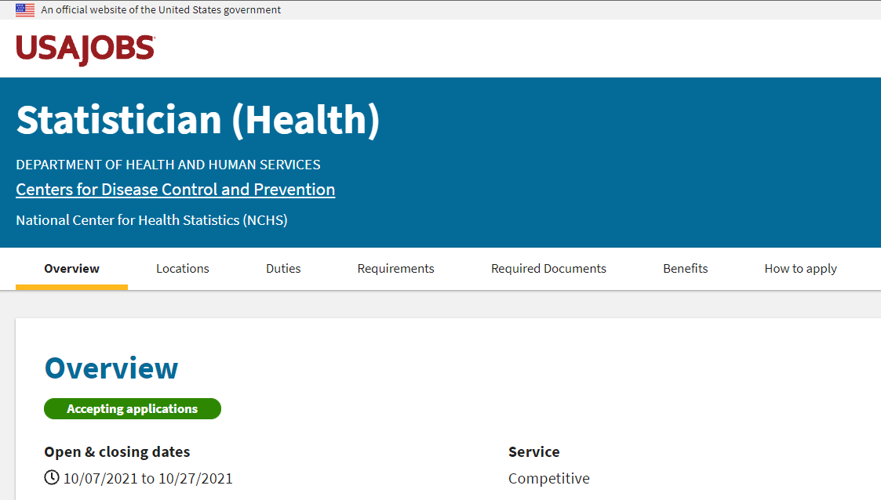
Recruiting New Staff: Methodologists
The vacancy number is HHS-CDC-DH-22-11257013 and is open from 10/07/2021 through 10/27/2021. The vacancy announcement can be found at: https://www.usajobs.gov/GetJob/ViewDetails/616727400

Slide 16
Thank you!

