Slide 1
Board of Scientific Counselors NCHS Strategic Planning
Brian C. Moyer, Ph.D., NCHS Director
January 27, 2021

Slide 2
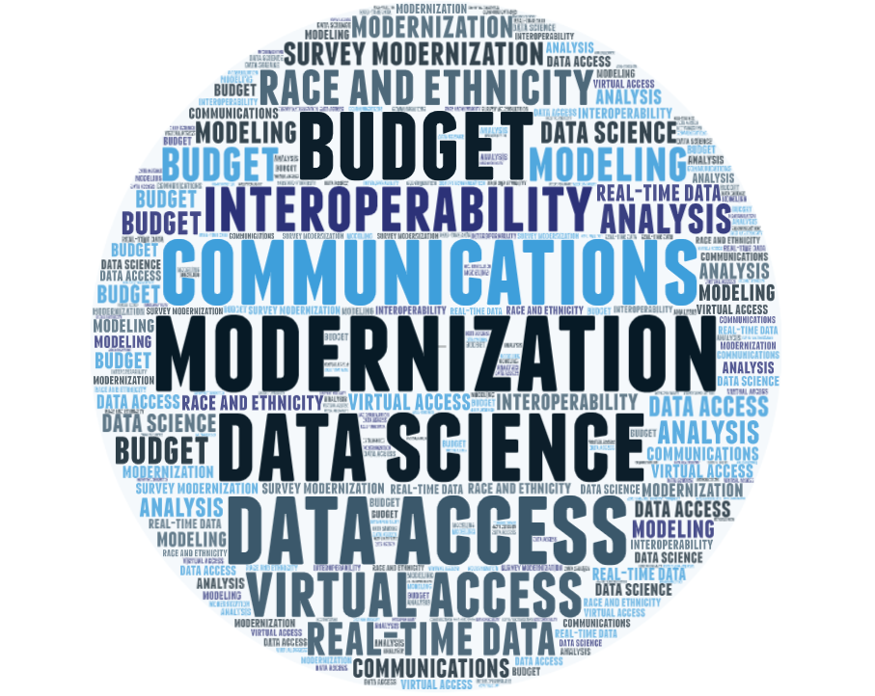
Strategic Planning Process

Slide 3
Case Studies and Beyond
Remote Data Access
Internal Communications
Disclosure Risk Assessment

Slide 4
NCHS: State of Data Science
Board of Scientific Counselors
1/27/2021
Chief Data Scientist
Travis Hoppe, PhD

Slide 5
What is “data science”? NIST: Data science is the empirical synthesis of actionable knowledge from raw data through the complete data lifecycle process

Slide 6
What is “data science”? NIST: Data science is the empirical synthesis of actionable knowledge from raw data through the complete data lifecycle process What does data science mean for NCHS? Scale Sustainability Automation Subject matter expertise Collaboration Culture change

Slide 7
How do we get there?
Notes:
How do we get there? How do we move data science forwards? How do we identify and address the problems along the way? We are thinking deeply about these problems!

Slide 8
Three programs
Strategic planning: Data Science Case Study
Guide NCHS over next 5-10 years
Data Modernization Initiative (DMI)
Management of CDC-wide effort to modernize
Innovation group
Survey, inspire, and encourage Data Science projects

Slide 9
Staff-run Innovation Breakout Sessions AI & Machine Learning Data Modernization Engagement Privacy & Disclosure API implementation Consolidated Statistical Platform (CSP)

Slide 10
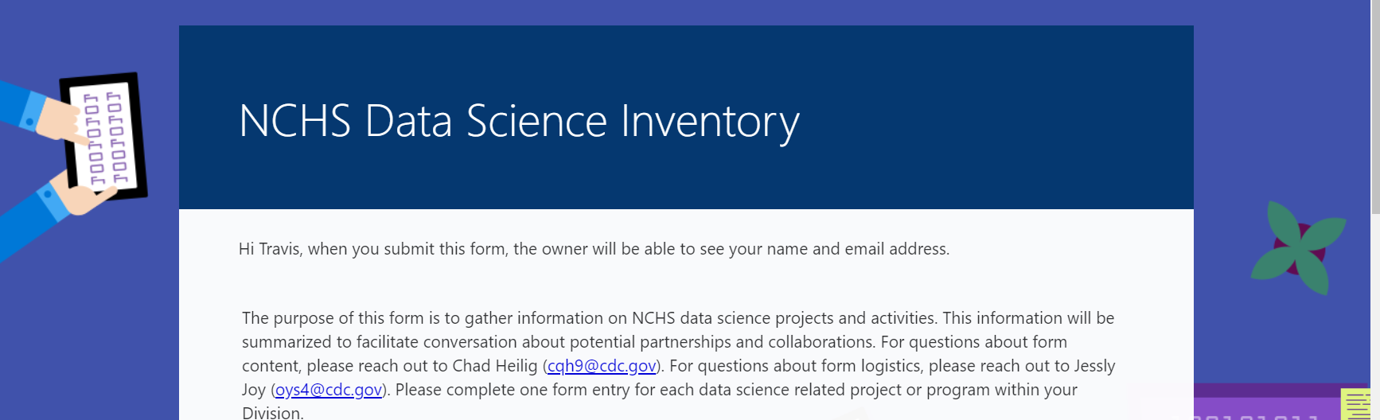
NCHS 2020 Innovation survey
Broaden perspective on the range of activities within the Center
Learn about concrete projects underway
Identify new cross-center collaborations
Identify ongoing and prospective R&D within the Center

Slide 11
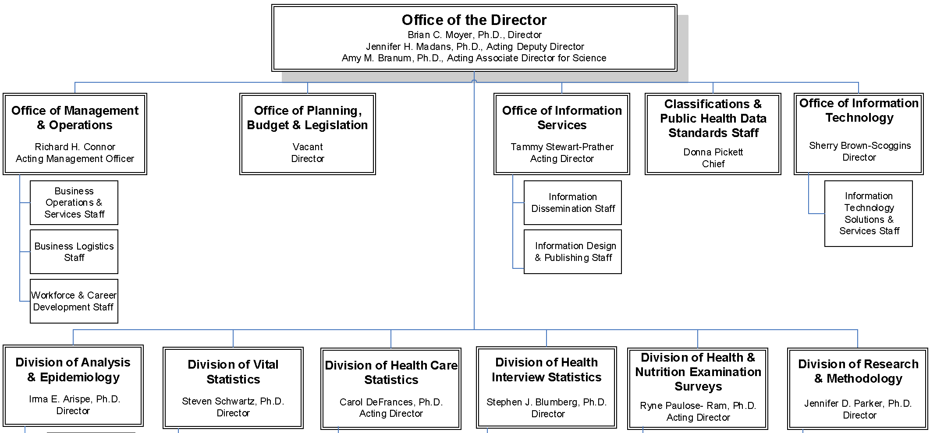
Responses per division (72 total)
3
3
15
6
6
8
16
15

Slide 12
Data Analytics multi-response question, single responses omitted
Data Science is already active in the Center

Slide 13
Activity Type multi-response question, single responses omitted
Viz, linkage, privacy, pipelines, and more!

Slide 14
Data Output multi-response question, single responses omitted
Different outputs, different stakeholders

Slide 15
Active highlights

Slide 16
Health, US Redesign
Topic based taxonomy to organize data, report key findings across NCHS major data systems, and a development of a robust API.
Small Area Estimation for Cancer Risk
Hierarchical Bayesian model to produce county-level estimates of cancer screening rates, current/former smoking prevalence, and hysterectomy prevalence. Combines information from the National Health Interview Survey (NHIS) and the Behavioral Risk Factors Surveillance Survey (BRFSS).

Slide 17
Natural Language Processing to classify drowning deaths
Identification of Opioid-Involved Health Outcomes
Make use of all available structured and unstructured data from the National Hospital Care Survey (NHCS), the National Death Index (NDI), and the National Vital Statistics System restricted mortality data (NVSS-M) to identify specific opioids (e.g., fentanyl and heroin) involved in outcomes such as drug-related hospital visits and drug poisoning deaths.
Ascertain places of drowning using literal text fields from death certificate records received from the National Vital Statistics System, Mortality (NVSS-M) using modern Natural Language Processing (NLP).

Slide 18
Nowcasting and Geospatial Analyses
Tools and analytic methods from NVSS (Vital Statistics) data to provide more accurate estimates of COVID-19 mortality at the state and county-level in near-real time, mitigating the impact of reporting delays.
Enhancing the identification of COVID-19 deaths
Identify COVID-19 deaths from unstructured text to enhance COVID-19 surveillance using the provisional mortality data.
Notes:
Image credit: Sam Varghese. Submitted for United Nations Global Call Out To Creatives - help stop the spread of COVID-19.

Slide 19
Expanding beyond
traditional statistics

Slide 20
New areas of growth
Predictive analytics: small area estimations, nowcasting, …
Classification tasks: EHR, RANDS, …
Remote Access: public APIs, data enclaves, …
Named entity recognition: opioids, ICD-10 coding, …
Differential privacy: synthetic data, federated learning, …
New datasets: DXA, PAM, Retinal imaging, …
Bibliometric analysis: NCHS publications, reports, and linked data, and social media engagement

Slide 21
NCHS: State of Data Science
Jennifer Parker
Director
Division of Research and Methodology

Slide 22
Three programs
Strategic planning: Data Science Case Study
Guide NCHS over next 5-10 years
Data Modernization Initiative (DMI)
Management of CDC-wide effort to modernize
Innovation group
Survey, inspire, and encourage Data Science projects

Slide 23
Strategic planning: Data Science Case Study
Identify connections and opportunities of Data Science Innovations and possibilities with HHS priorities, agency goals, division requirements and the varied needs of our NCHS data users and stake-holders
Promote grassroots ideas, NCHS-wide engagement and staff development
Investigate barriers and solutions
How can we manage risks?
New methods may depart from usual processes and be less transparent
Outputs may be sensitive to assumptions and require revisions or updates

