Slide 1
2018 Mortality Statistics Released
Released on January 30, 2020
Reports released in conjunction with data files - life expectancy, drug overdose, and maternal mortality
First release of a maternal mortality rate in over 10 years
    Communications Strategy developed for the release of these data
    New website, visual abstracts, early notice to key stakeholders, blast emails on release, webinar for partners, the public
    Briefings for HHS, Congress, Media

Slide 2
Life Expectancy at Birth, by sex
Year | Total | Male | Female
2010 | 78.7 | 76.2 | 81.0
2011 | 78.7 | 76.3 | 81.1
2012 | 78.8 | 76.4 | 81.2
2013 | 78.8 | 76.4 | 81.2
2014 | 78.9 | 76.5 | 81.3
2015 | 78.7 | 76.3 | 81.1
2016 | 78.7 | 76.2 | 81.1
2017 | 78.6 | 76.1 | 81.1
2018* | 78.7 | 76.2 | 81.2
*The increase in life expectancy has been driven in part by the decrease in “unintentional injuries,” which includes drug overdose deaths.

Slide 3
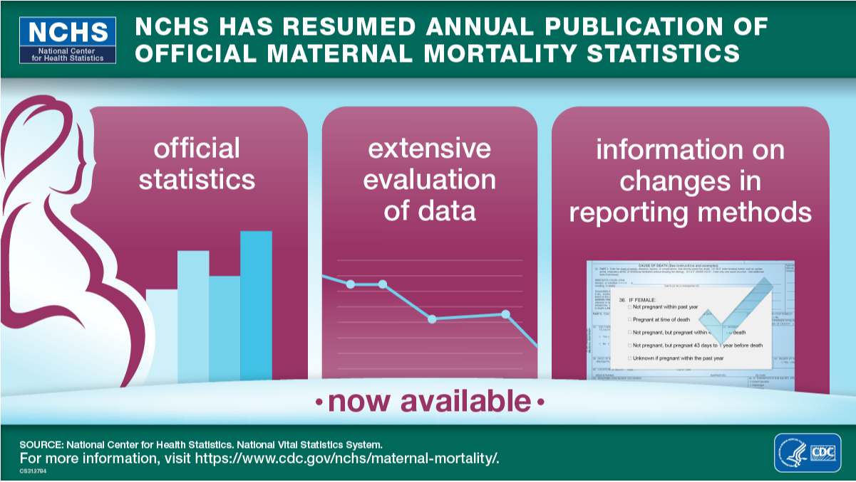

Slide 4
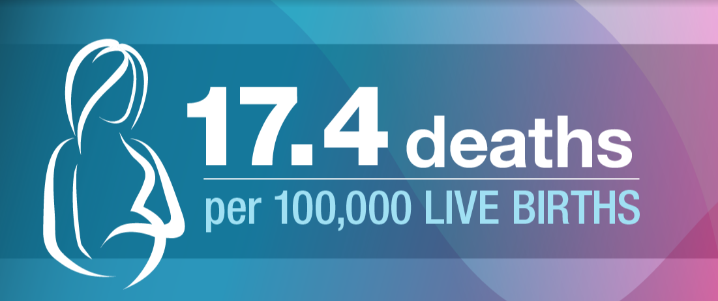
National Maternal Mortality Rate for 2018

Slide 5
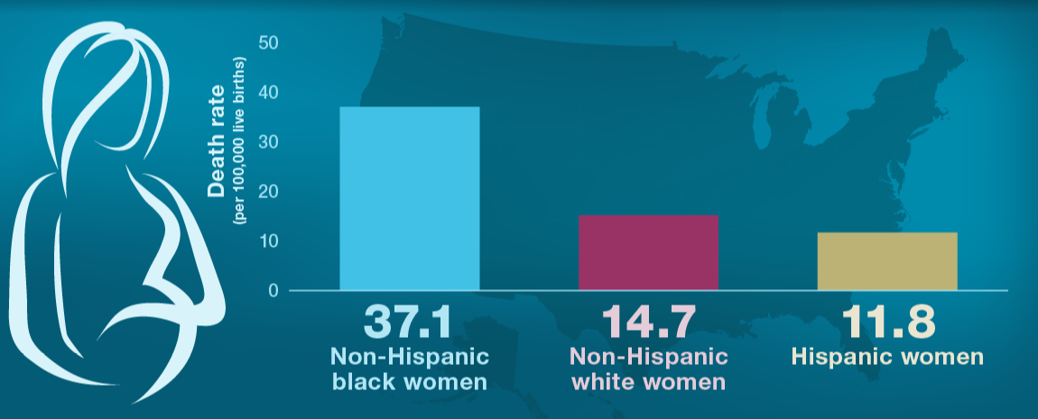
2018 Race Differences for Maternal Mortality

Slide 6
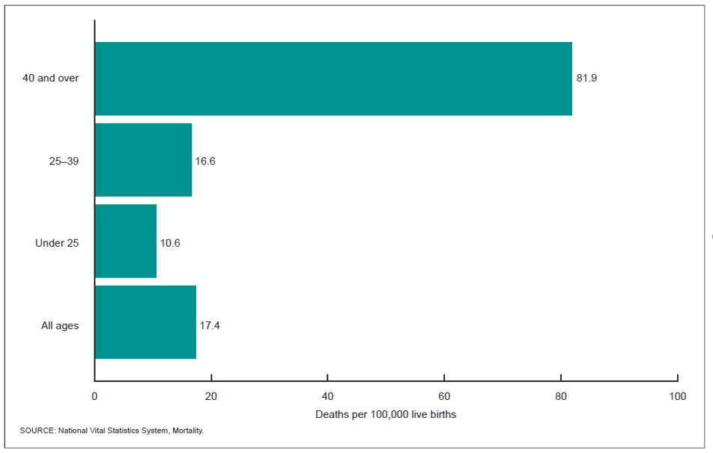
2018 Age Differences for Maternal Mortality

Slide 7
Maternal Mortality Rates without the Pregnancy Checkbox
NOTE: Trend line uses the coding method prior to 2003. Data for 2002 are included for comparison with the 2015–2018 values.

Slide 8
Results of Maternal Mortality Release Strategy
  Over 1,000 attended NCHS briefings
  Over 750 people attended the webinar
  Dedicated website drew 4,000 visitors on release date
  Significant increase in social media traffic
  NCHS visual abstracts widely used by others
  Significant media uptake
  Bottom line: people understood what we were saying

Slide 9
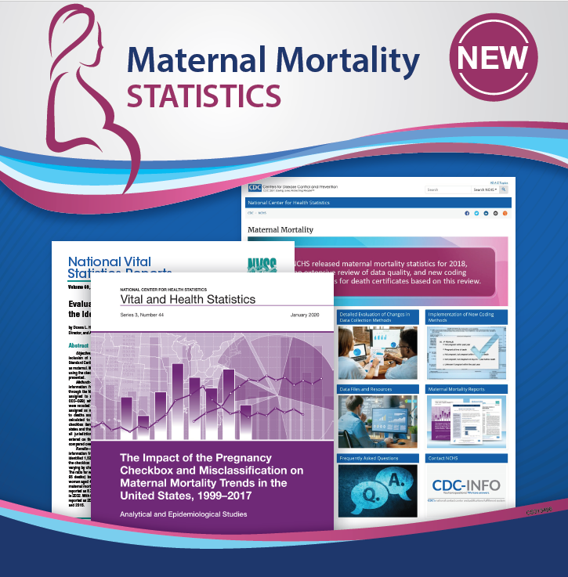
Maternal Mortality Reports and Products
https://www.cdc.gov/nchs/maternal-mortality/index.htm
https://www.cdc.gov/nchs/maternal-mortality/

