Slide 1
COVID-19 and NCHS Survey Programs

Slide 2
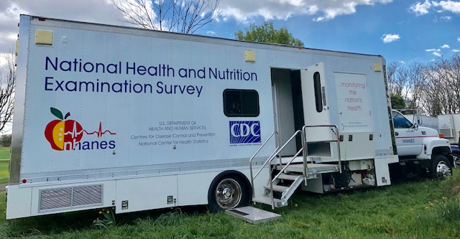
National Health and Nutrition Examination Survey (NHANES)
On March 16, 2020 data collection stopped due to COVID-19
NHANES mobile exam centers (MECs) are currently parked in Maryland
Data quality control, editing, and release of earlier years of data continues
NHANES truck with laboratory being used for COVID-19 testing in DC
Proposal for antibody testing of SARS-coV-2 using NHANES blood samples
Planning for resumption of NHANES data collection – potential impact on the redesign of NHANES to be fielded in 2023

Slide 3
Health Care Surveys
Looking at the possibility of delaying the start of fielding for many health care surveys (some were expected to start in May 2020)
May start induction interviews by phone as soon as possible
Considering adding COVID-19 questions to NAMCS, NHAMCS, NEHRS, NHCS and NPALS
including questions on the shortage of personal protective equipment, use of telemedicine, providers testing positive for COVID-19, across many health care surveys (outpatient, hospitals, and long-term care facilities)
Planning to analyze data from COVID questions to better understand the overall physician and hospital experience of the COVID response

Slide 4
National Health Interview Survey (NHIS)
Data Collection - March
In-person data collection suspended on March 19
All incomplete March cases transitioned to telephone contact only
March response rates were only two percentage points lower than February
Data Collection - April
No in-person data collection
All addresses contacted by phone only, if phone numbers could be identified
Good response rates from households contacted
Carefully evaluating bias due to households that could not be contacted

Slide 5
NHIS
Developed new questions to be added starting in July
Testing and hospitalization
Problems accessing non-COVID-related health care
Immunosuppression
Telehealth use
Social support
Collaborated with Census Bureau to add questions to Household Pulse survey
Anxiety and depression
Health insurance coverage
Problems accessing non-COVID-related health care
Collaborated with BLS to add question to Current Population Survey
Problems accessing non-COVID-related health care

Slide 6
Research and Methodology: COVID-19 Response
Research Data Center (RDC)
NCHS RDC is closed to researchers
Collaborating Center for Questionnaire Design and Evaluation Research
Cognitive interviewing has stopped but exploring ways to conduct virtual interviews
Research and Development Survey (RANDS) – COVID
Goal – to determine if RANDS can provide information on the public’s understanding of, response to, and health impacts from COVID-19

