Slide 1
Health, United States
Redesign Update
Speakers
Irma Arispe, PhD
Renee Gindi, PhD
Florence Lee, MPH
BSC Meeting
January 27, 2021
Zoom

Slide 2

Health, United States
Legislatively mandated annual report on health to the President and Congress
Covers four subject areas using 20+ government, private, and global sources
  Health status and determinants
  Health care utilization
  Health care resources
  Health care expenditures and payers

Slide 3
Health, United States Redesign Goals
Goals
  Increase timeliness
  Increase relevance to key stakeholders
  Increase audience awareness and use
Design questions
  What formats should be used to share information?
  What does a web-first product look like?
  How do we modernize data access?

Slide 4
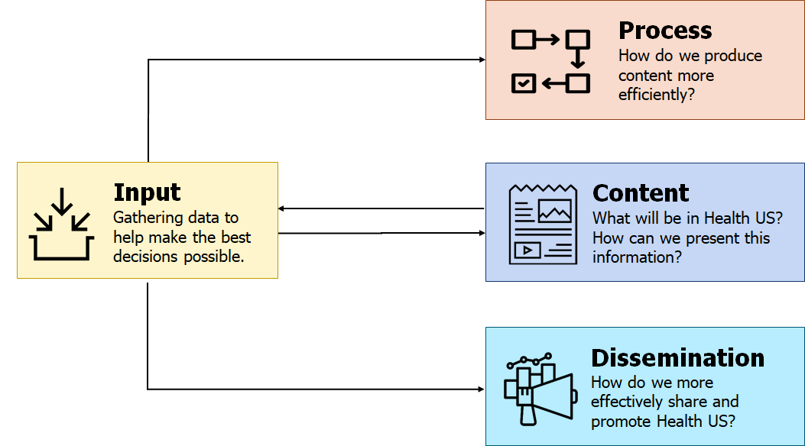
Health US Redesign Process

Slide 5







Health US Redesign Process Input Projects
May 2019–May 2020
Input
Gathering data to help make the best decisions possible.
Web user survey
Literature review
Stakeholder interviews
Market analysis
Web analytics
Audience research

Slide 6
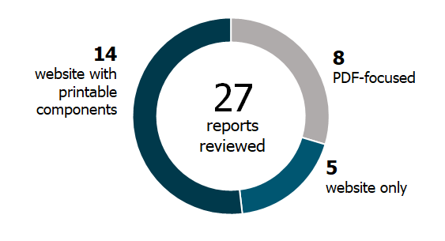
What format should be used to share information?
Area of exploration
For researchers:
PDF is good for in-depth reading and can be saved later as a lasting resource.
HTML is good for immediate discovery of content (search) and linking to additional information.
—Aalbersberg (2013)
MARKET
AUDIENCE
Over half of the products with a report component were optimized for online display. Many of these still had PDF components.
“Get away from the PDF format because it’s not searchable and won’t be retrieved in Google searches.”
INTERVIEW

Slide 7
Focus on building an online product
Design solution

Slide 8
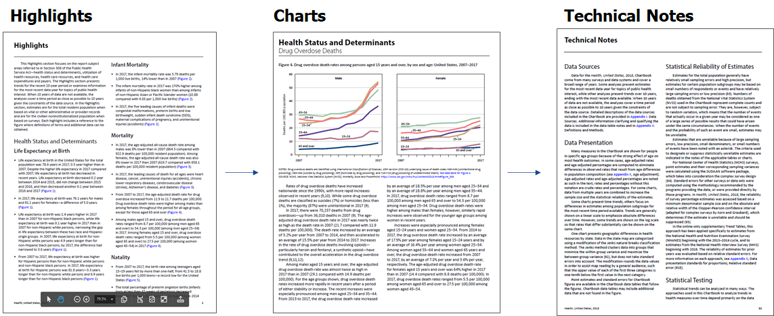
Print and PDF users move through content by section

Slide 9
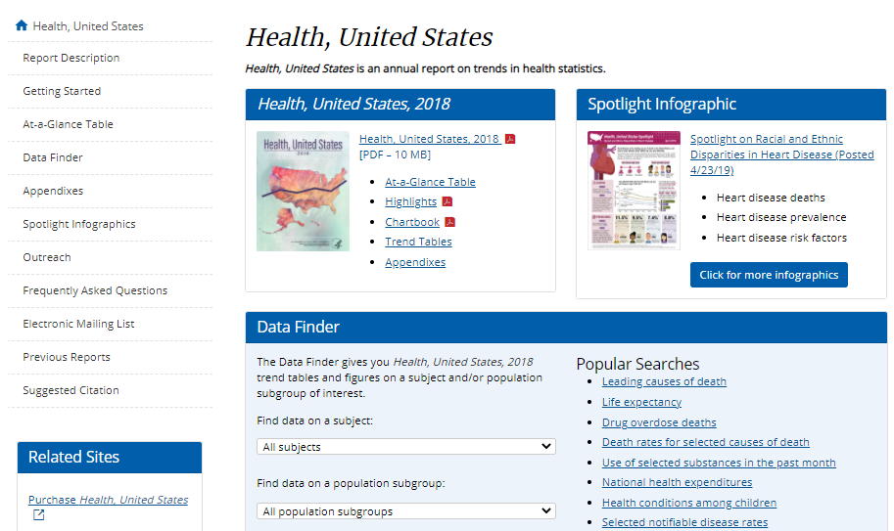
Current organization of website reflects print and PDF philosophy

Slide 10
What does a web-first product look like?
Area of exploration
Interested in a “table of contents” of health data by topic, from which a user can click into topics in any of the health reports, and information would be indexed in a way that one could look at the topic and go straight to the data rather than wading through the PDF reports.
“Researchers do not frequently use author names; rather, keyword searching, followed by detailed browsing through very long results lists, are more frequent strategies [….] Other social scientists search by short keyword queries or social construct.”
—Gregory (2019)
INTERVIEW
AUDIENCE
Source content was organized by topic based on their own market analysis. They suggested we do the same.
Public Affairs Office directs reporters to our Data Finder to look at the dropdown menu. They also expressed a desire for a more topic-driven dissemination approach.
INTERVIEW
INTERVIEW

Slide 11
Organize more by topic, less by report section
Design solution

Slide 12
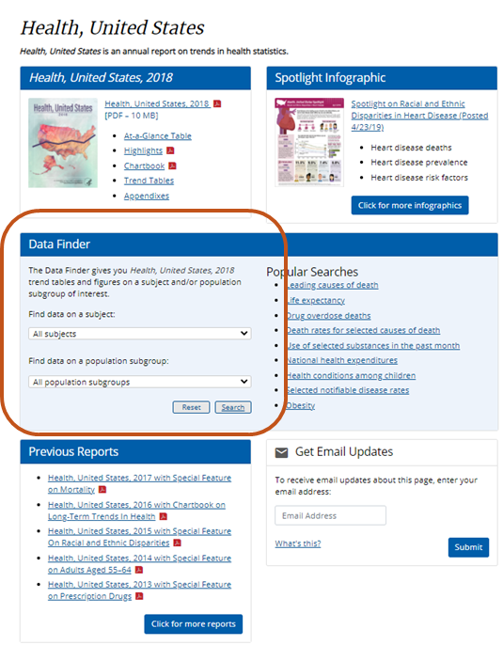
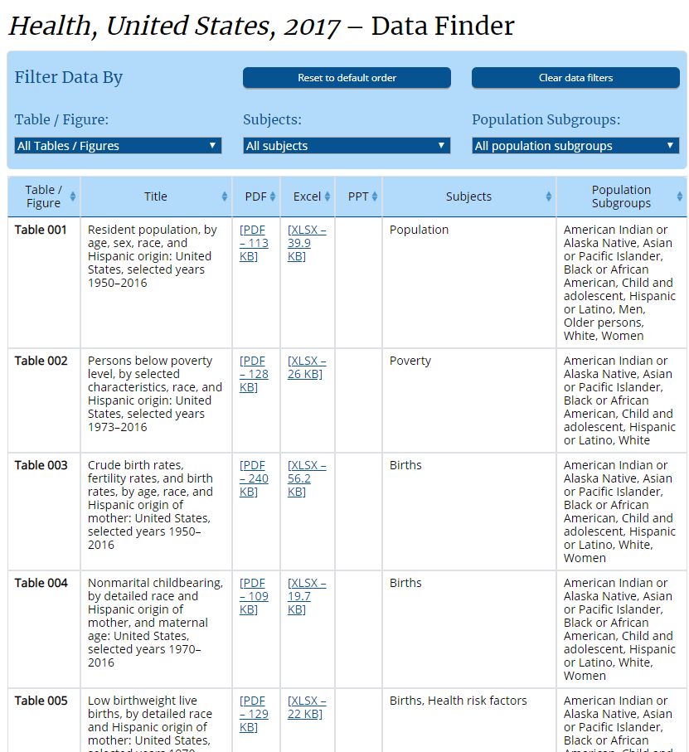
Health United States Data Finder

Slide 13
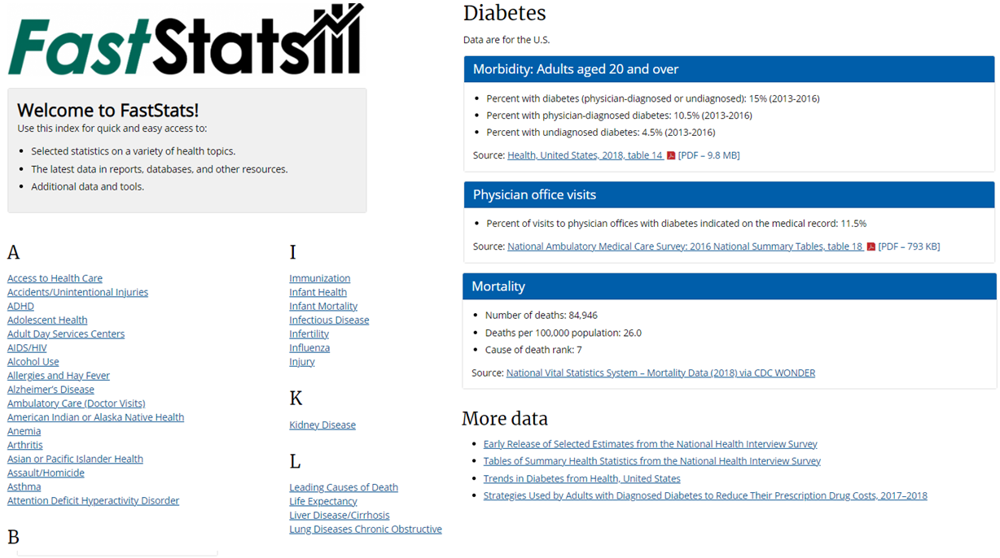
NCHS FastStats Program

Slide 14
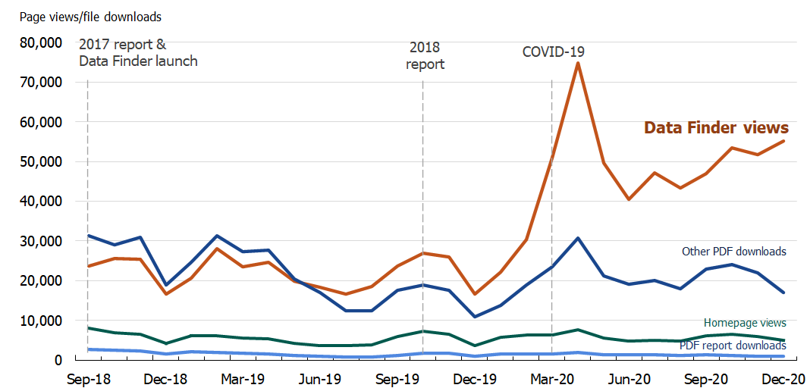
Views to topic-based Data Finder outpaced PDF downloads starting with release of Health US 2018.
WEB

Slide 15
Create a topic-based
Health, United States website
What’s next?

Slide 16
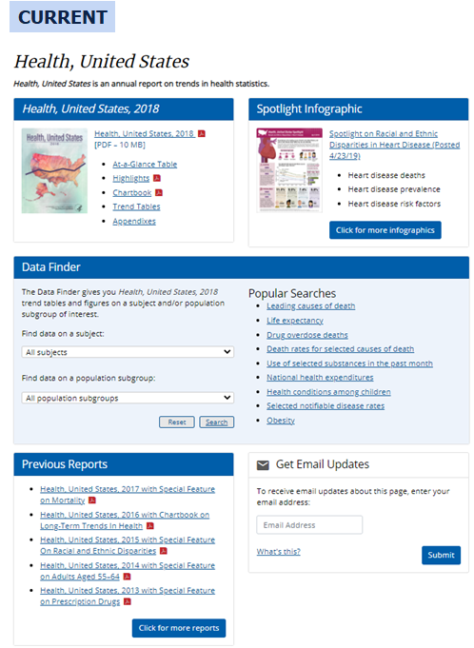
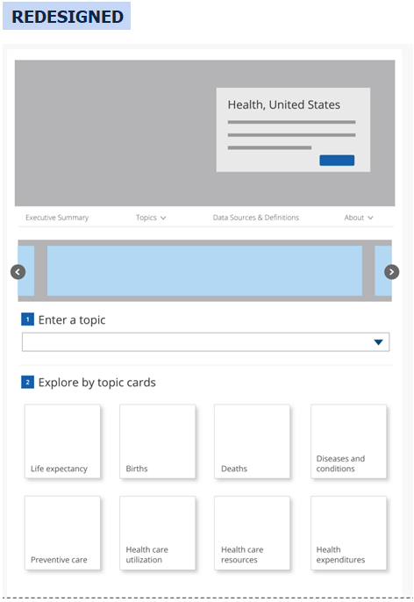
Current and Redesign Front Page

Slide 17
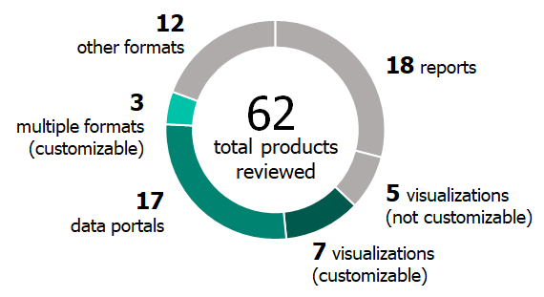
How do we modernize data access?
Area of exploration
Stakeholders mentioned a preference for creating custom views of the data.
“Website-driven and interactive”
“Things that are maximally flexible. Picking variables in interactive Excel spreadsheets with details is really useful.”
“Interactivity to create user-defined tables, very simple in technical terminology.”
MARKET
INTERVIEW
~45% of the data products reviewed gave users the ability to find or explore the data dynamically.

Slide 18
Add interactivity for customized exploration
Design solution

Slide 19
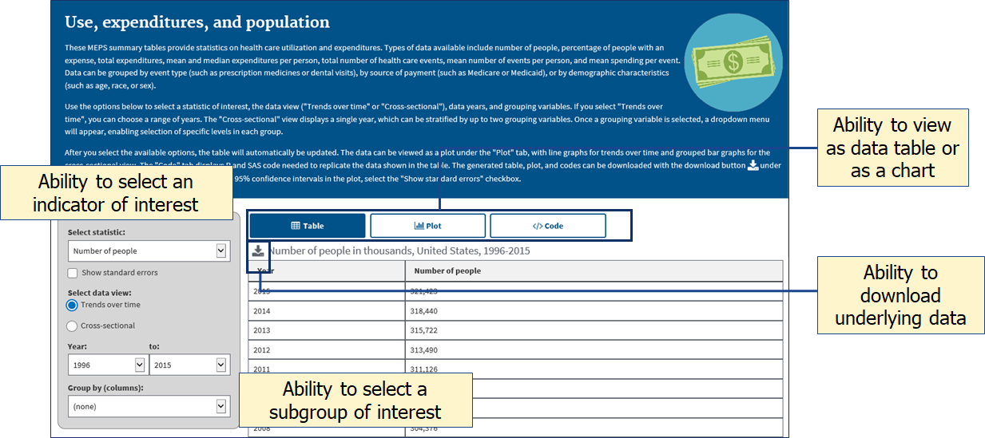
AHRQ MEPS Summary Tables
https://meps.ahrq.gov/mepstrends/home/index.html
MARKET

Slide 20
Transform trend tables into machine-readable datasets
What’s next?

Slide 21
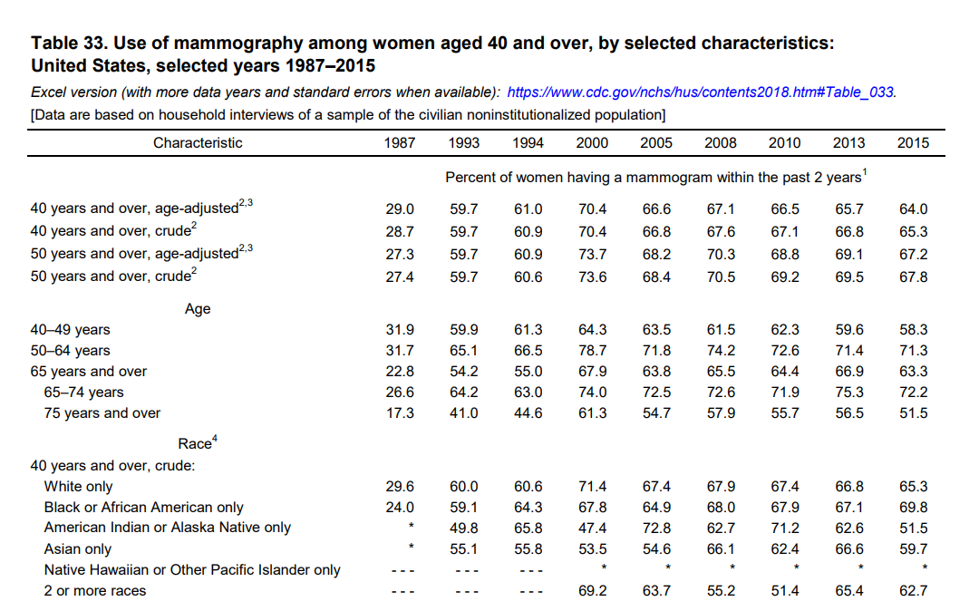
Health US Trend Table (PDF)

Slide 22
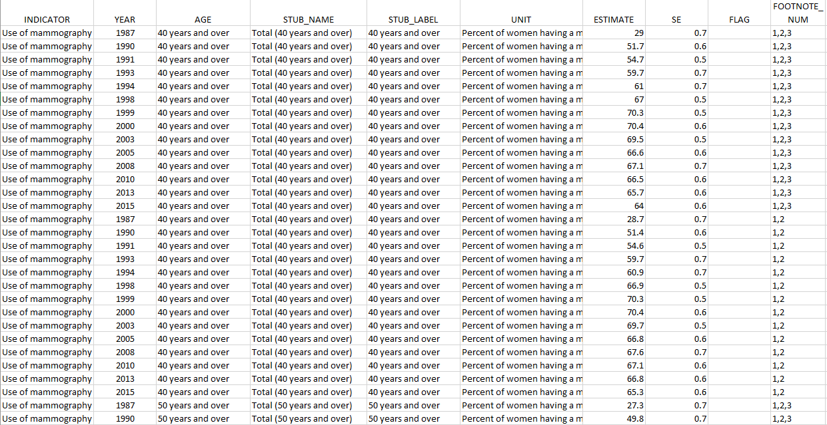
Health US Trend Table (Machine readable)

Slide 23
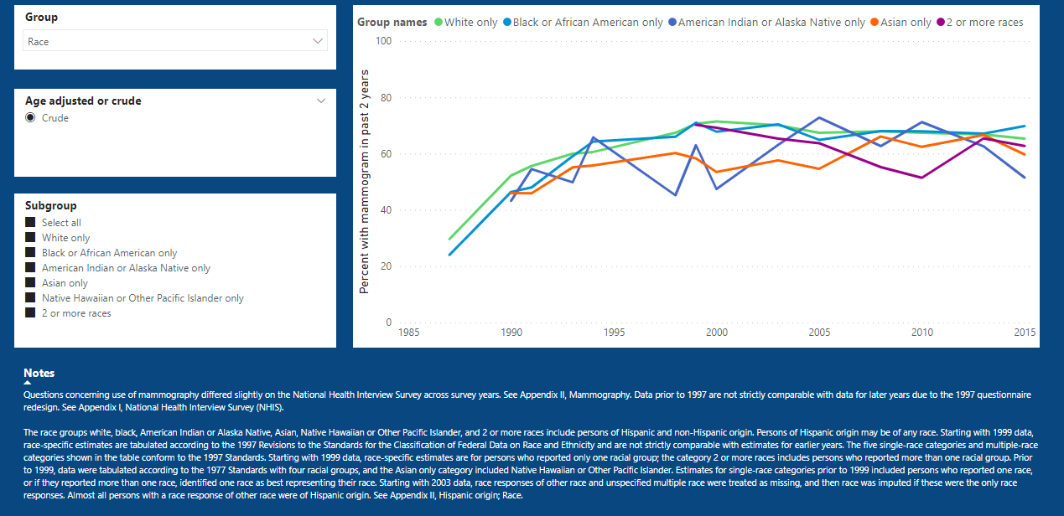
Health US Trend Table (Visualization)
Make data available via interactive tool on the NCHS website

Slide 24
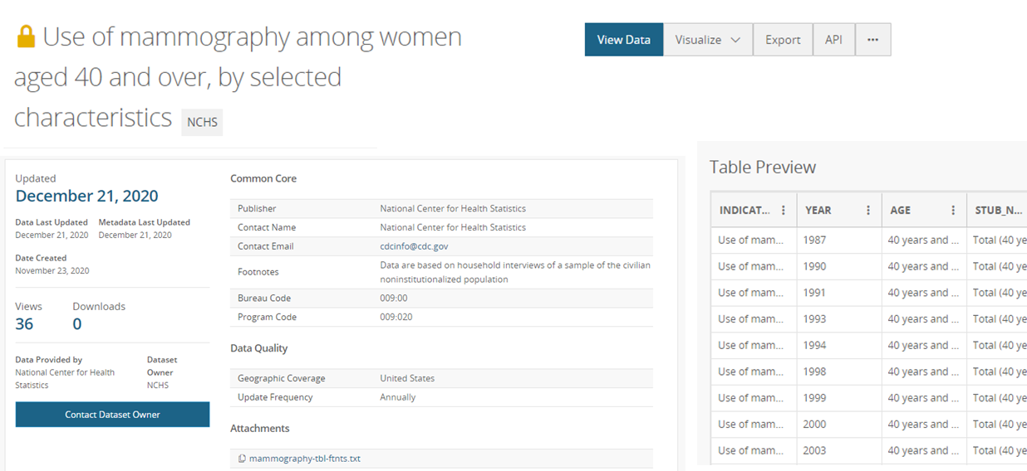
Make data available on open data platforms (data.cdc.gov)

Slide 25
Health US Redesign Process

Slide 26
Questions?

