Slide 1
NATIONAL HEALTH INTERVIEW SURVEY:
Release of 2019 Early Release Program Estimates
Stephen Blumberg, PhD
Director, Division of Health Interview Statistics
Tina Norris, PhD
Data Scientist, Division of Health Interview Statistics
NCHS Board of Scientific Counselors Meeting
September 18, 2020

Slide 2

Goals of the 2019 NHIS Questionnaire Redesign
Improve the relevance of covered health topics, better meeting the needs of DHHS and other data users
Harmonize overlapping content with other federal heath surveys
Reduce respondent burden and improve data quality
Shorten questionnaire and reduce variation in interview times
Eliminate or reduce content better covered by other methods
Establish a long-term structure of periodic content

Slide 3
September 2020 – A Momentous Month for NHIS
Sept 9: Early release of estimates from July-December 2019 and
January-March 2020
Sept 23: Release of 2019 public use data files and related documentation
Sept 23: Release of 4 NCHS Data Briefs on symptoms of anxiety and
depression and on mental health treatment
Sept 30: Release of NCHS Data Brief on reasons for being uninsured in
the United States for adults 18-64

Slide 4
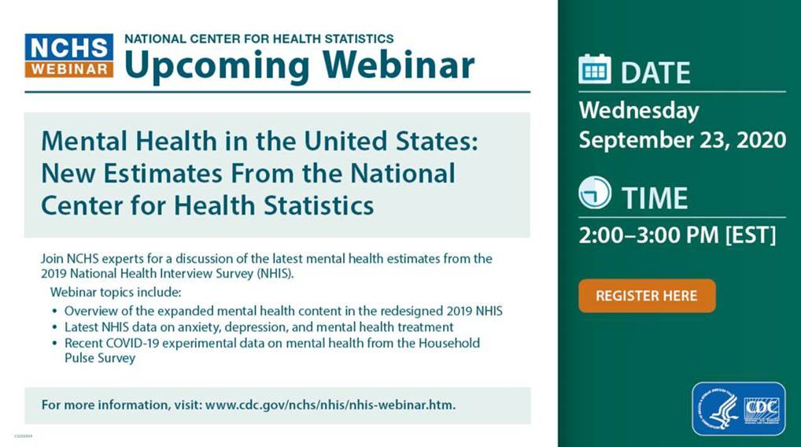

Slide 5
NHIS Early Release (ER) Program
Purpose: To position the NHIS for the surveillance of sentinel health events
Vision: Release less-than-annual estimates of a small set of key health indicators within just a few months of data collection
First product released in April 2001
Provides analytic reports and tables and preliminary microdata on an expedited schedule
Early Release products are developed prior to final processing and weighting to provide early access to the most recent information

Slide 6
NHIS Early Release (ER) Program, 2019 and beyond
Available every three months:
  Updated data query tool with quarterly estimates for 18 key health indicators
  Web tables with quarterly health insurance estimates
  Preliminary microdata files (in the RDC)
Available every six months:
  Updated data query tool with half-year estimates for the 18 key indicators by key demographics
  A report on health insurance coverage
  A report on wireless substitution

Slide 7
Early Release Indicators for Redesigned NHIS
Health Insurance Coverage (18-64 years)
  Lack of health insurance
  Public health plan coverage
  Private health insurance coverage
Health Status
  Disability status
  Workdays missed due to health
  Diagnosed hypertension
  Asthma episode
  Regularly experience chronic pain
  Regularly felt worried, nervous, or anxious
  Regularly felt depressed
Health Behaviors
  Current cigarette smoking
  Current electronic cigarette use
Health Care Access
  Did not get needed medical care due to cost
  Did not take medication as prescribed to reduce costs
  Did not get needed mental health care due to cost
Health Care Service Utilization
  Doctor visit
  Hospital emergency department visit
  Influenza vaccination
  Blood pressure check
  Counseled by a mental health professional
  Dental exam or cleaning
Telephone Ownership
  Adults living in wireless-only households

Slide 8
The September 9, 2020 Early Release
Key Health Indicators
  Interactive quarterly estimates from the January-December 2019 NHIS and January-March 2020 NHIS
  Interactive biannual estimates from the January-December 2019 NHIS
  Tables of quarterly and annual estimates from the 2019 NHIS
Health Insurance Coverage
  Early release of estimates from the 2019 NHIS (report)
  Tables of quarterly estimates from the January-December 2019 NHIS
  Tables of quarterly estimates from the January-March 2020 NHIS
Wireless Substitution
  Early release of estimates from the July-December 2019 NHIS (report)
Other
  Preliminary evaluation of the impact of the 2019 NHIS questionnaire redesign and weighting adjustments on Early Release Program estimates (working paper)
  Preliminary microdata files

Slide 9


Interactive Early Release Data Query Systems: https://www.cdc.gov/nchs/nhis/releases.htm

Slide 10
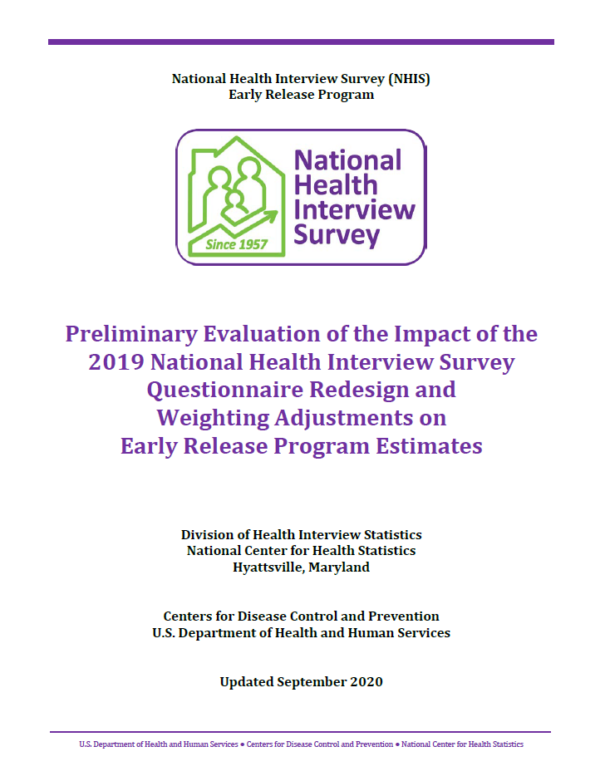
Working Paper
To examine whether differences observed between 2018 and 2019 may be due to:
  Changes from the questionnaire design
  Changes in the weighting approach
  Real change

Slide 11
Working Paper
Changes related to the questionnaire redesign
  Question wording
  Context effects
  Increased use of self-response
Evaluated by comparing estimates from a split sample in Q4/2018

Slide 12
Working Paper
Changes in the weighting approach
  Nonresponse adjustment now includes paradata
  Calibration now includes educational attainment, region, and urban/rural variables
Evaluated by weighting 2019 data using the old and new approach

Slide 13
Working Paper
Changes in the weighting approach
  Nonresponse adjustment now includes paradata
  Calibration now includes educational attainment, region, and urban/rural variables
Evaluated by weighting 2019 data using the old and new approach

Slide 17
Working Paper Results
Questionnaire design effects
  4 indicators
Weighting effects
  4 indicators
Both
  2 indicators
No impacts
  6 indicators
Large but not significant effects
  3 indicators

Slide 18
National Health Interview Survey and the Pandemic
Personal visits halted on March 19
Telephone contacts only from March 19 to June 30
  No impact on March response rates (~60%)
  Interviewers now spending time searching for phone numbers
  Response rates declined in April (~41%)
  Response rates rose slightly in May and June (~44%)
  Respondents were older and more likely to be college educated, own their home, and suburban

Slide 19
National Health Interview Survey and the Pandemic
Personal visits in limited areas resumed July 1
Telephone first approach
  July response rates increased slightly (~47%)
NHIS data collection changed again for August – December
  Personal visits in all areas permitted, but still telephone first
  Production sample size cut in half
  Interviewers are attempting to recontact 2019 sample adults by telephone

Slide 20
2020 National Health Interview Survey
Four different surveys,
same questionnaire
  Normal operations (January-March)
  Telephone only (April-June)
  Telephone first with reduced sample size (July-December)
  Sample adult followback survey (August-December)
Questions to ponder
  What are the most important things to consider before combining these datasets?
  Should we combine the followback data with the production data? If so, how?
  Should we incorporate additional nonresponse and calibration approaches?
  Should we release preliminary ER estimates before we have all the answers?

