Slide 1
BEYOND PULSE AND RANDS: Integrating Online Surveys into the National Health Interview Survey
Stephen Blumberg, PhD
Director, Division of Health Interview Statistics
Jennifer Parker, PhD
Director, Division of Research and Methodology
NCHS Board of Scientific Counselors Meeting
January 27, 2021

Slide 2
Providing Near-Real-Time COVID-19 Data with Experimental Online Surveys
Stephen J. Blumberg, Ph.D.
Presented to CDC Senior Leaders, November 17 and 23, 2020

Slide 3
NCHS Data Systems

Slide 4
National Health Interview Survey
“Gold standard” household health survey
Robust coverage of the population
Relatively high response rates (60%)
Professional Census Bureau interviewers
Extensive efforts to minimize error
Measurement errors
Coverage error
Nonresponse error
Processing errors

Slide 5
NHIS Early Release Program
Positions the NHIS for the surveillance of sentinel health events
Releases quarterly and biannual estimates of key health indicators within 6-9 months of data collection
January-March 2020 estimates were released in September
Estimates are developed prior to final processing and weighting
https://www.cdc.gov/nchs/nhis/releases.htm

Slide 6
Question for Today
Do you think augmenting NCHS in-person surveys with online surveys is the right strategy for producing data that are timely and responsive to changing data needs?

Slide 7
Household Pulse Survey
Purpose: To ascertain the impact of the pandemic on individuals and households
Health content: Anxiety, depression, mental health care use and unmet need, health insurance, delayed and foregone care due to pandemic
Sample: Email and cell-phone contact frames matched to Census Bureau’s Master Address File (MAF) records
Mode: Email and text invitations to take an online survey
Launched: April 23, 2020
Current sample size: Nearly 100,000 adults every 2 weeks
Response rate: About 10%

Slide 8
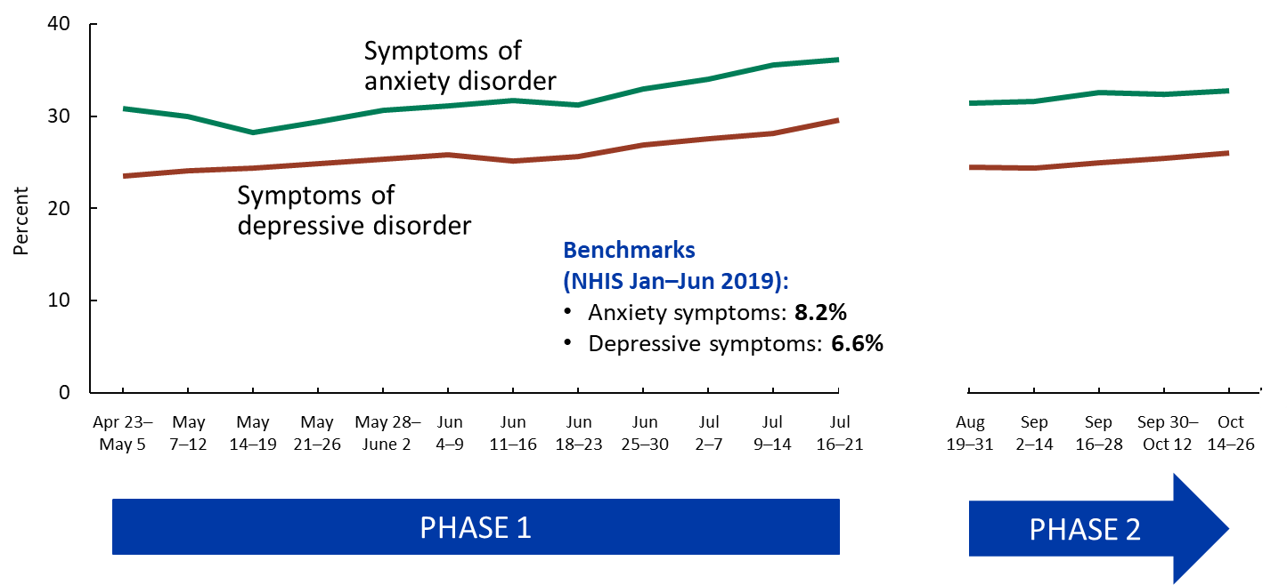
Symptoms of anxiety or depression: Household Pulse Survey, April 23 – October 26, 2020

Slide 9
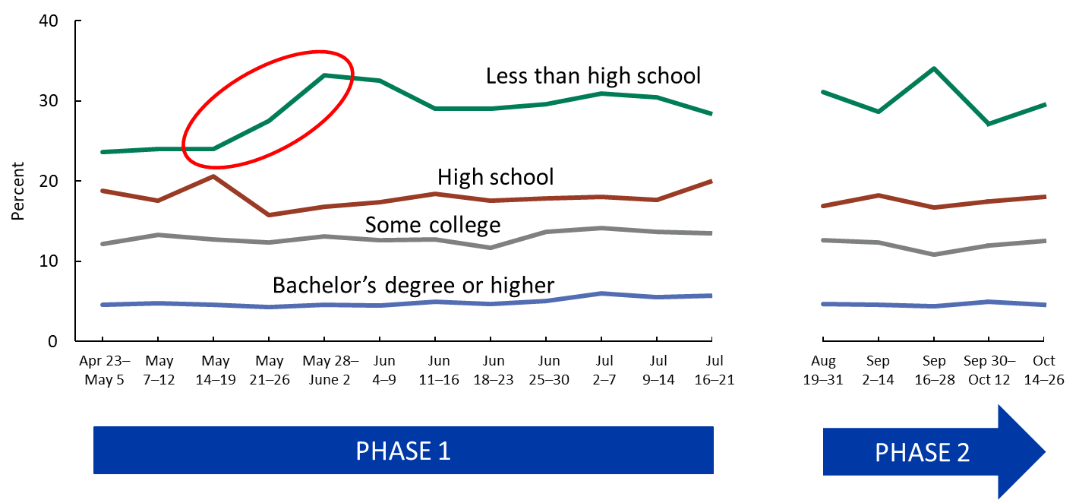
Uninsured adults, by education: Household Pulse Survey, April 23 – October 26, 2020

Slide 10
Hypothetical Data Collection and Release Schedule

Slide 11
RANDS – Research and Development Survey
Purpose: Methodological survey program that primarily uses web-based survey panels for evaluating measurement and estimation questions
RANDS COVID-19 content: Work loss due to illness, telemedicine, and reduced access to care
RANDS COVID-19 dates: June 9-July 6 (Round 1), August 3-20 (Round 2)
Sample: NORC AmeriSpeak panel, with both internet and phone panels
Sample size: 6,000 adults in each round
Completion rate (Round 1): 78%
Response rate (Round 1): 23%

Slide 12
Differences Between RANDS 1 and NHIS

Slide 13
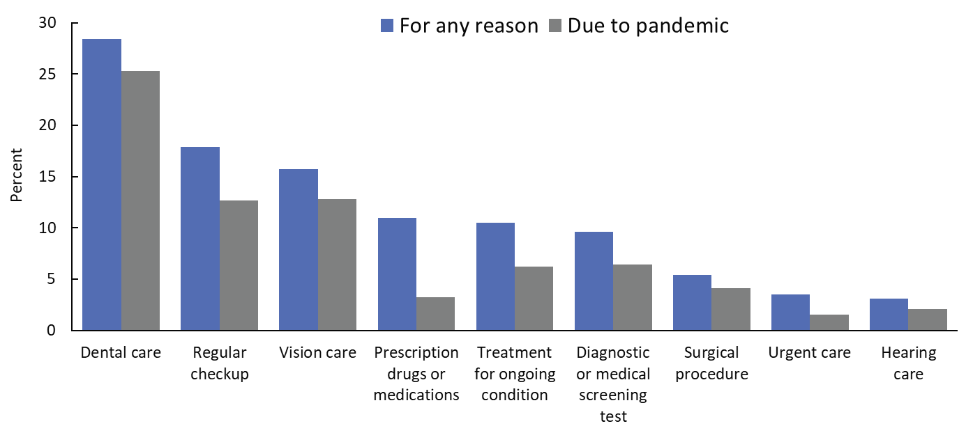
Unmet need for care in last 2 months, by type of care and reason for unmet need: RANDS, June 9 – July 6, 2020

Slide 14
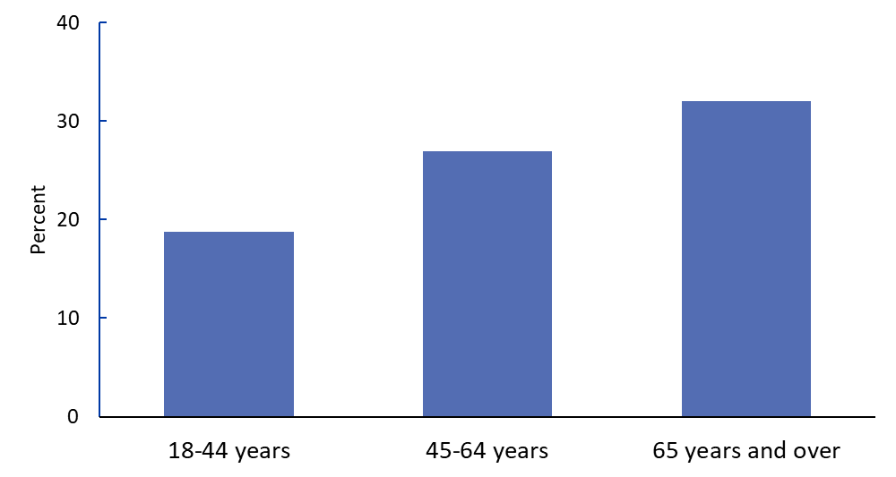
Scheduled one or more telemedicine appointments in last 2 months, by age: RANDS, June 9 – July 6, 2020

Slide 15
NCHS is Exploring Enhancing its Surveys with Supplemental Online Surveys
To advance question evaluation
providing insight into interpretation of NCHS survey results
To address emerging topics
that are not currently addressed by NCHS surveys
To include more targeted, detailed questions
when space is limited on NCHS surveys
To provide alternative mechanisms for production of timely estimates
when urgency is needed

Slide 16
Ongoing Modernization Work at NCHS
Creating the next generation of NCHS surveys
Understanding differences between RANDS and NHIS estimates by population subgroups and classes of health outcomes
Identifying new calibration methods for improving RANDS estimates using health and demographic benchmarks from NHIS
Exploring model-based estimates with multiple data sources

Slide 17
Questions for CDC Senior Leaders
How can we effectively communicate the differences in the quality of information provided from the various types of surveys we administer?
Do you think augmenting NCHS in-person surveys with alternative methods is the right strategy to produce closer-to-real-time data that are responsive to changing data needs?

Slide 18
What We Heard from CDC Senior Leaders
Value of timely data
Importance of NCHS having a mechanism for producing close-to-real-time data that are responsive to changing data needs
Concerns about quality of online survey data

Slide 19
PROPOSED: Commercial Panels for Online Quarterly Data Collection
Timely: Could provide either direct “advance estimates” or data for forecasts of key indicators, for publication within 1-2 months
Flexible: Could provide quick-turn-around estimates on novel and emerging topics
Extensible: Can also be used for question evaluation research and data quality assessments
But more methodological research is needed, for example:
Comparisons of direct estimates to NHIS estimates
Calibration methods to established benchmarks
Establishment of nowcasting and forecasting models
Head-to-head panel comparisons

Slide 20
Discussion Questions
Quality of Online Survey Estimates
Prioritization of Efforts to Improve Timeliness
Identification of Key Health Outcomes
Communicating Quality

Slide 21
Quality of Online Survey Estimates
Do you think augmenting NHIS with online surveys will yield estimates of sufficient quality for NCHS to stand behind?
What paths would you recommend to enhance quality and credibility?
One panel or many? Internet only or multi-mode?
Report direct estimates from online surveys? Or use online surveys with older NHIS data to estimate change and model a “nowcast” of the official estimate?
Report point estimates based on online survey data? Or use online surveys as just an early indication of direction of change?
Other options to consider?

Slide 22
Prioritization of Efforts to Improve Timeliness
Will more timely “advance estimates” increase credibility?
Would you recommend that quarterly data from commercial panels be a priority relative to producing ER estimates faster?
Advance estimates based on online surveys would stand up an ongoing mechanism for rapidly responding to changing data needs
Augmenting NHIS data with online survey data may enhance granularity of estimates in addition to timeliness
But relative to advance estimates, ER estimates are likely to be more accurate predicting the eventual final NHIS estimate

Slide 23
Value of More Timely Data from NHIS
ER estimates are now published 5-6 months after data collection
For which key indicators are more timely estimates most needed?

Slide 24
Communicating Quality
How can we effectively communicate the differences in the quality of information provided by different types of estimates?
The Census Bureau approach: “Experimental data”
RANDS during COVID-19: “Experimental Estimates”
How can we effectively communicate revisions or updates to estimates that may arise from new data or updated methods?

