Slide 1
FY 2020 DFC Non-Competing Continuation Application Workshop
White House Office of National Drug Control Policy (ONDCP)
in collaboration with the
Centers for Disease Control and Prevention (CDC)

Slide 2
ONDCP and CDC: Division of Responsibility
ONDCP is now partnering with CDC for the day to day management of the DFC and CARA grant programs
CDC’s National Center for Injury Prevention and Control (NCIPC) will serve as the day-to-day administrator of DFC and CARA grant programs
NCIPC currently funds drug overdose prevention programs in all 50 states, Washington DC, and four territories

Slide 3
Brief Overview
Brief Overview:
FY 2019 DFC-funded community coalitions currently in Years 1-4 and Years 6-9 must submit a non-competing continuation application.
FY 2020 DFC Non-Competing Continuation Application is found on Grants.gov
Notice of Funding Opportunity Number (NOFO):
CDC-RFA-CE20-2004

Slide 4
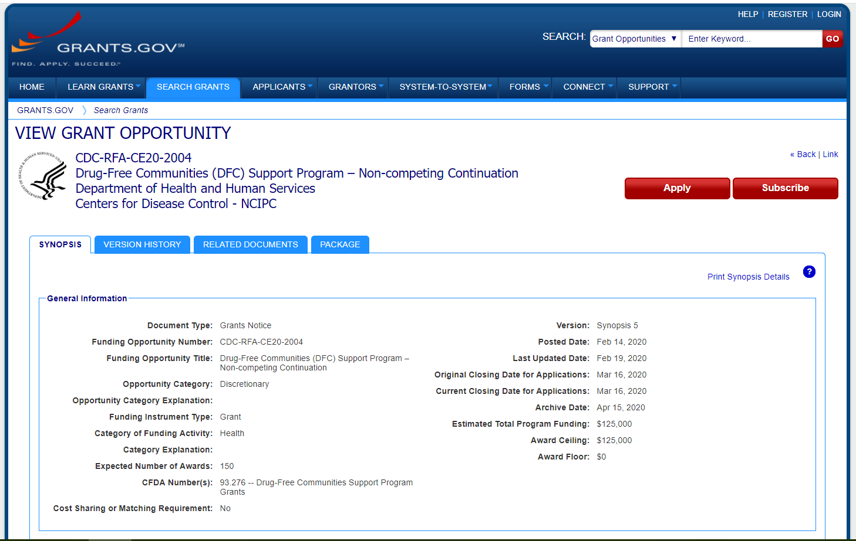
View of the Grant Opportunity Form
CDC-RFA-CE20-2004
Drug-Free Communities (DFC) SupportProgram - Non-Competing Continuation
Department of Health and Human Services
Centers for Disease Control - NCIPC

Slide 5
Frequently Asked Questions
Frequently Asked Questions

Slide 6
Deadlines
Deadlines:
For all recipients on the September 30 – September 29 Budget Period Cycle (recipients applying for Years 02-05 and Years 07-10), applications must be submitted by 3/16/2020, 11:59pm EST
For all recipients on the October 31 – October 30 Budget Period Cycle (only for recipients applying for Year 02 and Year 07 with this budget period on their current Notice of Award), applications must be submitted by 4/14/2020, 11:59pm EST
For all recipients on the December 31 – December 30 Budget Period Cycle (only for recipients applying for Year 02 and Year 07 with this budget period on their current Notice of Award), applications must be submitted by 6/15/2020, 11:59pm EST

Slide 7
Eligibility
Eligibility:
Drug-Free Communities (DFC) Support Program – Competing Continuation
SP-19-006
Drug-Free Communities (DFC) Support Program – New
SP-19-005
Drug-Free Communities Support Program – Competing Continuation
SP-18-003
Drug-Free Communities Support Program – New
SP-18-002
Drug-Free Communities (DFC) Support Program – Competing Continuation
SP-17-002
Drug-Free Communities (DFC) Support Program – New
SP-17-001
Drug-Free Communities (DFC) Support Program
SP-16-001

Slide 8
Required Contents of Application Packet
Required Contents of Application Packet:
SF-424 Application for Federal Domestic Assistance (online form)
SF-424A Budget Information-Non-Construction (online form)
Budget Justification (attachment)
Indirect Cost Rate Agreement (attachment)
Performance Narrative (12-Month Action Plan)
SF-LLL Disclosure of Lobbying Activities (online form)
Interim Federal Financial Report (FFR) SF-425 (attachment)
Attachment A: Checklist of Required Contents of Application Packet Section
Attachment B: Disclosure of Drug Free Communities (DFC) Support Program Coalition Information
CDC Risk Assessment Questionnaire

Slide 9
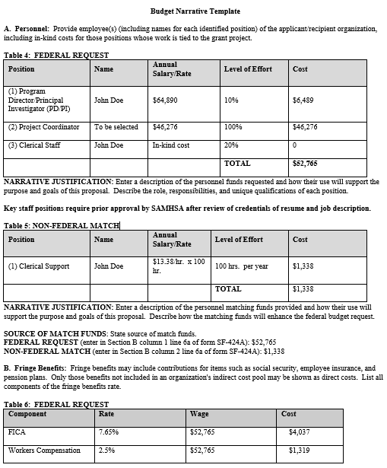
Budget Template
Budget Template:
Budget must be itemized
Proposed budget is reasonable and consistent with the purpose, objectives, and program strategy outlined in the project narrative
CDC’s budget preparation guidelines can be found at: www.cdc.gov/grants/documents/Budget-Preparation-Guidance.pdf

Slide 10
Application Submission
Application Submission:
CDC requires recipients to submit their non-competing continuation application, through www.grants.gov
If technical difficulties are encountered at www.grants.gov, applicants should contact Customer Service at www.grants.gov.
The www.grants.gov Contact Center is available 24 hours a day, 7 days a week, except federal holidays.
The Contact Center is available by phone at 1-800-518-4726 or by e-mail at support@grants.gov.
Active SAM and DUNS registrations are also required

Slide 11
NOFO Support
NOFO Support:
For questions specific to Notice of Funding Opportunity, Budget, Grant Application Package, or Match Requirements, email the CDC DFC unit:
DFC@cdc.gov
CDC DFC web page: www.cdc.gov/injury/fundedprograms/drug-free-communities/index.html

