Slide 1

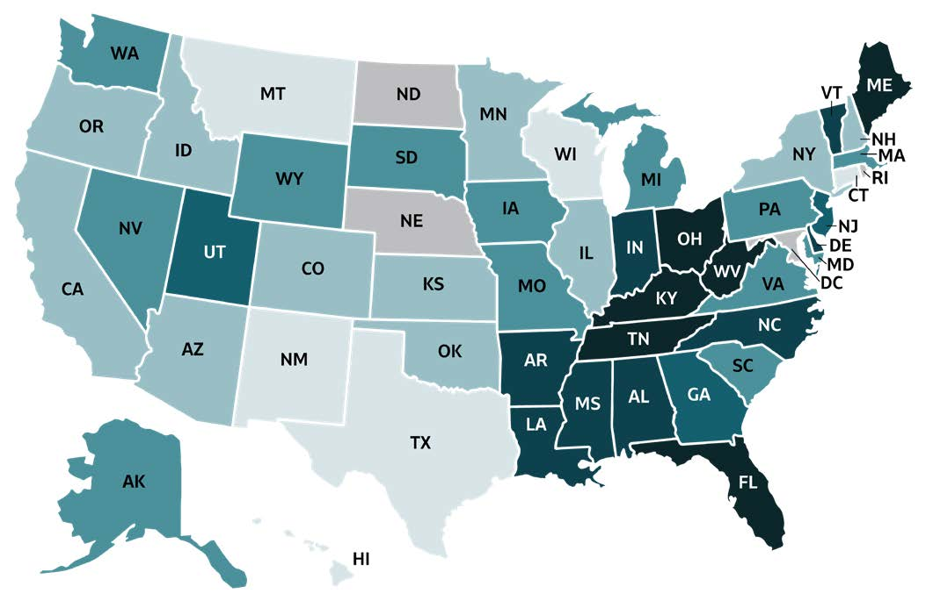
2019 VIRAL HEPATITIS
SURVEILLANCE REPORT
Figure 2.3. Rates of reported acute hepatitis B virus infection, by state or jurisdiction — United States, 2019
Color Key | Cases/100,000 Population | State or Jurisdiction
 | 0.0-0.2 | CT, HI, MT, NM, TX, WI
 | 0.3-0.4 | AZ, CA, CO, ID, IL, KS, MN, NH, NY, OK, OR
 | 0.5-0.8 | AK, IA, MA, MD, MI, MO, NV, PA, SC, SD, VA, WA, WY
 | 0.9-1.1 | GA, NJ, UT
 | 1.2-2.5 | AL, AR, DE, IN, LA, MS, NC, VT
 | 2.6-4.3 | FL, KY, ME, OH, TN, WV
 | Data not available | DC, ND, NE, RI
Source: CDC, National Notifiable Diseases Surveillance System.

