Slide 1
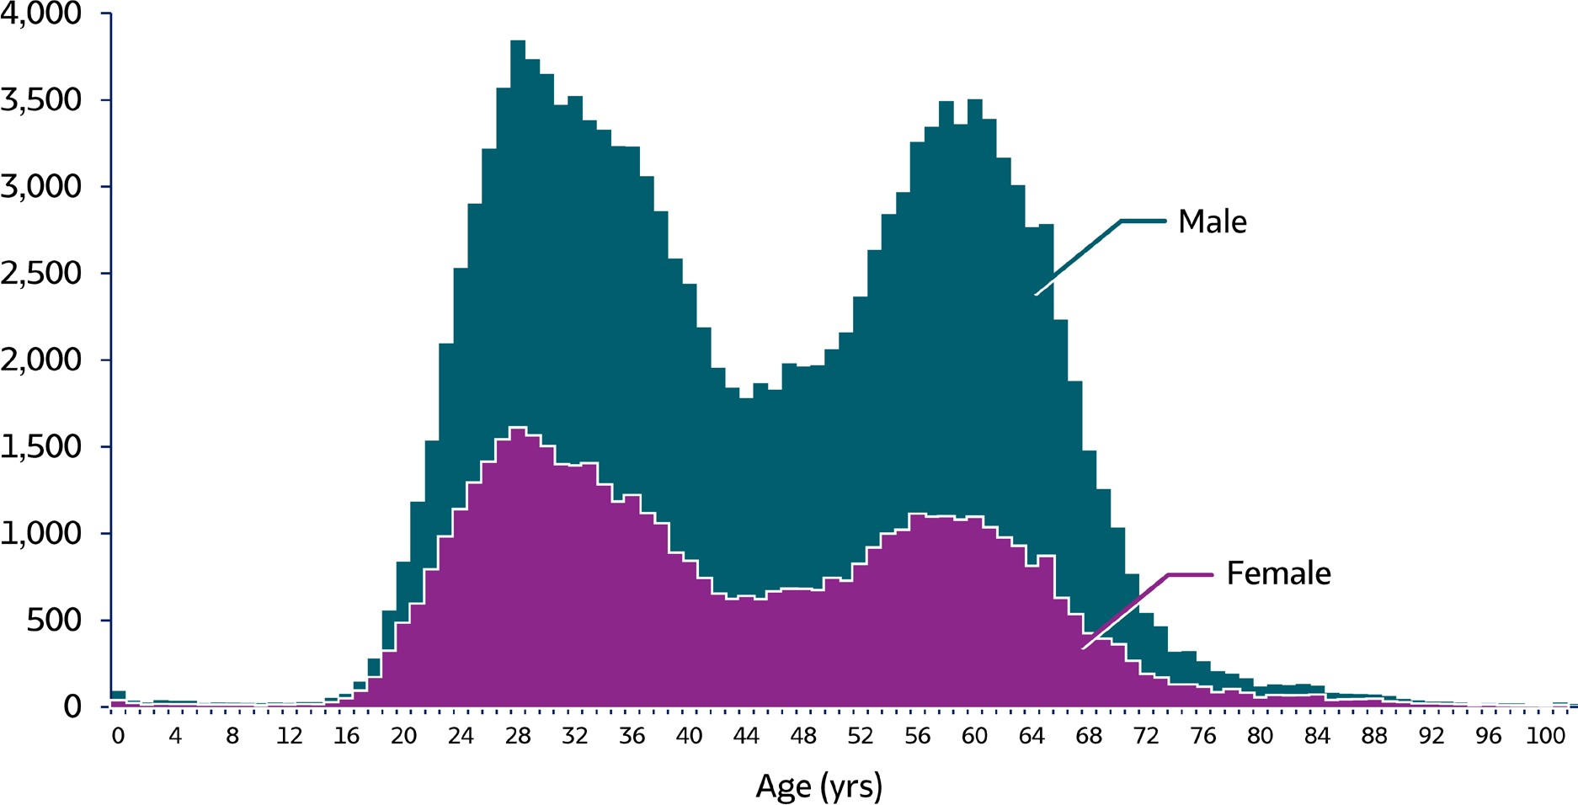
VIRAL HEPATITIS
SURVEILLANCE
Figure 3.8. Number of newly reported* chronic hepatitis C cases† by sex and age — United States, 2018 (N=137,713)
Source: CDC, National Notifiable Diseases Surveillance System.
* During 2018, cases of chronic hepatitis C were either not reportable by law, statute, or regulation; not reported; or otherwise unavailable to CDC from Alabama, Arizona, Arkansas, California, Delaware, District of Columbia, Hawaii, Indiana, Kentucky, Mississippi, Nevada, North Carolina, Rhode Island, and Texas.
† Only confirmed, newly diagnosed, chronic hepatitis C cases are included. For the complete case definition, see https://wwwn.cdc.gov/nndss/conditions/hepatitis-c- chronic/case-definition/2016/.

Slide 2
VIRAL HEPATITIS
SURVEILLANCE
Figure 3.8. Number of newly reported* chronic hepatitis C cases† by sex and age — United States, 2018 (N=137,713)
This graph shows the number of newly reported chronic hepatitis C cases by sex and age in the United States for 2018. Males overall had higher rates of hepatitis C than females. Both males and females showed a biphasic pattern of new infections, with infections rising throughout late teens and early twenties, decreasing through the twenties and thirties, rising again in the late forties through early sixties, then declining for the remaining years.
Source: CDC, National Notifiable Diseases Surveillance System.
* During 2018, cases of chronic hepatitis C were either not reportable by law, statute, or regulation; not reported; or otherwise unavailable to CDC from Alabama, Arizona, Arkansas, California, Delaware, District of Columbia, Hawaii, Indiana, Kentucky, Mississippi, Nevada, North Carolina, Rhode Island, and Texas.
† Only confirmed, newly diagnosed, chronic hepatitis C cases are included. For the complete case definition, see https://wwwn.cdc.gov/nndss/conditions/hepatitis-c- chronic/case-definition/2016/.

