Slide 1
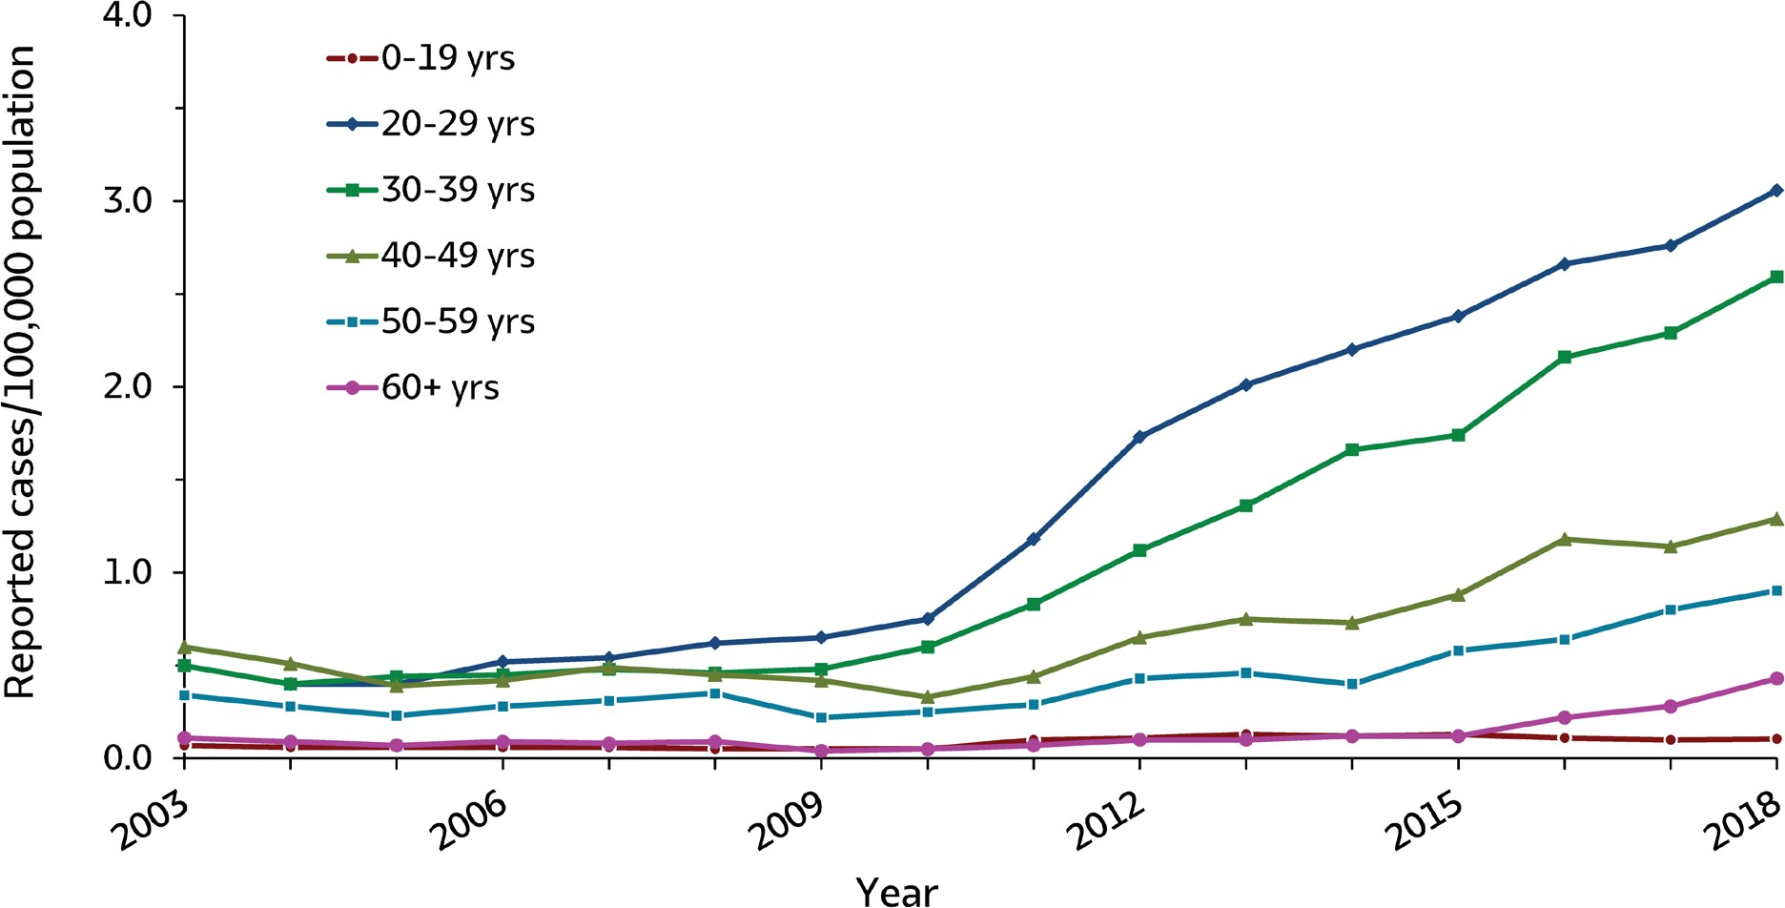
VIRAL HEPATITIS
SURVEILLANCE
Figure 3.4. Rates of reported acute hepatitis C, by age group — United States, 2003–2018
Source: CDC, National Notifiable Diseases Surveillance System.

Slide 2
VIRAL HEPATITIS
SURVEILLANCE
Figure 3.4. Rates of reported acute hepatitis C, by age group — United States, 2003–2018
Age (years) | 2003 | 2004 | 2005 | 2006 | 2007 | 2008 | 2009 | 2010 | 2011 | 2012 | 2013 | 2014 | 2015 | 2016 | 2017 | 2018
0-19 | 0.1 | 0.1 | 0.1 | 0.1 | 0.1 | 0.1 | 0.1 | 0.1 | 0.1 | 0.1 | 0.1 | 0.1 | 0.1 | 0.1 | 0.1 | 0.1
20-29 | 0.5 | 0.4 | 0.4 | 0.5 | 0.5 | 0.6 | 0.7 | 0.8 | 1.2 | 1.7 | 2.0 | 2.2 | 2.4 | 2.7 | 2.8 | 3.1
30-39 | 0.5 | 0.4 | 0.4 | 0.5 | 0.5 | 0.5 | 0.5 | 0.6 | 0.8 | 1.1 | 1.4 | 1.7 | 1.7 | 2.2 | 2.3 | 2.6
40-49 | 0.6 | 0.5 | 0.4 | 0.4 | 0.5 | 0.5 | 0.4 | 0.3 | 0.4 | 0.7 | 0.8 | 0.7 | 0.9 | 1.2 | 1.1 | 1.3
50-59 | 0.3 | 0.3 | 0.2 | 0.3 | 0.3 | 0.4 | 0.2 | 0.3 | 0.3 | 0.4 | 0.5 | 0.4 | 0.6 | 0.6 | 0.8 | 0.9
60+ | 0.1 | 0.1 | 0.1 | 0.1 | 0.1 | 0.1 | 0.0 | 0.1 | 0.1 | 0.1 | 0.1 | 0.1 | 0.1 | 0.2 | 0.3 | 0.4
Source: CDC, National Notifiable Diseases Surveillance System.

