Slide 1
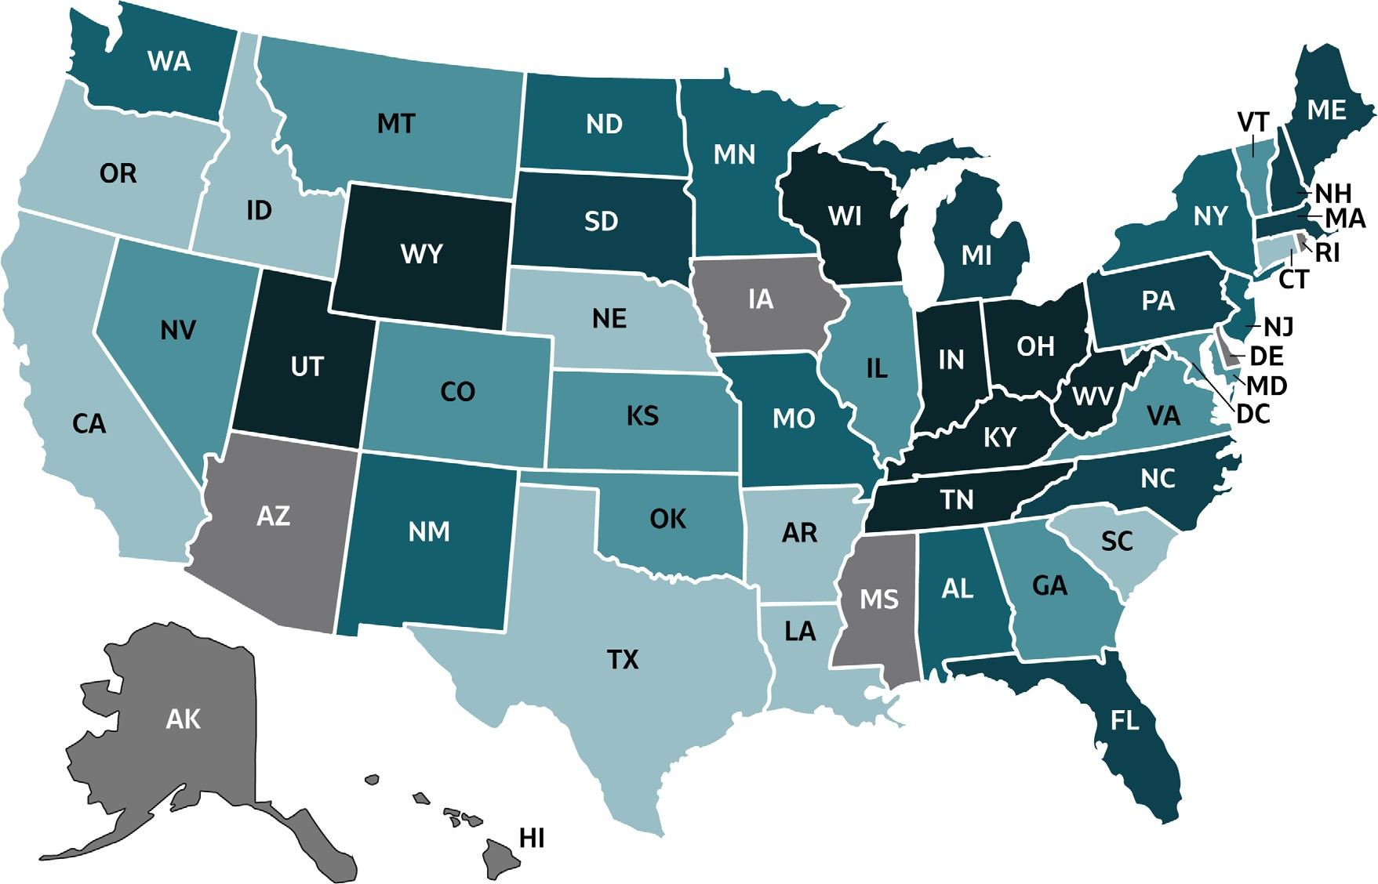
VIRAL HEPATITIS
SURVEILLANCE
Figure 3.3. Rates of reported acute hepatitis C, by state or jurisdiction — United States, 2018
Source: CDC, National Notifiable Diseases Surveillance System.

Slide 2
VIRAL HEPATITIS
SURVEILLANCE
Figure 3.3. Rates of reported acute hepatitis C, by state or jurisdiction — United States, 2018
Color Key | Cases/100,000 Population | States
 | 0-0.3 | AR, CA, CT, ID, LA, NE, OR, SC, TX
 | >0.3-0.9 | CO, GA, IL, KS, MD, MT, NV, OK, VT, VA
 | >0.9-1.3 | AL, MN, MO, NJ, NM, NY, ND, WA
 | >1.3-2.2 | FL, ME, MA, MI, NH, NC, PA
 | >2.2-4.0 | IN, KY, OH, SD, TN, UT, WV, WI, WY
 | Data Not Available | AK, AZ, DE, DC, HI, IA, MS, RI
Source: CDC, National Notifiable Diseases Surveillance System.

