Slide 1
Healthy Community Design
Planning and designing communities that make it easier for people
to live healthy lives
[presenter name/title here/affiliation]
Notes:
Every time we step out our doors, our health is affected by the physical design of our community. This presentation discusses how planning and designing communities with health in mind can lead to improved community health, wellness, and quality of life.
In June 2011, the U.S. Surgeon General released the National Prevention Strategy: America’s Plan for Health and Wellness. The report states that a part of achieving health and wellness is Building Healthy and Safe Community Environments and Empowering People to Make Healthy Choices. Healthy community design can help achieve that and more.

Slide 2
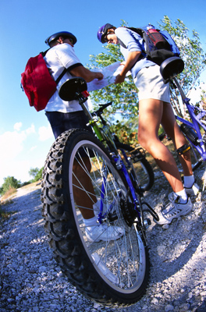
Presentation Roadmap
What is health?
What factors determine our health?
What is the built environment?
What is community design?
What is healthy community design?
How can community design affect your health?
What are the healthy community design principles and benefits?
How can I achieve healthy community design in my community?
Notes:
This presentation will cover the following topics
What is health?
What factors determine our health?
What is the built environment?
What is community design?
What is healthy community design?
How can community design affect your health?
What are the healthy community design principles and benefits?
How can I achieve healthy community design in my community?

Slide 3
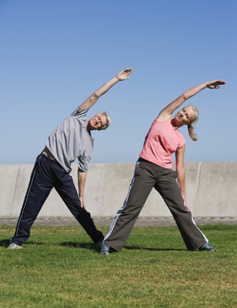
What is Health?
Health is the state of complete physical, mental and social well-being and not merely the absence of disease or infirmity
- World Health Organization
Notes:
A popular definition of health comes from the World Health Organization. They define health as the state of complete physical, mental, and social well-being, and not merely the absence of disease or infirmity. This means that health is more than being free of disease or not feeling sick; it is also a state of physical, mental, and social well-being. This state can bring about such feelings as happiness, contentment, and security.
****
Source:
World Health Organization. Frequently asked questions [online]. No date. [cited 2010 August 11]. Available from URL: http://www.who.int/suggestions/faq/en/.

Slide 4



What Factors Determine Our Health?
Family Health History
Environment
Behaviors/Lifestyles
Notes:
Major factors that determine our health are:
Family Health History: Many people have a family health history of some chronic diseases (like cancer, coronary heart disease, and diabetes) and health conditions (like high blood pressure). People who have a close family member with a chronic disease may have a higher risk for developing that disease than those without such a family member.
Behaviors/Lifestyles: We all make choices that affect our health. Some people choose to eat healthy, get regular physical activity and maintain a healthy weight; they don’t smoke or put themselves at risk for injury or catching a disease.
Environment – The environment can directly influence our health, such as when we are exposed to pollution or injured due to environmental hazards, and it also influences our behavior and lifestyle. Behaviors and lifestyle choices are in part, shaped by environment where people are born, grow, live, work, worship, and age; and the health systems available to them. The term “environment” can include the social, cultural, political, natural, and built environments. These environments can affect physical and mental health. For this presentation, we will concentrate on the built environment and how it can be a factor in your health.
***
Sources:
Centers for Disease Control and Prevention. Public health genomics: Family health history [online]. 2010 March 8 [cited 2010 Aug 11]. Available from URL www.cdc.gov/genomics/famhistory/index.htm.
World Health Organization. Social determinants of health [online]. No date [cited 2010 August 11]. Available from URL www.who.int/social_determinants/en/.

Slide 5

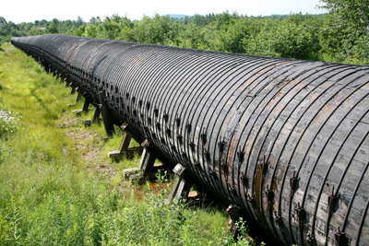
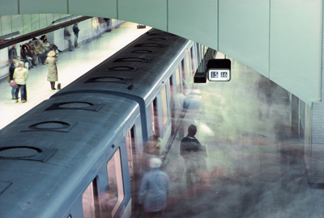
What is the Built Environment?
Notes:
The built environment are the manmade items that form the physical characteristics of a community.
The built environment can include schools, workplaces, parks and recreation areas, greenways, business areas, and transportation systems. It extends overhead in the form of electric transmission lines, underground in the form of waste disposal sites, water systems, subway trains, and across the country in the form of highways.
***
Sources:
Centers for Disease Control and Prevention. Healthy places terminology [online]. 2010 Jun 28. [cited 2010 Aug 11]. Available from URL www.cdc.gov/healthyplaces/terminology.htm.
National Institutes of Health. Obesity and the built environment [online] 2004 Aug 20. [cited 2010 Aug 11]. Available from URL http://grants.nih.gov/grants/guide/rfa-files/rfa-es-04-003.html.

Slide 6
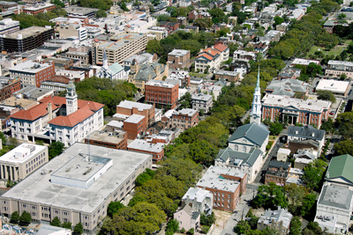

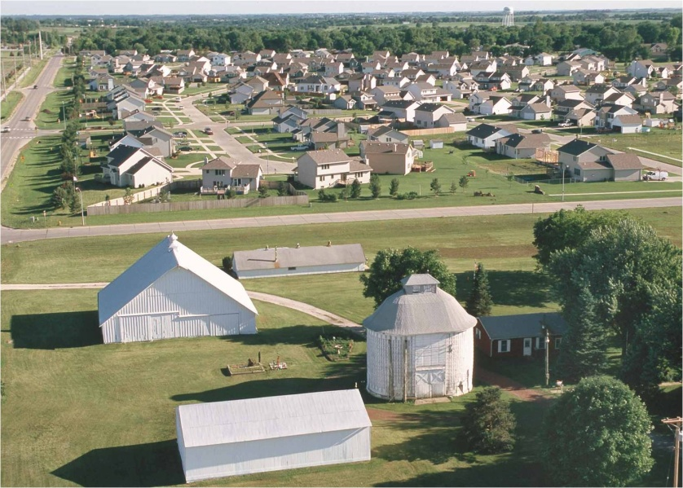
What is community design?
Notes:
The way we arrange all elements of the built environment make up a community’s physical design. Community design is usually decided by a community’s planning processes and policy decisions.

Slide 7
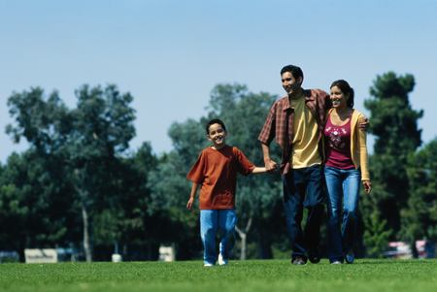
What is Healthy Community Design?
Planning and designing communities that make it easier for people to live healthy lives
Notes:
Healthy community design is planning and designing communities that make it easier for people to live healthy lives. Healthy community design links destinations that promote health, such as schools, parks, grocery stores, and work places, via a transportation network that facilitates safe travel for pedestrians, bicyclists, public transportation users, and automobile occupants. Healthy community design can influence the overall health of a community by making healthy lifestyle choices easily available and accessible to all community members.
Healthy community design links the traditional concepts of planning (such as land use, transportation, community facilities, parks, and open space) with health themes (such as physical activity, public safety, healthy food access, mental health, air and water quality, and social equity issues).
***
Source:
Design for Health. Integrating health into comprehensive planning [online]. No date [cited 2010 Aug 11]. Available from URL: www.designforhealth.net/resources/integratinghealthissue.html.

Slide 8
How Can Community Design Affect Our Health?
Social Capital
Air Quality
Physical Activity Levels
Access to Healthy Foods
Water Quality
Traffic-related Crashes
Social Equity
Climate Change/Extreme Weather
Notes:
Community Design can affect our health in a variety of ways. Let’s look at some of these health issues.

Slide 9

Physical Activity Levels
A sedentary lifestyle is a primary risk factor in cardiovascular disease, stroke, and all causes of death
Notes:
People who live in communities that make it safer to walk or bike to daily activities like shopping, work, school, and recreation are generally more physically active. Incorporating physical activity into our daily routines helps reduce our risk from leading chronic disease killers like stroke, cardiovascular disease, and some types of cancer such as colon and breast cancer.
One study looked at people who live in counties marked by sprawl-style development. These are spread-out areas where homes are far from any other destination; where driving is the most convenient way to get everything done, and people are less likely to have easy opportunities to walk, bicycle, or take transit as part of their daily routine. The study found that found that people living in counties marked by sprawling development are likely to walk less and weigh more than people who live in less sprawling counties. In addition, people in more sprawling counties are more likely to suffer from high blood pressure.
It is a well-established fact that physical activity prolongs life. On the other hand, the health risk of low physical fitness is comparable to, and in some studies greater than, the risk for hypertension, high cholesterol, diabetes, and even smoking.
Regular physical activity is very important to maintaining good health. CDC recommends that adults ages 16-64 take a minimum 10-minute brisk walk 3 times a day, 5 days a week. Communities designed to allow people to walk or bike to school and work, and while completing daily activities and errands, can contribute toward this recommendation.
***
Sources:
McCann BA, Ewing R. Measuring the effects of sprawl: A national analysis of physical activity, obesity and chronic disease. Smart Growth America Surface Transportation Policy Project: September 2003. Available from URL: www.smartgrowthamerica.org/report/HealthSprawl8.03.pdf [cited 2010 Aug 11].
Centers for Disease Control and Prevention. Physical activity for everyone [online]. 2010 June 21. [cited 2010 Aug 11]. Available from URL: www.cdc.gov/physicalactivity/everyone/guidelines/.
US Department of Health and Human Services. Physical activity and health: a report of the Surgeon General. Atlanta, Georgia: US Department of Health and Human Services, Public Health Service, CDC, National Center for Chronic Disease Prevention and Health Promotion; 1996.
NIH Consensus Development Panel on Physical Activity and Cardiovascular Health. NIH Consensus Conference: physical activity and cardiovascular health. JAMA 1996;276:241-246.
Wannamethee SG, et al. Lifestyle and 15-year survival free of heart attack, stroke, and diabetes in middle-aged British men. Arch Internal Med 1998;158(22):2433-40.
Wannamethee SG, et al. Physical activity and the prevention of stroke. J Cardiovasc Risk 1999;6(4):213-6.
Pate RR, et al. Physical activity and public health: a recommendation from the Centers for Disease Control and Prevention and the American College of Sports Medicine. JAMA 1995;273:402-407.
Lee IM, Paffenbarger RS Jr. Associations of light, moderate, and vigorous intensity physical activity with longevity. The Harvard Alumni Health Study. Am J Epidemiol 2000;151:293-9.
Wannamethee SG, et al. Changes in physical activity, mortality and incidence of coronary heart disease in older men. Lancet 1998;351:1603-08.
Wei M, et al. Relationship between low cardiorespiratory fitness and mortality in normal-weight, overweight, and obese men. JAMA 1999;282:1547-1553.
Sesso HD, et al. Physical activity and cardiovascular disease risk in middle-aged and older women. Am J Epidemiol 1999;150(4):408-16.
Wei M, et al. Relationship Between Low cardiorespiratory fitness and mortality in normal-weight, overweight, and obese men. JAMA 1999;282:1547-1553.
Blair SN, et al. Influences of cardiorespiratory fitness and other precursors on cardiovascular disease and all-cause mortality in men and women. JAMA 1996;276:205-210.

Slide 10


Community Design Affects Walking and Biking to School
Notes:
An example of how poor community design can affect children’s daily physical activity is walking to and from school. A CDC study found that distance and traffic danger were the main reasons parents did not let their children walk to school. Also, when new schools are built a long distance from where families live, children are driven to school, depriving them of an opportunity for physical activity, socializing with other students, and contributing to air pollution and risk for automobile crashes. On the other hand, if safe routes to school are provided, and if schools are located within walking or biking distance of where people live, then children can make walking or biking a part of their daily lives, establishing healthy habits that can last a lifetime.
***
Source:
Centers for Disease Control and Prevention. Barriers to children walking and biking to school—United States, 1999. Morbidity & Mortality Weekly Report 2002;51(32):701–704. [cited 2010 Aug 11]. Available from URL: http://www.cdc.gov/mmwr/PDF/wk/mm5132.pdf

Slide 11
Obesity Trends* Among U.S. Adults
BRFSS, 1990, 1999, 2009
(*BMI ≥30, or about 30 lbs. overweight for 5’4” person)
1990
1999
2009
No Data <10% 10%–14% 15%–19% 20%–24% 25%–29% ≥30%
Notes:
Communities that do not offer easy and accessible options for routine physical activity, such as walking to and from school, may be contributing to increased obesity rates in the United States. Today, more than 1/3 of U.S. adults and 17% of U.S. children are obese. Since 1980, obesity rates for adults have doubled and rates for children have tripled. Children and adolescents are developing obesity-related diseases, such as type 2 diabetes, that were once seen only in adults. Obese children are more likely to have risk factors for cardiovascular disease, including high cholesterol levels, high blood pressure, and abnormal glucose tolerance. One study of 5- to 17-year-olds found that 70% of obese children had at least one risk factor for cardiovascular disease and 39% of obese children had at least two risk factors.
***
Sources:
Centers for Disease Control and Prevention. Chronic disease prevention and health promotion: the obesity epidemic [online]. 2009 Dec 17. [cited 2010 Aug 11]. Available from URL: http://www.cdc.gov/chronicdisease/resources/publications/AAG/obesity.htm.
Centers for Disease Control and Prevention. Children’s health & built environment [online]. 2009 Jun 16. [cited 2010 Sep 16]. http://www.cdc.gov/healthyplaces/healthtopics/children.htm.

Slide 12

Air Pollution
Air pollution can
Aggravate asthma symptoms
Diminish lung function
Trigger heart attacks
Cause adverse birth outcomes
Increase risk of childhood cancer
Notes:
Transportation-related pollutants are one of the largest contributors to unhealthy air quality; exposure to traffic emissions has been linked to many negative health effects including: Exacerbation of asthma symptoms, diminished lung function, heart attacks, adverse birth outcomes such as low birth weight, and increase risk for childhood cancer.
But changes in the built environment, such as offering alternatives to driving --such as public transit, biking, and walking – can help reduce transportation-related pollutants and improve air quality and health outcomes.
So, communities that make it easier to walk, bike, or take public transit rather than drive can help reduce the number of cars on the road. This can reduce air pollution from cars which can improve the respiratory health and air quality of a community.
***
Sources:
Centers for Disease Control and Prevention. Healthy Places: Respiratory health and air pollution [online]. 2009 Nov 16. [cited 2010 Aug 11]. Available from URL www.cdc.gov/healthyplaces/healthtopics/airpollution.htm.

Slide 13

Water Quality
Water-resistant surfaces leads to urban and agricultural runoff that
    Pollute water supplies
      lakes,
      rivers,
      wetlands
    Increase flooding potential
      sewage overflow,
      property damage,
      infection and injuries from flood waters
Clean and safe drinking water is critical because waterborne illness can be a serious problem.
Notes:
Community design can also have several effects on drinking water supplies, recreation, fisheries and wildlife. Water-resistant surfaces such as roads, sidewalks, driveways, parking lots, and rooftops can keep precipitation events, such as rainwater and snowmelt, from soaking into the ground. The result is runoff. As the runoff moves, it picks up and carries away natural and human-made pollutants, finally depositing them into lakes, rivers, wetlands, coastal waters and ground waters. It may contain potentially dangerous materials, such as fecal material from overflowing sewage systems, agricultural runoff, and chemicals from industrial areas. Runoff water can contaminate private wells and community water systems with waterborne diseases that make drinking water unsafe. Injuries may also result from flood waters.
Healthy community design applies the low-impact development approach by incorporating wetlands into watershed planning; applying techniques such as soil amendments and bioretention; harvesting rooftop rainwater, and using permeable pavement to better deal with stormwater runoff, and restore ecologic water balances. Filtering water naturally through the soil, trees, green roofs, or rain gardens improves the quality and quantity of our drinking water.
***
Sources:
Centers for Disease Control and Prevention. Healthy places: water quality [online]. 2009 Nov 16. [cited 2010 Aug 11]. Available from URL: www.cdc.gov/healthyplaces/healthtopics/water.htm.
Centers for Disease Control and Prevention. Healthy water: water-related emergencies and outbreaks [online]. 2009 Apr 10. [cited 2010 Aug 11]. Available from URL: www.cdc.gov/healthywater/emergency/flood/index.html.
Centers for Disease Control and Prevention. Global WASH-related diseases and contaminants [online]. 2010 April 26. [cited 2011 Jan 21]. Available URL: www.cdc.gov/healthywater/global/wash_diseases.html
U.S. Environmental Protection Agency. polluted runoff (non-point source pollution) [online]. 2010 Aug 23 [cited 2010 Sept 13]. Available from URL: http://www.epa.gov/owow_keep/nps/index.html.

Slide 14

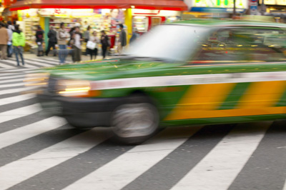
Traffic-Related Injuries and Deaths
Annual Statistics
30,000+ deaths
2+ million nonfatal injuries
$70 billion economic burden
The leading cause of death among those age 5–34 in U.S.
Notes:
Communities that make it easier and safer to walk, bike or take public transit help reduce the number of cars on the road. The combination of fewer cars on the road and how cars, bicycles, and pedestrians share space are all important in reducing traffic-related deaths and injuries in the U.S. More than 30,000 people die each year from car crashes. Car crashes are one of the leading causes of non-disease related deaths in the U.S. and the leading cause of death among those age 5-34 in the U.S. car crashes account for more than 2 million nonfatal injuries annually. In 2005 (the most current source of national fatal and non-fatal injury and cost data from multiple sources), the economic burden of motor vehicle-related deaths and injuries cost the United States more than $70 billion . Roadways that are designed to slow down the speed of moving vehicles and buffer bicyclists and pedestrians from automobile traffic can help reduce the probability of deaths and injuries from traffic crashes.
***
Sources:
Centers for Disease Control and Prevention. Motor vehicle safety [online]. 2011 May 20. [cited 2011 Jul 5]. Available from URL: http://www.cdc.gov/Motorvehiclesafety/index.html.
Centers for Disease Control and Prevention. 10 leading causes of injury deaths by age group highlighting
unintentional injury deaths, United States – 2007. No date. [cited 2011 Jul 5]. Available from URL: http://www.cdc.gov/injury/wisqars/pdf/Unintentional_2007-a.pdf.
Centers for Disease Control and Prevention. National estimates of the 10 leading causes of nonfatal injuries treated in hospital emergency departments, United States – 2008. No date. [cited 2011 Jul 5]. Available from URL: http://www.cdc.gov/injury/wisqars/pdf/Nonfatal_2008-a.pdf.
U.S. Department of Transportation. National Highway Traffic Safety Administration, National Center for Statistics and Analysis. Traffic safety facts 2008: a compilation of motor vehicle crash data from the fatality analysis reporting System and the general estimates system. Washington, DC: NHTSA; 2008. [cited 2010 Aug 11]. Available from URL: http://www-nrd.nhtsa.dot.gov/Pubs/811170.pdf.
Naumann R, Dellinger A, Zaloshnia E, Lawrence, B, Miller T. Incidence and Total Lifetime Costs of Motor Vehicle-Related Fatal and Nonfatal Injury by Road User Type, United States, 2005. Traffic Injury Prevention, Vol. 11, Issue 4, p. 353-360. August 2010.

Slide 15

Healthy Food Access
Healthy foods may not be readily available
Low-income/underserved communities have limited access to healthy foods
  Food Desert Locator (http://www.ers.usda.gov/data/fooddesert/index.htm)
Rural communities have high number of convenience stores
Notes:
Communities where healthy foods are not accessible and affordable may also be a contributor to the obesity epidemic in the United States. A healthy diet may be more difficult for some because healthy food options are not readily available, easily accessible, or affordable in their communities. In fact, scientific studies have found that low-income and underserved communities often have limited access to stores that sell healthy food, especially high-quality fruits and vegetables. And rural communities often have a higher number of convenience stores, where healthy foods are less available than in larger, retail food markets. The U.S. Department of Agriculture’s Food Desert Locator gives a spatial overview of low-income neighborhoods with high concentrations of people who are far from a grocery store.
Good nutrition is vital to good health and disease prevention. But it’s hard for people to eat their fruits and vegetables (and to stay away from too much junk food) if they don’t have access to fruits and vegetables! In one study of 50,000 neighborhood blocks in Detroit, researchers found that 92% of food retailers were comprised of “fringe food outlets” such as liquor stores and fast-food restaurants, while only 8% were grocery stores of any size. Access to affordable and healthy food is a part of healthy community design.
***
Sources:
Mari Gallagher Research & Consulting Group. Examining the impact of food deserts on public health in Detroit, 2007. [cited 2010 Aug 11]. Available from URL: http://marigallagher.com/projects/2/.
Story M, Kaphingst KM, Robinson-O'Brien R, Glanz K. Creating healthy food and eating environments: policy and environmental approaches. Annual Review of Public Health, April 2008;29:253–72.
Powell L. Food store availability and neighborhood characteristics in the United States. Preventive Medicine 2007;44:189–195.
Liese AD, Weis KE, Pluto D, Smith E, Lawson A. Food store types, availability and cost of foods in a rural environment. J Am Dietetic Assoc 2007;107(11):1916–23.
Zenk SN, Schulz AJ, Israel BA, James SA, Bao SM, Wilson ML. Fruit and vegetable access differs by community racial composition and socioeconomic position in Detroit, Michigan. Ethn Dis 2006;16(1):275–80.
Glanz, et al. Healthy nutrition environments: concepts and measures. Am J Health Promotion. 2005;19(5):330–3, ii.
Horowitz CR, Colson KA, Hebert PL, Lancaster K. Barriers to buying healthy foods for people with diabetes: evidence of environmental disparities. Am J Pub Health. 2004;94:1549–54.

Slide 16
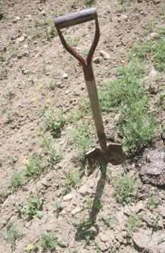

Climate Change
Potential effects
Stronger and longer heat waves
More frequent weather precipitation events
More frequent and severe droughts
Extreme weather events such as flooding and tropical cyclones
Notes:
How we design our communities may also determine how well we cope with climate change in the future. People are exposed to climate change through changing weather patterns (for example, more intense and frequent extreme events) and indirectly through changes in water, air, food quality and quantity, ecosystems, agriculture, and economy. At this early stage the effects of climate change are small but are expected to steadily increase in all countries and regions.
Because automobile emissions account for 26% of U.S. greenhouse gas emissions (a contributor to climate change), healthy community design elements may help slow down the effects of climate change by providing alternatives to driving cars (such as walking, biking and public transit).
As cities grow larger, they may experience stronger and longer heat waves because of the urban heat island effect. Two factors create the urban heat island effect: fewer trees and vegetative cover to cool cities by deflecting solar radiation and transpiring water back to the atmosphere; and the construction of dark surfaces that absorb heat and re-radiate that heat. Community design elements that may help lessen the urban heat island effect include:
Creating parks, green rooftop parks, gardens and green spaces,
Making building energy-efficient, and
Minimizing the use of dark surfaces that absorb heat and re-radiate that heat during the evenings, when the cities would otherwise cool down.
***
Sources:
Centers for Disease Control and Prevention. Climate change and public health [online]. 2010 April 23. [cited 2010 Aug 11]. Available from URL: www.cdc.gov/climatechange/.
Centers for Disease Control and Prevention. Climate change: science, health and the environment [online]. 2007 April 10. [cited 2010 Aug 11]. Available from URL: www2c.cdc.gov/podcasts/player.asp?f=5251#transcript.
The Intergovernmental Panel on Climate Change. Working group II: impacts, adaptation and vulnerability [online]. 2007. [cited 2010 Aug 11]. Available from URL: http://www.ipcc-wg2.org/index.html.
U.S. Environmental Protection Agency. Heat island effect [online]. 2010 Aug 13. [cited 2010 Sep 15]. Available from URL: http://www.epa.gov/heatisland/index.htm.

Slide 17

Social Capital
The fabric of a community and the community pool of human resources available
Notes:
The fabric of a community and the community pool of human resources available to it is often called “social capital.” This term refers to the individual and communal time and energy available for such things as community improvement, social networking, civic engagement, personal recreation, and other activities that create social bonds between individuals and groups. Such activities and bonds can have an effect on mental and physical health.
Numerous writers have observed a loss of social capital in recent years, and some authors have attributed this decline, in part, to suburbanization and sprawl. Healthy community design aims to increase social capital by creating
Parks, green spaces and public places for leisure and social activities and
Communities that are mixed-use which means a mix of housing, civic uses, and commercial uses, including retail, restaurants, and offices. Mixed use allows a community member to work closer to where they live, thus reducing their amount of commuting time and increasing their time for leisure and social activities.
***
Sources:
Centers for Disease Control and Prevention. Healthy places: social capital [online]. 2009 Nov 16. [cited 2010 Aug 11]. Available from URL: http://www.cdc.gov/healthyplaces/healthtopics/social.htm.
Etzioni A. The spirit of community : the reinvention of american society. New York: Crown Publishers; 1993.
Putnam R. bowling alone: the collapse and revival of american community. New York: Simon & Schuster; 2000.
Mo R and Wilkie C. Changing places: rebuilding community in the age of sprawl. New York: Henry Holt and Co.; 1997.
Calthorpe P. The Next American Metropolis: Ecology, Community, and the American Dream. Princeton: Princeton Architectural Press, 1993.

Slide 18

Social Equity
Access to all needs and the ability to remain in the community all their lives
Diverse housing options and price levels
Well-defined neighborhood centers that support jobs, commercial activity, and amenities
Notes:
Finding a good home in a safe neighborhood, that’s convenient to jobs, good schools, and other daily needs can be difficult; usually neighborhoods with lots of amenities are more expensive because more people want to live there. People who work in these neighborhoods, but can’t afford to live there, may have to live far away in areas that are not safe. Workers like police officers, firefighters, teachers who contribute so much to a community may have to sacrifice safety and convenience for affordability.
Healthy community design principles support social equity by promoting:
Communities where people of all abilities and ages can move about their community for all their needs, and, should they choose, remain in their community all their lives.
Diverse housing options and price levels so that all persons regardless of income can live in the same community where they work, play and worship.
Neighborhoods clustered around one or more well-defined neighborhood centers that support jobs of all types and skills, commercial activity, and a range of amenities.
Social equity means that every community member, regardless of age, income, ability or cultural custom should have:
Fair access to livelihood, education, and resources
Full participation in the political and cultural life of the community
Self-determination in meeting fundamental needs

Slide 19
Healthy Community Design Principles
Mixed land use and greater land density
Public transit
Pedestrian and bicycle infrastructure
Accessible and socially equitable community
Housing for different incomes and different stages of life
Accessible green spaces and parks
Community centers
Low Impact Development (LID) approach to storm water management
Notes:
19
Let’s review how healthy community design can improve our health where we live, work, play and worship. Here are some healthy community design principles. Many of these principles that make communities healthier also make them more attractive and affordable places, too. They are
Mixed land use and land use density that supports short distances between homes, workplaces, schools, and recreation so people can walk or bike more easily to them.
Public transit to reduce the dependence on automobiles.
Pedestrian and bicycle infrastructure, including sidewalks and bike paths that are safely removed from automobile traffic, as well as good right-of-way laws and clear, easy-to-follow signage.
A community that is accessible and socially equitable to all residents regardless of age, ability, income and cultural custom.
Housing for different incomes and stages of life.
Green space and parks that are accessible.
Community centers where people can gather and mingle as part of their daily activities.
Land development and storm water management using the Low Impact Development (or LID) approach. LID uses manmade and natural landscape features to handle storm water as a resource rather than a waste product.
***
Source:
Environmental Protection Agency. Low-Impact Development (LID) [online]. 2010 July 28. [cited 2010 Aug 11].
Available from URL: http://water.epa.gov/polwaste/green/.

Slide 20
Healthy Community Design Benefits
Improve air and water quality
Lower the risk of traffic-related injuries
Easier incorporation of physical activity into our everyday lives
Increase access to healthy food
Reduce contributions to climate change
Increase social connectivity and sense of community
Ensure social equity for all community members
Promote good mental health
Notes:
When a community implements healthy community design principles, the health benefits are many, such as:
Creating safe and comfortable streets and sidewalks that encourage community members to incorporate physical activity into their daily routine by biking an walking.
Increasing access to healthy foods.
Providing transportation options--like public transit, biking, and walking– that help reduce traffic and air pollution.
Protecting water quality and making communities more attractive by preserving wetlands and undeveloped land. This valued land may also give people a place to play, relax and connect with nature (which is good for mental health).

Slide 21

Healthy Community Design
Making it Happen in your Community
Target areas
Transportation
Land use and community development
Policies and programs
Notes:
Where do we start if we want to ensure that healthy community design decisions are being considered in our communities? The most common areas are those in our local government that deal with transportation, land use and community development, and policies and programs.

Slide 22
Why Transportation?
Transportation
Physical Activity
Obesity
Cardiovascular Health
Air Quality
Respiratory Health
Injury
Cardiovascular Health
Access to Healthy Destinations
Notes:
As discussed in this presentation, transportation systems impact health several ways – especially some of our nation’s biggest health issues, like obesity, physical activity, respiratory health, and vehicle-related injury and deaths. According to the Centers for Disease Control Prevention’s Transportation Recommendations: “Expanding the availability of, safety for, and access to a variety of transportation options and integrating health-enhancing choices into transportation policy has the potential to save lives by preventing chronic diseases, reducing and preventing motor-vehicle-related injury and deaths, improving environmental health, while stimulating economic development, and ensuring access for all people.”
Suggestions to find out about transportation issues in the community are your local:
Department of transportation
Department of public works ( who generally make decisions about sidewalks, signage and crosswalks)
Local advocacy groups
***
Source:
Centers for Disease Control and Prevention. CDC transportation recommendations. 2010 April 28. [cited 2011 Jul 6]. Available from URL: http://www.cdc.gov/transportation/.

Slide 23
Why Land Use & Community Development?
Land Use and Community Development
Creating Healthy Destinations
Healthy Food
Parks.
Greenspace,
Recreation
Social Capital
Mental Health
Multimodal Transport
Natural Resources
Housing, Work, School
Physical Activity
Obesity
Physical Activity
Cardiovascular Health
Equity and well-being
Air Quality, Water Quality
Respiratory Health, other
Notes:
Land use and community development also impact many aspects of our lives including our health. Land-use decisions can affect whether we have access to healthy food choices, parks and greenspace, good homes, jobs, and schools within our community. Land-use decisions affect our freedom to choose how we get to the grocery store, a park, or even work or school. A community that ensures freedom of choice supports bike lanes and paths, sidewalks, and transit stations and stops. A community that supports mixed-use development allows homes and shops offering the necessities of life within walking distance of each other. Land use and community development decisions can affect a community’s social capital, a necessary component in a community’s livability, health, and well-being. Community centers and town centers or public squares are examples of land-use decisions that allow people to gather, interact, and strengthen a community’s social bonds. How we use our land can affect our natural resources like wetlands and aquifers that might be a community’s source for drinking water. The health of our natural resources directly influences our own health and well-being. Supporting the compactness of development and maximizing the use of the existing infrastructure (also known as infill development) instead of building on previously undeveloped land helps protect natural resources.
To become involved in land use and community development decisions in your community, you can visit your
City planning department
Rural or metropolitan planning organization (RPO or MPO); and
Local community development organizations (sometimes referred to as CDC's, or community development corporations).

Slide 24
Why Policies and Programs?
Policies & Programs
Encourage people to make healthy choices
Notes:
Sometimes policies such as zoning codes (which regulate the use and development of property within specific categories), must be changed and smarter land-use practice encouraged so that healthy community design principles can be implemented. Creating community programs that promote healthy active living are also important. Policies and programs have the power to promote and encourage such healthy choices as:
Safe routes to school programs;
Farmers Markets in areas that have limited access to fruits and vegetables; and
Mixed-use neighborhoods where homes, shops, community services, public transit stops, and schools are within walking or biking distance of one another.
How do you find out if policies and programs in your community are improving health? City councils, Zoning boards or planning commissions often regulate zoning codes and hear appeals on zoning and land-use matters. Other areas that affect policy, planning and programs in your community might be your:
Local planning department
Local department of parks and recreation
Local non-profit land trusts
Local department of water, and
Local department of health.

Slide 25

Questions to Ask Decision-Makers
Are you considering the health impact of your decisions?
Do your decisions offer healthy community design benefits?
Are you making the healthy choice the easy choice for all community members?
Notes:
The most important questions you can impress upon all decision-makers are:
Are you considering the health impact of your decisions by seeking advice from public health professionals on the potential health effects of a project or policy before it is built or implemented?
Do your decisions offer the healthy community design benefits mentioned in this presentation?
Are you making the healthy choice the easy choice for all community members regardless of age, income, ability, or cultural custom?

Slide 26
Tools
Health Impact Assessment
http://www.cdc.gov/healthyplaces/hia.htm
PACE EH
http://www.cdc.gov/nceh/ehs/CEHA/default.htm
Community Audit Tools Resource – Active Living Research
http://www.activelivingresearch.org/resourcesearch/toolsandmeasures
CDC Public Health Tracking Network
http://ephtracking.cdc.gov/showCommunityDesign.action
Notes:
Several tools and processes exist that can help decision-makers determine the health impact of community design:
Health Impact Assessment, HIA for short, is a step-by-step process that brings potential public health impacts and considerations to the decision-making process for plans, projects, and policies that fall outside of traditional public health arenas, such as transportation and land use. The process can be useful in focusing on potential health outcomes such as obesity, physical inactivity, asthma, and injuries before a project or policy is built or implemented.
PACE EH: Protocol for Assessing Community Excellence in Environmental Health is a tool for assessing the health of a neighborhood. PACE EH takes local health officials and community members through a series of steps to collect necessary and relevant information pertaining to community environmental health concerns, rank issues, and set local priorities for action. For example, the process was used in the community of Wabasso by the Florida Department of Public Health. The community identified its top “health” issues which included street lighting to safely walk at night, accessible areas for safe physical activity and recreation, and access to safe drinking water. As a result of the process, streetlights and sidewalks were installed, and other improvements that affect health were made. The community also felt that after using PACE EH, government was better able to respond to issues in the community.
The Acting Living Research Web site, a national program of the Robert Wood Johnson Foundation, has a variety of tools for auditing the health of a community’s social and built environments.
The Centers for Disease Control and Prevention’s National Environmental Public Health Tracking Network Community Design landing page has maps, tables, and charts about transportation to work, air quality, and motor vehicle-related fatalities in your community.
****
Sources:
Centers for Disease Control and Prevention. Healthy places: health impact assessment[online]. 2010 May 14. [cited 2010 Oct 6]. Available from URL: http://www.cdc.gov/healthyplaces/hia.htm.
Centers for Disease Control and Prevention. Environmental health services: community environmental health assessment (CEHA) [online]. 2010 May 12 [cited 2010 Oct 13]. Available from URL: http://www.cdc.gov/nceh/ehs/CEHA/default.htm.

Slide 27
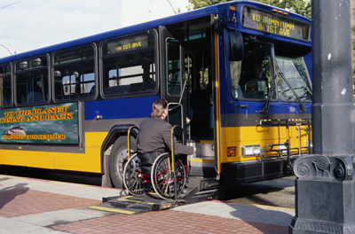

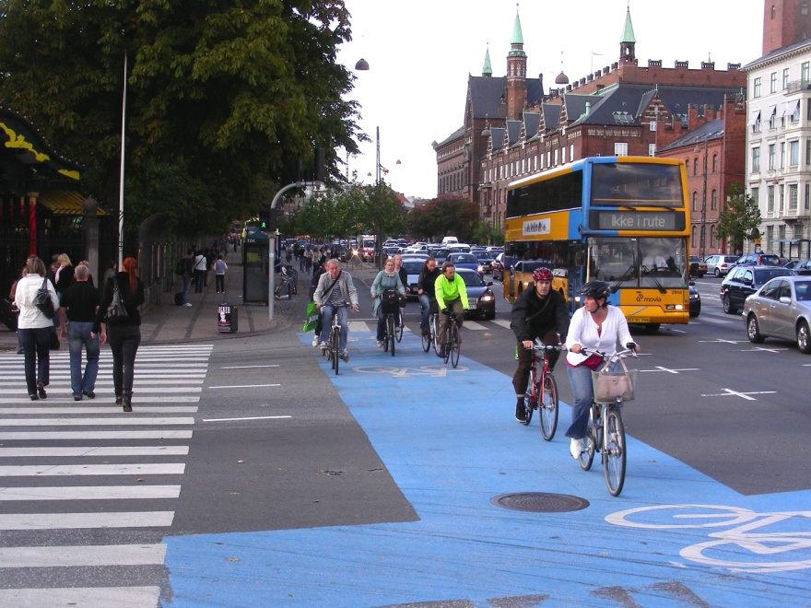

Healthy Active Living
Source: www.pedbikeimages.org / Ryan Snyder
Notes:
Your efforts with decision-makers could help transform a community from one that discourages healthy active living to one that embraces it for people of all ages, incomes and abilities, and provides a variety of transportation options.

Slide 28
Healthy Community Design Promotes Community Health and Wellness
Source: MIG, Inc. with permission
Notes:
Every time we step out our doors, our health is affected by the physical design of our community. I hope this overview has helped you better understand how healthy community design can lead to community health and wellness; and improve the quality of life for every person living in it, giving everyone a variety of healthy, available, accessible, and affordable options.

Slide 29

For More Information
Centers for Disease Control and Prevention
Healthy Community Design Initiative
Web site: www.cdc.gov/healthyplaces
Email: healthyplaces@cdc.gov
Notes:
For more information on healthy community design, visit the Healthy Community Design Initiative Web site at The Centers for Disease Control and Prevention.
Thank you.

