Slide 1

Asthma and Inhalant Allergens
National Center for Environmental Health
Division of Environmental Hazards and Health Effects
Notes:
Asthma and Inhalant Allergens

Slide 2
Allergens Can Affect Asthma
National Asthma Education and Prevention Program (NAEPP) Guidelines for the Diagnosis and Management of Asthma:
“Exposure of patients who have asthma to allergens … to which they are sensitive has been shown to increase asthma symptoms and precipitate asthma exacerbations. (Evidence A)”
Expert Panel Report 3: Guidelines for the Diagnosis and Management of Asthma, 2007
Notes:
The most recent National Asthma Education and Prevention Program (or NAEPP) guidelines for the diagnosis and management of asthma state:
“Exposure of patients who have asthma to allergens … to which they are sensitive has been shown to increase asthma symptoms and precipitate asthma exacerbations.”
These guidelines assigned a level “A” grade to the quality of evidence supporting this statement.

Slide 3
Inhalant Allergens Are Important in Asthma
From NAEPP guidelines:
“The important allergens for children and adults appear to be those that are inhaled.”
Expert Panel Report 3: Guidelines for the Diagnosis and Management of Asthma, 2007
Notes:
NAEPP guidelines also state:
“The important allergens for children and adults appear to be those that are inhaled,” which is why they are the focus of this presentation.

Slide 4
Objectives
Describe how inhalant allergens affect asthma
Describe types of inhalant allergens
Review NAEPP recommendations
  Evaluation of inhalant allergens for persons with asthma
  Environmental control of inhalant allergens
Notes:
The objectives of this presentation are to:
Describe the process through which inhalant allergens can affect individuals with asthma;
Describe the types of inhalant allergens that can affect individuals with asthma;
Review NAEPP recommendations for the evaluation of inhalant allergens for persons with asthma,
And review NAEPP recommendations for the environmental control of inhalant allergens for individuals with asthma found to be sensitive to inhalant allergens

Slide 5
How Inhalant allergens affect asthma
Notes:
How Inhalant Allergens Affect Asthma

Slide 6
Definitions
Allergen
  Substance that causes the immune system to overreact
  Also known as “allergic trigger”
  Examples: pollen, shellfish, antibiotics, poison ivy
Notes:
Below are some definitions.
An allergen is any substance that can cause the immune system to overreact, in persons who are sensitive to allergens. An allergen is also known as an “allergic trigger”.
Examples include pollen, shellfish, antibiotics, and poison ivy – these can cause the immune system to overreact in sensitive individuals. As illustrated by these examples, allergens can enter the body through multiple routes, including the airways, the gut, blood, and skin.

Slide 7
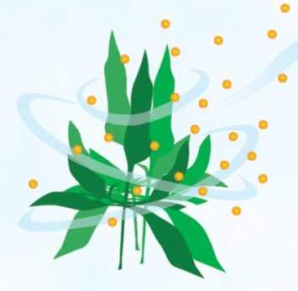
Definitions
Allergen
  Substance that causes the immune system to overreact
  Also known as “allergic trigger”
  Examples: pollen, shellfish, antibiotics, poison ivy
Inhalant allergen
Expert Panel Report 3: Guidelines for the Diagnosis and Management of Asthma, 2007; Middleton’s Allergy 7th Ed.
Notes:
Allergens that enter the body when a person inhales or breathes are known as inhalant allergens. Pollen is an example of an inhalant allergen.

Slide 8
How Inhalant Allergens Affect Asthma
Inhalant allergens
Enters airways
Expert Panel Report 3: Guidelines for the Diagnosis and Management of Asthma, 2007; Middleton’s Allergy 7th Ed.
Notes:
All individuals breathe inhalant allergens into their airways, when these allergens are present in the air.

Slide 9
How Inhalant Allergens Affect Asthma
Inflammation and obstruction in airways sensitive to allergens
Inhalant allergens
Enters airways
Expert Panel Report 3: Guidelines for the Diagnosis and Management of Asthma, 2007; Middleton’s Allergy 7th Ed.
Notes:
In individuals with airways that are sensitive to allergens, an inflammatory reaction to the allergens occurs, which can cause airway hyperresponsiveness and airway obstruction.

Slide 10
How Inhalant Allergens Affect Asthma
Inflammation and obstruction in airways sensitive to allergens
IgE antibody
Inhalant allergens
Enters airways
Expert Panel Report 3: Guidelines for the Diagnosis and Management of Asthma, 2007; Middleton’s Allergy 7th Ed.
Notes:
Here is a brief summary of why allergen-sensitive airways can narrow in the presence of inhaled allergens.
Individuals sensitive to allergens often have higher levels of immunoglobulin E (IgE) in their bodies. IgE is an allergy-related antibody that reacts to allergens and can start the inflammatory reaction that can lead to airway hyperresponsiveness and obstruction.
You might have heard of IgE, because IgE is what is found during allergy testing. High levels of IgE in the body can be related to an individual’s sensitivity to allergens.

Slide 11
How Inhalant Allergens Affect Asthma
Inflammation and obstruction in airways sensitive to allergens
IgE antibody
Inhalant allergens
Enters airways
Sensitized
Expert Panel Report 3: Guidelines for the Diagnosis and Management of Asthma, 2007; Middleton’s Allergy 7th Ed.
Notes:
Individuals with high levels of IgE to allergens can be called “sensitized” to these allergens.
Sensitization to inhalant allergens can occur as early as 1 to 3 years of age.

Slide 12


How Inhalant Allergens Affect Asthma
Inflammation and obstruction in airways sensitive to allergens
IgE antibody
Inhalant allergens
Enters airways
Histamine
Eosinophil
Expert Panel Report 3: Guidelines for the Diagnosis and Management of Asthma, 2007; Middleton’s Allergy 7th Ed.
Notes:
When an allergen causes airway inflammation, other chemicals and cells in the body are also involved.
For example, histamine is an allergy-related chemical that can participate in airway inflammation. In allergen-sensitive individuals, allergens can cause levels of histamine to increase, but histamine breaks down in the body too quickly to be measured routinely.
Also, the eosinophil is an allergy-related cell that can participate in airway inflammation. High blood levels of eosinophils can be related to an individual’s sensitivity to allergens.

Slide 13
How Inhalant Allergens Affect Asthma
Inflammation and obstruction in airways sensitive to allergens
IgE antibody
Inhalant allergens
Enters airways
Histamine: antihistamine
Eosinophil
Expert Panel Report 3: Guidelines for the Diagnosis and Management of Asthma, 2007; Middleton’s Allergy 7th Ed.
Notes:
You already might be familiar with histamine because individuals with allergies might take antihistamine medication.

Slide 14
How Inhalant Allergens Affect Asthma
Inflammation and obstruction in airways sensitive to allergens
No inflammation or obstruction in airways insensitive to allergens
Inhalant allergens
Enters airways
Expert Panel Report 3: Guidelines for the Diagnosis and Management of Asthma, 2007; Middleton’s Allergy 7th Ed.
Notes:
Individuals who are not sensitive to allergens react differently when they breathe in inhalant allergens.
Individuals with airways insensitive to allergens do not experience allergen-mediated airway inflammation, hyperresponsiveness or obstruction.

Slide 15
How Inhalant Allergens Affect Asthma
Inflammation and obstruction in airways sensitive to allergens
Allergic
No inflammation or obstruction in airways insensitive to allergens
Inhalant allergens
Enters airways
Not allergic
Expert Panel Report 3: Guidelines for the Diagnosis and Management of Asthma, 2007; Middleton’s Allergy 7th Ed.
Notes:
Individuals who are sensitive to allergens are often called “allergic”
Individuals who are not sensitive to allergens can be called “not allergic”

Slide 16
Types of Inhalant allergens
Notes:
Types of inhalant allergens that can affect individuals with asthma

Slide 17

Inhalant Allergens
Notes:
Inhalant allergens can be categorized into several different categories, based on where they are primarily found.

Slide 18

Inhalant Allergens
Indoor allergens
Furry animal pets
  Cats
  Dogs
  Rabbits
  Hamsters
  Guinea pigs
Notes:
Indoor allergens are primarily found indoors.
These include allergens from furry animal pets, such as cats and dogs. Allergens from cats and dogs come from sources like fur, skin (also known as dander), and, to a lesser extent, saliva.
Other furry pets also produce allergens, such as rabbits, hamsters, or guinea pigs.
It is important to know that there are no breeds of furry animal pets that are definitively hyopallergenic or “low-allergen”.

Slide 19
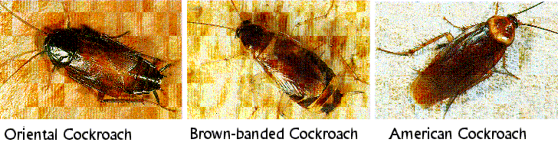
Inhalant Allergens
Indoor allergens
Furry animal pets
Mice
Cockroaches
Notes:
Other indoor allergens come from animals that might be less desirable in the home, such as mice or cockroaches.
Mouse allergens primarily come from mouse urine, but also dander. Cockroach allergens mostly come from their fecal pellets and dried carcasses.
Although mouse and cockroach allergens can be found in suburban and rural environments, the levels tend to be higher in urban environments.

Slide 20
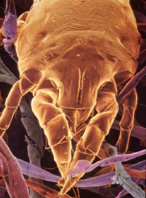
Inhalant Allergens
Indoor allergens
Furry animal pets
Mice
Cockroaches
House dust mites
Notes:
Another source of indoor allergens are house dust mites.
House dust mites are whitish, 8-legged arthropod creatures so small they can barely be seen by the naked eye. Each dust mite is about as big as 2 to 4 grains of fine beach sand.
House dust mites thrive in high humidity, and in areas where shed human and animal skin flakes accumulate, such as bedding, carpet, and upholstery.

Slide 21
Inhalant Allergens
Outdoor allergens
Trees
Notes:
Outdoor allergens are primarily found outdoors. However, outdoor allergens can enter homes through open windows and doors, or passively on hair or clothes.
Outdoor allergens include pollens from some trees. Trees are sources of inhalant allergens only if they produce pollen that is meant to be carried by the wind (to other trees). If trees produce pollen that is meant to be carried by bees, these bee-pollinated trees are not sources of inhalant allergens.
In temperate climates, the highest levels of tree allergens are usually in early spring. However, the timing of “tree pollen season” differs in different parts of the country. Similarly, important tree allergens vary by geographic region, because different trees grow in different geographic regions.

Slide 22
Inhalant Allergens
Outdoor allergens
Trees
Grasses
Notes:
Grasses are another source of outdoor inhalant allergens.
In temperate climates, the highest levels of grass allergens usually occur in late spring to the middle of summer. However, like trees, the timing of “grass pollen season” differs by geographic region.

Slide 23
Inhalant Allergens
Outdoor allergens
Trees
Grasses
Weeds
Notes:
Outdoor inhalant allergens are also produced by weeds, including ragweed.
High levels of weed allergens usually occur in late summer to early autumn, but the timing of “weed pollen season” differs by geographic region.

Slide 24
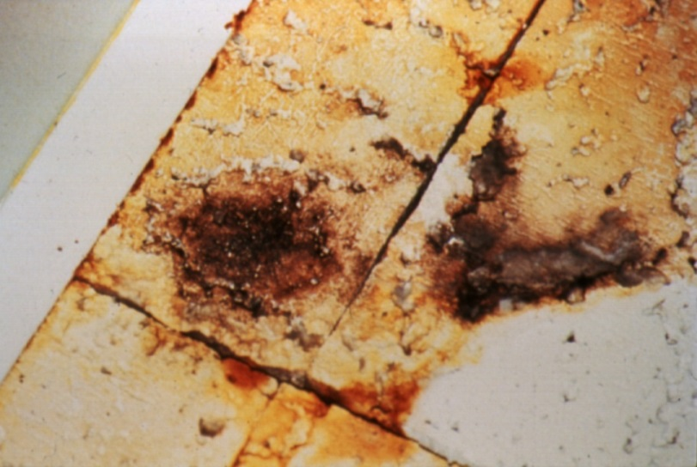
Inhalant Allergens
Mold allergens
Outdoors
Indoors
Notes:
Molds can grow outdoors or indoors, so clinically relevant levels of mold inhalant allergens can be found outdoors or indoors.
Molds can be found in all regions and all climates of the United States. Levels of outdoor mold can vary by season in some geographic regions.

Slide 25
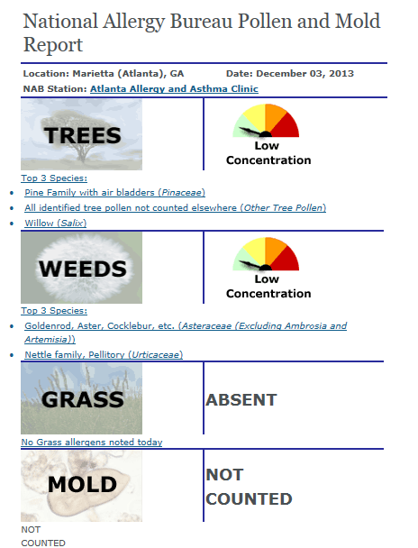
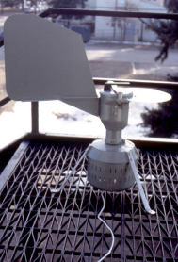
Inhalant Allergens
Outdoor allergens
Trees
Grasses
Weeds
Molds
pollen.aaaai.org/nab
Notes:
Levels of outdoor inhalant allergens from trees, grasses, weeds, or molds often can be found online. These levels come from pollen sampling devices, an example of which is shown on this slide. Measurements from these pollen-sampling devices are used to generate reports of pollen levels.
Shown here is an example of a pollen and mold report for the Atlanta area, which indicates there were low levels of tree and weed pollen in the air. Grass pollens were absent, and mold spores were not counted.

Slide 26
Inhalant Allergens Summary
Indoor
Indoor or Outdoor
Outdoor
Notes:
Here is a summary of what we have covered so far regarding inhalant allergens.
Inhalant allergens from furry animal pets, mice, cockroaches, and house dust mites are primarily found indoors.
Inhalant allergens from molds can be found indoors or outdoors.
Inhalant allergens from pollen grains from trees, grasses, and weeds are mostly found outdoors, but can enter homes through open windows, open doors, or passively on hair or clothes.
It is also important to note that individuals can be sensitive to one, several, or many different types of inhalant allergens.

Slide 27
Inhalant Allergens Summary
Indoor
Indoor or Outdoor
Outdoor
Seasonal
Notes:
Before moving on to the next section, here are a few more terms often used to describe inhalant allergens.
Outdoor inhalant allergens are often referred to as “seasonal”, because levels of outdoor inhalant allergens can differ from season to season, especially in temperate climates.

Slide 28
Inhalant Allergens Summary
Indoor
Indoor or Outdoor
Outdoor
Perennial*
Seasonal
*Some indoor inhalant allergens can exhibit seasonal variation
Notes:
In contrast, indoor inhalant allergens are often thought of as “perennial”, because levels of indoor inhalant allergens can often be present year-round.

Slide 29
evaluation of inhalant allergens
Notes:
NAEPP guidelines regarding the evaluation of inhalant allergens for persons with asthma

Slide 30
Who Should Be Evaluated?
From NAEPP guidelines:
“The Expert Panel recommends that patients who have asthma at any level of severity should be queried about exposures to inhalant allergens, particularly indoor inhalant allergens, and their potential effect on the patient’s asthma. (Evidence A)”
Expert Panel Report 3: Guidelines for the Diagnosis and Management of Asthma, 2007
Notes:
NAEPP guidelines state:
“The Expert Panel recommends that patients who have asthma at any level of severity should be queried about exposures to inhalant allergens, particularly indoor inhalant allergens, and their potential effect on the patient’s asthma.”
The guidelines assigned a level “A” grade to the quality of evidence supporting this statement.

Slide 31

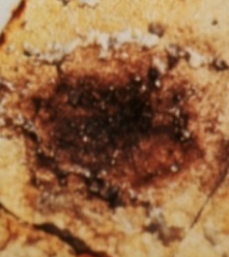
Who Should Be Evaluated?
From NAEPP guidelines:
“The Expert Panel recommends that patients who have asthma at any level of severity should be queried about exposures to inhalant allergens, particularly indoor inhalant allergens, and their potential effect on the patient’s asthma. (Evidence A)”
(emphasis added)
Expert Panel Report 3: Guidelines for the Diagnosis and Management of Asthma, 2007
Notes:
To paraphrase, the guidelines state that any person with asthma should be evaluated for exposures to inhalant allergens, particularly indoor inhalant allergens.
As mentioned earlier in this presentation, indoor inhalant allergens include furry pet animals, mice, cockroaches, house dust mites, and molds.

Slide 32
Inhalant Allergens and Persistent Asthma
For at least those patients who have persistent asthma, the clinician should evaluate the potential role of allergens, particularly indoor inhalant allergens (Evidence A):
Expert Panel Report 3: Guidelines for the Diagnosis and Management of Asthma, 2007
Notes:
For individuals with persistent asthma, the NAEPP guidelines provide further details about evaluating inhalant allergens.

Slide 33
Inhalant Allergens and Persistent Asthma
For at least those patients who have persistent asthma, the clinician should evaluate the potential role of allergens, particularly indoor inhalant allergens (Evidence A):
Use the patient’s medical history to identify allergen exposures that may worsen the patient’s asthma
Expert Panel Report 3: Guidelines for the Diagnosis and Management of Asthma, 2007
Notes:
The guidelines recommend that the patient’s medical history be used to identify allergen exposures that can worsen the patient’s asthma.

Slide 34
Inhalant Allergens and Persistent Asthma
For at least those patients who have persistent asthma, the clinician should evaluate the potential role of allergens, particularly indoor inhalant allergens (Evidence A):
Use the patient’s medical history to identify allergen exposures that may worsen the patient’s asthma
Use skin testing or in vitro testing to reliably determine sensitivity to perennial indoor inhalant allergens to which the patient is exposed
Expert Panel Report 3: Guidelines for the Diagnosis and Management of Asthma, 2007
Notes:
The guidelines recommend testing for allergies using skin testing or in vitro testing (also known as blood testing).

Slide 35
Inhalant Allergens and Persistent Asthma
For at least those patients who have persistent asthma, the clinician should evaluate the potential role of allergens, particularly indoor inhalant allergens (Evidence A):
Use the patient’s medical history to identify allergen exposures that may worsen the patient’s asthma
Use skin testing or in vitro testing to reliably determine sensitivity to perennial indoor inhalant allergens to which the patient is exposed
Expert Panel Report 3: Guidelines for the Diagnosis and Management of Asthma, 2007
Notes:
Allergy testing can help determine sensitivity to inhalant allergens to which an individual is exposed.
As mentioned earlier in this presentation, allergy testing looks for IgE, an allergy-related antibody. Individuals with higher levels of IgE to an allergen are more likely to have immune systems that overreact to that allergen.
If this happens, these individuals can experience airway inflammation, hyperresponsiveness and obstruction when exposed to that allergen, potentially leading to worsened asthma symptoms or an asthma exacerbation.

Slide 36
Inhalant Allergens and Persistent Asthma
For at least those patients who have persistent asthma, the clinician should evaluate the potential role of allergens, particularly indoor inhalant allergens (Evidence A):
Use the patient’s medical history to identify allergen exposures that may worsen the patient’s asthma
Use skin testing or in vitro testing to reliably determine sensitivity to perennial indoor inhalant allergens to which the patient is exposed
(emphasis added)
Expert Panel Report 3: Guidelines for the Diagnosis and Management of Asthma, 2007
Notes:
These recommendations apply to all individuals with persistent asthma, but it is worth recognizing that the phrase “for at least those patients who have persistent asthma” indicates these recommendations might also apply to individuals with intermittent asthma.

Slide 37
Inhalant Allergens Tested Can Vary
By residential area
  Geographic region
  Urban, suburban, or rural
By individual circumstances
  Pets
  Work exposures
Expert Panel Report 3: Guidelines for the Diagnosis and Management of Asthma, 2007; Middleton’s Allergy 7th Ed. , 2009
Notes:
In light of these recommendations, it is important to also keep in mind that the inhalant allergen sensitivities tested during allergy testing can vary from person to person. There can be several reasons for this.
One consideration is the geographic region where the allergy test recipient lives. As mentioned earlier in this presentation, persons living in different parts of the country are often exposed to different kinds of tree, grass, or weed allergens, so allergy tests for these plants often differ by geographic region.
Another consideration is whether an individual lives in an urban, suburban, or rural setting. As mentioned earlier in this presentation, mouse and cockroach allergens can be found in urban, suburban, and rural environments. However, because levels of these allergens are often higher in low-income urban environments, allergy testing for mouse and cockroach sensitivity might be especially important in urban areas.
Individual circumstances can also contribute to variability in allergy testing for inhalant allergens. For example, an individual with asthma who lives with a pet rabbit might be affected by inhalant allergens from the rabbit, so it would be reasonable to include testing for rabbit allergen sensitivity for this individual.
Similarly, another individual with asthma might work with rats in his or her occupation, so it would be reasonable to include testing for rat allergen sensitivity for this individual.

Slide 38
Control of inhalant allergens
Notes:
NAEPP guidelines regarding the environmental control of inhalant allergens for individuals with asthma

Slide 39
NAEPP Components of Asthma Management
Measures of asthma assessment and monitoring
Education for a partnership in asthma care
Control of environmental factors and comorbid conditions that affect asthma
— Inhalant allergens
Medications
Expert Panel Report 3: Guidelines for the Diagnosis and Management of Asthma, 2007
Notes:
Controlling inhalant allergens is part of the NAEPP’s third component of asthma management, ““Control of environmental factors and comorbid conditions that affect asthma.”

Slide 40
NAEPP Management of Inhalant Allergens
Patients who have asthma at any level of severity should:
Reduce, if possible, exposure to allergens to which the patient is sensitized and exposed
Know that effective allergen avoidance requires a multifaceted, comprehensive approach; individual steps alone are generally ineffective (Evidence A)
Expert Panel Report 3: Guidelines for the Diagnosis and Management of Asthma, 2007
Notes:
Regarding the control of inhalant allergens, the guidelines state: “Patients who have asthma at any level of severity should:
- Reduce, if possible, exposure to allergens to which the patient is sensitized and exposed.
- Know that effective allergen avoidance requires a multifaceted, comprehensive approach; individual steps alone are generally ineffective.
The body of research that supports a multifaceted, comprehensive approach to allergen exposure reduction is so strong, it was assigned a level “A” grade.
With this in mind, we will briefly review highlights of NAEPP recommendations regarding specific sources of inhalant allergens.

Slide 41
Management of Furry Animal Pets
If the patient is sensitive to the animal, the treatment of choice is removal of the exposure from the home
If removal of the animal is not acceptable:
  Keep the pet out of the patient’s bedroom
  Keep the patient’s bedroom door closed
Expert Panel Report 3: Guidelines for the Diagnosis and Management of Asthma, 2007
Notes:
For the management of inhalant allergens from furry animal pets, the guidelines state: “If the patient is sensitive to the animal, the treatment of choice is removal of the exposure from the home.”
The guidelines also offer an alternative if this action is not acceptable to the individual involved:
“If removal of the animal is not acceptable: Keep the pet out of the patient’s bedroom, and keep the patient’s bedroom door closed”.

Slide 42
Management of Animal Pests
Integrated Pest Management (IPM)
Physical Changes
Kitchen and Bathroom
  Cleaning*
  Pesticide application (low toxicity)
  Sealing cracks and holes
Patient’s Bedroom
  Cleaning*
  Pesticide (low toxicity)
Education
Clean up spills
Eat only in kitchen
Use sealed food containers
Dispose of trash frequently
*Cleaning to remove dead cockroaches, cockroach fecal pellets, or mouse urine that could contain allergens
Expert Panel Report 3: Guidelines for the Diagnosis and Management of Asthma, 2007; Portnoy et al., JACI, 2012; Portnoy et al., JACI, 2013; Kass et al., Environ Health Perspect, 2009
Notes:
To manage inhalant allergens from animal pests such as cockroaches or mice, the NAEPP’s emphasis on a multifaceted, comprehensive approach is exemplified in what is known as “Integrated Pest Management”, or “IPM”.
Integrated Pest Management involves physical changes and education to reduce animal pests in the home, and, consequently, reduce inhalant allergens from animal pests.
Physical changes to the kitchen and bathroom include cleaning these rooms (to remove dead cockroaches, cockroach fecal pellets, or mouse urine that could contain allergens), sealing cracks and holes to block routes of entry, and, when necessary, low-toxicity pesticides (applied out of the reach of children and pets).
Physical changes to the patient’s bedroom also include cleaning and, when necessary, low-toxicity pesticides (applied out of the reach of children and pets).
Education is an important component of IPM. Because indoor pests need food and water to survive, behavior changes such as cleaning up spills, eating only in the kitchen, using sealed food containers, and disposing of trash frequently can help reduce animal pests and their allergens in the home.

Slide 43
Management of House Dust Mites
Encase mattress and pillow(s) in allergen-impermeable covers
Wash sheets and blankets weekly
Expert Panel Report 3: Guidelines for the Diagnosis and Management of Asthma, 2007; Portnoy et al., Ann Allergy Asthma Immunol, 2013
Notes:
Because house dust mites are prone to accumulate in bedding, recommended actions to control house dust mites include:
Encasing the mattress and pillow(s) in allergen-impermeable covers, so that dust mite-sensitive individuals are exposed to lower amounts of house dust mite allergens in their bedding;
And washing sheets and blankets weekly, because this can help kill and remove house dust mites that settle into sheets and blankets.

Slide 44

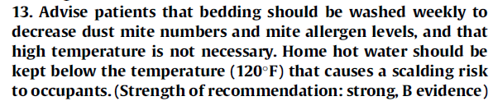
Management of House Dust Mites
Encase mattress and pillow(s) in allergen-impermeable covers
Wash sheets and blankets weekly
Expert Panel Report 3: Guidelines for the Diagnosis and Management of Asthma, 2007; Portnoy et al., Ann Allergy Asthma Immunol, 2013
Notes:
Notably, guidelines regarding environmental assessment and exposure control of house dust mites were published by allergists in 2013.
This panel of experts advised other allergists to advise their patients sensitive to house dust mites that bedding should be washed weekly to decrease house dust mite numbers and mite allergen levels, and that high temperature water is not necessary. One of their concerns about hot water was the risk for injury from scalding.
When these allergists evaluated the available research to support this statement, they felt the evidence was strong enough to merit a level “B” rating.

Slide 45
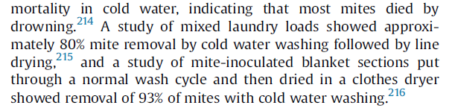
Management of House Dust Mites
Encase mattress and pillow(s) in allergen-impermeable covers
Wash sheets and blankets weekly
Expert Panel Report 3: Guidelines for the Diagnosis and Management of Asthma, 2007; Portnoy et al., Ann Allergy Asthma Immunol, 2013
Notes:
In the research they evaluated, these allergists found that most house dust mites died by drowning.

Slide 46
Management of House Dust Mites
Encase mattress and pillow(s) in allergen-impermeable covers
Wash sheets and blankets weekly
Expert Panel Report 3: Guidelines for the Diagnosis and Management of Asthma, 2007; Portnoy et al., Ann Allergy Asthma Immunol, 2013
Notes:
One study found that 80% of house dust mites were removed when laundry was washed in cold water and then dried on a clothesline.

Slide 47
Management of House Dust Mites
Encase mattress and pillow(s) in allergen-impermeable covers
Wash sheets and blankets weekly
Expert Panel Report 3: Guidelines for the Diagnosis and Management of Asthma, 2007; Portnoy et al., Ann Allergy Asthma Immunol, 2013
Notes:
Another study found that 93% of house dust mites were removed when laundry was washed in cold water and then dried in a clothes dryer.
Based on this evidence, these allergy experts indicated that using hot water was not as important as washing sheets and blankets weekly.

Slide 48
Management of Indoor Molds
Decrease indoor humidity to <50%
Ventilate bathrooms and kitchens
Repair leaks
Address water condensation problems
Expert Panel Report 3: Guidelines for the Diagnosis and Management of Asthma, 2007; www.cdc.gov/mold
Notes:
With respect to molds:
Because indoor molds thrive in humid environments, the guidelines recommend that individuals with asthma who are sensitive to indoor molds take measures to decrease relative humidity in the home (throughout the home) to below 50%, if possible.
This can include ventilating bathrooms and kitchens, repairing leaky faucets, and addressing water condensation problems.
The CDC also has a website dedicated to mold and health (www.cdc.gov/mold), which includes fact sheets on mold, mold removal, and mold remediation.

Slide 49
Management of Outdoor Inhalant Allergens
When possible, stay indoors with windows closed in an air-conditioned environment during peak pollen season
Expert Panel Report 3: Guidelines for the Diagnosis and Management of Asthma, 2007
Notes:
For individuals sensitive to outdoor inhalant allergens (that is, tree pollen, grass pollen, weed pollen, or outdoor mold spores),
NAEPP guidelines recommend staying indoors with windows closed in an air-conditioned environment during peak pollen season, but the authors of these guidelines also recognize this might not always be possible.

Slide 50
Conclusions
Inhalant allergens cause airway inflammation, hyperresponsiveness, and obstruction
Indoor allergens include furry animal pets, mice, cockroaches, house dust mites, and molds
Outdoor allergens include molds, as well as pollens from trees, grasses, and weeds
Outdoor allergens vary by season and geography
Notes:
In conclusion, for individuals with asthma who are sensitive to inhalant allergens, breathing in these allergens can cause airway inflammation, hyperresponsiveness, and obstruction.
Indoor inhalant allergens include furry animal pets, mice, cockroaches, house dust mites, and molds.
Outdoor inhalant allergens include molds, as well as pollens from some trees, grasses, and weeds.
Compared to indoor inhalant allergens, outdoor inhalant allergens typically exhibit more seasonal and geographic variation.

Slide 51
Conclusions
All persons with asthma should be queried regarding exposures to inhalant allergens
  Potential effect on asthma
  Importance of indoor inhalant allergens
Allergy testing can reliably determine sensitivity to inhalant allergens
Reduced allergen exposure can benefit sensitive individuals
Effective allergen avoidance requires a multifaceted, comprehensive approach
Notes:
With respect to inhalant allergens and asthma, NAEPP guidelines state that all persons with asthma should be queried regarding exposures to inhalant allergens and how these allergens might affect these individuals’ asthma. The guidelines emphasize that it is especially important to ask about the presence and potential effects of indoor allergens.
NAEPP guidelines also recommend allergy testing by skin test or blood test to reliably determine sensitivity to inhalant allergens. This recommendation applies to all individuals with persistent asthma, and might apply to individuals with intermittent asthma.
Reduced allergen exposure can benefit individuals with asthma who are sensitive to allergens.
Finally, NAEPP guidelines stress that effective allergen avoidance requires a multifaceted, comprehensive approach.

Slide 52
Additional Resources
Expert panel report 3: guidelines for the diagnosis and management of asthma (EPR⎯3 2007). NIH Publication No. 07-4051. Bethesda, MD: U.S. Department of Health and Human Services; National Institutes of Health; National Heart, Lung, and Blood Institute; National Asthma Education and Prevention Program, 2007.
www.cdc.gov/asthma/public_health.html
  Home-based Multi-trigger, Multi-component Environmental Interventions
  Asthma: A Presentation of Asthma Management and Prevention
www.cdc.gov/mold
Notes:
Additional Resources

Slide 53
References
CDC, Asthma: A Presentation of Asthma Management and Prevention, http://www.cdc.gov/asthma/speakit/default.htm
EPR⎯3. Expert panel report 3: guidelines for the diagnosis and management of asthma (EPR⎯3 2007). NIH Publication No. 07-4051. Bethesda, MD: U.S. Department of Health and Human Services; National Institutes of Health; National Heart, Lung, and Blood Institute; National Asthma Education and Prevention Program, 2007.
Chew GL, et al. Mold and endotoxin levels in the aftermath of Hurricane Katrina: a pilot project of homes in New Orleans undergoing renovation. Environ Health Perspect. 2006 Dec;114(12):1883-9.
Esch, Robert E. and Bush, Robert K. Middleton’s Allergy. 7th Ed. Ed. N. Franklin Adkinson Jr. et al. Philadelphia: Mosby, 2009.
Kass D, et al. Effectiveness of an integrated pest management intervention in controlling cockroaches, mice, and allergens in New York City public housing. Environ Health Perspect. 2009 Aug;117(8):1219-25.
Portnoy J, et al. Environmental assessment and exposure control of dust mites: a practice parameter. Ann Allergy Asthma Immunol. 2013 Dec;111(6):465-507.
Portnoy J, et al. Environmental assessment and exposure reduction of cockroaches: a practice parameter. J Allergy Clin Immunol. 2013 Oct;132(4):802-8.e1-25.
Portnoy J, et al. Environmental assessment and exposure control: a practice parameter —furry animals. Ann Allergy Asthma Immunol. 2012 Apr;108(4):223.e1-15.
Notes:
References

