Slide 1
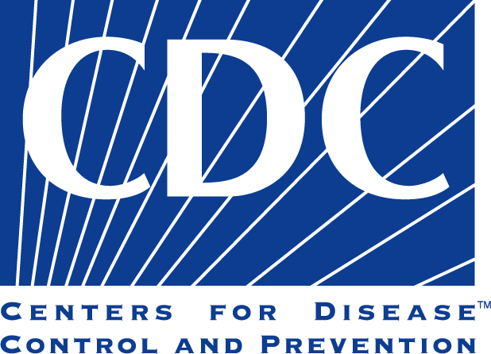
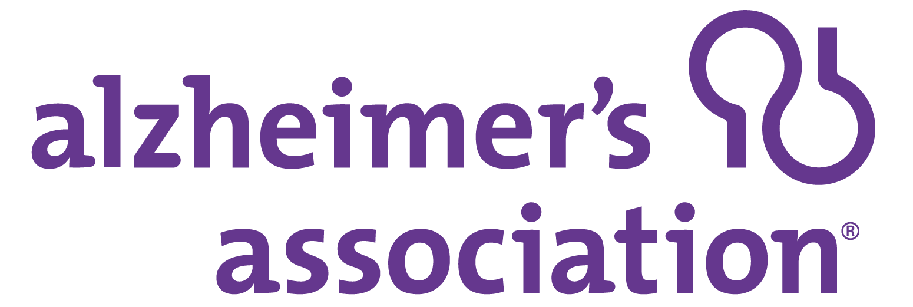
A Public Health Approach to Alzheimer’s and Other Dementias
Alzheimer’s Disease –
A Public Health Crisis
Notes:
Disclaimer:
The mark "CDC” is owned by the US Department of Health and Human Services and is used with permission. Use of this logo is not an endorsement by HHS or CDC of any particular product, service, or enterprise.
Talking Points:
This presentation entitled Alzheimer’s Disease - A Public Health Crisis, is part of a curriculum for public health students entitled, A Public Health Approach to Alzheimer’s and Other Dementias. It was developed by the Emory Centers for Training and Technical Assistance for the Alzheimer’s Association with funding from the Centers for Disease Control and Prevention.
During this module, we will discuss the epidemic of Alzheimer’s and other dementias, and why it is an important issue for public health to understand and act on.

Slide 2
Learning Objectives
Provide a general description of dementia and Alzheimer’s disease
Explain the current and projected scope of the epidemic
Discuss the cost burden of Alzheimer’s for federal/state governments and individuals/caregivers
Describe the care burden of Alzheimer’s, including caregivers and the health care system
Identify health disparities related to Alzheimer’s and other dementias
Explain why public health must play a role in addressing the Alzheimer’s epidemic
Notes:
By the end of the presentation, you will be able to:
Provide a general description of dementia and Alzheimer’s disease
Explain the current and projected scope of the epidemic
Discuss the cost burden of Alzheimer’s for federal/state governments and individuals/caregivers
Describe the care burden of Alzheimer’s, including caregivers and the health care system
Identify health disparities related to Alzheimer’s and other dementias
Explain why public health must play a role in addressing the Alzheimer’s epidemic

Slide 3
Alzheimer’s – Public Health Crisis¹
Historically viewed as aging or medical issue
Impact at national, state, and local levels
Multi-faceted approach needed
Notes:
For many years after its discovery in 1906, Alzheimer’s disease was primarily viewed through the lenses of medical care and aging.
There are valid reasons for this. Medical care is an essential component of identifying and treating individuals with Alzheimer’s disease, which primarily affects older populations. Aging services, such as nursing homes and programs aimed at assisting seniors, are often a vital source of support for people with Alzheimer’s and other dementias.
Yet Alzheimer’s disease affects more than just the individual and his or her medical and support team.
The impact of Alzheimer’s is felt at national, state, and local levels, as well as on a family and personal level, through financial burdens, resource needs, and professional requirements. It is a growing epidemic that has profound social and economic implications, especially given the current trends of an aging population.
As more is learned about Alzheimer’s disease and its impact, it becomes clear that a multi-faceted response by the health care sector, government, public health and within communities is vitally important to address the growing crisis within the U.S. and throughout the world.

Slide 4
What Is Dementia?^{2,3}
General term for decline in cognitive function severe enough to interfere with daily life
Affects memory, thinking ability, social ability
Many dementias are progressive
Notes:
It is first important to understand what characterizes dementia.
Dementia is a general term for a decline in cognitive functioning- that is, thinking, remembering, and reasoning severe enough to interfere with daily life.
Dementia is not a specific disease. It is an overall term that describes a wide range of symptoms associated with a decline in memory or other thinking skills. Dementia is characterized by damage to the brain cells due to age, brain injury, other conditions or diseases, heredity, or a combination of factors.
Many dementias are progressive, meaning that symptoms start out slowly and gradually get worse. In the most severe stages of dementia, a person must depend on others for basic activities of daily life.
The causes of dementia can vary, depending on the types of brain changes that may be taking place. Alzheimer's disease is the most common cause of dementia in older adults. Other dementias include Lewy body dementia, frontotemporal disorders, and vascular dementia. It is common for people to have mixed dementia—a combination of two or more types of dementia.

Slide 5
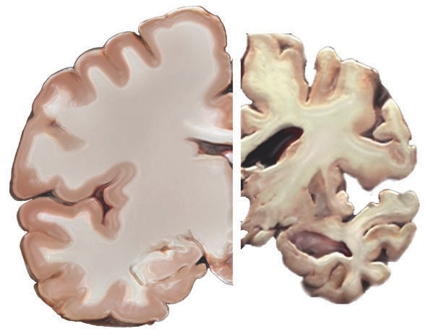
What Is Alzheimer’s Disease?^{4,5}
Irreversible, progressive brain disease
Slowly destroys memory, thinking skills, and ability to carry out basic functions
Brain changes can begin years prior to any noticeable symptoms
Most common cause of dementia (60%-80% of cases)
Notes:
Certain brain diseases and conditions cause dementia. Alzheimer’s disease is an irreversible, progressive brain disease that slowly destroys memory and thinking skills, and eventually the ability to carry out the simplest tasks. The brain changes associated with Alzheimer’s disease occur on a continuum and can begin up to 20 years before a person has any noticeable symptoms or impairment. Alzheimer’s progressively damages and eventually destroys brain cells over the course of many years, even decades.
Alzheimer’s disease is the most common cause of dementia. It accounts for an estimated 60% to 80% of cases.
The term Alzheimer’s dementia is used to describe the stage of Alzheimer’s disease when an individual has observable symptoms such as memory loss, mood/behavior changes, and difficulty with activities of daily living.
*Note: The image on the slide shows a healthy brain (left side) as compared to a severe Alzheimer’s brain (right side). The Alzheimer’s brain is significantly smaller than the healthy brain.
Media supplement: “Inside the Brain: A tour of how the mind works” Alzheimer’s Association.
Link: https://www.alz.org/alzheimers-dementia/what-is-alzheimers/brain_tour

Slide 6
Scope of the Epidemic
Alzheimer’s Disease – A Public Health Crisis
Notes:
Now that you have a basic understanding of Alzheimer’s and dementia, we will turn to how widespread these conditions are.

Slide 7
Scope of the Epidemic (U.S.)⁶
Over 5.8 million adults
1 in 10 adults age ≥65
1 in 3 adults age ≥85
2/3 are women
Notes:
Alzheimer’s disease must be considered a public health crisis. There are many reasons for this.
First, the burden is large and it is growing. Today, over 5.8 million adults in the U.S. are living with Alzheimer’s disease, including an estimated 200,000 under the age of 65.
One in ten adults age 65 and older (10%) currently has Alzheimer’s dementia meaning they are in the stage of Alzheimer’s disease when their symptoms are noticeable and impacting daily living. Approximately one in three (32%) people age 85 and older has the disease.
Women make up almost 2/3 of seniors living with Alzheimer’s dementia in the U.S. According to the Framingham Heart Study data, the estimated lifetime risk for Alzheimer’s dementia at age 45 was approximately one in five (20%) for women and one in ten (10%) for men.

Slide 8
Health Disparities^{7,8}
African-Americans and Hispanics have higher rates of dementia than whites:
African-Americans: 2 times more likely
Hispanics: 1.5 times more likely
Less likely to receive a diagnosis
Often diagnosed at later stages, requiring more medical care
Notes:
The rates of Alzheimer’s and other dementias also reveal certain health disparities.
Although whites make up the majority of people with Alzheimer’s in the U.S., African-Americans and Hispanics have higher rates of Alzheimer’s and other dementias than people of other races and ethnicities.
In the United States, older African-Americans are about two times more likely than older whites to have Alzheimer’s and other dementias. It is estimated that the prevalence is 64% higher in African-Americans. Yet, African-Americans are less likely to receive a diagnosis of Alzheimer’s or other dementias than whites.
Older Hispanics are about one and one-half times more likely than older whites to have these conditions.
When African-Americans and Hispanics are diagnosed, it is often in the later stages of the disease when cognitive and physical impairment are more severe and require more medical care. Thus, they incur much higher costs for care such as hospitals, doctors, home health or nursing home services.
Genetic factors do not appear to impact risk or prevalence. The greater prevalence in these groups may be caused by the increased incidence of other chronic conditions such as high blood pressure and diabetes- both suspected risk factors for Alzheimer’s and other dementias. Socioeconomic factors may also play a role in risk, diagnosis, and care.
Large proportional increases are also expected in both African-American and Hispanic populations in the U.S., which will contribute significantly to the growth of the epidemic in these groups and overall.
Information is emerging about the prevalence of Alzheimer’s in other racial and ethnic groups, including Asian Americans and American Indians/Alaska Natives. It appears that the prevalence is lower in these groups.

Slide 9
Alzheimer’s Deaths⁹
6th leading cause of death
5th leading cause among adults age ≥65
Deaths increased 145% from 2000-2017
Notes:
Alzheimer’s disease is the 6th leading cause of death in the United States and the 5th leading cause of death for those aged 65 and older.
Deaths from Alzheimer’s disease increased 145% from 2000 to 2017, while deaths from other major diseases (including stroke, prostate cancer, and HIV/AIDS) decreased.
The science related to Alzheimer’s and other dementias is rapidly evolving. Current evidence indicates that opportunities may exist to lessen the burden of the disease while the search for a cure continues.

Slide 10
Changes in Causes of Death between 2000-2017¹⁰
Notes:
Compared to other top causes of death in the U.S., deaths from Alzheimer’s have increased significantly, while deaths from other causes have declined.
From 2000 to 2017, the percentage changes in deaths are as follows:
HIV: declined by 60.6%
Stroke: declined by 12.7%
Heart disease: declined by 8.9%
Prostate cancer: declined by 1.9%
Breast cancer: increased by .5%
Alzheimer’s disease: increased by 145%

Slide 11
Growing Epidemic^{11,12}
By 2050 U.S. population age ≥ 65 expected to be 88 million
By 2050, 13.8 million with Alzheimer’s
Today, one new case every 65 seconds
By 2050, every 33 seconds
Notes:
The number of people living with Alzheimer’s and other dementias will continue to grow each year, as the number and proportion of the U.S. population age 65 and older continues to increase rapidly.
The cause of the increase can be attributed to people living longer, the large increase in the number of people over age 65 (baby boomers), and the increasing population of racial and ethnic groups with higher prevalence of Alzheimer’s and other dementias.
By 2050, the U.S. population aged 65 and over is expected to be 88 million.
By 2050, the number of Americans living with Alzheimer’s disease is expected to total 13.8 million.
Today, someone in the U.S. develops Alzheimer’s every 65 seconds. By 2050, that rate is expected to increase to one person every 33 seconds.

Slide 12
Worldwide Epidemic¹³
Estimated 50 million have dementia with 10 million new cases annually
Projected to nearly double every 20 years:
82 million in 2030
152 million in 2050
New case of dementia every 3 seconds
Notes:
Worldwide, the total number of people with dementia (including Alzheimer’s disease) is estimated at 50 million.
This number is projected to nearly double every 20 years to 82 million in 2030 and 152 million in 2050.
The total number of new cases of dementia each year worldwide is nearly 10 million, which equates to one new case every three seconds.

Slide 13
Financial burden
Alzheimer’s Disease – A Public Health Crisis
Notes:
The escalating Alzheimer’s disease epidemic has profound implications for government budgets.

Slide 14
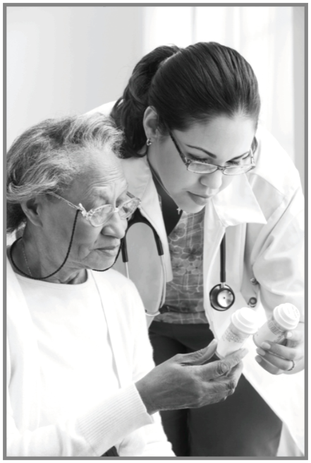
Financial Burden: U.S. & Worldwide^{14,15}
Alzheimer’s is the most expensive disease in U.S.
Annual costs of direct care over $290 billion
Worldwide annual costs exceed $818 billion (2015)
Notes:
Alzheimer’s disease is the most expensive disease to treat and provide care for in the U.S., costing more than heart disease and cancer.
In the U.S., the annual costs of direct care for people with Alzheimer’s disease exceed $290 billion. “Direct care” includes both paid health care, long-term care, and out of pocket costs. It does not include costs of caregiving provided by family members, which will be discussed later in the module.
Worldwide, the annual costs of Alzheimer’s and other dementias are estimated to be over $818 billion.

Slide 15
Discussion Question 1
What are Medicare and Medicaid?
Notes:
First, we’ll start by looking at the Alzheimer’s disease burden on two federally-funded health care programs. What are Medicare and Medicaid?
Open responses.

Slide 16
Medicare & Medicaid¹⁶
Medicare: federally-funded health insurance
U.S. citizen or legal permanent resident age ≥ 65
People under age 65 with certain disabilities or End-Stage Renal Disease
Medicaid: funded by federal and state governments
Helps with medical costs and nursing home expenses for low-income individuals
Notes:
Alzheimer’s disease imposes a significant cost on federal and state budgets through Medicare and Medicaid.
Medicare is federally funded health insurance for people age 65 and older who are U.S. citizens or legal permanent residents, or people under 65 with certain disabilities or with End-Stage Renal Disease (kidney failure that requires dialysis or a kidney transplant).
Medicaid is a program funded by both federal and state governments to help with medical costs for some people with limited income and resources.
Medicare does not cover the cost of long-term care for assisted living, nursing homes, or in-home care such as sitters or certified nursing assistants. Medicaid will cover the cost of nursing home care for low-income individuals or once an individual has limited personal assets and/or may require that the majority of the individual’s monthly income be spent on nursing home care expenses.

Slide 17
Alzheimer’s: Medicare & Medicaid^{17,18}
Pays 67% of health and long-term costs of Alzheimer’s
Nearly 1 in 5 Medicare dollars
Per-person spending for those with Alzheimer’s:
Medicare: 3 times higher than average
Medicaid: 23 times higher than average
Notes:
These facts underscore the significant costs facing Medicare and Medicaid as a result of the Alzheimer’s epidemic.
About 67% of the health and long-term care costs of caring for those with Alzheimer’s disease are paid for by Medicare and Medicaid.
In 2019, the Medicare and Medicaid government programs will spend an estimated $195 billion caring for those with Alzheimer’s and other dementias- 67% of total annual costs of these conditions. Nearly one in every five Medicare dollars is spent on people with Alzheimer’s and other dementias.
Average per-person Medicare spending for those with Alzheimer’s and other dementias is three times higher than average per-person spending across all other seniors. Medicaid payments are 23 times higher. People with Alzheimer’s and other dementias also have high out-of-pocket costs. These costs are for Medicare and other health insurance premiums and for deductibles, copayments and services not covered by Medicare, Medicaid or additional sources of support.

Slide 18
Alzheimer’s: Projected Costs (2050)^{19,20}
Total annual costs over $1.1 trillion
Annual costs to Medicare: $559 billion (over 300% increase)
Out-of-pocket costs: $198 billion
Notes:
Just as the number of people with Alzheimer’s disease is projected to dramatically increase, so will the costs associated with their care.
Currently, 1 in every 5 dollars spent by Medicare is spent on someone with Alzheimer’s. By 2050, it will be 1 in every 3 dollars. If current conditions go unchanged, in 2050 the annual costs of treating Alzheimer’s disease in the US will be over $1.1 trillion. Annual costs to Medicare will increase over 300% to $559 billion.
It is estimated that Medicaid spending on people with Alzheimer’s will reach $191 billion in 2050. Combined costs for Medicare and Medicaid expenses will be $750 billion (in today’s dollars).
Out-of-pocket costs for individuals and families affected by Alzheimer’s and other dementias will similarly see increases from $63 billion in today’s dollars to $198 billion in 2050.

Slide 19
Care burden
Alzheimer’s Disease – A Public Health Crisis
Notes:
The care burden associated with the Alzheimer’s disease epidemic is also a significant and growing challenge.

Slide 20
Care Workforce
Caregivers (family or friends)
Health care providers
Paid care providers
Notes:
People with Alzheimer’s and other dementias are generally cared for by a network of family or friend caregivers, health care providers, and paid care providers (such as those who help with daily tasks and self-care).
Most individuals with Alzheimer’s disease have a primary caregiver, often a family member, who is crucial to ensuring appropriate care.
The type and scope of the care needed by people with Alzheimer’s disease changes throughout the course of the illness.

Slide 21
Alzheimer’s & Dementia Caregivers²¹
83% of care provided to older adults is by family members, friends or other unpaid caregivers
70% of people with Alzheimer’s live in the community
Over 16 million caregivers (family and friends)
18.5 billion hours of unpaid care annually
Unpaid care valued at $233.9 billion (2018)
Notes:
In the US, 83% of the care provided to older adults is by family members, friends or other unpaid caregivers.
About 70% of people with Alzheimer’s disease live in the community in home settings where the vast majority of their care is provided by family and friends.
Currently in the U.S., it is estimated that over 16 million family and friends provide nearly 18.5 billion hours of unpaid care annually.
In 2018, this care was valued at $233.9 billion. This is approximately 46% of the net value of Walmart annual sales which was $500.3 billion in 2018 and nearly 10 times the total annual revenue of McDonald’s which was $22.8 billion in 2017.

Slide 22
Discussion Question 2
What might be the roles and responsibilities of a caregiver for someone with Alzheimer’s?
Notes:
Ask: What might be the roles and responsibilities of a caregiver for someone with Alzheimer’s?
Open responses.

Slide 23
Alzheimer’s & Dementia Caregivers^{22,23}
Caregiver profile
2/3 are women (typically daughter or wife)
Middle-aged
Over half currently employed
Caregiving responsibilities
Help with activities of daily living
Medical and financial management
Provide increasing levels of care as disease progresses
Notes:
The term caregiver is used to describe a person who provides a level of care and support for another that exceeds typical responsibilities of daily life. This is usually a family member or friend. This does not include hired help, such as home health aides, which we’ll discuss in a few slides.
According to caregiver data from the Behavioral Risk Factor Surveillance System (BRFSS), the typical caregiver for a person with Alzheimer’s or another dementia is the middle-aged daughter/daughter-in-law who is also often still employed or self-employed.
Caregiving responsibilities, especially in the moderate and severe stages of Alzheimer’s, often include:
Help with activities of daily living such as dressing, bathing, toileting, and feeding
Shopping, meal preparation, transportation
Medication management, financial management
Providing emotional support
People with Alzheimer’s require increasing levels of care as the disease progresses; more severe stages may require constant supervision and result in complete dependence on caregivers (paid and/or unpaid).

Slide 24
Caregivers: Challenges²⁴
Physical, psychological, social challenges
$11.8 billion additional health care costs (2018)
60% rate emotional stress as high or very high
30-40% suffer from depression
Increased likelihood of new or worsening health problems
Notes:
Caregivers of people with Alzheimer’s and other dementias often experience physical, psychological, and social challenges.
Several recent findings highlight these challenges:
Due to the physical and emotional toll of caring for someone with Alzheimer’s or other dementias, these caregivers had $11.8 billion in additional health care costs in 2018.
Nearly 60% of Alzheimer’s and dementia caregivers rate the emotional stress of caregiving as high or very high.
About 30-40% of Alzheimer’s and dementia caregivers suffer from depression, as compared to 5-17% of non-caregivers of similar ages.
Caring for a loved one with Alzheimer’s can put caregivers at increased risk for new or worsening health conditions. Nearly 75% of caregivers express concern about the ability to maintain their own health since becoming a caregiver. Many caregivers delay attending to their own health care needs due to lack of time and/or resources.

Slide 25
Caregivers: Impact on Work²⁵
Went in late/ left early/ took time off (57%)
Went from full-time to part-time work (18%)
Took leave of absence (16%)
Turned down a promotion (8%)
1 in 6 quit work entirely to be a caregiver
Notes:
In many cases, caring for an individual with Alzheimer’s has a negative effect on employment, income, and financial security.
Among Alzheimer’s and dementia caregivers who are employed full or part time:
57% said they had to go in late, leave early, or take time off because of their caregiving responsibilities
18% had to go from working full time to part time
16% took a leave of absence
8% turned down a promotion
1 in 6 had to quit work entirely either to become a caregiver or because their caregiving duties became too demanding.

Slide 26
Caregivers: Length of Care^{26,27}
86% at least one year
50% four or more years
May range from 4-20 years
Burden of care higher than for non-dementia caregiving
Notes:
Caregivers of individuals with Alzheimer’s and other dementias spend much more time providing care than caregivers of individuals with other conditions.
In 2017, of the unpaid Alzheimer’s and dementia caregivers:
86% had been providing care for at least a year
50% had been providing care for four or more years
All rates for length of care are significantly higher for dementia caregivers than for non-dementia caregivers.
In addition to the overall length of time care is provided, the intensity and variety of care provided is greater among those caring for someone with dementia than among caregivers for individuals without dementia. According to a report by the National Alliance for Caregiving, the burden of care index for dementia caregivers is much higher than the burden for non-dementia caregivers. The burden of care index is based on the number of hours of care, types and number of care activities performed.

Slide 27
Caregivers: Critical Role
Health care system could not sustain costs of care without caregivers
Support for caregivers is a public health issue
Notes:
The burden on caregivers is significant; yet they play a critical role in supporting individuals with Alzheimer’s and dementia.
More broadly, without caregivers, the health care system could not sustain the costs of care for persons with Alzheimer’s and other dementias.
Assuring caregivers receive needed support is a public health issue.

Slide 28
Health Professionals: Shortage^{28,29}
Shortage of health care professionals trained to work with older adults
Additional 3.5 million needed by 2030
Currently have half the number of certified geriatricians needed
Less than 1% of RNs, PAs, and pharmacists identify as geriatric
Many not adequately trained for Alzheimer’s and dementia
Notes:
With the growing number of older adults in the U.S. population (both with and without Alzheimer’s and other dementias), the country is facing a workforce shortage of health care professionals who are trained to meet the needs of older adults. Furthermore, many professionals already in the workforce are often not adequately trained on the needs of people with Alzheimer’s and other dementias.
Current estimations of workforce shortages include:
The U.S. will need an additional 3.5 million health care professionals by 2030 just to maintain the current ratio of health care professionals to older adults.
The U.S. has approximately half the number of certified geriatricians than it needs. Currently, this equates to 1 geriatrician for every 1,924 adults age 65 or older.
Less than 1% of registered nurses, physician assistants, and pharmacists identify themselves as specializing in geriatrics.

Slide 29
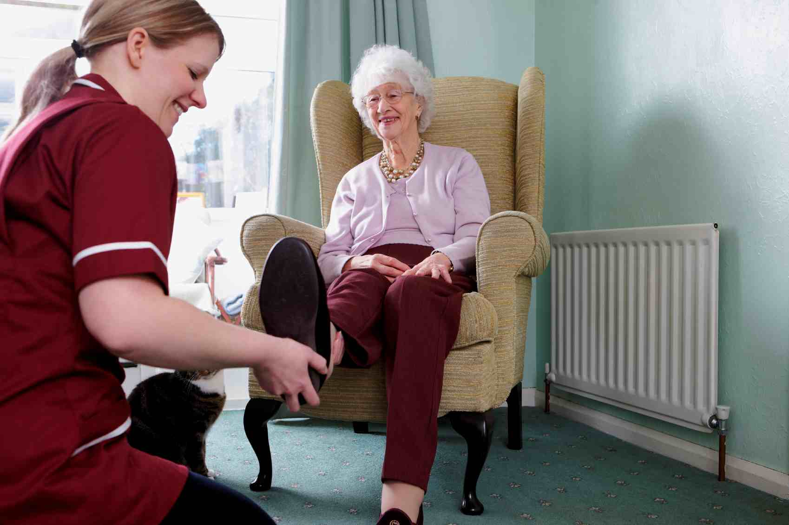
Direct Care Workforce³⁰
Provide majority of care for Alzheimer’s (after caregivers)
Include nurse aides, home health aides, personal-care aides and home-care aides
Help with daily activities: bathing, dressing, eating
Costs range from $48,000 to over $90,000 a year
Notes:
Many older adults, including those with Alzheimer’s and other dementias, receive a large part of their care from direct-care workers, such as nurse aides, home health aides, personal-care aides, and home-care aides.
These workers help with bathing, dressing, eating, and numerous other daily tasks, both at home and within institutions.
It typically costs $132 per day or $48,000/year for a home care agency to provide care in the home.
For care provided in a long term care facility, the cost is about $48,000 per year for assisted living and upwards of $90,000 or more per year for nursing home care.
Given that Medicare and most private insurance (other than long term care insurance) do not cover these costs, most individuals and/or their families pay out of pocket for this care.

Slide 30
Direct Care Workforce: Challenges³¹
Workforce shortage
Rapid increases in number of workers needed as population ages
High turnover
Recruitment and retention difficult
Challenging job given nature of the work
Limited training, especially on Alzheimer’s and dementia
Notes:
Challenges within the direct care workforce include shortages in the number of workers needed and insufficient training. As with family caregivers, the role of providing ongoing, extensive care for a person with Alzheimer’s and other dementias is physically and emotionally taxing. This makes finding, hiring, and retaining the right person for the role difficult. Added to that is the challenge of finding the large amount of workers needed to care for the rapidly increasing population needing care services. These jobs typically pay slightly more than minimum wage, often have inconsistent work hours, and usually includes working weekends, holidays, overnight hours…whenever an individual needs care.
Subsequently, turnover rates are high among direct-care workers, and recruitment and retention are persistent challenges.
Many direct-care workers receive little training on Alzheimer’s and dementia care although there is a growing awareness of the need for training related to the special care needs and considerations for people with Alzheimer’s or other dementias. For most direct-care workers currently, the average training is 75 hours, with little focus on Alzheimer’s and dementia.
Many people wish to remain in their own home or a loved one’s home as they age. Therefore, there is tremendous growth in the home care industry. The home care workforce more than doubled between 2007 and 2017, with the expectation that the field will need to add another one million jobs by 2026 to keep pace with the growing tide of older adults needing care.

Slide 31
Public health approach
Alzheimer’s Disease – A Public Health Crisis
Notes:
Fortunately, there are ways to intervene using public health tools and techniques. The public health approach can be used to improve the quality of life for those living with the disease, their caregivers, and to reduce the costs associated with the disease.

Slide 32
Healthy People 2030³²
Proposed objectives for Alzheimer’s and other dementias:
Increasing diagnosis and awareness
Reducing preventable hospitalizations
Increasing number of older adults discussing their memory issues with a health care professional
Notes:
Alzheimer’s and other dementias were included for the first time in Healthy People 2020.
Healthy People, released every ten years by the U.S. Department of Health and Human Services, is a framework of goals and objectives that is used to guide national health promotion and disease prevention efforts in the U.S.
The proposed objectives for Healthy People 2030 includes the topic area “Dementias, including Alzheimer’s” and contains specific objectives regarding increasing diagnosis and awareness, reducing preventable hospitalizations, and increasing the number of older adults who discuss their confusion or memory loss issues with a health care professional. Public health has a role to play in reaching those objectives.
Inclusion in Healthy People underscores the growing public health threat that Alzheimer’s and other dementias pose to the nation.

Slide 33
Role of Public Health³³
4 key ways public health can have an impact:
Surveillance/monitoring
Risk reduction
Early detection and diagnosis
Safety and quality of care
Notes:
Note to presenter: See module 3 for more information.
According to the Healthy Brain Initiative’s State and Local Public Health Partnerships to Address Dementia, public health has a vital role to play in promoting cognitive function and addressing the impact on the healthcare system, community and individuals.
Through its broad community-based approach, public health can provide the following:
Surveillance and monitoring that allows public health to compile data and use it to:
Develop strategies and interventions
Inform public policy
Guide research
Evaluate programs and policies
Educate populations
Risk reduction strategies: Primary prevention strategies can be used to promote risk reduction for cognitive decline and dementia, as well as promote cognitive health in general.
Early detection and diagnosis: Public health plays an important role in efforts to increase early detection and diagnosis of Alzheimer’s, including:
Educating the public about the warning signs of dementia, benefits of early detection, and training to health care providers and newly diagnosed individuals, families, and caregivers.
Identifying and promoting strategies designed to promote early detection
Safety and quality of care: Caring for those with Alzheimer’s and dementia requires specialized knowledge about the disease continuum and skill to effectively communicate and care for individuals and their family caregivers. Providing training for health care providers and caregivers can increase the quality of care and safety of the individual and the caregiver. Information sharing is also important for those in the community who may interact with individuals with Alzheimer’s such as first responders, public transportation providers, pharmacies, faith communities, etc.
As mentioned earlier, dementia caregivers also face challenges such as emotional and physical stress, lack of time for self-care, financial issues, isolation, etc. Caregivers need support and access to resources that will enable them to maintain their health and well-being during the years of caregiving.

Slide 34
Dementia Capable Systems and dementia friendly communities
Dementia capable systems
Support services
Workforce training and education
Dementia friendly communities
Safe, supportive environments
Notes:
Note to presenter: See module 4 for more information.
Public health also has a role to play in supporting dementia capable systems and dementia friendly communities. At a larger level, states and communities can become dementia capable and accommodate the needs of a population with Alzheimer’s and other dementias.
A dementia capable system is one that meets the needs of people with dementia and their caregivers by providing education, support, and services. Public health can contribute to a dementia capable system through:
Ensuring access to support services for people with dementia and their caregivers
Workforce training and education
Public health also can support the creation of dementia friendly communities. These are cross-sector, community-wide efforts to have support services, resources, and safe environments that allow people with dementia and their caregivers to stay connected to the community. Over time, these partnerships should:
Enhance support services and resources
Address accessibility and mobility barriers
Provide dementia training for health care providers and first responders
Provide a range of resources to support family caregivers such as respite care services.

Slide 35
For More Information
For more information, please visit:
Alzheimer’s Association: http://www.alz.org
CDC’s Alzheimer’s Disease and Healthy Aging Program: https://www.cdc.gov/aging/
Notes:
For more information on the topics covered in this presentation, please go to the Alzheimer’s Association website at http://www.alz.org or the Centers for Disease Control and Prevention’s Alzheimer’s Disease and Healthy Aging Program at https://www.cdc.gov/aging/. There you can find resources, latest research and information.

Slide 36
COMPETENCIes
Academy for Gerontology in Higher Education (AGHE):
1.3.3 Demonstrate knowledge of signs, symptoms, and impact of common cognitive and mental health problems in late life (e.g., dementia, depression, grief, anxiety).
Council on Education for Public Health (CEPH) Foundational Competencies
2. Locate, use, evaluate and synthesize public health information (bachelors-level).
4. Interpret results of data analysis for public health research, policy, or practice (masters-level).
Council on Linkages Between Academia and Public Health Practice:
2A. Identifies current trends (e.g., health, fiscal, social, political, environmental) affecting the health of a community.
Notes:
Presenter Note: This slide can be edited as needed or removed.
The content in this presentation supports the development of the following competencies:
Academy for Gerontology in Higher Education (AGHE):
1.3.3 Demonstrate knowledge of signs, symptoms, and impact of common cognitive and mental health problems in late life (e.g., dementia, depression, grief, anxiety).
Council on Education for Public Health (CEPH) Foundational Competencies
2. Locate, use, evaluate, and synthesize public health information (bachelors-level)
4. Interpret results of data analysis for public health research, policy, or practice (masters-level)
Council on Linkages Between Academia and Public Health Practice:
2A. Identifies current trends (e.g., health, fiscal, social, political, environmental) affecting the health of a community.

Slide 37
References
¹Alzheimer’s Association and Centers for Disease Control and Prevention. Healthy Brain Initiative, State and Local Public Health Partnerships to Address Dementia: The 2018-2023 Road Map. Chicago, IL: Alzheimer’s Association; 2018.
²Alzheimer’s Association. (n.d.) What is Dementia? Retrieved from https://www.alz.org/alzheimers-dementia/what-is-dementia#causes
³National Institute on Aging. (2017) What is Dementia? Retrieved from https://www.nia.nih.gov/health/what-dementia
⁴Alzheimer’s Association. (n.d.) What is Dementia? Retrieved from http://www.alz.org/what-is-dementia.asp#causes
⁵National Institute on Aging. (2019) Alzheimer’s Disease Fact Sheet. Retrieved from https://www.nia.nih.gov/health/alzheimers-disease-fact-sheet
⁶Alzheimer’s Association. (2019) 2019 Alzheimer’s Disease Facts and Figures.
⁷Matthews, K.A. et al. (2019) Racial and Ethnic Estimates of Alzheimer's Disease and Related Dementias in the United States (2015–2060) in Adults Aged ≥ 65 years. Retrieved from https://aanddjournal.net/article/S1552-5260(18)33252-7/fulltext
⁸Alzheimer’s Association. (2018) Race, Ethnicity, and Alzheimer’s Fact Sheet.
⁹Alzheimer’s Association. (2019) 2019 Alzheimer’s Disease Facts and Figures.
¹⁰ Alzheimer’s Association. (2019) 2019 Alzheimer’s Disease Facts and Figures.
¹¹Alzheimer’s Association. (2019) 2019 Alzheimer’s Disease Facts and Figures. ¹² Matthews, K.A. et al. (2019) Racial and Ethnic Estimates of Alzheimer's Disease and Related Dementias in the United States (2015–2060) in Adults Aged ≥ 65 years. Retrieved from https://aanddjournal.net/article/S1552-5260(18)33252-7/fulltext
¹³World Health Organization. (2017) Key Facts. Retrieved from https://www.who.int/news-room/fact-sheets/detail/dementia
¹⁴Alzheimer’s Association. (2019) 2019 Alzheimer’s Disease Facts and Figures.
¹⁵Alzheimer’s Disease International. (2015) World Alzheimer Report 2015: The Global Impact of Dementia: An Analysis of Prevalence, Incidence, Cost and Trends. Retrieved from http://www.worldalzreport2015.org/
¹⁶Department of Health and Human Services. (2019) What’s Medicare? Retrieved from https://www.medicare.gov/pubs/pdf/11306-Medicare-Medicaid.pdf

Slide 38
References continued
¹⁷Alzheimer’s Association. (2019) 2019 Alzheimer’s Disease Facts and Figures. ¹⁸Alzheimer’s Association. (2018) Costs of Alzheimer’s to Medicare and Medicaid.
¹⁹Alzheimer’s Association. (2016) 2016 Alzheimer’s Disease Facts and Figures.
²⁰Alzheimer’s Association. (2018) Costs of Alzheimer’s to Medicare and Medicaid.
²¹Alzheimer’s Association. (2019) 2019 Alzheimer’s Disease Facts and Figures.
²²Alzheimer’s Association. (2019) 2019 Alzheimer’s Disease Facts and Figures.
²³Centers for Disease Control and Prevention. (2019) Behavioral Risk Factor Surveillance System (BRFSS) Caregiver Module. Retrieved from https://www.cdc.gov/aging/healthybrain/brfss-faq-caregiver.htm
²⁴Alzheimer’s Association. (2018) Alzheimer’s Disease Caregivers.
²⁵Alzheimer’s Association. (2018) Alzheimer’s Disease Caregivers.
²⁶ Alzheimer’s Association. (2018) Alzheimer’s Disease Caregivers.
²⁷ National Alliance for Caregiving & Alzheimer’s Association. (2017) Dementia Caregiving in the U.S.
²⁸ Alzheimer’s Association. (2019) 2019 Alzheimer’s Disease Facts and Figures.
²⁹ Institute of Medicine (US) Committee on the Future Health Care Workforce for Older Americans. (2008) Retooling for an Aging America: Building the Health Care Workforce. Washington (DC): National Academies Press (US).
³⁰Alzheimer’s Association. (2019) 2019 Alzheimer’s Disease Facts and Figures.
³¹ Paraprofessional Healthcare Institute (PHI). (2018) U.S. Home Care Workers Key Facts.
³² Department of Health and Human Services. (n.d.) Healthy People Topics and Objectives. Retrieved from https://www.healthypeople.gov/
³³ Alzheimer’s Association and Centers for Disease Control and Prevention. Healthy Brain Initiative, State and Local Public Health Partnerships to Address Dementia: The 2018-2023 Road Map. Chicago, IL: Alzheimer’s Association; 2018.

