Slide 1
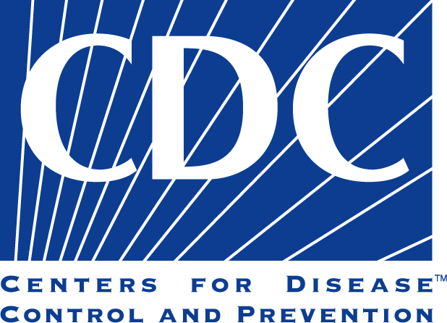
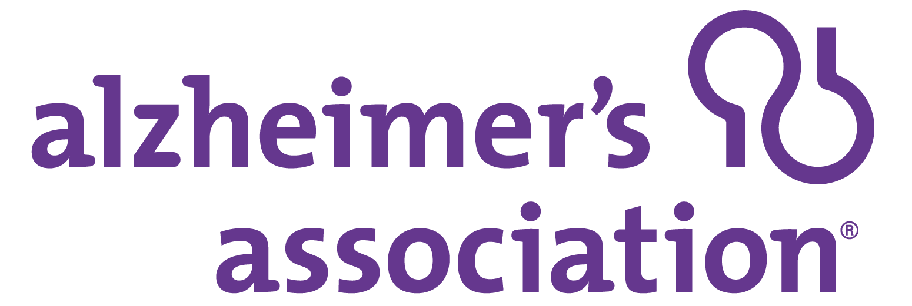
A Public Health Approach to Alzheimer’s and Other Dementias
Alzheimer’s & Other Dementias –
The Basics
Notes:
DISCLAIMERS
This publication was supported by Cooperative Agreement Number 5U58DP002945-05, funded by the Centers for Disease Control and Prevention. Its contents are solely the responsibility of the authors and do not necessarily represent the official views of the Centers for Disease Control and Prevention or the Department of Health and Human Services.
The mark "CDC” is owned by the US Dept. of Health and Human Services and is used with permission. Use of this logo is not an endorsement by HHS or CDC of any particular product, service, or enterprise.
Talking Points:
This presentation entitled, Alzheimer’s and Other Dementias – The Basics is part of a curriculum for public health students entitled, A Public Health Approach to Alzheimer’s and Other Dementias. It was developed by the Emory Centers for Training and Technical Assistance for the Alzheimer’s Association with funding from the Centers for Disease Control and Prevention.
This module provides background information on cognitive health, cognitive impairment, dementia, and Alzheimer’s disease. It provides essential information on Alzheimer’s disease, including what is known about its causes, its progression, risk factors, and care.

Slide 2
Learning Objectives
Define cognitive health
Define and differentiate between dementia and Alzheimer’s
List at least 5 early signs of Alzheimer’s
Describe the changes that occur during the course of Alzheimer’s
Describe the role of caregivers
Notes:
By the end of the presentation, you will be able to:
Define cognitive health
Define and differentiate between dementia and Alzheimer’s
List at least 5 early signs of Alzheimer’s
Describe the changes that occur during the course of Alzheimer’s
Describe the role of caregivers

Slide 3
Discussion Question 1
What is cognitive health?
Notes:
Ask: What is cognitive health?
Open responses.

Slide 4
Cognitive Health¹
Cognition: the ability to think, learn, and remember
Cognitive health continuum: “optimal functioning” to severe disability
Notes:
To understand what happens to a person when he or she develops Alzheimer’s or dementia, it is helpful to first consider cognitive health.
Cognition refers to the ability to think, learn, solve problems, and remember.
Cognitive health can be viewed along a continuum. At one end is “optimal functioning,” which refers to a healthy brain that can perform the following mental processes:
Learning new things
Intuition
Judgment
Language
Remembering
At the other end of the spectrum are people with severe Alzheimer’s, dementia, and other brain injuries with limited cognitive functioning.

Slide 5
Cognitive Aging^{2,3,4}
The brain changes as it ages
Increase in wisdom and expertise
Speed of processing, making decisions, remembering may slow
Normal part of aging
Notes:
Like other organs in the human body, the brain changes as it ages. Physical structures in the brain change, and its ability to carry out various functions tends to decline.
Wisdom and expertise can increase with age, while the speed of processing information, making decisions, and recall of information can slow down.
This process is known as cognitive aging, which refers to a decline in memory, decision-making, processing speed, and learning. For example, a person might need longer to learn a new skill, have more difficulty recalling certain words or finding common items such as glasses or keys. These changes are considered a normal part of aging and varies from person to person from day to day.
When changes in a person’s cognitive ability affects their daily life, it may be an indication that it is due to something other than normal aging changes. Subjective Cognitive Decline is self-reported confusion or memory loss that is happening more often or is getting worse. A growing body of evidence suggests that Subjective Cognitive Decline is one of the earliest warning signs for Alzheimer’s and other dementias. In the 2016 Behavioral Risk Factor Surveillance System (BRFSS) surveys conducted by state health departments, one in 9 adults age 45 or older reported experiencing subjective cognitive decline. Over half of those respondents reporting Subjective Cognitive Decline had not talked about their memory issues with a health care provider.

Slide 6
Mild Cognitive Impairment (MCI)^{5,6}
Difficulty with cognitive processes
Not severe enough to interfere with daily life
Increased risk of Alzheimer’s or dementia
May be caused by external factors (vitamin B12 deficiency, depression)
Notes:
Mild cognitive impairment (MCI) is a condition in which people have memory or other thinking problems that are noticeable, but their symptoms are not severe enough to interfere with everyday activities.
Symptoms of MCI may include forgetting important information that he or she would have previously recalled easily (such as appointments, conversations, or recent events), or a decreased ability to make sound decisions, judge the time or sequence of steps needed to complete a complex task, or have trouble with visual perception.
A person with MCI is at an increased risk of developing Alzheimer’s or other dementia.
In some cases, however, the condition may be caused by external factors, such as medication, vitamin B12 deficiency, and depression. In these cases, the condition may be reversed if the underlying cause is addressed, reverse on its own, or remain stable.

Slide 7
Cognitive Impairment⁷
Difficulty with cognitive processes that affect everyday life
Spans wide range of functioning
Can occur as a result of Alzheimer’s, dementia, stroke, traumatic brain injury
Notes:
Further along the cognitive health continuum is cognitive impairment.
When a person has trouble with cognitive processes that begin to affect the things he or she does in everyday life, it is often referred to as cognitive impairment.
Cognitive impairment spans a wide range of functioning. It can occur as a result of Alzheimer’s or other dementias, or with other conditions such as stroke and traumatic brain injury.

Slide 8
Dementia⁸
Decline in mental ability severe enough to interfere with daily life
Not a specific disease
Not normal aging
Caused by damage to brain cells from disease or trauma
Many dementias are progressive
Notes:
Dementia is a general term for a decline in mental ability severe enough to interfere with daily life.
Dementia is not a specific disease. Rather, it’s an overall term that describes a wide range of symptoms associated with a decline in memory or other thinking skills.
Dementia is NOT normal aging.
It is caused by damage to brain cells from disease or trauma (such as a brain injury or stroke). This damage interferes with the ability of brain cells to communicate with each other. When brain cells cannot communicate normally, thinking, behavior, and feelings can be affected.
Many dementias are progressive, meaning symptoms start out slowly and gradually get worse.
There are several types of dementia. Alzheimer’s is the most common cause of dementia, followed by vascular dementia.
Vascular dementia is a decline in thinking skills caused by conditions that block or reduce blood flow to the brain such as a stroke that deprives brain cells of vital oxygen and nutrients.
Other types of dementia include Lewy Body dementia, frontotemporal, Huntington’s disease and others. Researchers increasingly believe a large number of dementia cases are mixed dementia when a person has multiple types of dementia.
Sometimes dementia-like symptoms can be caused by other conditions, such as depression, vitamin deficiencies, thyroid problems, and some infections, that when treated will result in improvement of dementia-like symptoms. A key difference between these conditions and dementia is that the symptoms usually appear suddenly, whereas dementia develops slowly over time. This is one reason why it is important for someone with memory changes to be seen by a health professional to determine a possible cause of confusion or memory loss.

Slide 9
ALZHEIMER’S DISEASE
Alzheimer’s and Other Dementias – The Basics
Notes:
The most common cause of dementia is Alzheimer’s disease. We will focus our attention on understanding more about the stages of Alzheimer’s as well as risk factors, treatment, and management of the disease.

Slide 10
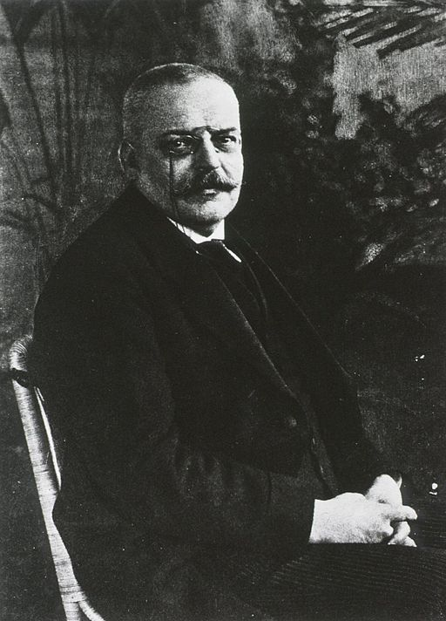
Alzheimer’s History⁹
Identified in 1906 by Dr. Alois Alzheimer
Examined brain of woman who died after living with profound memory loss
Found abnormal clumps (plaques) and tangled fibers (tangles) in the brain
Notes:
Alzheimer’s disease was first identified in 1906 by Dr. Alois Alzheimer. He noticed certain changes in the brain tissue of a woman in her 50s who had died after several years of progressive cognitive impairment, hallucinations, disorientation, and unpredictable behavior.
Dr. Alzheimer examined her brain after death and found many abnormal clumps (now called amyloid plaques) and tangled bundles of fibers (now called neurofibrillary, or tau, tangles). These plaques and tangles in the brain are still considered some of the hallmarks of Alzheimer’s disease, along with the loss of connections between nerve cells (neurons) in the brain.

Slide 11
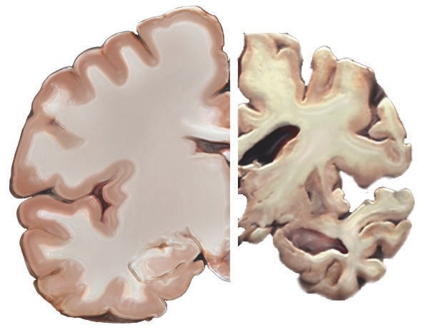
Alzheimer’s Overview¹⁰
Most common cause of dementia
60% - 80% of cases
Progressive – symptoms gradually worsen over number of years
Notes:
Alzheimer’s disease is the most common cause of dementia. It accounts for an estimated 60% to 80% of cases.
Alzheimer’s is a progressive disease, in which brain changes may go unnoticed for years, but gradually worsen over time as the brain deteriorates due to the disease. The image on the slide shows a healthy brain (left side) as compared to a severe Alzheimer’s brain (right side). The Alzheimer’s brain is significantly smaller than the healthy brain.
Alzheimer’s is viewed as a continuum where brain changes can begin a decade or more before symptoms begin to appear. Eventually the brain changes caused by Alzheimer’s may result in the first symptoms of cognitive decline, and over time reach the mild cognitive impairment stage. The term Alzheimer’s dementia refers to the stage of the disease when an individual has observable symptoms such as memory loss, mood/behavior changes, and difficulty with activities of daily living.
In mild (early) stages of dementia, people experience some memory loss, but with severe (late-stage) Alzheimer’s, individuals lose the ability to carry on a conversation and respond to their environment. The degenerative nature of the disease means many in the severe stage have difficulty moving, often become bed-bound, and need round-the-clock care.

Slide 12
Alzheimer’s Causes¹¹
Precise changes in brain largely unknown
Probably develops as a result of complex interactions among:
Age
Genetics
Environment
Lifestyle
Coexisting medical conditions
Notes:
Although research has revealed a great deal about Alzheimer’s, the precise changes that occur in the brain and trigger the development of the disease remain largely unknown.
Experts agree that in the vast majority of cases, Alzheimer’s, like other common chronic conditions, probably develops as a result of complex interactions among multiple factors, including advancing age, genetics, environment, lifestyle, and coexisting medical conditions.

Slide 13
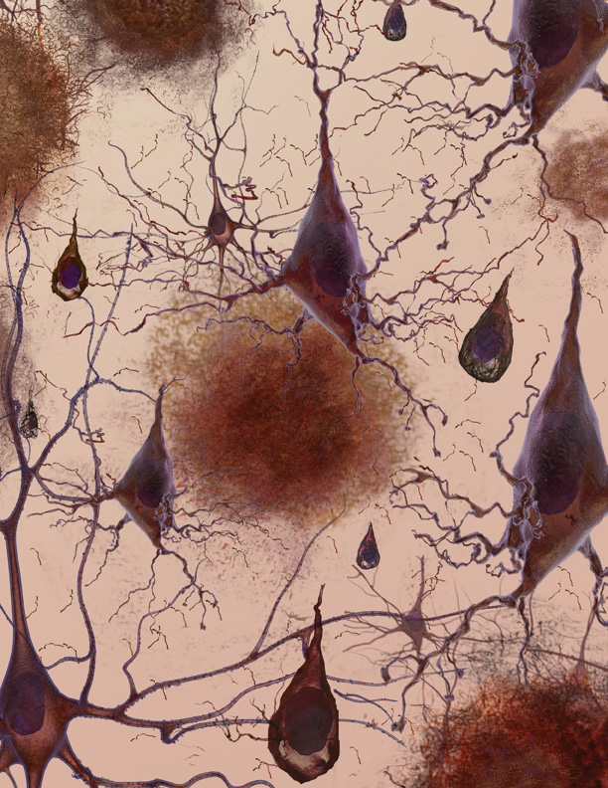
Alzheimer’s Physical BRAIN Changes¹²
Brain shrinks dramatically
Nerve cell death
Tissue loss
Plaques: abnormal clusters of protein fragments
Tangles: twisted strands of another protein
Notes:
Alzheimer’s leads to nerve cell death and tissue loss throughout the brain. Over time, the brain shrinks dramatically, affecting nearly all its functions.
Scientists are not absolutely sure what causes cell death and tissue loss in the Alzheimer’s brain, but plaques and tangles are prime suspects.
Plaques, abnormal clusters of protein fragments, build up between nerve cells in the brain. Plaques form when protein pieces called beta-amyloid clump together.
Dead and dying nerve cells contain tangles, which are made up of twisted strands of another protein.
Plaques and tangles tend to spread through the brain in a predictable pattern as Alzheimer’s progresses.
*Note: The image on the slide shows a microscopic illustration of Alzheimer’s tissue with plaques and tangles.
Video Supplement: “How Alzheimer’s Changes the Brain.” National Institutes of Health. (run time: 4 mins.) https://www.nia.nih.gov/health/what-happens-brain-alzheimers-disease or https://youtu.be/0GXv3mHs9AU
“Inside the Brain: A tour of how the mind works” Alzheimer’s Association. https://www.alz.org/alzheimers-dementia/what-is-alzheimers/brain_tour

Slide 14
Discussion Question 2
What are the characteristics of Alzheimer’s?
Notes:
Ask: What are the characteristics of Alzheimer’s?
Open responses.

Slide 15
10 EARLY Signs of Alzheimer’s¹³
Memory loss that disrupts daily life
Challenges in planning or solving problems
Difficulty completing familiar tasks
Confusion with time or place
Trouble understanding visual images and spatial relationships
Notes:
In the last slide we looked at the physical changes that take place inside the brain as a result of Alzheimer’s, but what most people associate with Alzheimer’s is the cognitive and behavioral symptoms. These symptoms also change and become more severe as the disease progresses.
Alzheimer’s affects people in different ways. The most common symptom begins with gradually worsening ability to remember new information. As damage spreads, individuals experience other difficulties.
The following are ten early signs and symptoms of Alzheimer’s:
Memory loss that disrupts daily life
One of the most common signs of Alzheimer’s dementia, especially in the early stages, is forgetting recently learned information.
Others include: forgetting important dates or events; asking for the same information over and over; relying on family members for things they used to handle on their own.
Challenges in planning or solving problems
Some people may experience changes in their ability to develop and follow a plan or work with numbers.
They may have trouble following a familiar recipe or keeping track of monthly bills.
They may have difficulty concentrating and take much longer to do things than they did before.
Difficulty completing familiar tasks at home, at work or at leisure
People with Alzheimer’s may have a hard time completing daily tasks. Sometimes, people may have trouble driving to a familiar location, managing a budget at work, or using a cell phone.
Confusion with time or place
People with Alzheimer’s can lose track of dates, seasons, and the passage of time. They may have trouble understanding something if it is not happening immediately. Sometimes they may forget where they are or how they got there.
Trouble understanding visual images and spatial relationships
For some people, having vision problems is a sign of Alzheimer’s. They may have difficulty with balance or judging distance, and trip over things at home, or spill or drop things more often. In terms of perception, they may pass a mirror and think someone else is in the room. They may not recognize their own reflection.

Slide 16
10 EARLY Signs of Alzheimer’s (continued)¹⁴
New problems with words in speaking or writing
Misplacing things and losing the ability to retrace steps
Decreased or poor judgment
Withdrawal from work or social activities
Changes in mood and personality
Notes:
New problems with words in speaking or writing
People with Alzheimer’s may have trouble following or joining a conversation. They may stop in the middle of a conversation and have no idea how to continue, or they may repeat themselves. They may struggle with vocabulary or call things by the wrong name (e.g., calling a watch a “hand clock”).
Misplacing things and losing the ability to retrace steps
A person with Alzheimer’s may put things in unusual places. They may lose things and be unable to go back over their steps to find them again. Sometimes, they may accuse others of stealing.
Decreased or poor judgment
People with Alzheimer’s may experience changes in judgment or decision-making. For example, they may use poor judgment when dealing with money, such as giving large amounts to telemarketers. They may pay less attention to grooming or keeping themselves clean.
Withdrawal from work or social activities
A person with Alzheimer’s may start to remove themselves from hobbies, social activities, work, or volunteer projects. They may have trouble keeping up with a favorite sports team or remembering how to complete a favorite hobby.
Changes in mood and personality
The mood and personalities of people with Alzheimer’s can change. They can become confused, suspicious, depressed, fearful, or anxious. They may be easily upset at home, at work, with friends, or in places where they are out of their comfort zone.

Slide 17
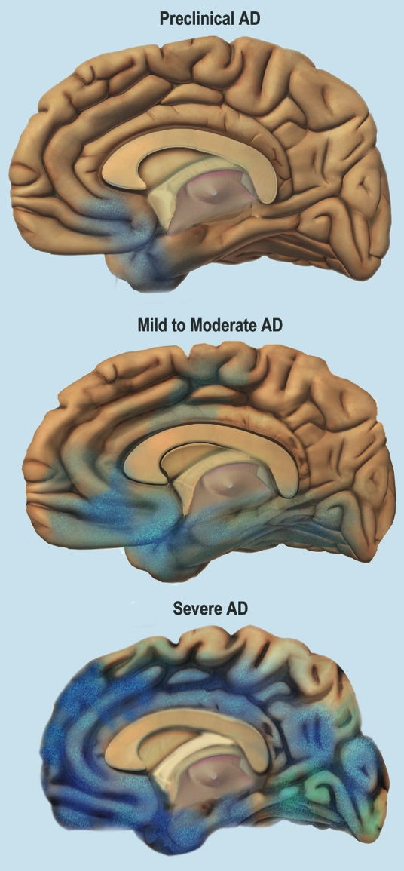
Stages of Alzheimer’s¹⁵
Average lifespan 4-8 years after diagnosis; as long as 20 years
Progresses slowly in 3 stages:
Mild (early-stage)
Moderate (middle-stage)
Severe (late-stage)
Notes:
On average, a person with Alzheimer’s lives four to eight years after diagnosis, but can live as long as 20 years, depending on many factors (such as the progression of the disease, other co-occurring conditions, infections, and unintentional injuries). The symptoms of Alzheimer’s worsen over time, although the rate at which the disease progresses varies.
Alzheimer’s typically progresses slowly in three general stages – mild (early-stage), moderate (middle-stage), and severe (late-stage).
The beginning of Alzheimer’s – or the presymptomatic stage - starts years before there are noticeable changes or symptoms. Eventually the brain changes caused by Alzheimer’s may result in the first symptoms of cognitive decline, and over time reach the mild cognitive impairment stage. For many of these individuals, dementia will progress through early, mid, and late stages.
*Note: The image on the slide shows the progression of changes to the brain, from preclinical Alzheimer’s (top), mild to moderate (middle), to severe (bottom).

Slide 18
Mild Alzheimer’s (Early-Stage)¹⁶
Able to function independently
Common difficulties:
Forgetting familiar words
Losing everyday objects
Trouble remembering names
Greater difficulty performing tasks
Forgetting material just read
Increasing trouble with planning, organizing
Notes:
In the mild stages of Alzheimer’s, a person may function independently. He or she may still drive, work, and be part of social activities.
Despite this, the person may feel as if he or she is having memory lapses, such as forgetting familiar words or the location of everyday objects.
Other common difficulties in the mild stage of Alzheimer’s include:
Trouble remembering names when introduced to new people
Having greater difficulty performing tasks in social or work settings
Forgetting material that one has just read
Increasing trouble with planning or organizing

Slide 19
Moderate Alzheimer’s (Middle-Stage)¹⁷
Requires increasing care
Symptoms include:
Forgetfulness of personal history
Confusion about place or time
Need for help with bathing, toileting, dressing
Changes in sleep patterns
Increased risk of wandering
Personality and behavioral changes
Notes:
As the disease progresses, a person with Alzheimer’s will require a greater level of care.
In the moderate stage, damage to nerve cells in the brain can make it difficult to express thoughts and perform routine tasks.
During this stage, symptoms will be noticeable to others and may include:
Forgetfulness of events or about one’s own personal history
Confusion about where they are or what day it is
The need for help choosing proper clothing for the season or the occasion
Trouble controlling bladder and bowels in some individuals
Changes in sleep patterns, such as sleeping during the day and becoming restless at night
An increased risk of wandering and becoming lost
Personality and behavioral changes, including suspiciousness and delusions or compulsive, repetitive, behavior like hand-wringing or tissue shredding

Slide 20
Severe Alzheimer’s (Late-Stage)¹⁸
Typically longest stage
Requires full-time care
Loss of awareness of recent experiences and surroundings
Changes in physical abilities (walking, sitting, swallowing)
Vulnerable to infections
Notes:
The severe stage of Alzheimer’s is typically the longest stage and can last for many years. In the severe stage of Alzheimer’s, individuals lose the ability to respond to their environment, to carry on a conversation, and, eventually, to control movement. They may still say words or phrases, but communicating becomes difficult.
As memory and cognitive skills continue to worsen, personality changes may take place, and individuals need extensive help with daily activities. At this stage, individuals may:
Require full-time, round-the-clock assistance with daily personal care
Lose awareness of recent experiences as well as of their surroundings
Experience changes in physical abilities, including the ability to walk, sit, and eventually, swallow
Become vulnerable to infections, especially pneumonia

Slide 21
Risk factors
Alzheimer’s and Other Dementias – The Basics
Notes:
Let’s look at the risk factors for Alzheimer’s disease.

Slide 22
Risk Factors: Age^{19,20,21}
#1 risk factor is advancing age
Risk doubles every 5 years after age 65
1 in 3 people age ≥ 85
Notes:
Currently, researchers don’t fully understand what causes Alzheimer’s disease in most people. As described earlier, in most cases it is likely a combination of genetic, environmental, and lifestyle factors that take place over a long period of time.
A number of risk factors have been identified that contribute to the development of Alzheimer’s. Other risk factors are associated with dementia but need additional research.
The greatest risk factor for Alzheimer’s dementia is advancing age. Most individuals with Alzheimer’s diagnoses are age 65 or older. However, Alzheimer’s and dementia are not normal parts of aging.
The risk of developing Alzheimer’s increases with age. It approximately doubles every five years after age 65. In persons age 85 or older, about one in three have Alzheimer’s.

Slide 23
Younger-Onset Alzheimer’s Disease²²
Affects people younger than 65
Many are in their 40s and 50s
200,000 have younger onset (in U.S.)
Up to 5% of population with Alzheimer’s
Notes:
While the vast majority of Alzheimer’s occurs in older adults, Alzheimer’s disease is not just a disease of old age. Younger-onset Alzheimer’s (also known as early-onset) affects people beginning in their 40s and 50s. Although it is not known why younger-onset cases occur, scientists have identified rare genes that directly cause Alzheimer’s in a few families.
In the U.S., it is estimated that approximately 200,000 people have younger-onset Alzheimer’s disease- up to 5% of the population with Alzheimer’s.

Slide 24
Risk Factors: Family History, Education²³
Family history
Environmental factors
Years of formal education
Notes:
In addition to advancing age, another strong risk factor is family history. People who have an immediate family member- a parent, brother, sister, or child- with Alzheimer’s are more likely to develop the disease. This risk increases if more than one family member has the disease.
When diseases tend to run in families, either hereditary (genetics) or environmental factors, or both, may play a role.
Scientists have identified a number of hereditary genes that either increase the likelihood or guarantee that people with the gene will develop Alzheimer’s.
Researchers are trying to determine the link between dementias and possible environmental factors such as exposure to pesticides, food additives, air pollution, and other problematic chemical compounds.
Several studies have demonstrated that fewer years of formal education and lower levels of cognitive engagement may be risk factors for dementia. People who have more years of formal education have lower rates of Alzheimer’s and other dementias than those with less education. Additional studies suggest that remaining socially and mentally active throughout life may support brain health and possibly reduce the risk of Alzheimer’s and other dementias.
Some researchers have proposed a “cognitive reserve” hypothesis to explain why some people maintain cognitive functioning even when damage to the brain from Alzheimer’s is present. They posit that mental activity and stimulation over the life course (such as through education, mentally stimulating jobs, or leisure activities) enable some brains to flexibly and efficiently use cognitive networks (networks of neuron-to-neuron connections) in ways that may mask or delay appearance of symptoms.

Slide 25
Risk Factors: Race & Ethnicity²⁴
African-Americans: 2 times greater risk
Hispanics: 1.5 times greater risk
Cardiovascular risk factors more common
Lower levels of education, socioeconomic status
Notes:
Race and ethnicity may also contribute to increased risk of developing Alzheimer’s and other dementias. In the U.S., older African-Americans are about two times more likely than older whites to have Alzheimer’s. Older Hispanics are about one and one-half times more likely than older whites to have Alzheimer’s.
Variations in health, lifestyle, and socioeconomic circumstances across racial groups likely account for most of the differences in risk of Alzheimer’s and other dementias by race. For example, African-American and Hispanic communities have higher incidence of certain Alzheimer’s risk factors:
Conditions such as high blood pressure and diabetes which are risk factors for Alzheimer’s, are more common in African-Americans and Hispanic populations than in whites.
Lower levels of education and other socioeconomic characteristics (such as lower income and access to quality care) among older racial and ethnic minorities may also contribute to increased risk.
Some studies suggest that differences based on race and ethnicity do not persist in rigorous analyses that account for such risk factors.

Slide 26
Risk Factors: Women^{25,26}
2/3 of affected population
16% of women age ≥ 71 (11% of men)
After age 65, have more than 1 in 5 chance (1 in 11 for men)
Notes:
Almost 2/3 of U.S. adults with Alzheimer’s are women.
Among those aged 71 and older, 16% of women have Alzheimer’s and other dementias, compared with 11% of men.
At age 65, women without Alzheimer’s have more than a one in five chance of developing Alzheimer’s during the remainder of their lives, compared with a one in 11 chance for men.
This may be partially explained by the fact that women live longer, on average, than men. Men who live longer may also be healthier and not have some of the chronic conditions such as cardiovascular disease that can heighten risk for Alzheimer’s and other dementias.
However, researchers are questioning whether Alzheimer’s risks for women could be higher at any age due to biological and/or genetic variations or differences in life experiences such as educational attainment.
Although rates of Alzheimer’s are higher among women, the risk for some other types of dementia, such as vascular dementia, are greater in men.

Slide 27
Modifiable Risk Factors: Head Trauma²⁷
Moderate and severe traumatic brain injury
Moderate injury: 2.3 times greater risk
Severe injury: 4.5 times greater risk
Risk remains for years after injury
Notes:
There are some risk factors that may be changed or prevented to help reduce the risk of developing Alzheimer’s.
Research has linked moderate and severe traumatic brain injury to a greater risk of developing Alzheimer’s or another type of dementia years after the original head injury.
One of the key studies showing an increased risk found that older adults with a history of moderate traumatic brain injury (unconsciousness lasting more than 30 minutes) had a 2.3 times greater risk of developing Alzheimer’s than their peers with no history of head injury.
Those with a history of severe traumatic brain injury (unconsciousness lasting more than 24 hours) had a 4.5 times greater risk of Alzheimer’s. Also, people with repeated head injuries (such as boxers, football players, and combat veterans) are at an even higher risk of developing dementia.

Slide 28
Modifiable Risk Factors: Lifestyle^{28,29}
Increases risk
Current smoking
Midlife obesity
Decreases risk
Physical activity
Heart-healthy diets: DASH, Mediterranean diet
Mental and social activity
Notes:
Certain lifestyle factors may help to lower the risk for developing Alzheimer’s and other dementias.
There is fairly strong evidence that current smoking increases the risk of cognitive decline and possibly also dementia, and that quitting smoking may reduce the associated risk to levels comparable to those who have never smoked.
Diet and physical activity may help to prevent against obesity; midlife obesity has been shown to increase risk for Alzheimer’s and other dementias.
Exercise may also directly benefit brain cells by increasing blood and oxygen flow in the brain.
Current evidence also suggests that eating a heart-healthy diet may also help protect the brain against cognitive decline.
Two diets that have been studied and may be beneficial are the DASH (Dietary Approaches to Stop Hypertension) diet and the Mediterranean diet.
The DASH diet emphasizes vegetables, fruits, and fat-free or low-fat dairy products; includes whole grains, fish, poultry, beans, seeds, nuts, and vegetable oils, and limits sodium, sweets, sugary beverages, and red meats.
The Mediterranean diet includes relatively little red meat and emphasizes whole grains, fruits and vegetables, fish and shellfish, and nuts, olive oil, and other healthy fats.
More recently, researchers have been studying a combined version of the DASH and Mediterranean diet called the MIND diet, which stands for Mediterranean-DASH Intervention for Neurodegenerative Delay. This diet has more emphasis on foods that support a healthy brain, such as those with omega-3 fatty acids.
Some studies have also indicated that staying cognitively and socially active may help reduce the risk of cognitive decline. This involves mentally stimulating activities and social connections.

Slide 29
Modifiable Risk Factors: Cardiovascular^{30,31}
Heart-head connection
Cardiovascular risk factors:
High blood pressure in midlife
Heart disease
Stroke
Diabetes
Notes:
Growing evidence suggests that the health of the brain is closely linked to the overall health of the heart and blood vessels.
The brain is nourished by one of the body’s richest networks of blood vessels. With every beat, the heart pumps blood to the head, where brain cells use the food and oxygen carried by the blood in order to function normally.
As a result, many factors that damage the heart or blood vessels may also damage the brain and may increase the risk for developing Alzheimer’s and other dementias.
Several conditions known to increase the risk of cardiovascular disease, including high blood pressure, heart disease, stroke, and diabetes, appear to increase the risk of developing dementia.
Some autopsy studies show that as many as 80% of individuals with Alzheimer’s also have cardiovascular disease.
Controlling high blood pressure may reduce the combined risk of mild cognitive impairment and dementia. In addition to treating high blood pressure, reducing the risk for cardiovascular disease also includes not smoking, preventing or effectively managing diabetes, as well as avoiding obesity. This is especially important for people in their 40s-50s (midlife) when the early brain changes of Alzheimer’s can begin.

Slide 30
Treatment & Management
Alzheimer’s and Other Dementias – The Basics
Notes:
Next, we will discuss how Alzheimer’s dementia is diagnosed, treated, and managed.

Slide 31
Diagnosing Alzheimer’s DEMENTIA³²
No single test
Medical evaluation
Medical history
Mental status testing
Information from family and friends
Physical and neurological exams
Rule out other causes
Notes:
Physicians can almost always determine if a person has dementia; however, it can be difficult to identify the exact cause.
Establishing a diagnosis for Alzheimer’s can be more challenging. There is no single test that can show whether a person has Alzheimer’s.
A careful medical evaluation is required, which includes:
A thorough medical history
Mental status testing
Information from family and friends
Physical and neurological exams
Tests (such as blood tests and brain imaging) to rule out other causes of dementia-like symptoms

Slide 32
Treating & Managing Alzheimer’s³³
No cure
Drug and non-drug treatments
Goals of existing treatment
Maintain quality of life
Maximize functioning in daily activities
Foster safe environment
Promote social engagement
Notes:
Currently, there is no cure for Alzheimer’s and no treatment that slows the progression of the disease. Drug and non-drug treatments may help with both cognitive and behavioral symptoms, but don’t affect the underlying disease.
Medications are used to treat symptoms and are more effective if administered after early diagnosis.
The chief goals of existing treatment are to:
Maintain quality of life
Maximize function in daily activities
Enhance cognition, mood, and behavior
Foster a safe environment
Promote social engagement, as appropriate
Clinical trials are ongoing for a search for a cure and better treatment of the Alzheimer’s and other dementias. Researchers need people at-risk of or living with dementia, caregivers, and healthy individuals to participate in clinical trials to test potential treatments and methods of prevention.

Slide 33
Alzheimer’s: Co-Morbidities^{34,35}
Additional chronic conditions (e.g., heart disease, diabetes, depression)
Difficult to manage
Higher rates of hospitalizations and costs
Preventable hospitalizations
Notes:
Treating people with Alzheimer’s often requires the management of co-morbidities. Co-morbidities refer to additional chronic conditions – such as heart disease, diabetes, depression, and arthritis – that are present in combination with a primary disease. People with Alzheimer’s and other dementias are more likely to have co-morbidities than other older people without dementia. It is estimated that more than 95% of people with dementia have one or more chronic conditions.
The cognitive problems associated with Alzheimer’s and dementia can lead to poor self-management of co-morbidities. On average, people with dementia have twice as many hospital stays and have significantly higher Medicare costs of other older people.
Most of the hospitalizations are not for Alzheimer’s itself, but for these other conditions that are often complicated by, or result from, Alzheimer’s, such as falls. Many of these hospitalizations are preventable (or potentially avoidable) with better quality care and management of co-morbidities and injury risks.

Slide 34
Alzheimer’s: Unique Aspects³⁶
Financial hardship
May lose income and savings
Increased reliance on public programs
Stigma
Vulnerability to abuse
Caregiver burden
Notes:
People with younger-onset dementia may lose income and savings when they become unable to work. Those with dementia at any age may need to pay for additional services, especially as the disease progresses.
As the need for care intensifies, many people with Alzheimer’s and dementia may live in nursing homes for long periods of time. The financial burden of this care can result in turning to Medicaid and other public programs to help pay for their services and support.
People with dementia report being afraid of the reactions of others and a lower perceived status within society because of the diagnosis. The stigma associated with dementia may contribute to social exclusion, a reluctance to seek help or even a diagnosis, a sense of shame and inadequacy, and low self-esteem.
People with Alzheimer’s and other dementias tend to be especially vulnerable to abuse because the disease may prevent them from reporting the abuse or recognizing it. Abuse can occur anywhere, including at home and in care settings. Abuse can take many forms: physical or emotional abuse, neglect, and/or financial misuse.
Another unique aspect of Alzheimer’s is the level of care that must be provided as the disease progresses and the stress this can put on the caregiver. An individual with Alzheimer’s will need ever-increasing levels of care. Most people with Alzheimer’s disease have a primary caregiver – often a family member – who is crucial to ensuring appropriate care. As the person with Alzheimer’s declines, the primary caregiver often takes on an increasing role in advocating for and attending to all aspects of the person’s health and well-being as well as all their financial affairs. Given the level, duration, and intensity of care needed, caregivers for people with dementia have a greater burden of care than non-dementia caregivers.

Slide 35
Alzheimer’s: Caregivers³⁷
Types of care activities include daily living activities, medication management, financial management
Level of care needed increases and often results in complete dependence
Caregiving has significant physical and emotional stress
Notes:
The term caregiver is used to describe a person who provides a level of care and support for another that exceeds typical responsibilities of daily life.
Caregiving responsibilities, especially in the moderate and severe stages, often include:
Helping with dressing, bathing, using the toilet, and eating
Shopping, meal preparation, transportation, medication management, and financial management
Providing emotional support
People with Alzheimer’s require increasing levels of care as the disease progresses; more severe stages may require constant supervision and result in complete dependence on caregivers (paid or unpaid).
Being a caregiver for someone with Alzheimer’s can take a significant physical and emotional toll.
Caregivers of someone with Alzheimer’s or other dementias are at increased risk for negative health impacts
Nearly 60% of Alzheimer’s and dementia caregivers rate the emotional stress of caregiving as high or very high

Slide 36
Role of Public Health
4 key ways public health can have an impact:
Surveillance/monitoring
Risk reduction/primary prevention
Early detection and diagnosis
Safety and quality of care
Notes:
(see module 3 for more information)
Public health plays an important part in addressing Alzheimer’s. Four key public health intervention tools that can reduce the burden of Alzheimer’s disease are:
Surveillance/monitoring that allows public health to compile data and use it to:
Develop interventions
Inform public policy
Guide research
Educate populations
Promoting primary prevention can be used to promote risk reduction and promote cognitive health
Public health may play an important role increasing early detection and diagnosis of Alzheimer’s disease
Safety and quality of care: Caring for those with Alzheimer’s and dementia requires specialized knowledge about the disease continuum and skill to effectively communicate and care for individuals and their family caregivers. Providing training for health care providers and caregivers can increase the quality care for and safety of the individual, as well as help caregivers sustain their role. Information sharing is also important for those in the community who may interact with individuals with Alzheimer’s such as first responders, public transportation providers, pharmacies, faith communities, etc.

Slide 37
Dementia Capable Systems and dementia friendly communities
Dementia capable systems
Support services
Workforce training
Dementia friendly communities
Notes:
(see module 4 for more information)
Public health also has a role to play in supporting dementia capable systems and dementia friendly communities. At a larger level, states, and communities can become dementia capable in accommodating the needs of a population with Alzheimer’s and other dementias.
A dementia capable system is a system or infrastructure that works to meet the needs of a people with dementia and their caregivers through providing education, support, and services.
Public health can contribute to a dementia capable system through:
Ensuring access to support services for people with dementia and their caregivers
Workforce training and education
Public health can also support the creation of dementia friendly communities. These are cross-sector, community-wide efforts to have support services, resources, and safe environments that allow people with dementia and their caregivers to stay connected to the community. This can include enhancing support services and resources, addressing accessibility and mobility issues, providing dementia training for health care, police, EMS, and firefighters, and providing resources to support family caregivers such as respite care services.

Slide 38
For More Information
For more information, please visit:
Alzheimer’s Association: http://www.alz.org
CDC’s Alzheimer’s Disease and Healthy Aging Program: https://www.cdc.gov/aging/
Notes:
For more information on the topics covered in this presentation, please go to the Alzheimer’s Association website at http://www.alz.org or the Centers for Disease Control and Prevention’s Alzheimer’s Disease and Healthy Aging Program at https://www.cdc.gov/aging/. There you can find resources, latest research and information.

Slide 39
COMPETENCIES
Academy for Gerontology in Higher Education (AGHE):
1.2.1 Distinguish normal biological aging changes from pathology including genetic factors.
1.2.4 Recognize common late-life syndromes and diseases and their related bio-psycho-social risk and protective factors.
Council on Education for Public Health (CEPH) Foundational Competencies:
2. Locate, use, evaluate, and synthesize public health information (bachelors level)
4. Interpret results of data analysis for public health research, policy, or practice (masters level)
Council on Linkages Between Academia and Public Health Practice:
1A1. Describes factors affecting the health of a community (e.g., equity, income, education, environment)
Notes:
(this slide can be edited as needed or removed)
The content in this presentation supports the development of the following competencies:
Academy for Gerontology in Higher Education (AGHE):
1.2.1 Distinguish normal biological aging changes from pathology including genetic factors.
1.2.4 Recognize common late-life syndromes and diseases and their related bio-psycho-social risk and protective factors.
Council on Education for Public Health (CEPH) Foundational Competencies:
2. Locate, use, evaluate and synthesize public health information (bachelor’s level)
4. Interpret results of data analysis for public health research, policy or practice (master’s-level)
Council on Linkages Between Academia and Public Health Practice:
1A1. Describes factors affecting the health of a community (e.g., equity, income, education, environment)

Slide 40
References 1
¹ National Institute on Aging. (n.d.) Cognitive Health and Older Adults. Retrieved from https://www.nia.nih.gov/health/cognitive-health-and-older-adults
²Institute of Medicine. (2015) Cognitive Aging: Progress in Understanding and Opportunities for Action.
³National Institute on Aging. (n.d.) Do Memory Problems Always Mean Alzheimer’s Disease?
⁴Taylor CA, Bouldin ED, McGuire LC. Subjective Cognitive Decline Among Adults Aged ≥45 Years — United States, 2015–2016. MMWR Morb Mortal Wkly Rep 2018;67:753–757. DOI: http://dx.doi.org/10.15585/mmwr.mm6727a1
⁵Alzheimer’s Association. Alzheimer’s Association. (2019) 2019 Alzheimer’s Disease Facts and Figures.
⁶ National Institute on Aging. (n.d.) What is Mild Cognitive Impairment? Retrieved from https://www.nia.nih.gov/alzheimers/topics/mild-cognitive-impairment
⁷Alzheimer’s Association and Centers for Disease Control and Prevention. Healthy Brain Initiative, State and Local Public Health Partnerships to Address Dementia: The 2018-2023 Road Map. Chicago, IL: Alzheimer’s Association; 2018.
⁸ Alzheimer’s Association. (n.d.) What is Dementia? Retrieved from http://www.alz.org/what-is-dementia.asp#causes
⁹ National Institute on Aging. (n.d.) Alzheimer’s Disease Fact Sheet. Retrieved from https://www.nia.nih.gov/health/alzheimers-disease-fact-sheet
¹⁰ Alzheimer’s Association. (n.d.) What is Alzheimer’s? Retrieved from https://www.alz.org/alzheimers-dementia/what-is-alzheimers
¹¹ Alzheimer’s Association. (n.d.) Causes and Risk Factors. Retrieved from https://www.alz.org/alzheimers-dementia/what-is-alzheimers/causes-and-risk-factors
¹² Alzheimer’s Association. (n.d.) Inside the Brain- A Tour of How the Mind Works. Retrieved from https://www.alz.org/alzheimers-dementia/what-is-alzheimers/brain_tour
¹³ Alzheimer’s Association. (n.d.) 10 Early Signs and Symptoms of Alzheimer’s. Retrieved from https://www.alz.org/alzheimers-dementia/10_signs

Slide 41
References 2
¹⁴ Alzheimer’s Association. (n.d.) 10 Early Signs and Symptoms of Alzheimer’s. Retrieved from https://www.alz.org/alzheimers-dementia/10_signs
¹⁵ Alzheimer’s Association. (n.d.) Stages of Alzheimer’s. Retrieved from https://www.alz.org/alzheimers-dementia/stages
¹⁶ Alzheimer’s Association. (n.d.) Stages of Alzheimer’s. Retrieved from https://www.alz.org/alzheimers-dementia/stages
¹⁷ Alzheimer’s Association. (n.d.) Stages of Alzheimer’s. Retrieved from https://www.alz.org/alzheimers-dementia/stages
¹⁸ Alzheimer’s Association. (n.d.) Stages of Alzheimer’s. Retrieved from https://www.alz.org/alzheimers-dementia/stages
¹⁹ Alzheimer’s Association. (n.d.) Causes and Risk Factors. Retrieved from https://www.alz.org/alzheimers-dementia/what-is-alzheimers/causes-and-risk-factors
²⁰ Alzheimer’s Association. (2019) 2019 Alzheimer’s Disease Facts and Figures.
²¹ Alzheimer’s Association. (n.d.) Younger/Early Onset. Retrieved from https://www.alz.org/alzheimers-dementia/what-is-alzheimers/younger-early-onset
²² Alzheimer’s Association. (n.d.) Younger/Early Onset. Retrieved from https://www.alz.org/alzheimers-dementia/what-is-alzheimers/younger-early-onset
²³Alzheimer’s Association. (n.d.) Causes and Risk Factors. Retrieved from https://www.alz.org/alzheimers-dementia/what-is-alzheimers/causes-and-risk-factors
²⁴ Alzheimer’s Association. (2019) 2019 Alzheimer’s Disease Facts and Figures.
²⁵ Alzheimer’s Association. (2019) 2019 Alzheimer’s Facts & Figures.
²⁶ Podcasy, J. & Epperson, C. (2016) Considering Sex and Gender in Alzheimer Disease and Other Dementias. Dialogues in Clinical Neuroscience, 18(4), 437–446.
²⁷Alzheimer’s Association. (n.d.) Traumatic Brain Injury. Retrieved from https://www.alz.org/alzheimers-dementia/what-is-dementia/related_conditions/traumatic-brain-injury

Slide 42
References 3
²⁸ Morris, MC, Tangney, CC, Wang, Y, Sacks, FM, Bennett, DA, and Aggarwal, NT. (2015) MIND Diet Associated with Reduced Incidence of Alzheimer’s Disease. Alzheimer’s & Dementia,11(9), 1007–1014. doi:10.1016/j.jalz.2014.11.009.
²⁹ Alzheimer’s Association. (n.d.) Prevention. Retrieved from https://www.alz.org/alzheimers-dementia/research_progress/prevention
³⁰ Alzheimer’s Association. (n.d.) Prevention. Retrieved from https://www.alz.org/alzheimers-dementia/research_progress/prevention
³¹ Yaffe, K. (2019). Prevention of Cognitive Impairment with Intensive Systolic Blood Pressure Control. JAMA, 321(6), 548-549.
³² Alzheimer’s Association. (n.d.) Diagnosis. Retrieved from https://www.alz.org/alzheimers-dementia/diagnosis
³³ Alzheimer’s Association. (2019) 2019 Alzheimer’s Disease Facts and Figures.
³⁴ Alzheimer’s Association and Centers for Disease Control and Prevention. Healthy Brain Initiative, State and Local Public Health Partnerships to Address Dementia: The 2018-2023 Road Map. Chicago, IL: Alzheimer’s Association; 2018.
³⁵ Alzheimer’s Association. (2019) 2019 Alzheimer’s Disease Facts and Figures.
³⁶ Alzheimer’s Association. (n.d.) Abuse. Retrieved from https://www.alz.org/help-support/caregiving/safety/abuse
³⁷ Alzheimer’s Association. (n.d.) Caregiving. Retrieved from https://www.alz.org/help-support/caregiving

