Slide 1
Meeting with Contacts for TB Assessment

Slide 2
Learning Objectives
After this session, participants will be able to:
Explain why contact assessments are conducted
Explain how contacts are referred for assessment
Explain what information needs to be obtained from a TB contact
Describe how to maintain confidentiality when meeting with contacts
Notes:
Review slide content
Remind participants that the objectives of assessing contacts were covered in Day 1
Explain to participants that this session will continue focusing on effective communication skills when meeting with contacts

Slide 3
Why Conduct a Contact Assessment?
Determination of contacts’ TB symptoms
Gathering of social and medical information
Referral or in-person testing for TB infection with a TST or IGRA
Provision of treatment as indicated
Notes:
Review slide content

Slide 4
How Are Contacts Referred for an Assessment?(1)
Health department referral
Health care worker informs the contact about exposure and the need for a medical evaluation
Case referral
Case agrees to inform the contact about exposure and the need for a medical evaluation
Notes:
Review slide content
State that if case is going to do the referral, an agreement should be made on a timeline and follow-through if the timeline is not met
Referral process may vary by jurisdiction, thus it is important to follow local policy regarding referrals
Ask participants how contacts are referred in their jurisdiction

Slide 5
How Are Contacts Referred for an Assessment? (2)
The case should be given a choice of whether to inform contacts about their exposure to TB prior to health department referral process
Discuss referral options with case
Notes:
Review slide content

Slide 6
When and How Should a Contact Assessment be Conducted?
The initial contact assessment should be within 3 working days of the contact having been identified
Should be conducted in-person
The investigator should use effective communication skills
Notes:
Review slide content
Remind the participants that some of these slides will be a review of the process that they learned on Day 1

Slide 7
How Do You Conduct the Contact Visit? (1)
Introduce yourself and explain purpose of visit
Ask to speak to the contact
Verify the contact’s identity
Ask to speak in privacy
Inform the contact that the purpose of the visit is to discuss a health matter
Discuss the contact’s potential exposure to TB, but maintain the case’s confidentiality
Notes:
Review slide content
Emphasize that it is important to confirm the identity of the contact. For example, there may be a “John Smith Senior” and “John Smith Junior” – if you don’t verify age, you may be notifying the wrong person and breaking the other person’s confidentiality
Explain to the participants that it is important to inform the contact about your reason for meeting with them. The people you investigate have a right to know why they are being visited.
Explain that the investigators should discuss potential exposure but maintain the case’s confidentiality. Maintaining confidentiality is discussed more on the next few slides.

Slide 8
How to Maintain the Case’s Confidentiality When Meeting with a Contact
Do not reveal the case’s name
Use gender neutral language
Do not mention the name of the case’s health care worker, place and dates of diagnosis, or hospitalization
Do not reveal specific dates or environment in which exposure occurred
Confidentiality should not be violated even if the contact refuses to be evaluated
Notes:
Review slide content
Note that confidentiality is key to CI interviews and requires skill. Be aware that people will try creative ways to find out who the case is.
Share any examples you have had meeting with contacts and confidentiality challenges
Explain to the participants that they can achieve their goal by convincing contacts to act promptly and appropriately

Slide 9
How to Maintain the Contact’s Confidentiality
Inform the contact that medical evaluations may be shared with health care workers who have a “need to know”
Assure the contact that their information will not be shared with family, friends, or others without consent
Stress that confidentiality is reinforced by local and state policies, statutes, and/or regulations
Notes:
Review slide content
Mention that permission to reveal the case’s name may be jurisdiction specific

Slide 10
How Do You Conduct the Contact Visit? (2)
Provide education on TB
Describe TB assessment process
Assess for TB symptoms
Administer TST/ IGRA or schedule an appointment
Ask questions to gather social and medical information to assess the contact’s TB risk and further guide CI efforts
Identify barriers to care and treatment
Notes:
Review slide content
Explain that asking additional questions about social information can help guide the CI efforts by potentially identifying additional contacts

Slide 11
Educating the Contact about TB
Explain
The difference between LTBI and TB disease
The progression from LTBI to TB disease
Testing for TB infection
Initial test
Possibility for follow-up test
Stress the importance of taking LTBI treatment, if needed
Notes:
Review slide content

Slide 12
Tips for Educating Contacts about TB
Have culturally and language-specific education materials available
Avoid using medical terms and recognize when to refer questions to appropriate personnel
Notes:
Review slide content

Slide 13
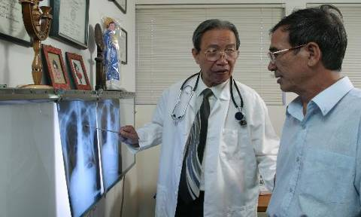
Determination of Contacts’ Potential TB Symptoms
During the initial assessment, all contacts with symptoms of TB disease should be medically examined immediately
Notes:
Review slide content

Slide 14
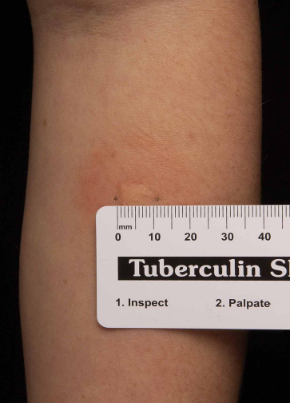
Referral or In-Person Testing for TB Infection with a TST or IGRA
Contacts should receive a TST or IGRA unless a previous, documented positive result exists
A TST induration of 5 mm or larger is positive
A contact with a
Positive TST or IGRA should be medically examined for TB disease
Negative TST or IGRA should be re-tested 8 to 10 weeks after date of last exposure (window period)
Notes:
Review slide content
Remind participants what the window period is (discussed on Day 1)

Slide 15
Obtaining Social and Medical Information
Key information to obtain from contacts:
Current TB symptoms (if any) and onset dates
Previous LTBI or TB (and related treatment)
Previous TST or IGRA results
HIV status
Offer HIV testing if status unknown
Other medical conditions or treatments that increase TB risk
Socio-demographic factors
Notes:
Review slide content
Explain that if no documentation of previous LTBI or TB treatment/results exists, the test will need to be repeated

Slide 16
Provision of Treatment
The decision to test a contact should be considered a commitment to treat
Contacts with a positive TST or IGRA should be offered LTBI treatment
Once TB disease is excluded
Regardless of whether they received BCG vaccine in the past
Unless there is a compelling reason not to treat
Contacts with TB disease need to be treated under DOT
Notes:
Review slide content
Remind participants of the importance of treatment, and that a decision to test is a decision to treat
Explain that a compelling reason not to treat someone with LTBI would be if the person has hepatitis or end-stage liver disease
Note that IGRAs are not influenced by BCG

Slide 17
Reminder: Communication Tips
Two-way communication is essential to ensure the contact
Understands the information
Appreciates the seriousness of the situation
Be sure to
Use open-ended questions
Reinforce the contact’s understanding by asking him or her to explain your message
Notes:
Review slide content

Slide 18
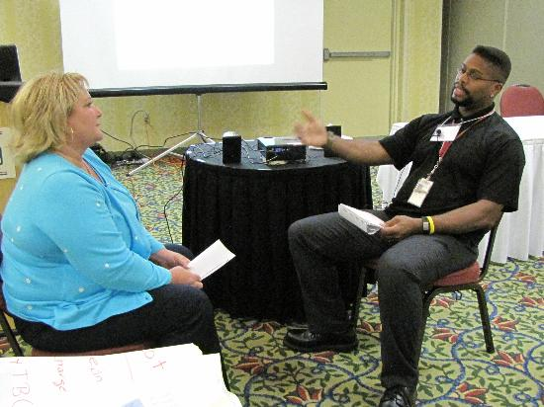
Meeting with a Contact: Demonstration by Facilitators
Notes:
Note to facilitator: This demonstration should be between you and another facilitator. The main purpose is to demonstrate how to maintain confidentiality even when a contact is being persistent in trying to identify how they may have been exposed
One facilitator should play the interviewer and one should play the contact
The interviewer should introduce themselves and explain the purpose of the contact assessment meeting
The contact should try and get the interviewer to reveal the name of the case
Time: 5-10 minutes

Slide 19
Meeting with a Contact Exercise
Refer to Appendix U
Notes:
Note to facilitator: Refer to instructions provided in Appendix U
Have participants pair up and practice meeting with a contact
Time: 20 minutes

Slide 20
Review
Why are contact assessments conducted?
How are contacts referred for assessment?
What information needs to be obtained from a TB contact?
How can confidentiality be maintained when meeting with contacts?
Notes:
Review slide content
Note for facilitator: Answers to review questions:
Contact assessments are conducted because it allows for:
Determination of contacts’ potential TB symptoms
Obtaining social and medical information
Referral or in-person testing for TB infection with a TST or IGRA
Provision of treatment as indicated
Contacts are referred by the health department or by the case
Information to obtain from the case includes:
Current TB symptoms (if any) and onset dates
History of previous TB exposure or TST/IGRA
History of previous LTBI or TB disease treatment
HIV status
4. Ways to maintain confidentiality include:
Do not reveal case’s name
Use gender neutral language
Do not reveal specific details

