Slide 1
Sexually Transmitted Infections
Surveillance 2022
Chlamydia
Notes:
This slide set was prepared by the Division of STD Prevention, National Center for HIV, Viral Hepatitis, STD, and TB Prevention (NCHHSTP), Centers for Disease Control and Prevention (CDC). These slides display trends for STIs in the United States through 2022. Data presented include case notifications provided to CDC through the National Notifiable Diseases Surveillance System (NNDSS) and data collected through projects and programs that monitor STIs in various settings, including the STD Surveillance Network (SSuN), and the Gonococcal Isolate Surveillance Project (GISP).
For more information on data sources, data collection and reporting practices, and case definitions, please see the Technical Notes, available at https://www.cdc.gov/std/statistics/2022/technical-notes.htm.
All data points for figures presented in these slides are available at https://www.cdc.gov/std/statistics/2022/data.zip.
NOTE: This slide set is in the public domain. You may reproduce these slides without permission; however, citation as to source is appreciated.
Centers for Disease Control and Prevention. Sexually Transmitted Infections Surveillance 2022. Atlanta: U.S. Department of Health and Human Services; 2024.
You are also free to adapt and revise these slides; however, you must remove the CDC name and logo if changes are made.

Slide 2
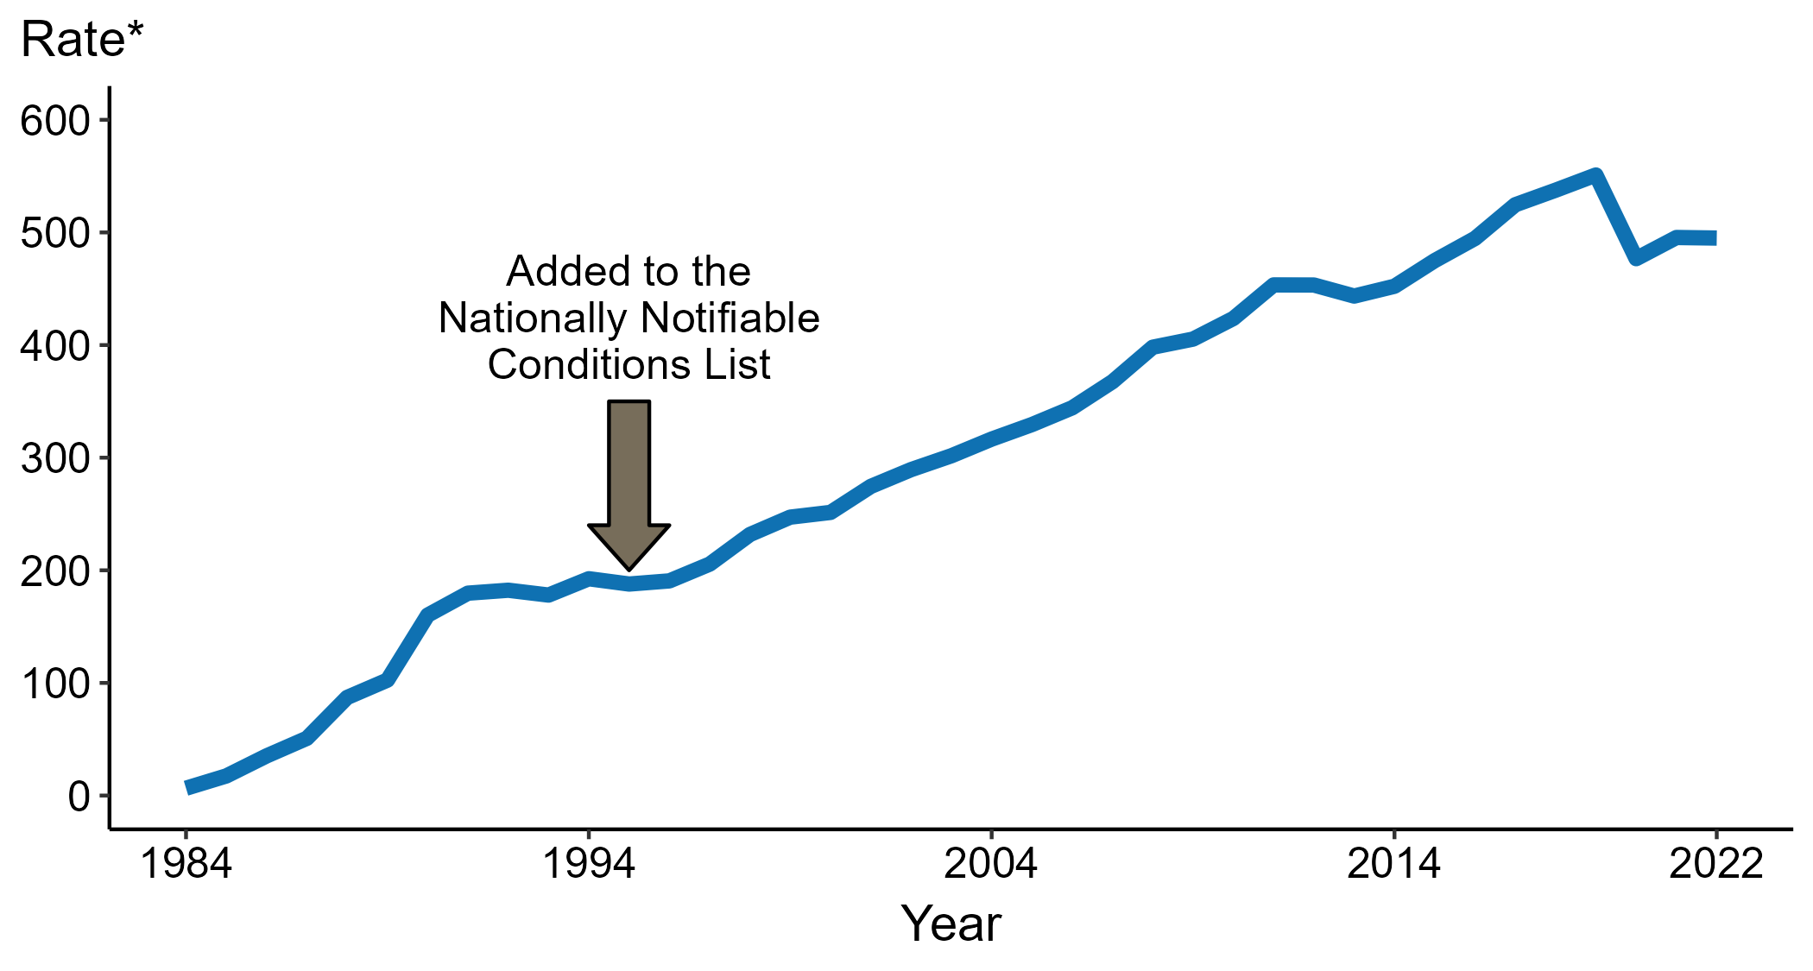
Chlamydia — Rates of Reported Cases by Year, United States, 1984–2022
* Per 100,000
Notes:
Data collection for chlamydia began in 1984 and chlamydia was made a nationally notifiable condition in 1995; however, chlamydia was not reportable in all 50 states and the District of Columbia until 2000. Steady increases in chlamydia case rates beginning in 1996 are due, in part, to improved reporting, increased screening, and the use of more sensitive diagnostic tests.
In 2022, a total of 1,649,716 cases of chlamydia were reported in the United States. During 2021 to 2022, the rate of reported chlamydia did not change substantially (<1.0% change; from 495.5 to 495.0 per 100,000).
This report includes data from years that coincide with the COVID-19 pandemic, which introduced uncertainty and difficulty in interpreting STI surveillance data. See Impact of COVID-19 on STIs for more information.
See Technical Notes (https://www.cdc.gov/std/statistics/2022/technical-notes.htm) for information on chlamydia case reporting.
Data for all figures are available at https://www.cdc.gov/std/statistics/2022/data.zip. The file “CT - Rates by Year (US 1984-2022).xlsx” contains the data for the figure presented on this slide.

Slide 3
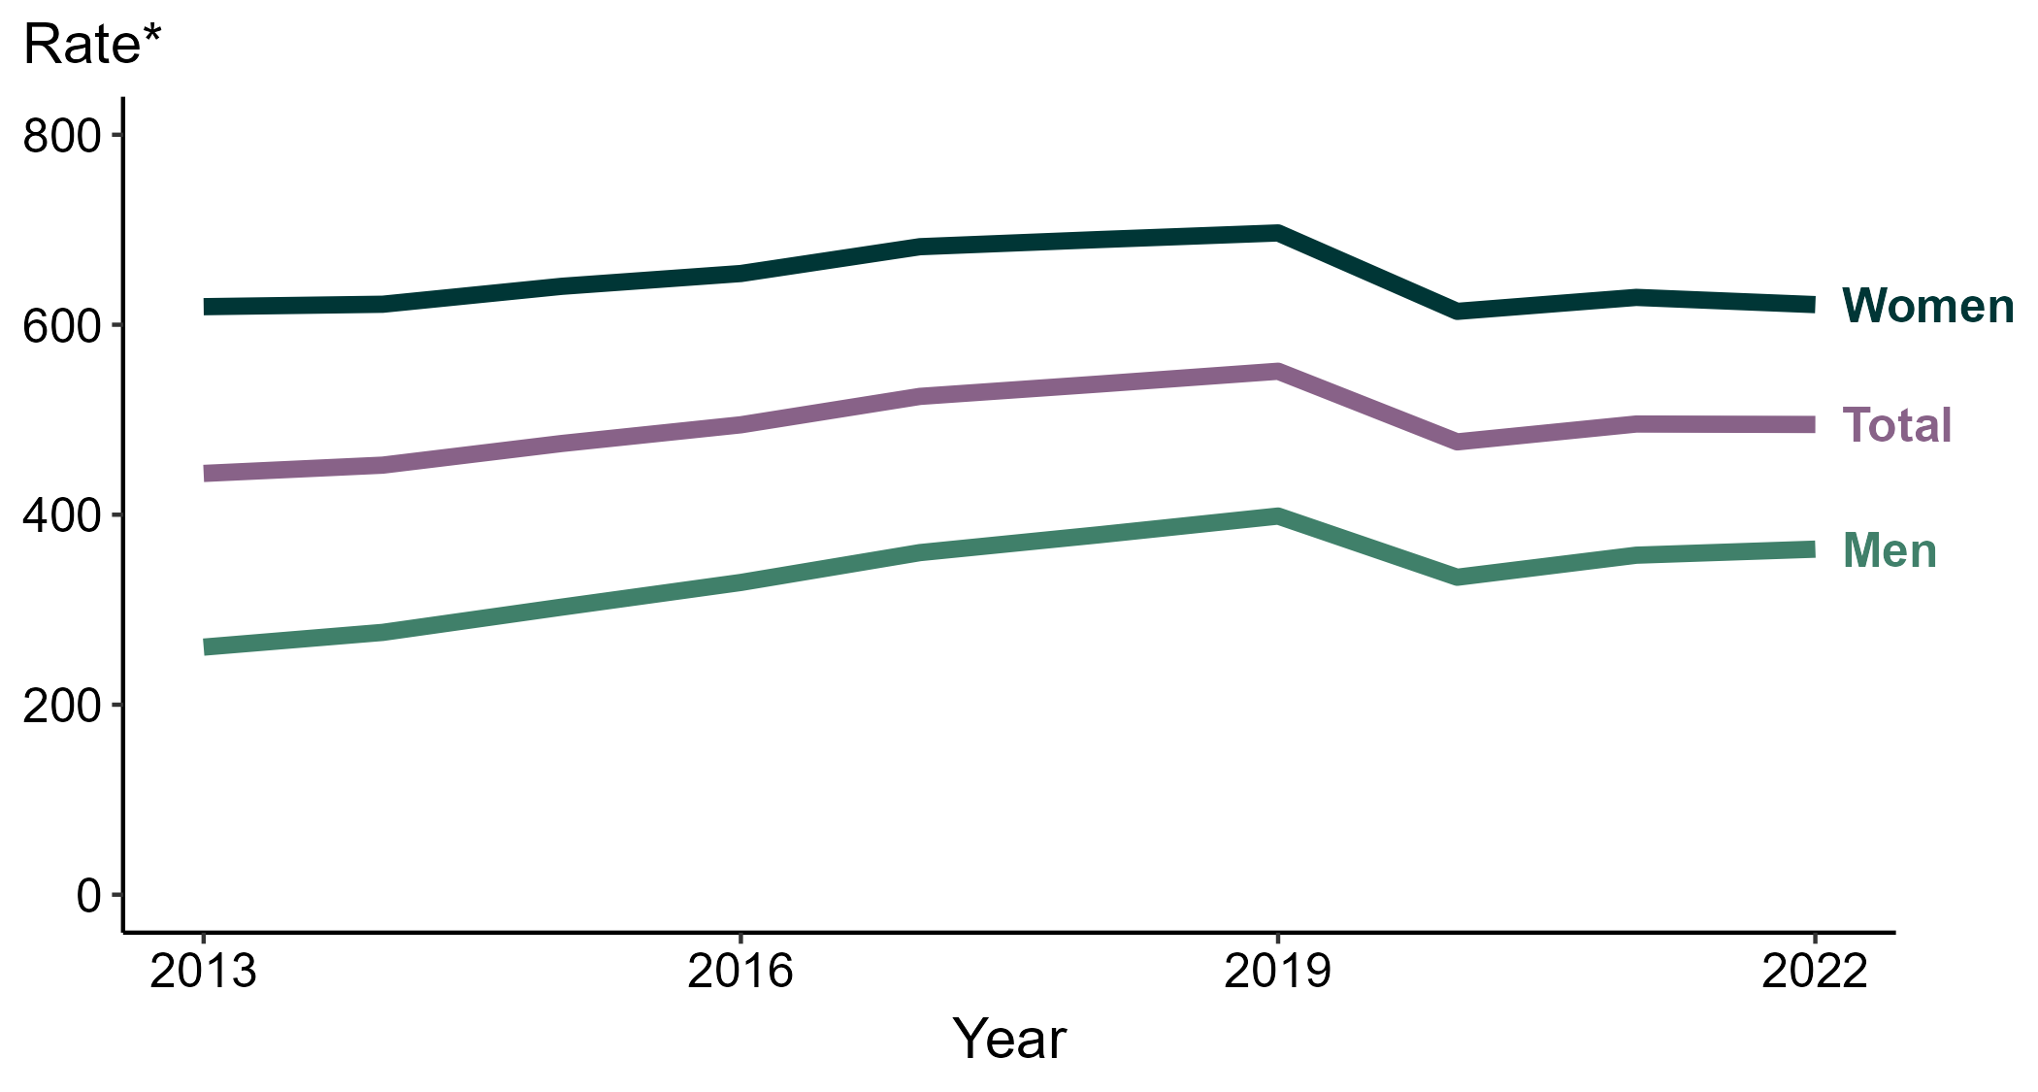
Chlamydia — Rates of Reported Cases by Sex, United States, 2013–2022
* Per 100,000
Notes:
During 2021 to 2022, the rate of reported chlamydia among men increased 1.8% (from 357.4 to 363.7 per 100,000) and the rate among women decreased 1.2% (from 628.8 to 621.2 per 100,000).
Over the last five years, the rate of reported chlamydia among men decreased 4.0% (from 378.9 to 363.7 per 100,000) and the rate among women decreased 9.9% (from 689.6 to 621.2 per 100,000). Over the last 10 years, the rate among men increased 39.6% (from 260.6 to 363.7 per 100,000) and the rate among women did not change substantially (<1.0% change; from 619.0 to 621.2 per 100,000).
This report includes data from years that coincide with the COVID-19 pandemic, which introduced uncertainty and difficulty in interpreting STI surveillance data. See Impact of COVID-19 on STIs for more information.
See Technical Notes (https://www.cdc.gov/std/statistics/2022/technical-notes.htm) for information on chlamydia case reporting. Table A1 (https://www.cdc.gov/std/statistics/2022/tables/a1.htm) provides information on unknown, missing, or invalid values of select variables.
Data for all figures are available at https://www.cdc.gov/std/statistics/2022/data.zip. The file “CT - Rates by Sex (US and Terr 2013-2022).xlsx” contains the data for the figure presented on this slide.

Slide 4
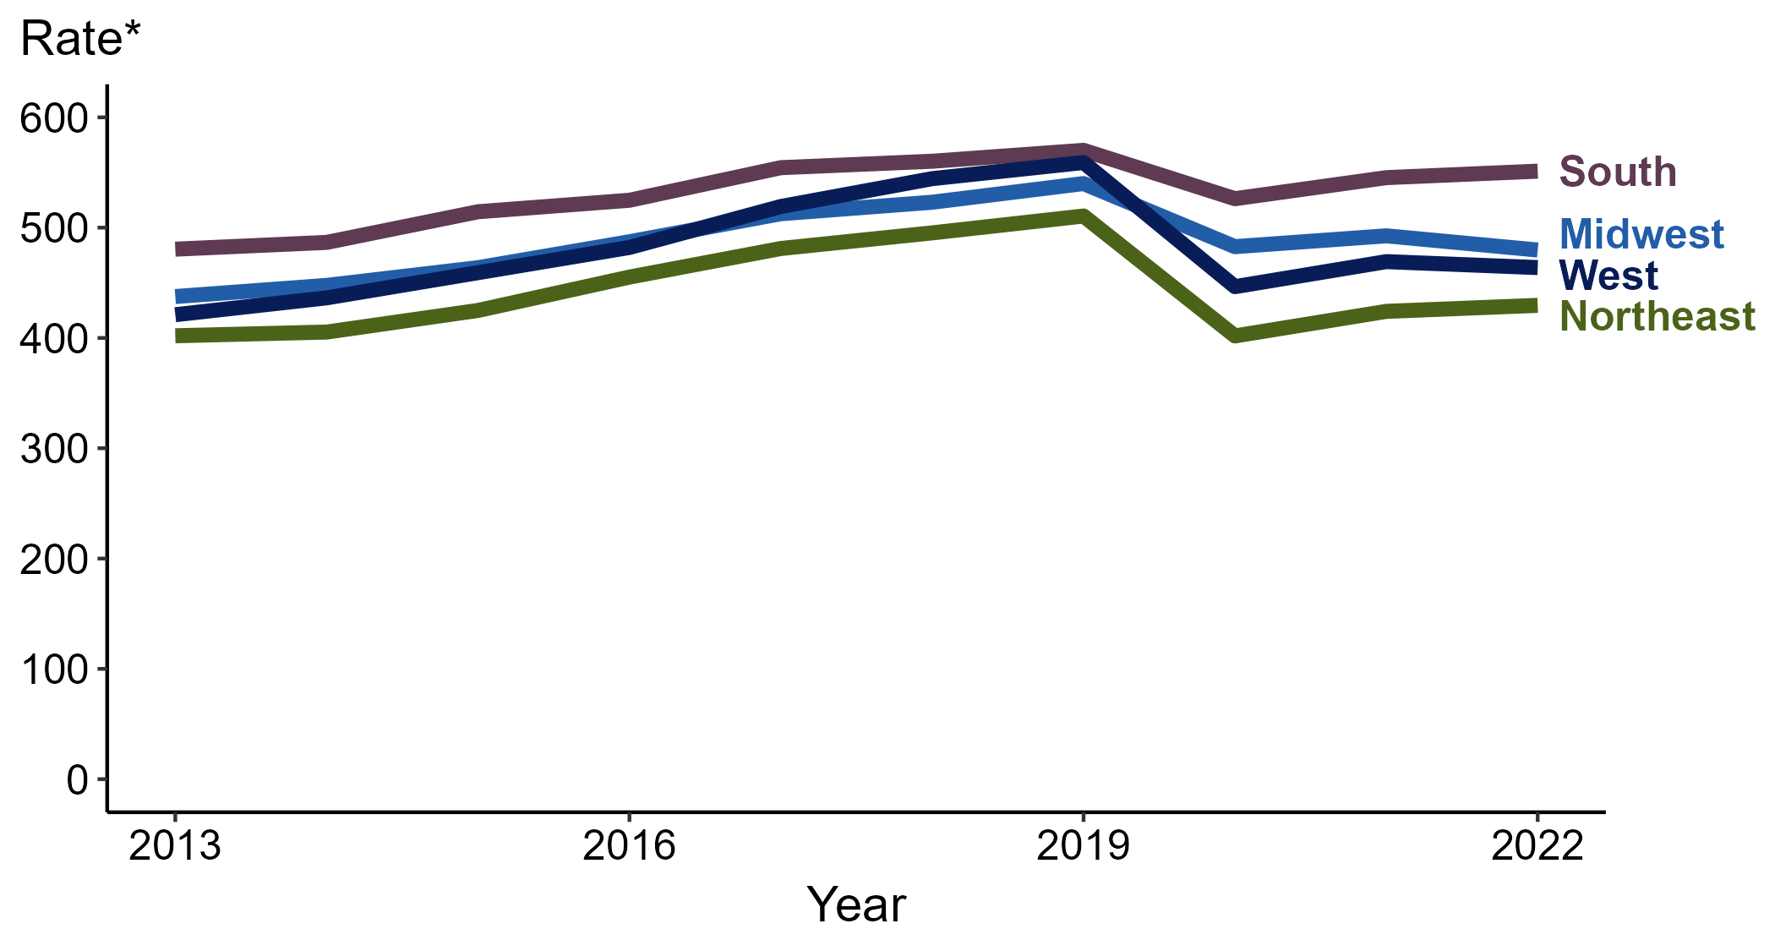
Chlamydia — Rates of Reported Cases by Region, United States, 2013–2022
* Per 100,000
Notes:
In 2022, the South had the highest rate of reported chlamydia (551.2 cases per 100,000; 1.1% increase from 2021), followed by the Midwest (479.7 cases per 100,000; 2.6% decrease from 2021), the West (463.8 cases per 100,000; 1.2% decrease from 2021), and the Northeast (429.5 cases per 100,000; 1.3% increase from 2021).
There were no substantial increases (≥1.0%) in the rate of reported cases of chlamydia in any region during the five-year period from 2018 to 2022. The South had the greatest 10-year increase in rates of reported cases of chlamydia (480.5 to 551.2 per 100,000; 14.7% increase from 2013).
This report includes data from years that coincide with the COVID-19 pandemic, which introduced uncertainty and difficulty in interpreting STI surveillance data. See Impact of COVID-19 on STIs for more information.
See Technical Notes (https://www.cdc.gov/std/statistics/2022/technical-notes.htm) for information on chlamydia case reporting.
Data for all figures are available at https://www.cdc.gov/std/statistics/2022/data.zip. The file “CT - Rates by Region (US 2013-2022).xlsx” contains the data for the figure presented on this slide.

Slide 5
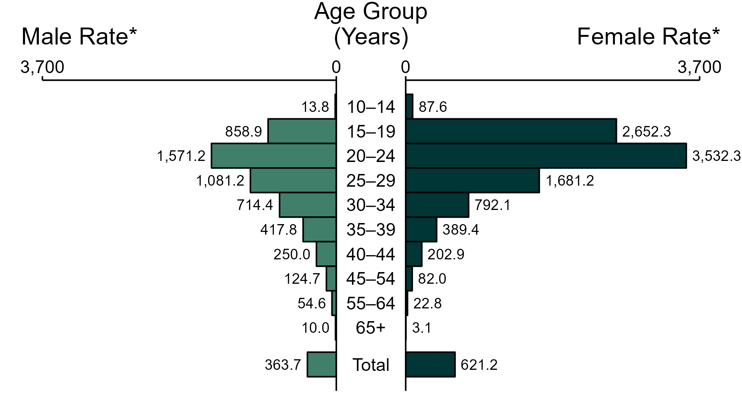
Chlamydia — Rates of Reported Cases by Age Group and Sex, United States, 2022
* Per 100,000
NOTE: Total includes cases of all ages, including those with unknown age.
Notes:
In 2022, the rate of reported chlamydia was higher among women (621.2 per 100,000) compared to men (363.7 per 100,000).
Among women, those aged 20 to 24 years had the highest rate of reported cases of chlamydia (3,532.3 per 100,000), followed by women aged 15 to 19 years (2,652.3 per 100,000) and women aged 25 to 29 years (1,681.2 per 100,000). Among men, those aged 20 to 24 years also had the highest rate of reported cases of chlamydia (1,571.2 per 100,000), followed by men aged 25 to 29 years (1,081.2 per 100,000) and men aged 15 to 19 years (858.9 per 100,000).
This report includes data from years that coincide with the COVID-19 pandemic, which introduced uncertainty and difficulty in interpreting STI surveillance data. See Impact of COVID-19 on STIs for more information.
See Technical Notes (https://www.cdc.gov/std/statistics/2022/technical-notes.htm) for information on chlamydia case reporting. Table A1 (https://www.cdc.gov/std/statistics/2022/tables/a1.htm) provides information on unknown, missing, or invalid values of select variables.
Data for all figures are available at https://www.cdc.gov/std/statistics/2022/data.zip. The file “CT - Rates by Age Group and Sex (US 2022).xlsx” contains the data for the figure presented on this slide.

Slide 6
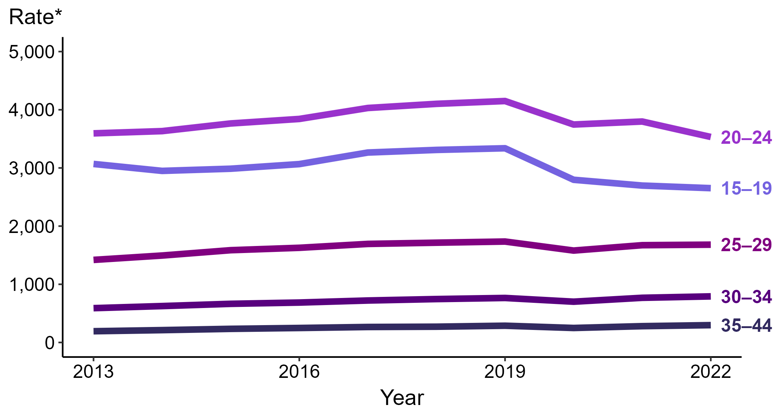
Chlamydia — Rates of Reported Cases Among Women Aged 15–44 Years by Age Group, United States, 2013–2022
* Per 100,000
Notes:
Among women aged 15 to 44 years in 2022, those aged 20 to 24 years had the highest rate of reported cases of chlamydia (3,532.3 cases per 100,000; 7.0% decrease from 2021), followed by those aged 15 to 19 years (2,652.3 cases per 100,000; 1.7% decrease from 2021), those aged 25 to 29 years (1,681.2 cases per 100,000; <1.0% change from 2021), those aged 30 to 34 years (792.1 cases per 100,000; 3.2% increase from 2021), and those aged 35 to 44 years (297.7 cases per 100,000; 6.3% increase from 2021).
This report includes data from years that coincide with the COVID-19 pandemic, which introduced uncertainty and difficulty in interpreting STI surveillance data. See Impact of COVID-19 on STIs for more information.
See Technical Notes (https://www.cdc.gov/std/statistics/2022/technical-notes.htm) for information on chlamydia case reporting. Table A1 (https://www.cdc.gov/std/statistics/2022/tables/a1.htm) provides information on unknown, missing, or invalid values of select variables.
Data for all figures are available at https://www.cdc.gov/std/statistics/2022/data.zip. The file “CT - Rates Women 15-44 Years by Age Group (US 2013-2022).xlsx” contains the data for the figure presented on this slide.

Slide 7
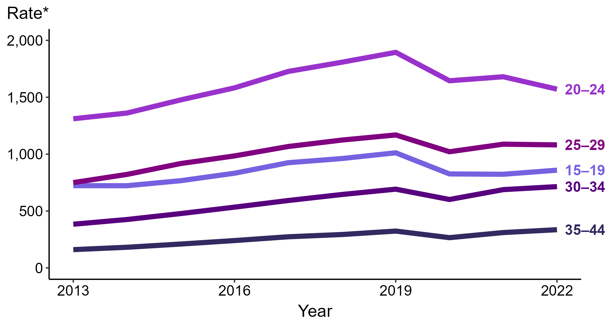
Chlamydia — Rates of Reported Cases Among Men Aged 15–44 Years by Age Group, United States, 2013–2022
* Per 100,000
Notes:
Among men aged 15 to 44 years in 2022, those aged 20 to 24 years had the highest rate of reported cases of chlamydia (1,571.2 cases per 100,000; 6.5% decrease from 2021), followed by those aged 25 to 29 years (1,081.2 cases per 100,000; <1.0% change from 2021), those aged 15 to 19 years (858.9 cases per 100,000; 4.4% increase from 2021), those aged 30 to 34 years (714.4 cases per 100,000; 3.8% increase from 2021), and those aged 35 to 44 years (335.7 cases per 100,000; 8.0% increase from 2021).
This report includes data from years that coincide with the COVID-19 pandemic, which introduced uncertainty and difficulty in interpreting STI surveillance data. See Impact of COVID-19 on STIs for more information.
See Technical Notes (https://www.cdc.gov/std/statistics/2022/technical-notes.htm) for information on chlamydia case reporting. Table A1 (https://www.cdc.gov/std/statistics/2022/tables/a1.htm) provides information on unknown, missing, or invalid values of select variables.
Data for all figures are available at https://www.cdc.gov/std/statistics/2022/data.zip. The file “CT - Rates Men 15-44 Years by Age Group (US 2013-2022).xlsx” contains the data for the figure presented on this slide.

Slide 8
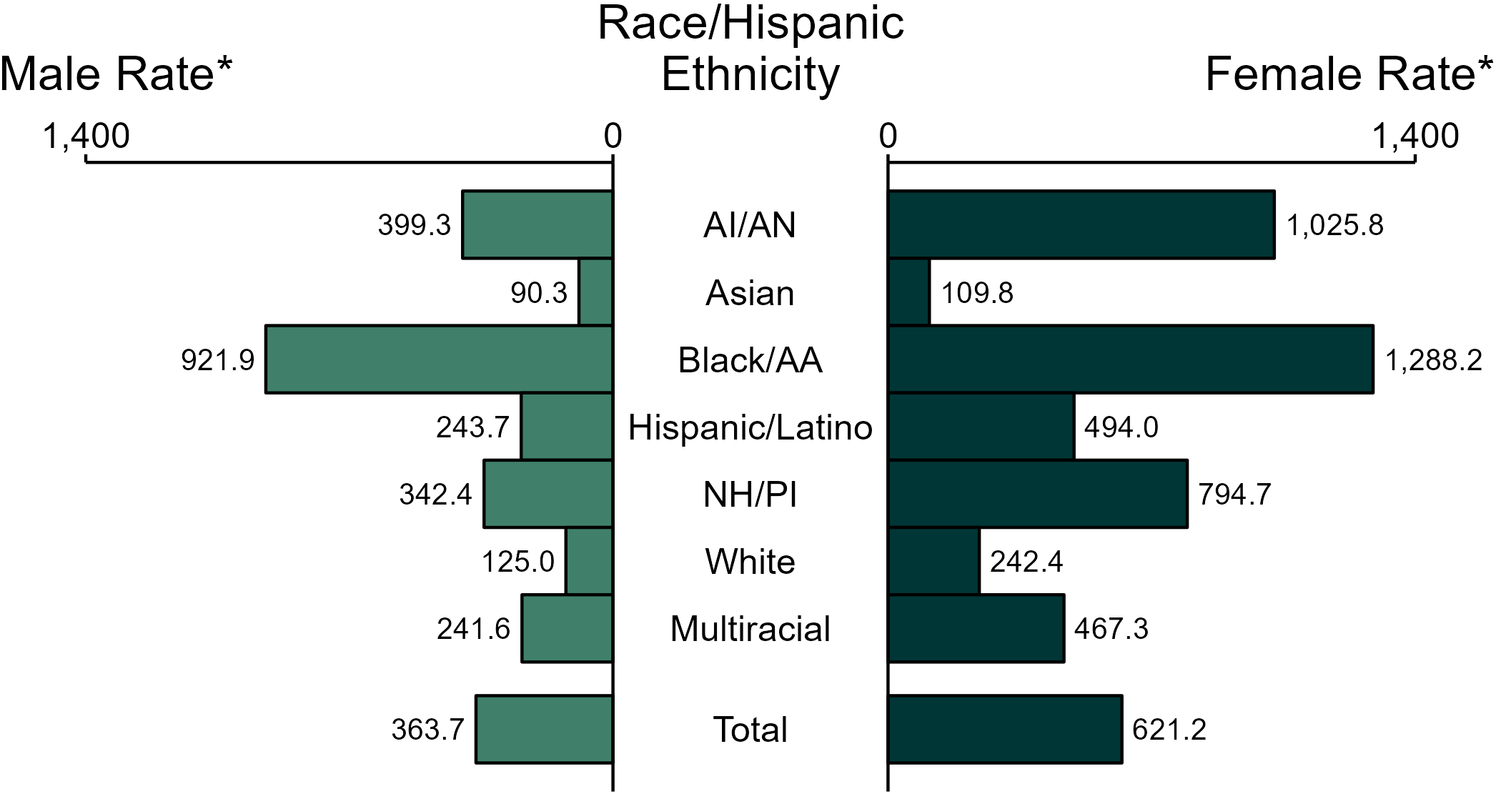
Chlamydia — Rates of Reported Cases by Race/Hispanic Ethnicity and Sex, United States, 2022
* Per 100,000
ACRONYMS: AI/AN = American Indian or Alaska Native; Black/AA = Black or African American; NH/PI = Native Hawaiian or other Pacific Islander
NOTE: Total includes all cases including those with unknown race/Hispanic ethnicity.
Notes:
In 2022, the rate of reported chlamydia was higher among women (621.2 per 100,000) compared to men (363.7 per 100,000).
Among women, non-Hispanic Black or African American women had the highest rate of reported cases of chlamydia (1,288.2 per 100,000), followed by non-Hispanic American Indian or Alaska Native women (1,025.8 per 100,000) and non-Hispanic Native Hawaiian or other Pacific Islander women (794.7 per 100,000). Among men, non-Hispanic Black or African American men also had the highest rate of reported cases of chlamydia (921.9 per 100,000), followed by non-Hispanic American Indian or Alaska Native men (399.3 per 100,000) and non-Hispanic Native Hawaiian or other Pacific Islander men (342.4 per 100,000).
Using non-Hispanic White persons as the referent category, the greatest relative racial disparity in rates of reported chlamydia across both sexes was observed among non-Hispanic Black or African American men, with a rate ratio of 7.4 times that of non-Hispanic White men. Among women, the greatest relative disparity was observed among non-Hispanic Black or African American women as well, with a rate 5.3 times that of non-Hispanic White women.
This report includes data from years that coincide with the COVID-19 pandemic, which introduced uncertainty and difficulty in interpreting STI surveillance data. See Impact of COVID-19 on STIs for more information.
See Technical Notes (https://www.cdc.gov/std/statistics/2022/technical-notes.htm) for information on chlamydia case reporting, race/Hispanic ethnicity categorization, and reporting of race/Hispanic ethnicity for STI cases. Table A1 (https://www.cdc.gov/std/statistics/2022/tables/a1.htm) provides information on unknown, missing, or invalid values of select variables.
Data for all figures are available at https://www.cdc.gov/std/statistics/2022/data.zip. The file “CT - Rates by Race Hispanic Ethnicity and Sex (US 2022).xlsx” contains the data for the figure presented on this slide.

Slide 9
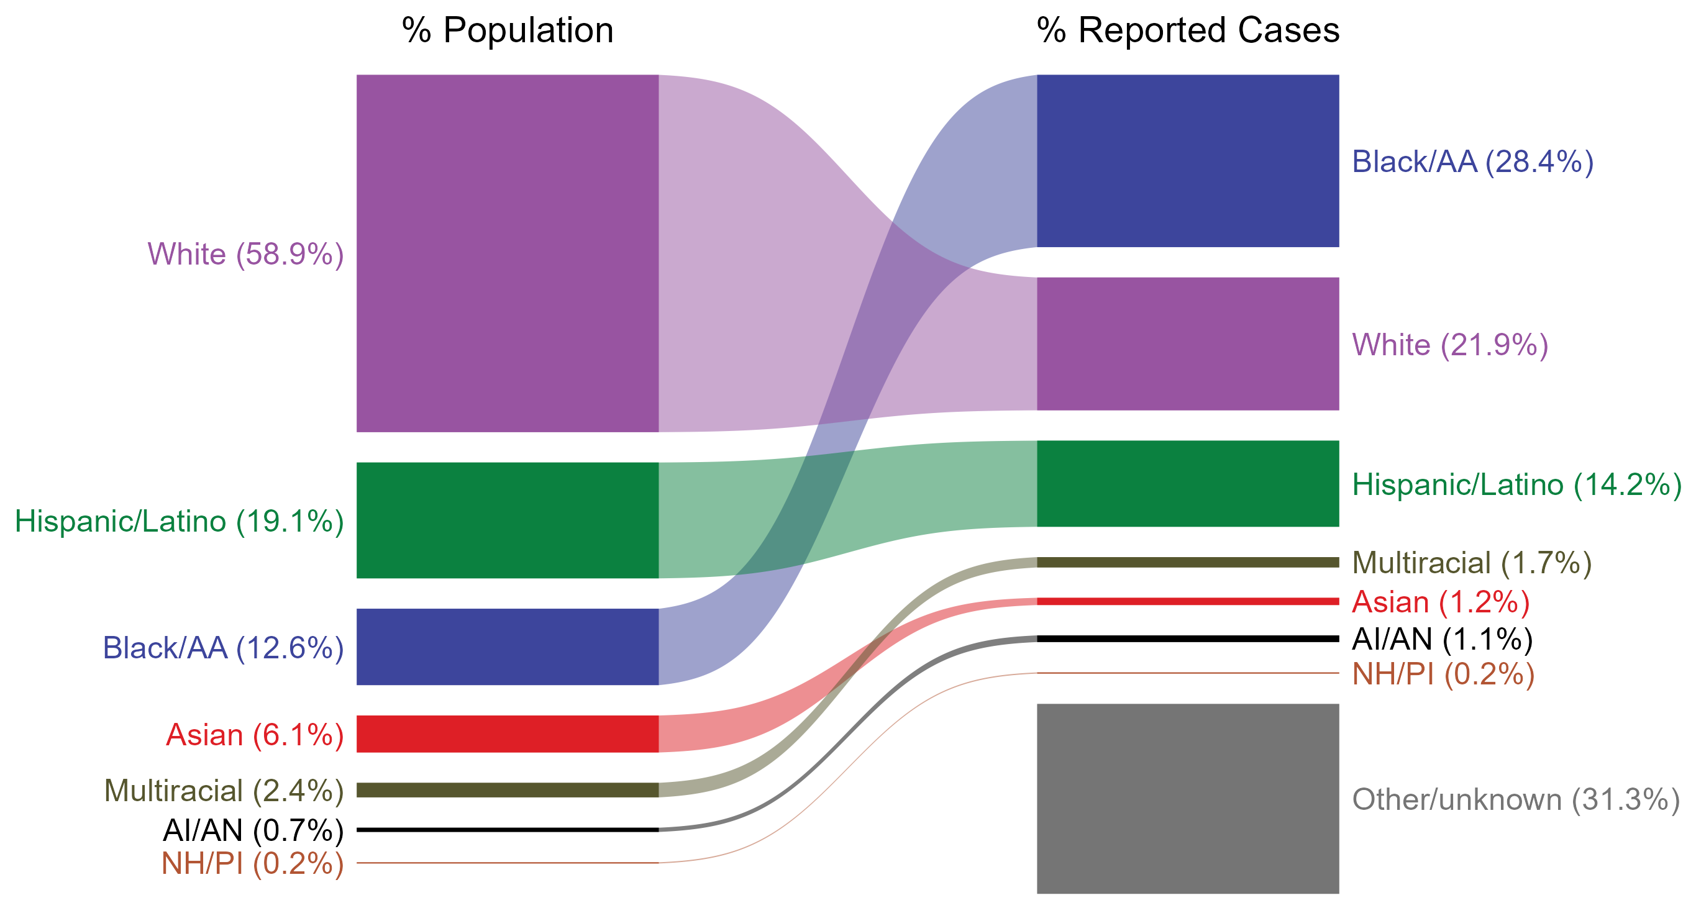
Chlamydia — Total Population and Reported Cases by Race/Hispanic Ethnicity, United States, 2022
* Per 100,000
NOTE: In 2022, a total of 515,552 chlamydia cases (31.3%) had missing, unknown, or other race and were not reported to be of Hispanic ethnicity. These cases are included in the “other/unknown” category.
ACRONYMS: AI/AN = American Indian or Alaska Native; Black/AA = Black or African American; NH/PI = Native Hawaiian or other Pacific Islander
Notes:
The percentages of chlamydia cases by race/Hispanic ethnicity were disproportionate to the percentages among the total population of the United States in 2022. The greatest absolute and relative disparities were observed among non-Hispanic Black or African American persons, who represented 28.4% of reported chlamydia cases (n = 468,384; 41.3% of chlamydia cases with reported race or Hispanic ethnicity) despite being 12.6% of the US population. This is means that the burden of chlamydia among non-Hispanic Black or African American persons was 15.8% greater than — or 2.3 times — what would be expected based on their proportion of the population. Additionally, non-Hispanic American Indian or Alaska Native persons were also overrepresented among chlamydia cases relative to their proportion of the population.
This report includes data from years that coincide with the COVID-19 pandemic, which introduced uncertainty and difficulty in interpreting STI surveillance data. See Impact of COVID-19 on STIs for more information.
See Technical Notes (https://www.cdc.gov/std/statistics/2022/technical-notes.htm) for information on chlamydia case reporting, race/Hispanic ethnicity categorization, and reporting of race/Hispanic ethnicity for STI cases.
Data for all figures are available at https://www.cdc.gov/std/statistics/2022/data.zip. The file “CT - Population and Cases by Race Hispanic Ethnicity (US 2022).xlsx” contains the data for the figure presented on this slide.

Slide 10
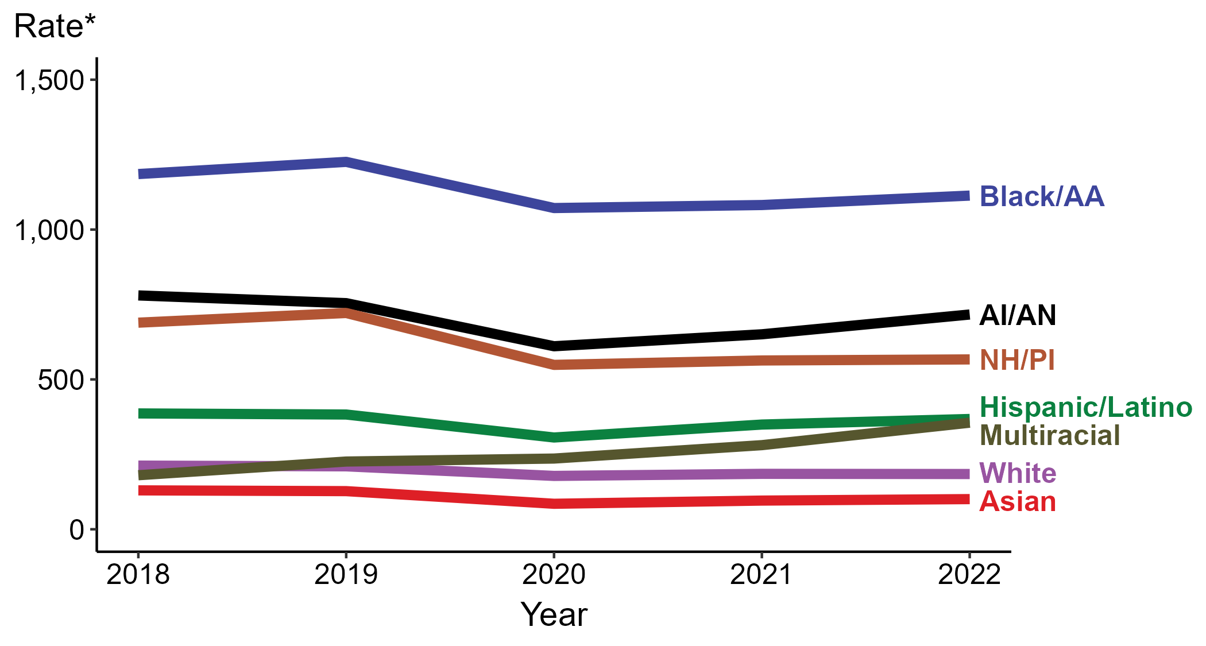
Chlamydia — Rates of Reported Cases by Race/Hispanic Ethnicity, United States, 2018–2022
* Per 100,000
ACRONYMS: AI/AN = American Indian or Alaska Native; Black/AA = Black or African American; NH/PI = Native Hawaiian or other Pacific Islander
Notes:
In 2022, the highest rate of reported chlamydia cases per 100,000 persons was among non-Hispanic Black or African American persons (1,113.3), followed by non-Hispanic American Indian or Alaska Native persons (716.6).
During 2021 to 2022, the greatest increase in rate of reported chlamydia cases per 100,000 persons was among non-Hispanic persons of multiple races (280.7 to 355.6; 26.7% increase). Non-Hispanic persons of multiple races also had the only five-year increase in rate of reported chlamydia (180.3 to 355.6; 97.2% increase from 2018).
There were no substantial (≥1.0%) decreases in the rate of reported chlamydia cases per 100,000 persons among any race or Hispanic ethnicity group during 2021 to 2022. Non-Hispanic Asian persons had the greatest five-year decrease in rate of reported chlamydia (129.8 to 100.6; 22.5% decrease from 2018).
This report includes data from years that coincide with the COVID-19 pandemic, which introduced uncertainty and difficulty in interpreting STI surveillance data. See Impact of COVID-19 on STIs for more information.
See Technical Notes (https://www.cdc.gov/std/statistics/2022/technical-notes.htm) for information on chlamydia case reporting, race/Hispanic ethnicity categorization, and reporting of race/Hispanic ethnicity for STI cases. Table A1 (https://www.cdc.gov/std/statistics/2022/tables/a1.htm) provides information on unknown, missing, or invalid values of select variables.
Data for all figures are available at https://www.cdc.gov/std/statistics/2022/data.zip. The file “CT - Rates by Race Hispanic Ethnicity (US 2018-2022).xlsx” contains the data for the figure presented on this slide.

Slide 11
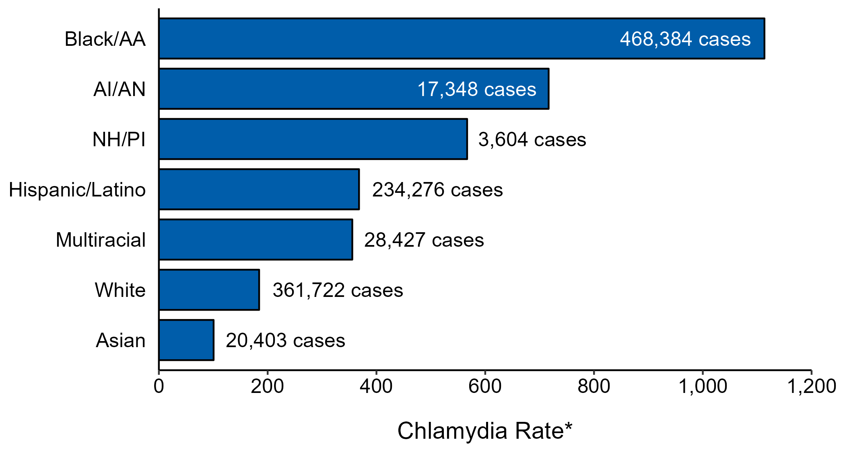
Chlamydia — Case Counts and Rates of Reported Cases by Race/Hispanic Ethnicity, United States, 2022
* Per 100,000 population
NOTE: In 2022, a total of 515,552 chlamydia cases (31.3%) had missing, unknown, or other race and were not reported to be of Hispanic ethnicity. These cases are not shown in this plot.
ACRONYMS: AI/AN = American Indian or Alaska Native; Black/AA = Black or African American; NH/PI = Native Hawaiian or other Pacific Islander
Notes:
In 2022, rates of chlamydia were highest among non-Hispanic Black or African American persons (1,113.3 per 100,000), followed by non-Hispanic American Indian or Alaska Native persons (716.6 per 100,000) and non-Hispanic Native Hawaiian or other Pacific Islander persons (566.7 per 100,000). The greatest number of reported chlamydia cases was among non-Hispanic Black or African American persons (468,384 cases), followed by non-Hispanic White persons (361,722 cases) and Hispanic or Latino persons of any race(s) (234,276 cases).
This report includes data from years that coincide with the COVID-19 pandemic, which introduced uncertainty and difficulty in interpreting STI surveillance data. See Impact of COVID-19 on STIs for more information.
See Technical Notes (https://www.cdc.gov/std/statistics/2022/technical-notes.htm) for information on chlamydia case reporting and reporting of race/Hispanic ethnicity for STI cases.
Data for all figures are available at https://www.cdc.gov/std/statistics/2022/data.zip. The file “CT - Cases and Rates by Race Hispanic Ethnicity (US 2022).xlsx” contains the data for the figure presented on this slide.

Slide 12
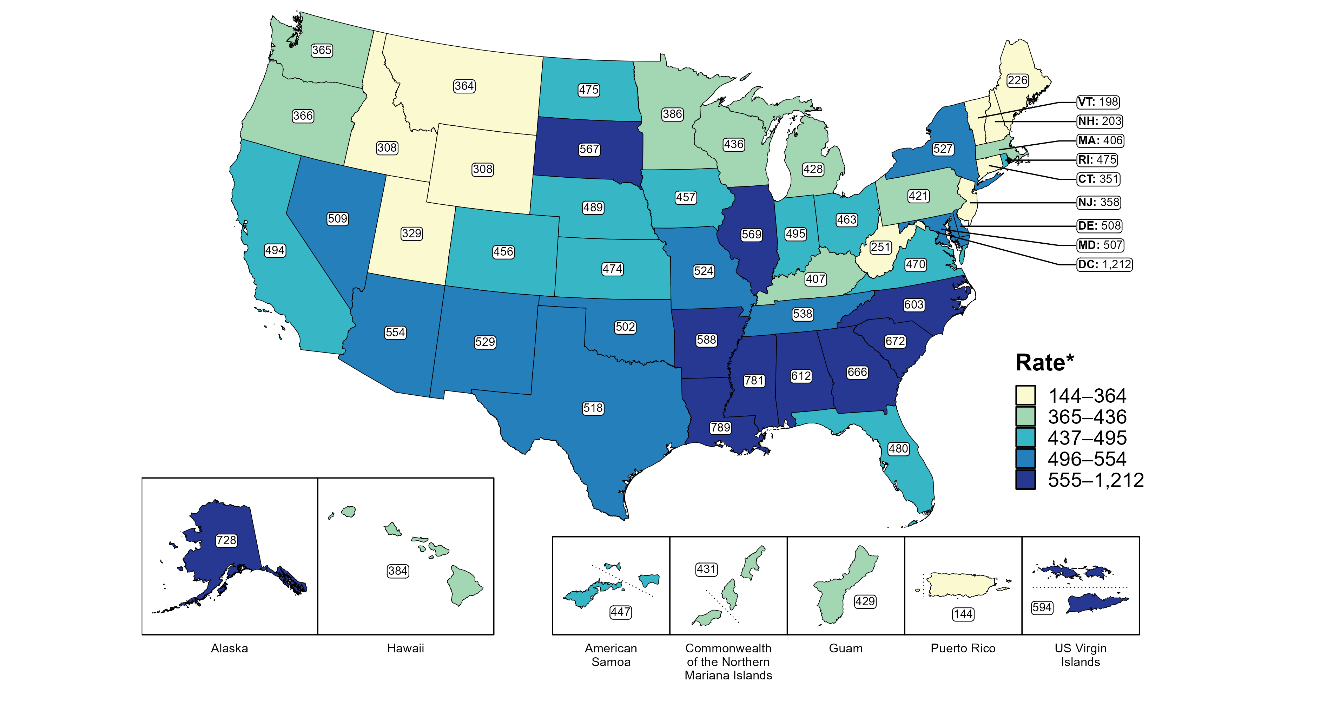
Chlamydia — Rates of Reported Cases by Jurisdiction, United States and Territories, 2022
* Per 100,000
Notes:
In 2022, rates of reported chlamydia ranged by state from 198 cases per 100,000 population in Vermont to 789 cases per 100,000 population in Louisiana. The rate of reported chlamydia in the District of Columbia was 1,212 per 100,000 population.
Among US territories, rates of reported chlamydia ranged from 144 cases per 100,000 population in Puerto Rico to 594 cases per 100,000 population in the US Virgin Islands.
This report includes data from years that coincide with the COVID-19 pandemic, which introduced uncertainty and difficulty in interpreting STI surveillance data. See Impact of COVID-19 on STIs for more information.
See Technical Notes (https://www.cdc.gov/std/statistics/2022/technical-notes.htm) for information on chlamydia case reporting and on interpreting reported rates in US territories.
Data for all figures are available at https://www.cdc.gov/std/statistics/2022/data.zip. The file “CT - Rates by Jurisdiction (US and Terr 2022).xlsx” contains the data for the figure presented on this slide.

Slide 13
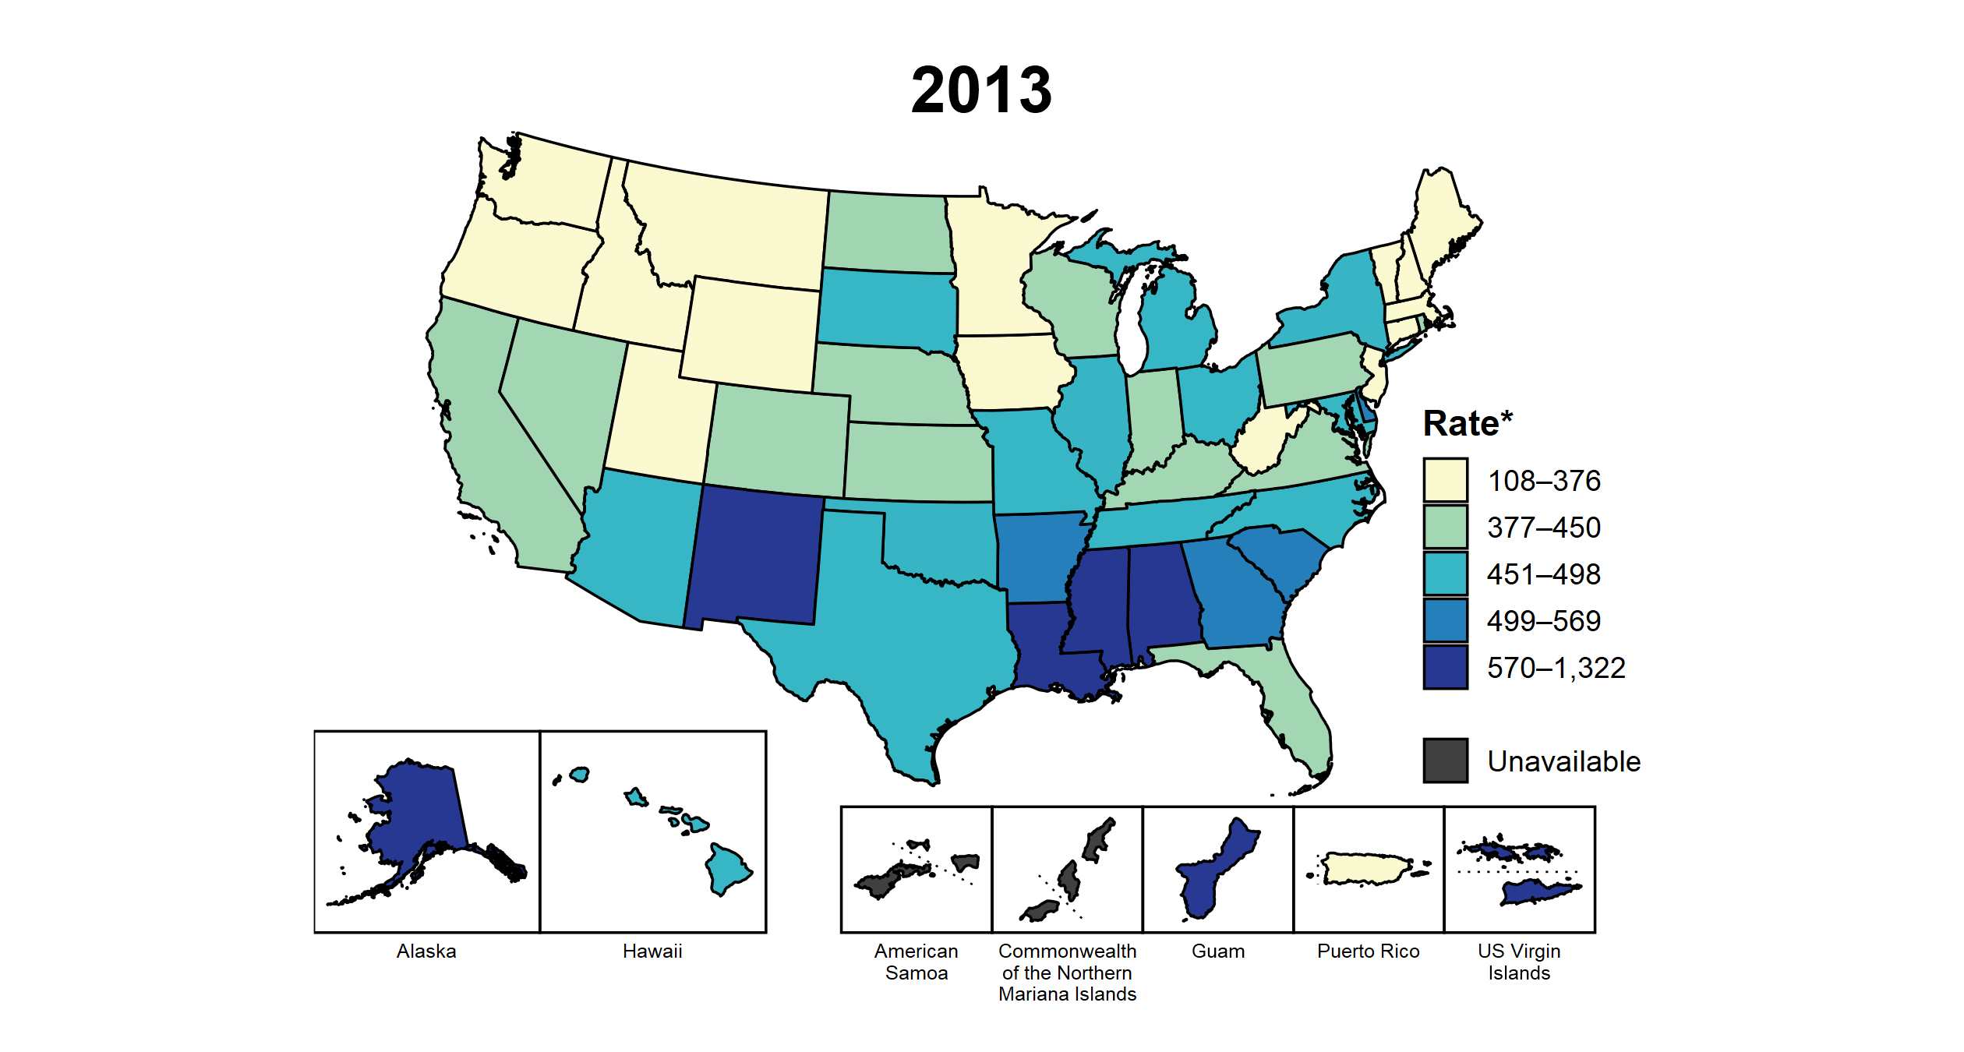
Chlamydia — Rates of Reported Cases by Jurisdiction, United States and Territories, 2013–2022
* Per 100,000
Notes:
This slide contains an animated figure that will play when the slide is in presentation mode. A static version of the figure that displays maps from the first and last years of the range is available as a separate slide.
In 2013, nine states, the District of Columbia (DC), and two US territories (22.2% of areas with available data) had a rate of reported chlamydia greater than or equal to 499 cases per 100,000 population. This increased to 20 states, DC, and one US territory (39.3% of areas with available data) in 2022. During 2021 to 2022, rates of reported chlamydia increased in 16 states, DC, and three territories.
American Samoa and the Commonwealth of the Northern Mariana Islands began reporting data on chlamydia cases to CDC in 2018; data are not available for those areas prior to that year. In addition, data on reported chlamydia cases in 2018 are not available for the US Virgin Islands. Due to a network security incident in December 2021, the Maryland Department of Health could not finalize their 2021 STI case notification data. Data for 2021 from Maryland have been suppressed for this figure; however, they are included in national and regional case counts and rates displayed in other figures.
This report includes data from years that coincide with the COVID-19 pandemic, which introduced uncertainty and difficulty in interpreting STI surveillance data. See Impact of COVID-19 on STIs for more information.
See Technical Notes (https://www.cdc.gov/std/statistics/2022/technical-notes.htm) for information on chlamydia case reporting and on interpreting reported rates in US territories.
Data for all figures are available at https://www.cdc.gov/std/statistics/2022/data.zip. The file “CT - Rates by Jurisdiction (US and Terr 2013-2022).xlsx” contains the data for the figure presented on this slide.

Slide 14
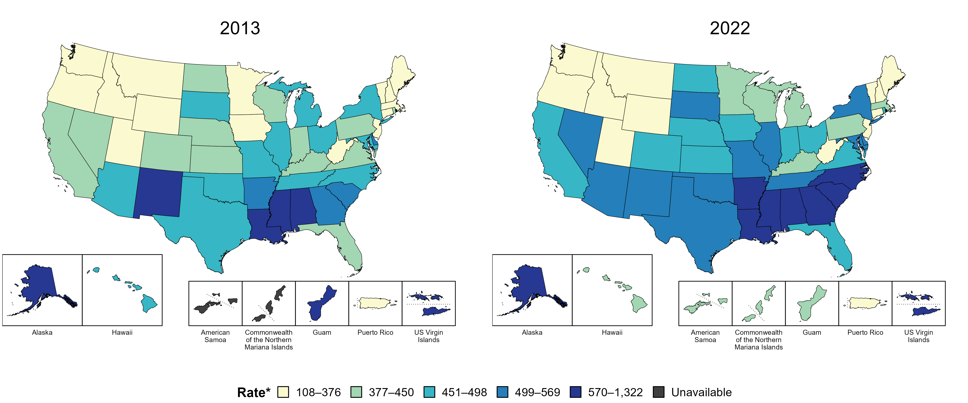
Chlamydia — Rates of Reported Cases by Jurisdiction, United States and Territories, 2013 and 2022
* Per 100,000
Notes:
In 2013, nine states, the District of Columbia (DC), and two US territories (22.2% of areas with available data) had a rate of reported chlamydia greater than or equal to 499 cases per 100,000 population. This increased to 20 states, DC, and one US territory (39.3% of areas with available data) in 2022.
American Samoa and the Commonwealth of the Northern Mariana Islands began reporting data on chlamydia cases to CDC in 2018; data are not available for those areas prior to that year.
This report includes data from years that coincide with the COVID-19 pandemic, which introduced uncertainty and difficulty in interpreting STI surveillance data. See Impact of COVID-19 on STIs for more information.
See Technical Notes (https://www.cdc.gov/std/statistics/2022/technical-notes.htm) for information on chlamydia case reporting and on interpreting reported rates in US territories.
Data for all figures are available at https://www.cdc.gov/std/statistics/2022/data.zip. The file “CT - Rates by Jurisdiction (US and Terr 2013 and 2022).xlsx” contains the data for the figure presented on this slide.

Slide 15
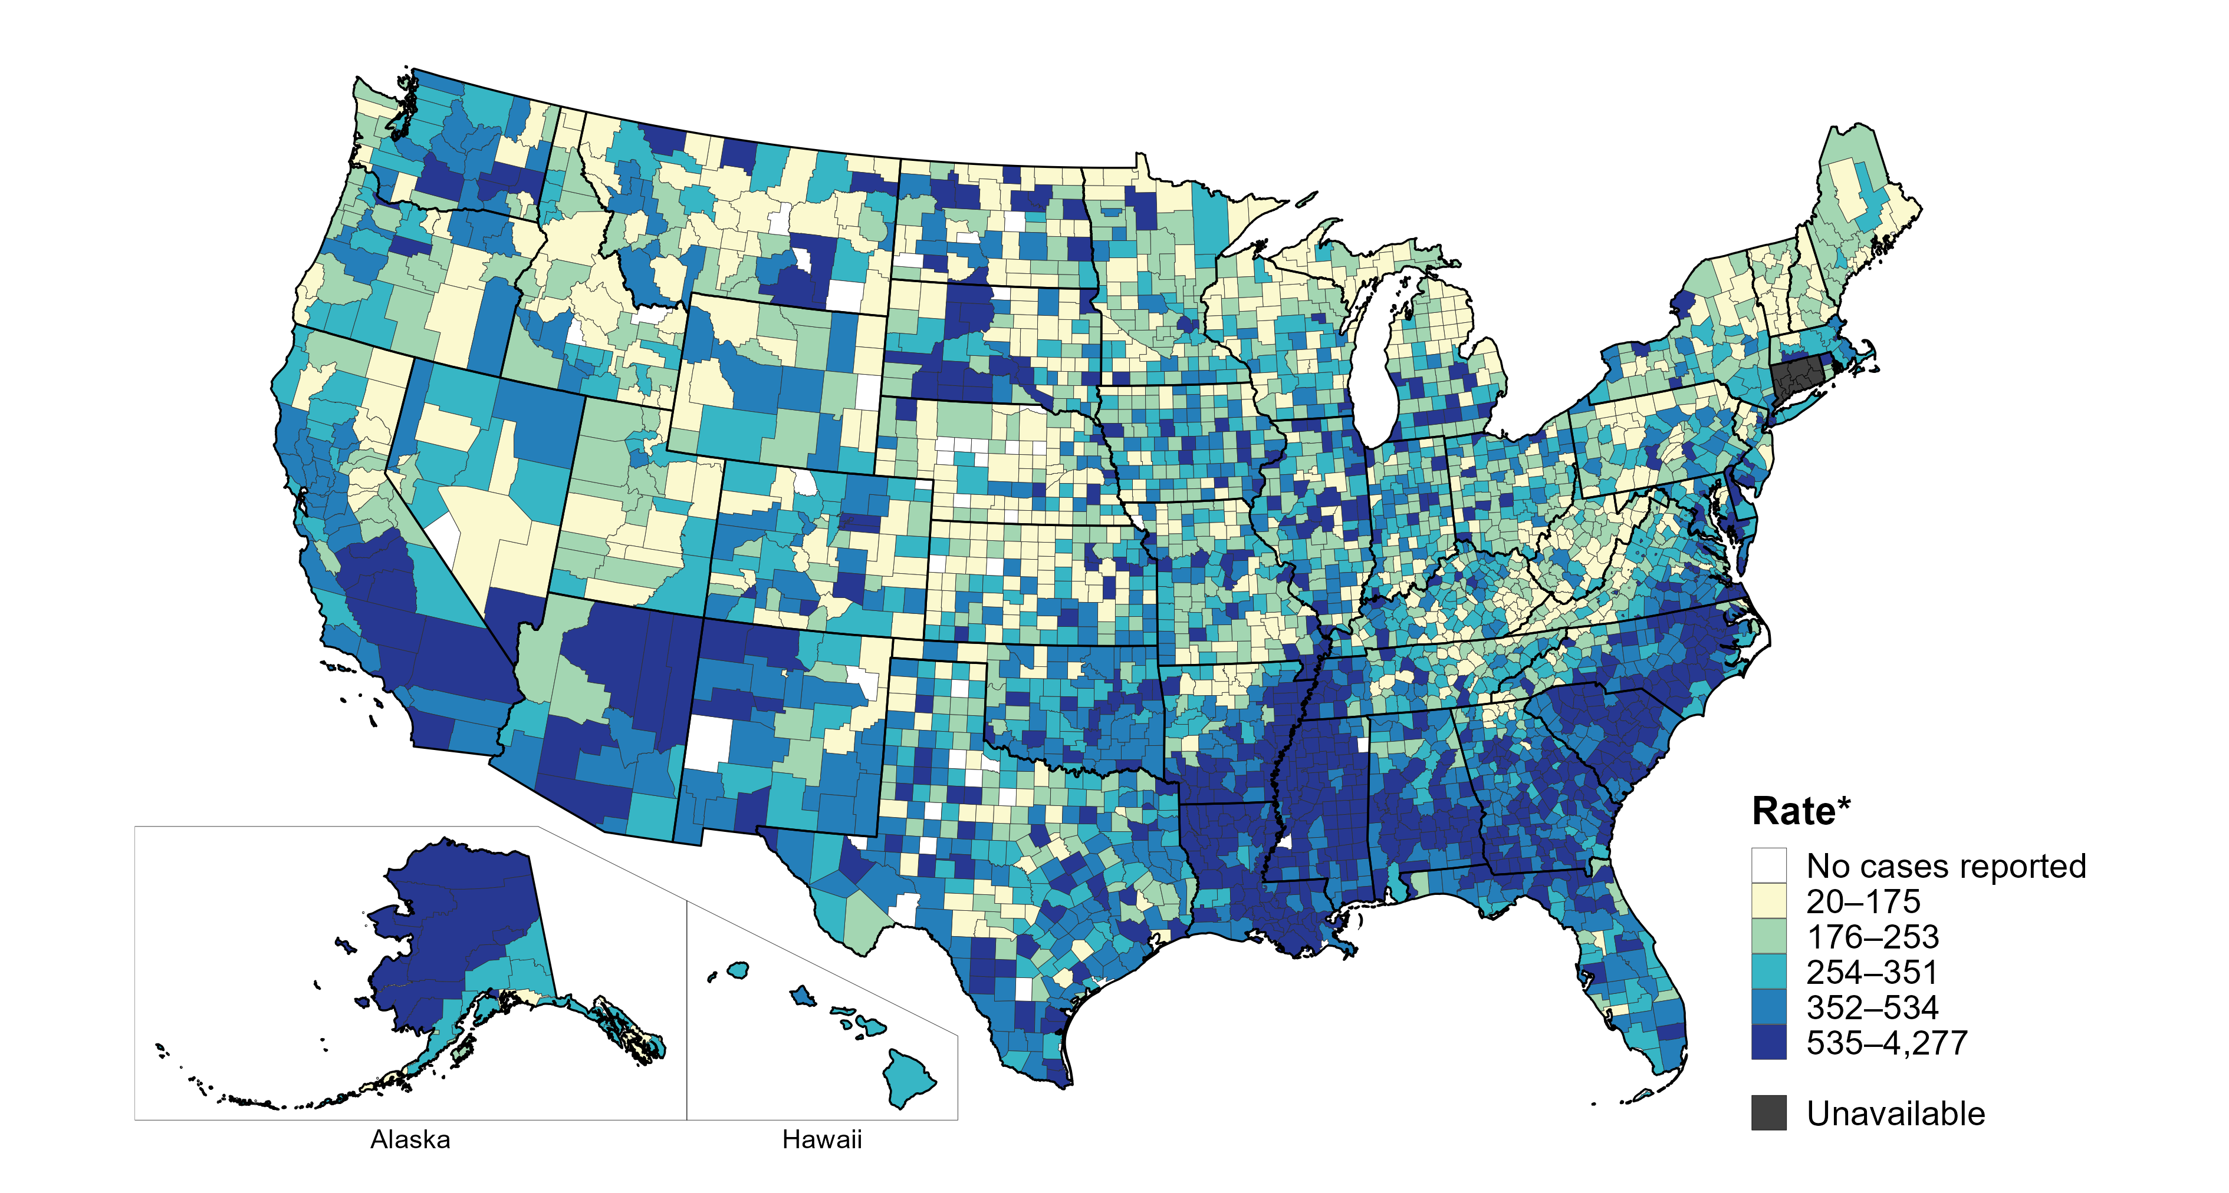
Chlamydia — Rates of Reported Cases by County, United States, 2022
* Per 100,000
Notes:
In 2022, 99% of counties and county equivalents with available data in the United States reported at least one case of chlamydia. Out of 3,135 counties and county equivalents with available data, 93 (3%) reported half of all cases of chlamydia.
In 2022, Connecticut adopted nine planning regions as county-equivalent geographic units; as STI case notification data were not available in the new county-equivalent units for 2022, data for Connecticut have been suppressed for this figure.
This report includes data from years that coincide with the COVID-19 pandemic, which introduced uncertainty and difficulty in interpreting STI surveillance data. See Impact of COVID-19 on STIs for more information.
See Technical Notes (https://www.cdc.gov/std/statistics/2022/technical-notes.htm) for information on chlamydia case reporting. Table A1 (https://www.cdc.gov/std/statistics/2022/tables/a1.htm) provides information on unknown, missing, or invalid values of select variables.
Data for all figures are available at https://www.cdc.gov/std/statistics/2022/data.zip. The file “CT - Rates by County (US 2022).xlsx” contains the data for the figure presented on this slide.

Slide 16
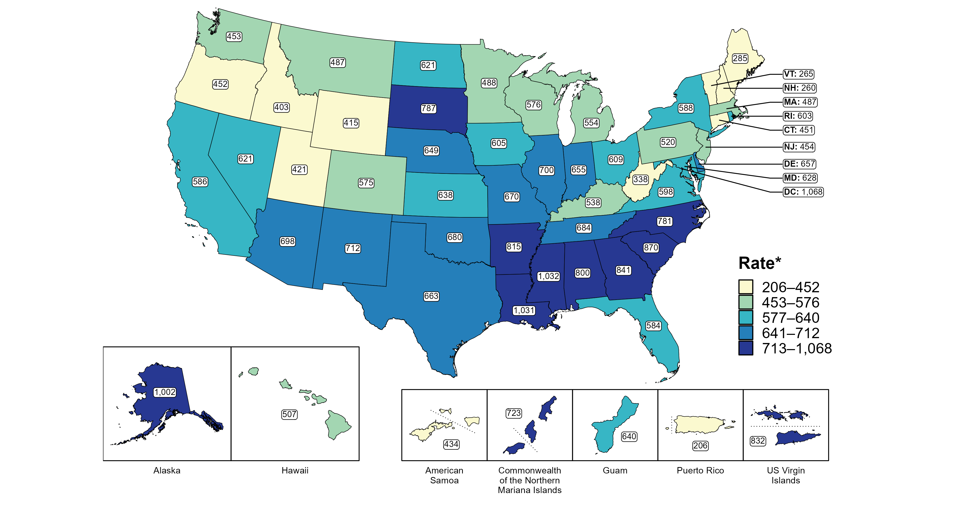
Chlamydia — Rates of Reported Cases Among Women by Jurisdiction, United States and Territories, 2022
* Per 100,000
Notes:
In 2022, rates of reported chlamydia among women ranged by state from 260 cases per 100,000 women in New Hampshire to 1,032 cases per 100,000 women in Mississippi. The rate of reported chlamydia in the District of Columbia was 1,068 per 100,000 women.
Among US territories, rates of reported chlamydia ranged from 206 cases per 100,000 women in Puerto Rico to 832 cases per 100,000 women in the US Virgin Islands.
This report includes data from years that coincide with the COVID-19 pandemic, which introduced uncertainty and difficulty in interpreting STI surveillance data. See Impact of COVID-19 on STIs for more information.
See Technical Notes (https://www.cdc.gov/std/statistics/2022/technical-notes.htm) for information on chlamydia case reporting and on interpreting reported rates in US territories. Table A1 (https://www.cdc.gov/std/statistics/2022/tables/a1.htm) provides information on unknown, missing, or invalid values of select variables.
Data for all figures are available at https://www.cdc.gov/std/statistics/2022/data.zip. The file “CT - Rates Women by Jurisdiction (US and Terr 2022).xlsx” contains the data for the figure presented on this slide.

Slide 17
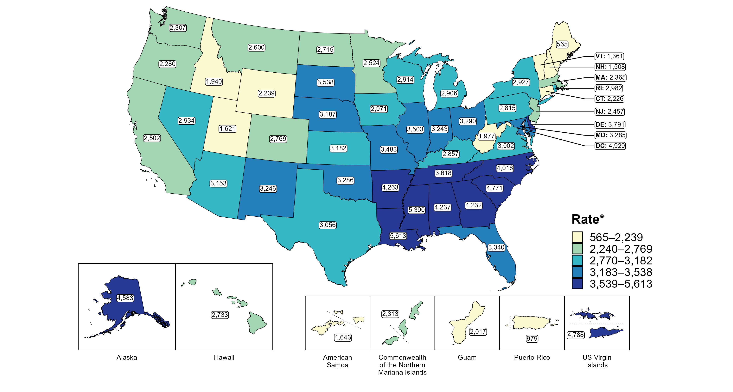
Chlamydia — Rates of Reported Cases Among Women Aged 15–24 Years by Jurisdiction, United States and Territories, 2022
* Per 100,000
Notes:
In 2022, rates of reported chlamydia among women aged 15 to 24 years ranged by state from 565 cases per 100,000 women aged 15 to 24 years in Maine to 5,613 cases per 100,000 women aged 15 to 24 years in Louisiana. The rate of reported chlamydia in the District of Columbia was 4,929 per 100,000 women aged 15 to 24 years.
Among US territories, rates of reported chlamydia ranged from 979 cases per 100,000 women aged 15 to 24 years in Puerto Rico to 4,788 cases per 100,000 women aged 15 to 24 years in the US Virgin Islands.
This report includes data from years that coincide with the COVID-19 pandemic, which introduced uncertainty and difficulty in interpreting STI surveillance data. See Impact of COVID-19 on STIs for more information.
See Technical Notes (https://www.cdc.gov/std/statistics/2022/technical-notes.htm) for information on chlamydia case reporting and on interpreting reported rates in US territories. Table A1 (https://www.cdc.gov/std/statistics/2022/tables/a1.htm) provides information on unknown, missing, or invalid values of select variables.
Data for all figures are available at https://www.cdc.gov/std/statistics/2022/data.zip. The file “CT - Rates Women 15-24 Years by Jurisdiction (US and Terr 2022).xlsx” contains the data for the figure presented on this slide.

Slide 18
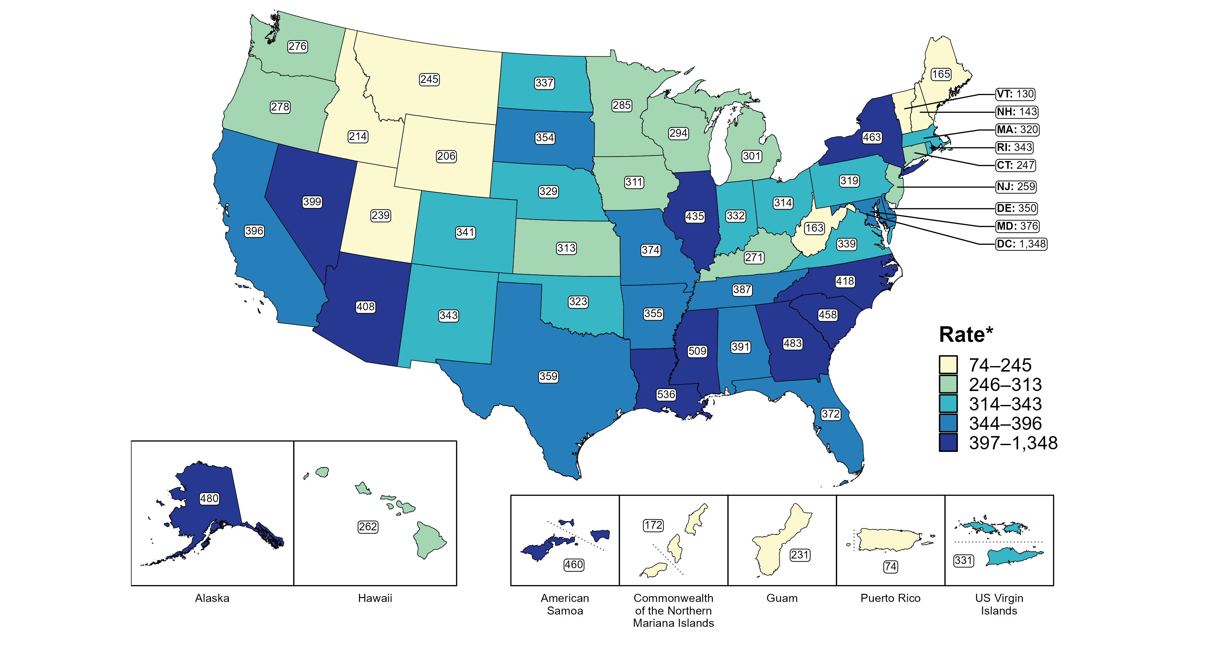
Chlamydia — Rates of Reported Cases Among Men by Jurisdiction, United States and Territories, 2022
*Per 100,000
Notes:
In 2022, rates of reported chlamydia among men ranged by state from 130 cases per 100,000 men in Vermont to 536 cases per 100,000 men in Louisiana. The rate of reported chlamydia in the District of Columbia was 1,348 per 100,000 men.
Among US territories, rates of reported chlamydia ranged from 74 cases per 100,000 men in Puerto Rico to 460 cases per 100,000 men in American Samoa.
This report includes data from years that coincide with the COVID-19 pandemic, which introduced uncertainty and difficulty in interpreting STI surveillance data. See Impact of COVID-19 on STIs for more information.
See Technical Notes (https://www.cdc.gov/std/statistics/2022/technical-notes.htm) for information on chlamydia case reporting and on interpreting reported rates in US territories. Table A1 (https://www.cdc.gov/std/statistics/2022/tables/a1.htm) provides information on unknown, missing, or invalid values of select variables.
Data for all figures are available at https://www.cdc.gov/std/statistics/2022/data.zip. The file “CT - Rates Men by Jurisdiction (US and Terr 2022).xlsx” contains the data for the figure presented on this slide.

Slide 19
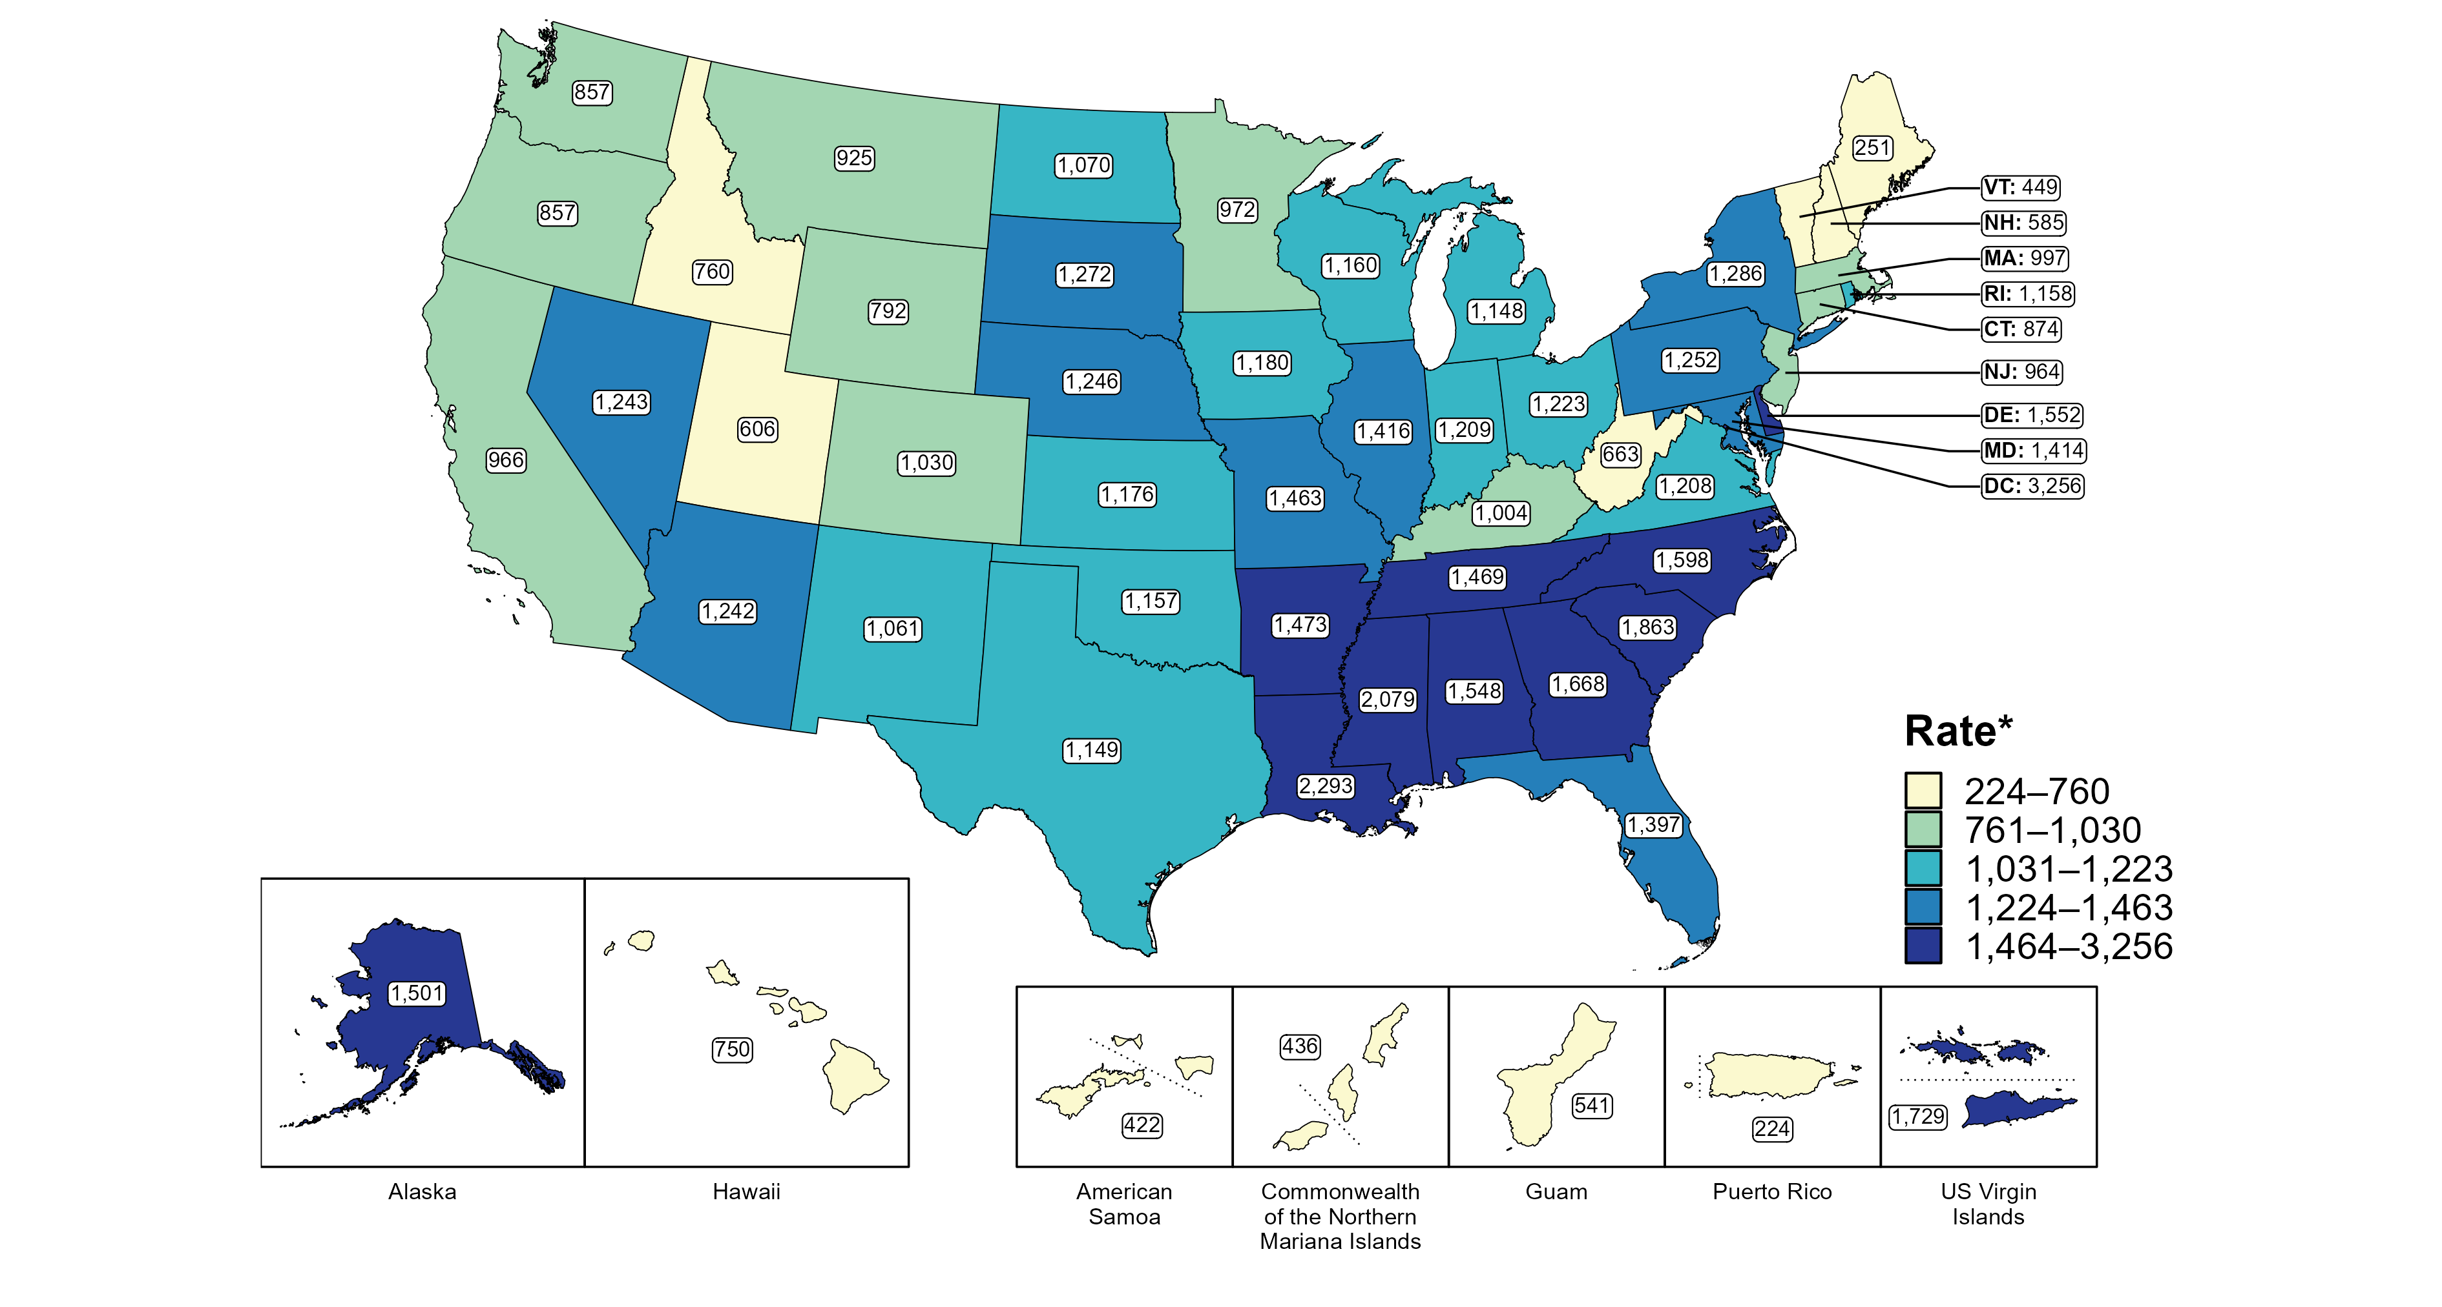
Chlamydia — Rates of Reported Cases Among Men Aged 15–24 Years by Jurisdiction, United States and Territories, 2022
* Per 100,000
Notes:
In 2022, rates of reported chlamydia among men aged 15 to 24 years ranged by state from 251 cases per 100,000 men aged 15 to 24 years in Maine to 2,293 cases per 100,000 men aged 15 to 24 years in Louisiana. The rate of reported chlamydia in the District of Columbia was 3,256 per 100,000 men aged 15 to 24 years.
Among US territories, rates of reported chlamydia ranged from 224 cases per 100,000 men aged 15 to 24 years in Puerto Rico to 1,729 cases per 100,000 men aged 15 to 24 years in the US Virgin Islands.
This report includes data from years that coincide with the COVID-19 pandemic, which introduced uncertainty and difficulty in interpreting STI surveillance data. See Impact of COVID-19 on STIs for more information.
See Technical Notes (https://www.cdc.gov/std/statistics/2022/technical-notes.htm) for information on chlamydia case reporting and on interpreting reported rates in US territories. Table A1 (https://www.cdc.gov/std/statistics/2022/tables/a1.htm) provides information on unknown, missing, or invalid values of select variables.
Data for all figures are available at https://www.cdc.gov/std/statistics/2022/data.zip. The file “CT - Rates Men 15-24 Years by Jurisdiction (US and Terr 2022).xlsx” contains the data for the figure presented on this slide.

Slide 20
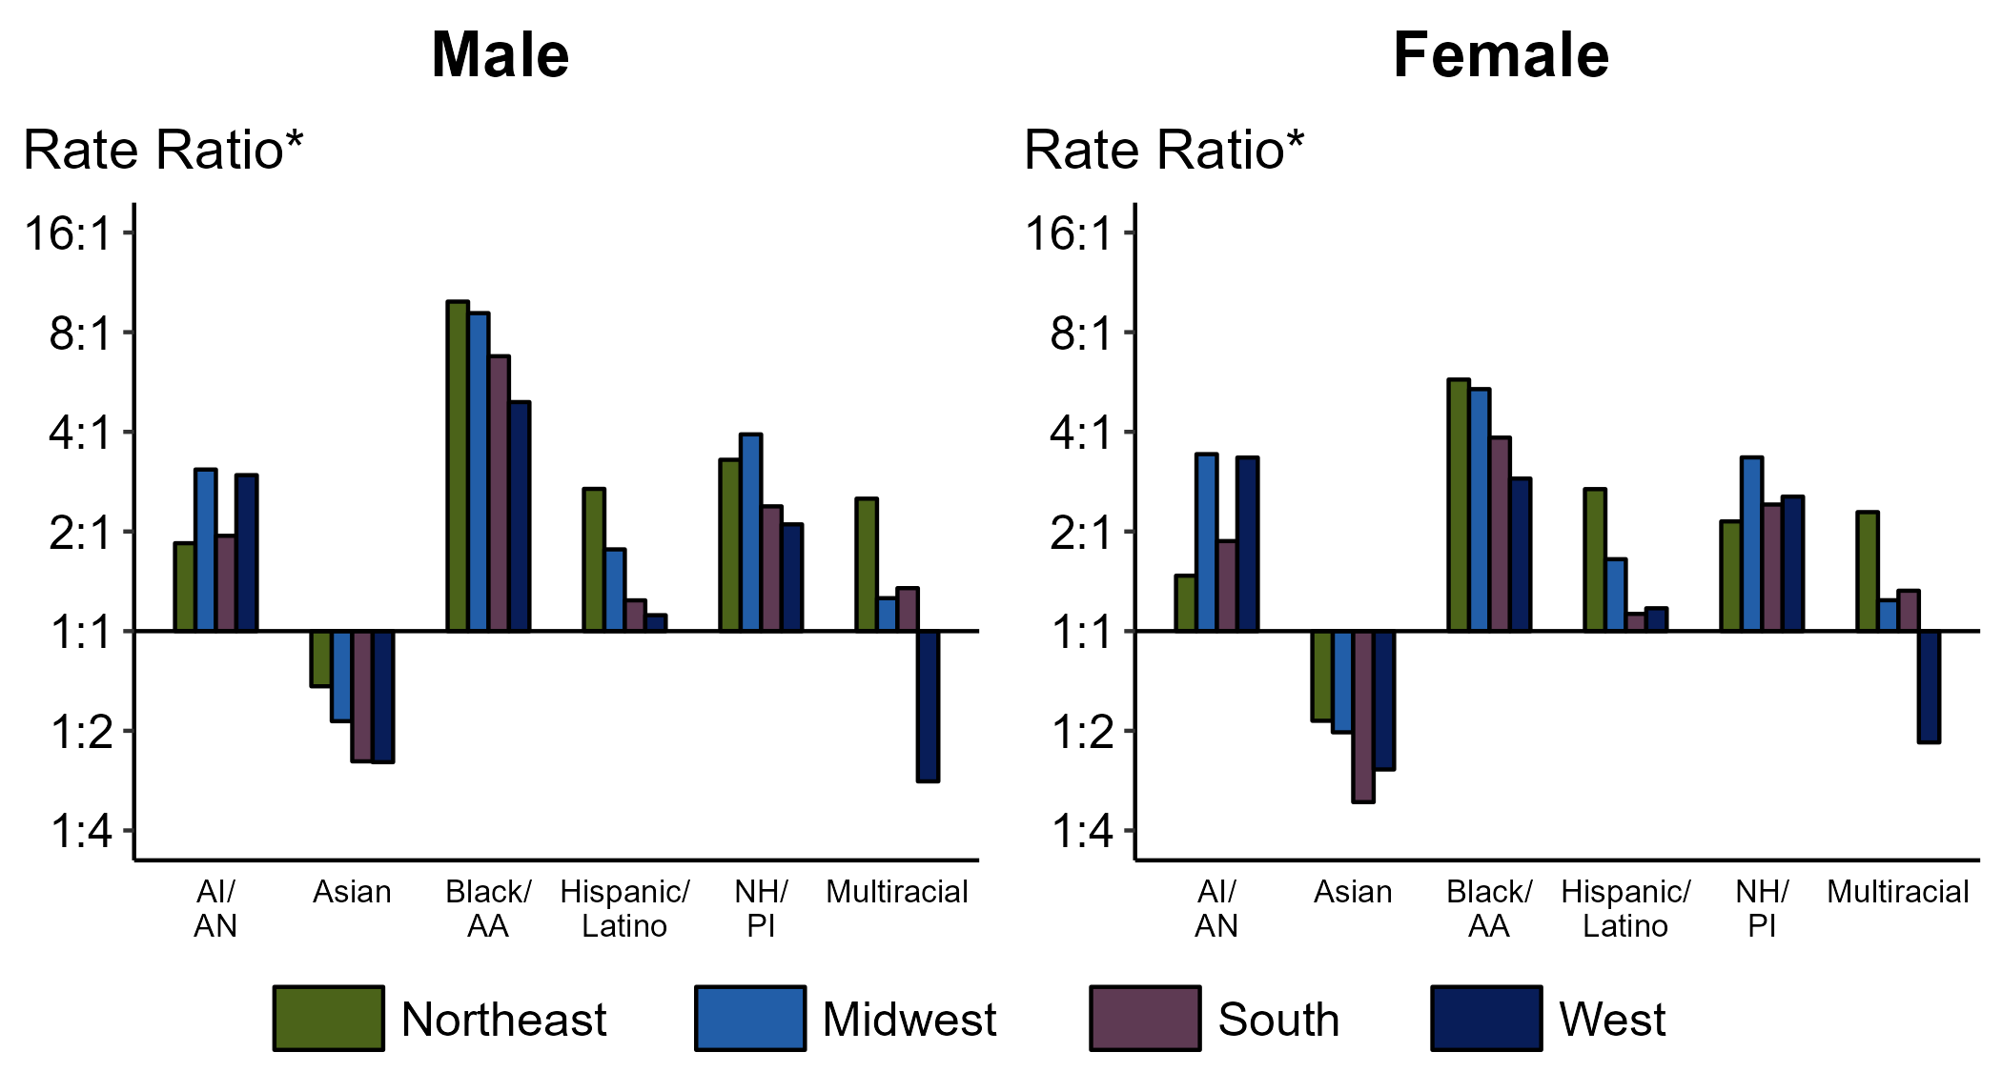
Chlamydia — Ratios of Rates of Reported Cases Among Persons Aged 15–24 Years by Sex, Race/Hispanic Ethnicity, and Region, United States, 2022
* For the rate ratios, non-Hispanic White persons are the referent population. Y-axis is log scale.
ACRONYMS: AI/AN = American Indian or Alaska Native; Black/AA = Black or African American; NH/PI = Native Hawaiian or other Pacific Islander
Notes:
Among men and women aged 15-24 years, rate ratios of rates of reported chlamydia by race/Hispanic ethnicity (using non-Hispanic White persons as the referent population) varied by region in 2022. Among men aged 15-24 years, the greatest rate ratio was in the Northeast where the rate of reported chlamydia among non-Hispanic Black men was 9.9 times the rate among non-Hispanic White men. Among women aged 15-24 years, the greatest rate ratio was in the Northeast where the rate of reported chlamydia among non-Hispanic Black women was 5.8 times the rate among non-Hispanic White women.
This report includes data from years that coincide with the COVID-19 pandemic, which introduced uncertainty and difficulty in interpreting STI surveillance data. See Impact of COVID-19 on STIs for more information.
See Technical Notes (https://www.cdc.gov/std/statistics/2022/technical-notes.htm) for information on chlamydia case reporting, race/Hispanic ethnicity categorization, and reporting of race/Hispanic ethnicity for STI cases. Table A1 (https://www.cdc.gov/std/statistics/2022/tables/a1.htm) provides information on unknown, missing, or invalid values of select variables.

Slide 21
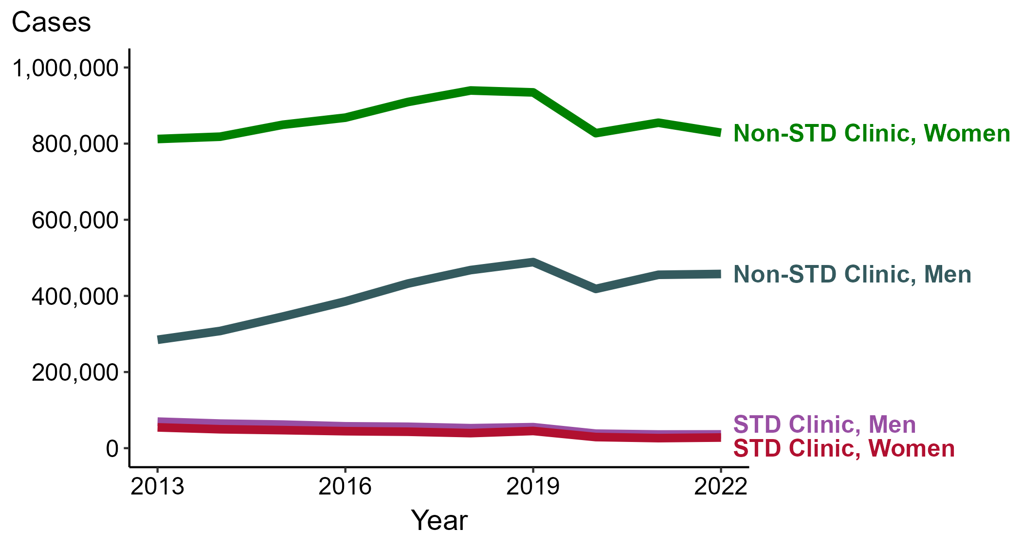
Chlamydia — Reported Cases by Reporting Source and Sex, United States, 2013–2022
NOTE: During 2013 to 2022, the proportion of all cases with unknown reporting source was 15.3%, from a low of 12.7% (n = 178,273) in 2013 to a high of 17.9% (n = 295,170) in 2022.
Notes:
During 2021 to 2022, the number of chlamydia cases reported from STD clinics did not change substantially (<1.0% change) among men (35,913 to 36,135 cases) and increased 5.8% among women (26,395 to 27,930 cases), while the number of cases reported from non-STD clinics did not change substantially (<1.0% change) among men (455,459 to 457,559 cases) and decreased 3.1% among women (854,917 to 828,629 cases).
During a ten-year period (2013 to 2022), the number of chlamydia cases reported from STD clinics decreased 48.1% among men (69,680 to 36,135 cases) and decreased 48.8% among women (54,590 to 27,930 cases), while the number of cases reported from non-STD clinics increased 60.7% among men (284,722 to 457,559 cases) and increased 2.0% among women (812,153 to 828,629 cases).
This report includes data from years that coincide with the COVID-19 pandemic, which introduced uncertainty and difficulty in interpreting STI surveillance data. See Impact of COVID-19 on STIs for more information.
See Technical Notes (https://www.cdc.gov/std/statistics/2022/technical-notes.htm) for information on chlamydia case reporting. Table A1 (https://www.cdc.gov/std/statistics/2022/tables/a1.htm) provides information on unknown, missing, or invalid values of select variables.
Data for all figures are available at https://www.cdc.gov/std/statistics/2022/data.zip. The file “CT - Cases by Reporting Source and Sex (US 2013-2022).xlsx” contains the data for the figure presented on this slide.

Slide 22
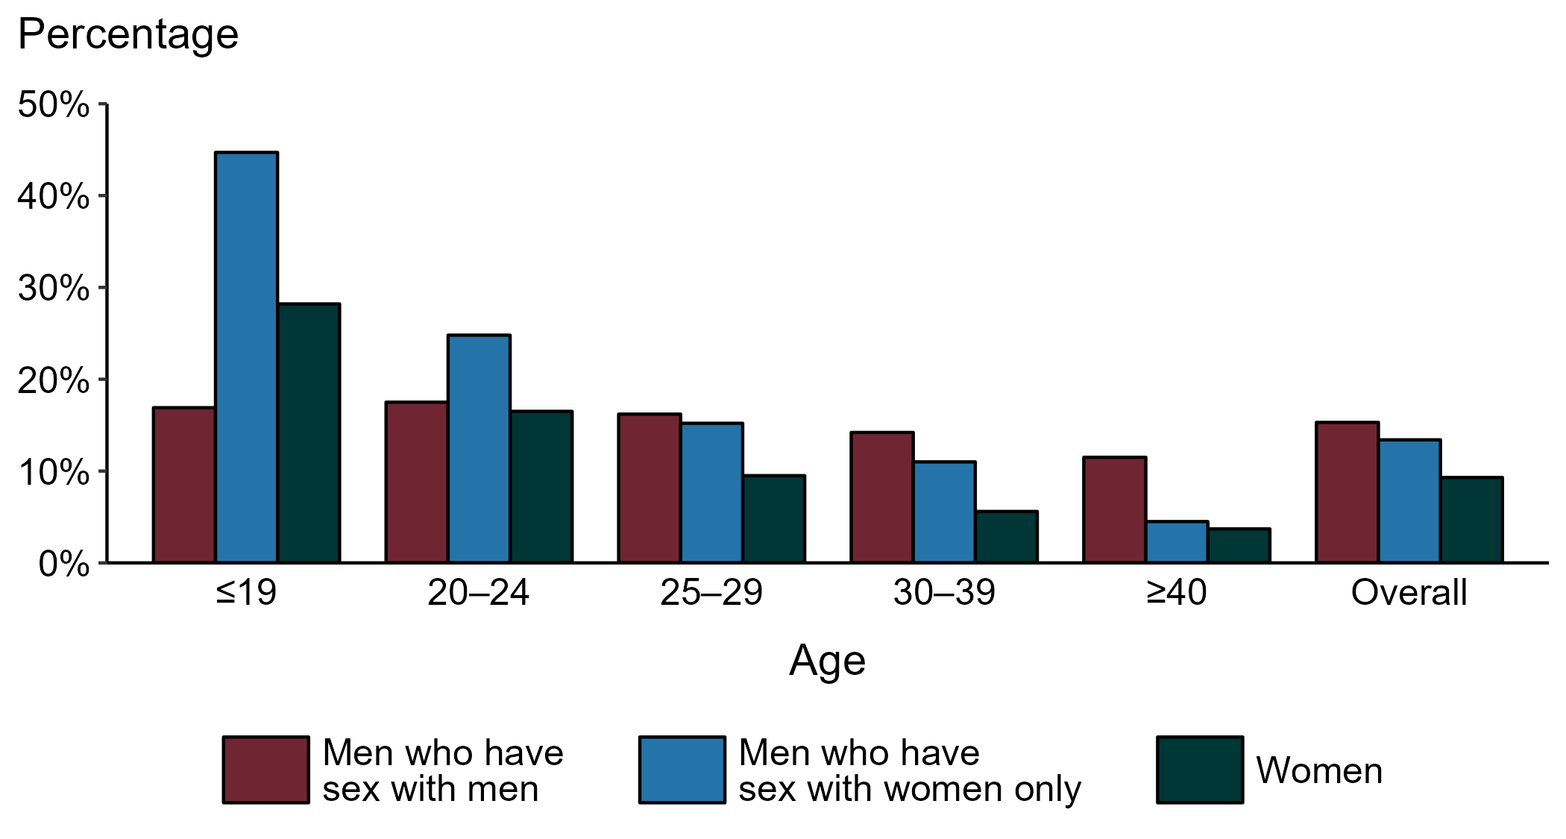
Chlamydia — Proportion of STD Clinic Patients Testing Positive by Age Group, Sex, and Sex of Sex Partners, STD Surveillance Network (SSuN), 2022
NOTE: Results are based on 49,665 unique patients in 10 participating jurisdictions (Baltimore City, California [excluding San Francisco], Columbus, Florida, Indiana, Multnomah County, New York City, Philadelphia, San Francisco, and Washington) with known sex of sex partners attending SSuN STD clinics who were tested ≥1 times for chlamydia in 2022.
Notes:
Among patients accessing care in participating STD clinics in the STD Surveillance Network (SSuN) who were tested for chlamydia in 2022 and had known sexual orientation or sex of sex partners, 15.3% of gay, bisexual and other men who have sex with men (MSM), 13.4% of men who have sex with women only (MSW), and 9.3% of women were found to be positive. The proportion testing positive for chlamydia varied by sex and sex of sex partners, as well as by age group. The highest proportion of patients testing positive were MSW aged 19 years and younger (44.7%). Of note, adolescent patients represent a relatively small subgroup of the clinic population and changes in the number of events in the numerator or a small denominator may lead to substantial fluctuations from year to year. Hence, data should be interpreted with caution.
This report includes data from years that coincide with the COVID-19 pandemic, which introduced uncertainty and difficulty in interpreting STI surveillance data. See Impact of COVID-19 on STIs for more information.
See Technical Notes (https://www.cdc.gov/std/statistics/2022/technical-notes.htm) for information on SSuN methodology.

Slide 23
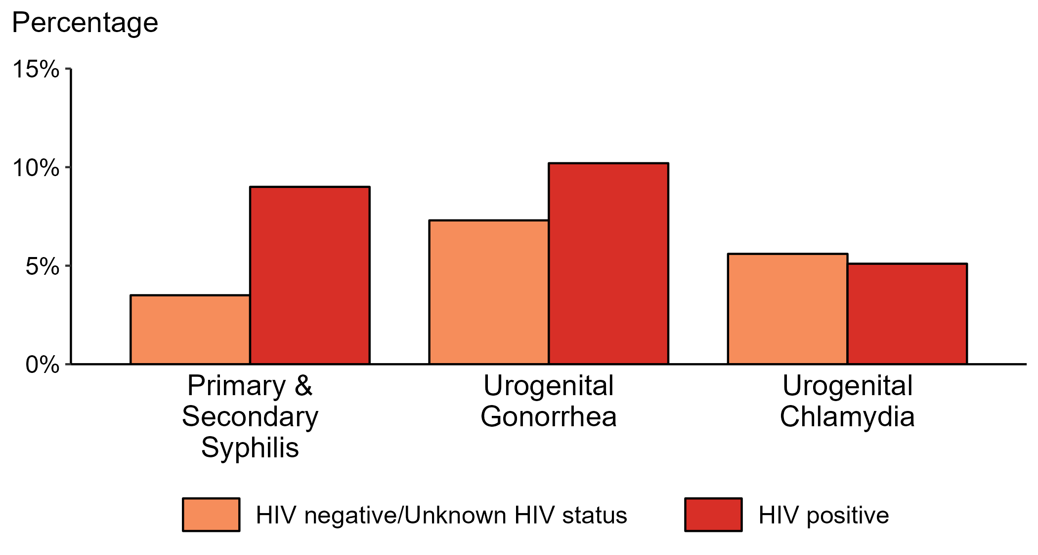
Proportion of MSM with Primary and Secondary Syphilis, Urogenital Gonorrhea, or Urogenital Chlamydia by HIV Status, STD Surveillance Network (SSuN), 2022
NOTE: Results are based on data obtained from patients attending a participating STD clinic in 10 jurisdictions (Baltimore City, California [excluding San Francisco], Columbus, Florida, Indiana, Multnomah County, New York City, Philadelphia, San Francisco, and Washington).
ACRONYMS: MSM = Gay, bisexual, and other men who have sex with men
Notes:
Among gay, bisexual, and other men who have sex with men (MSM) attending participating STD clinics in the STD Surveillance Network in 2022, the portion diagnosed with primary and secondary syphilis was higher for those that were HIV positive compared with those not known to be HIV positive (9.0% versus 3.5%). The pattern was similar for urogenital gonorrhea, with the proportion of testing positive higher among HIV-positive MSM compared with MSM not known to be HIV positive (10.2% versus 7.3%); however, the proportion testing positive for urogenital chlamydia was similar (5.1% among HIV-positive MSM and 5.6% among MSM not known to be HIV positive).
For this figure, HIV status is categorized using documented in the clinic records (based on self-report or most recent HIV test result) or matched information documented in the jurisdiction’s HIV registry.
This report includes data from years that coincide with the COVID-19 pandemic, which introduced uncertainty and difficulty in interpreting STI surveillance data. See Impact of COVID-19 on STIs for more information.
See Technical Notes (https://www.cdc.gov/std/statistics/2022/technical-notes.htm) for information on SSuN methodology.

Slide 24
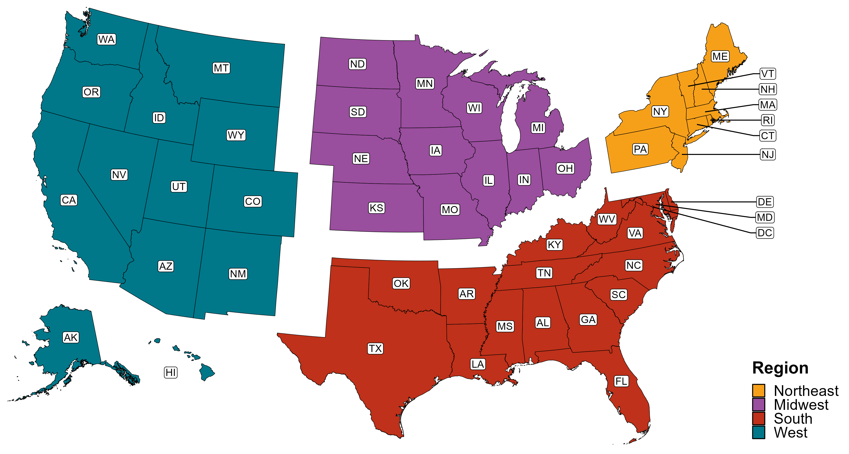
Reference Map of US Census Regions

