Slide 1
Increasing Access to Drinking Water in Schools Tool Kit
Step by step guidance on using the tool kit

Slide 2
Learning Objectives
Explain the benefits of providing students with access to drinking water during the school day
Describe how to use the tool kit to help schools increase access to drinking water
Notes:
NARRATIVE
The purpose of this presentation is to
Outline the benefits of providing students with access to drinking water during the school day; and
Describe how to use the tool kit to help schools increase access to drinking water

Slide 3
Water and Health
Provides healthy alternative to sugar sweetened beverages
Helps children maintain a healthy weight status
Improves cognitive function
Helps prevent dental cavities
Child Care Hlth Dev 2007;33:409–15. Pediatrics 2009;123:e661–e667. Arch Pediatr Adolesc Med. 2009; 163(4):336–343. Nutr Rev 2010;68(8):439–458. Hum Brain Mapp 2011;32:71–79. Appetite 2009;53:469–472. Appetite 2009;52:776–779. Appetite 2009;53:143–146.
Notes:
NARRATIVE
There are several reasons why increasing access to drinking water in schools is an important issue.
First, access to safe, free drinking water throughout the school environment gives students a healthy alternative to sugar-sweetened beverages before, during, and after school, and can help children maintain healthy weight status.
We also know that adequate hydration may improve cognitive function, which is important for learning.
Drinking water, if fluoridated, also plays a role in preventing cavities

Slide 4
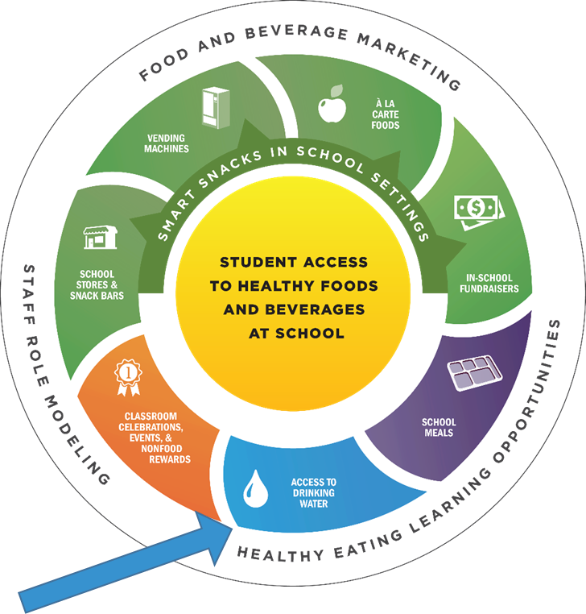
Water Access is Part of a Healthy School Nutrition Environment
http://www.cdc.gov/healthyschools/parentengagement/pdf/healthy-students_badge_7.pdf
Notes:
NARRATIVE
CDC and many national organizations recommend establishing a healthy school nutrition environment to support both student health and learning.
The school nutrition environment refers to: 1) the foods and beverages that are available to students throughout the school day, and 2) information and messages about food, beverages, and nutrition that students encounter on school grounds.
This diagram shows the different components of a healthy school nutrition environment and as you can see, access to drinking water is one of these components.

Slide 5

Healthy, Hunger-Free Kids Act Requirements
  Schools that participate in the USDA school meal programs are required to provide students with potable drinking water that is
  free of charge
  during meal times
    where lunch meals and afterschool snacks are served
    when breakfast is served in the cafeteria
7 CFR § 210.10(a)(1) and 7CFR § 220.8(a)(1)
https://www.gpo.gov/fdsys/pkg/FR-2016-07-29/pdf/2016-17227.pdf
SP 28- 2011: Child Nutrition Reauthorization 2010: Water Availability During National School Lunch Program Meal Service
Notes:
NARRATIVE
As a result of the Healthy, Hunger-Free Kids Act of 2010, schools that participate in the USDA school meal programs are required to provide students with access to potable water, free of charge, during meal times.
During lunch and afterschool snack service, the free water must be available wherever the meals are served.
During breakfast, the water is only required to be available when breakfast is served in the cafeteria.

Slide 6
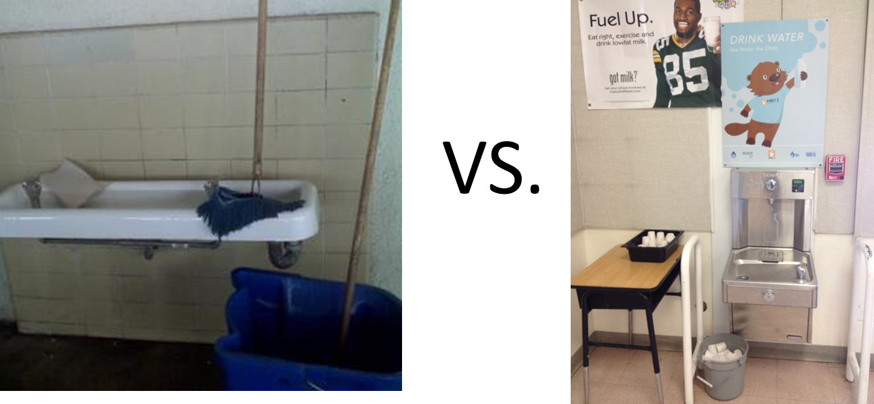
What does drinking water access look like in schools?
Notes:
NARRATIVE
Survey data indicate that most schools are providing access to drinking water, but this is based on the respondents’ knowledge and perceptions of water access. However, we know that how this gets implemented can vary from school to school.
For example, both of these photos could technically count as meeting the requirements for free drinking water during the meal periods. However, the photo on the left is not very inviting, and most students would probably choose not to drink out of a fountain that has debris and a mop in it. On the other hand, the photo on the right hand side shows a water dispenser that is clean, appealing, has great signage near it promoting water, and also has cups available if students do not have their own drinking water bottle to refill or would like to take a cup of water back to their table to drink with their meal.
Ideally, students’ access to drinking water at school goes beyond the federal requirement and includes policies and practices that
Provide students with multiple water access points across the school
Allow students can have water bottles during the day
Promote water promoted in a variety of ways.

Slide 7
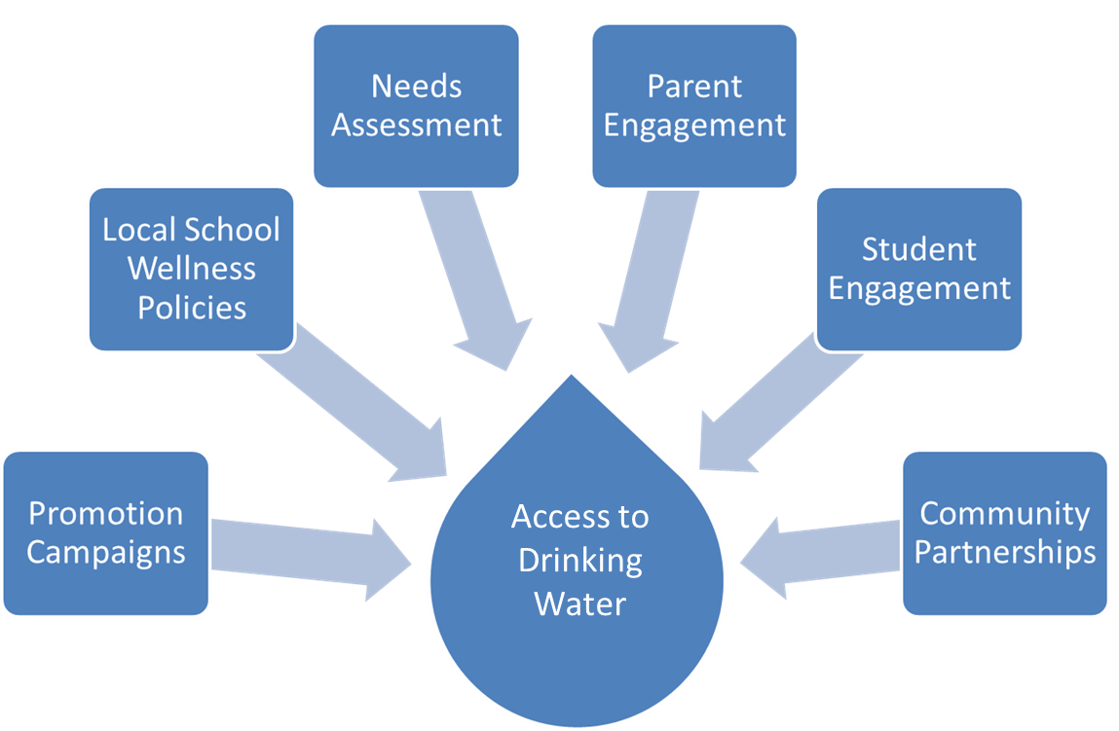
How can schools begin to address water access?
Notes:
NARRATIVE
There are many ways that schools can begin to address water access everything from new policies, to promotion campaigns, building new partnership, and engaging parents and students.
So where should schools start if they are interested in increasing access to drinking water?

Slide 8
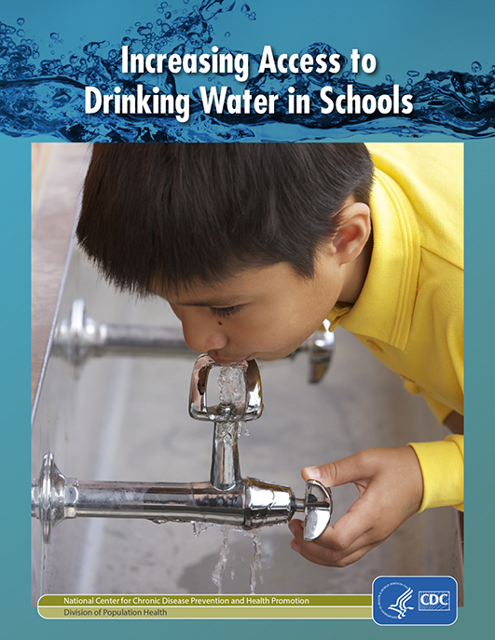
Increasing Access to Drinking Water in Schools
Tool Kit
Who should use the tool kit?
  School health councils
  Nutrition services providers
  Principals
  Teachers
  Parents
  Public health partners
  Community members
  University staff
https://www.cdc.gov/healthyschools/npao/pdf/water_access_in_schools_508.pdf
Notes:
NARRATIVE
One way schools can get started is to become familiar with and use the CDC Increasing Access to Drinking Water in Schools tool kit.
CDC worked with many individuals and organizations to develop the Increasing Access to Drinking Water in Schools Tool Kit which describes key steps schools can take to meet federal requirements for drinking water during the meal periods, as well as to make drinking water available and accessible across the school campus.
This tool kit can be used by school health councils, nutrition services providers, principals, teachers, parents, and other school staff who are interested in increasing access to drinking water. In addition, other stakeholders may choose to use the tool kit, such as public health partners, community members, and university staff, to support the implementation and evaluation of these efforts.
The tool kit includes a needs assessment checklist, and action plan template, examples of water promotion campaigns, and guidance on evaluating this work.
The remaining slides will walk through the tool kit in more detail and highlight the various templates that are included and how to use them.

Slide 9
Process for increasing access to drinking water in schools
Conduct needs assessment
Put the plan into action
Evaluate progress
Develop a plan
Revise plan as needed
Notes:
NARRATIVE
This diagram describes the process outlined in the tool kit to help schools address to address drinking water.
A great first step is to conduct a needs assessment of the water environment in the school.
This will help to identify current strengths and areas for opportunity.
This step can help to inform the development of a water access plan and guide activities to improve the water access environment.
Let’s look at each step a bit closer, beginning with the needs assessment.

Slide 10
Conduct a Needs Assessment
Assess policies and practices related to water access
Review water testing requirements and recommendations
Identify key personnel to become water access champions
Identify the school’s water access points
Assess students’ and other stakeholders’ perceptions about the drinking water
1
2
3
4
5
Notes:
Because every school is different, it is important to spend time thinking through what specific changes to water accessibility are needed, consider the resources available to make the changes, and what training and promotion will help ensure that the changes are successful.
The needs assessment process outlined in the tool kit is very comprehensive and includes the following steps:
Assessing policies and practices related to water access;
Reviewing water testing requirements and recommendations;
Conducting an assessment of the school’s water access points;
Assessing students’ and other stakeholders’ perceptions about the drinking water; and
Identifying key personnel to become water access champions.
The tool kit includes a School Drinking Water Needs Assessment Checklist and Planning Guide (Appendix 1) to help schools navigate this process and provides examples of key questions to consider.

Slide 11

Step 1: Assess state, district, and school policies and practices related to water access
Food Service Areas
  Meet or exceed USDA requirements
  Sanitary code specific to food service areas.
Campus-Wide
  State or local plumbing codes with a fountain to student ratio
  Standard operating procedures (SOPs) for water delivery devices
  State or local laws or regulations on community water fluoridation.
Notes:
NARRATIVE
The first step of the needs assessment process is to examine state, district, and school level policies and practices related to water access.
Policies about water access may be established at the federal, state, and local levels.
The School Drinking Water Needs Assessment Checklist and Planning Guide, which can be found in Appendix 1 of the tool kit, addresses policies and practices for
Food service areas, such as meeting or exceeding USDA requirements for water access during meal periods, and sanitary code specific to food service areas.
The entire school campus, such as state or local plumbing codes and requirements in local school wellness policy.

Slide 12
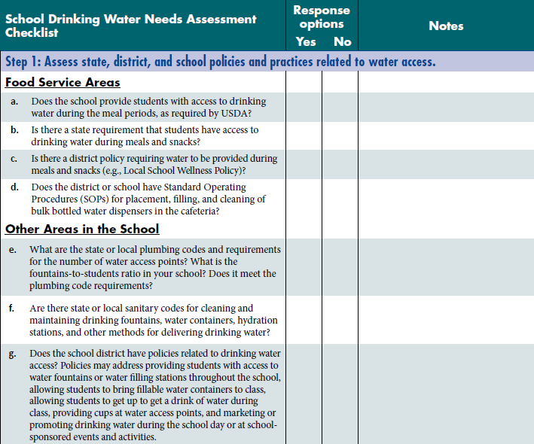
School Drinking Water Needs Assessment Checklist
Notes:
NARRATIVE
This slide shows the first section of the School Drinking Water Needs Assessment Checklist in the tool kit which addresses policies and practices related to water access.
For example, the questions related to the food serviced areas ask:
Does the school provide students with access to drinking water during the meal periods, as required by USDA?
Is there a state requirement that students have access to drinking water during meals and snacks?
Is there a district policy requiring water to be provided during meals and snacks (e.g., Local School Wellness Policy)?
Does the district or school have Standard Operating Procedures (SOPs) for placement, filling, and cleaning of bulk bottled water dispensers in the cafeteria?
The individual(s) filling out the School Drinking Water Needs Assessment Checklist should respond to each of the questions, and can use the notes section of the checklist, capture additional details or clarifying comments. For example, if your school district is working on developing a local school wellness policy that would incorporate language on student access to water fountains or filling stations throughout the school day, you might make note of the steps being taken to achieve that, or the barriers that make it difficult to achieve. Those notes will help guide you in developing your goals and objectives later in the planning process.

Slide 13
Step 2: Review federal, state, and local water testing requirements and recommendations
Testing requirements depend on water source
  local public water supplier (e.g., municipal water system)
  public water system (e.g., well)
EPA provides guidance for all schools on water testing requirements and recommendations
  https://www.epa.gov/schools-air-water-quality/schools-water-quality
Notes:
NARRATIVE
The next step of the needs assessment process is to review federal, state and local water testing requirements and recommendations.
Schools are responsible for providing safe drinking water. Drinking water comes into the school facilities from either (a) a public water supplier (e.g., water utilities or water suppliers, such as cities, towns, and water districts) or (b) an on-site water system (e.g., a well). In the United States, most school districts (80%) get their drinking water from a community or municipal source. There are different testing requirements for schools depending on the source of the drinking water.
Current federal law does not require schools using a local public water supplier (e.g., municipal water system) to regularly test the water because the public water supplier is required to regularly test the water to ensure that it meets federal and state drinking water standards for contaminants, including bacteria and certain chemicals. However, the water pipes and plumbing fixtures in the schools can affect the safety and quality of the water. Therefore, the Environmental Protection Agency (EPA) recommends that all schools routinely test drinking water for lead and perform regular maintenance to ensure that drinking water is safe.
Schools that would like to test water for lead should review the EPA guidance for schools (see web link on the slide).

Slide 14
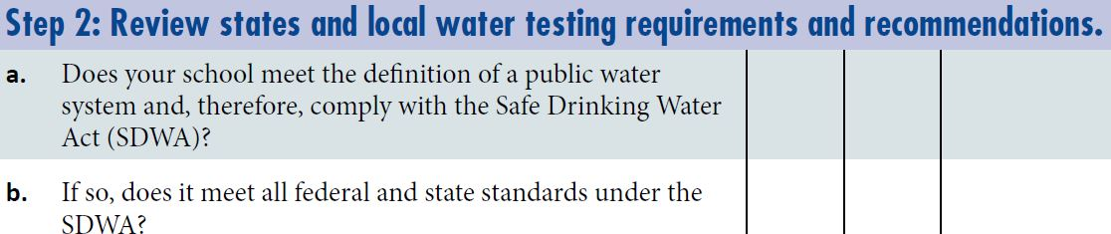
Step 2: Review states and local water testing requirements and recommendations
Notes:
NARRATIVE
This slide shows the portion of the School Drinking Water Needs Assessment Checklist and Planning Guide that addresses state and local water testing requirements and recommendations.

Slide 15
Step 3: Learn about the school water environment
Number of water access points
Location of water access points
Fountain-to-student ratio at the school
Cleanliness of drinking water access points
Availability of cups
Notes:
NARRATIVE
The third step is to conduct an assessment of the current drinking water environment including:
Number of water access points- Water access points may include water fountains, water coolers, hydration stations, and other water filling stations, but should not include bottled water for sale because not all students may be able to purchase bottled water
Location and accessibility of water access points- How many are accessible to students during the school day and during after-school hours?
Fountain-to-student ratio at the school-Does it meet the state plumbing code requirements? Schools can contact their local building inspector for plumbing code information and standards.
Are drinking water access points clean and operating properly? Important elements to assess here include (a) clarity of the water; (b) cleanliness (i.e., any visible dirt, gum, or trash); (c) actual delivery of water (i.e., Is water coming out?); (d) temperature of the water (i.e., Is it cold?); and (e) sufficient water pressure to maintain an adequate stream of water to drink from or fill a cup or water bottle. If the school relies on bulk bottled water dispensers, determine if they are routinely sanitized, and if cups are provided and routinely restocked.
Are cups provided at water access points?-Research show that students tend to drink more water when cups are provided

Slide 16
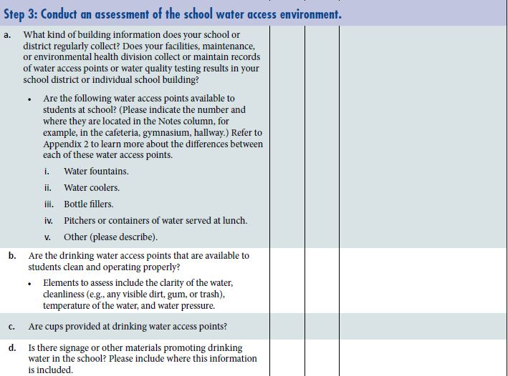
Step 3: Conduct an assessment of the school water access environment
Notes:
NARRATIVE
And this is a closer view of the questions on the School Drinking Water Needs Assessment Checklist and Planning Guide related to the school environment.

Slide 17

Step 4: Assess perceptions about drinking water access at school
  Ask about
  Accessibility
  Taste, health, and safety
  Barriers
  Ways to promote drinking water
  *See sample assessment questions in Appendix 5
Notes:
NARRATIVE
Schools may want to conduct a general survey about perceptions of drinking water among students and other stakeholders to help guide what changes are needed, as well as address misperceptions about drinking water.
Topics to ask about include
accessibility of school drinking water
attitudes about drinking water, including perceptions of tap water taste, health, and safety
barriers to drinking water
ways to promote drinking water
Schools can engage existing student groups who might be interested in water issues to help conduct the assessment. Potential student groups include sports teams, environmental clubs, student nutrition committee, and other groups interested in gathering information from students.
We have included sample questions that could be included in a survey in Appendix 5.

Slide 18
Step 5: Identify key water access champions
Potential water champions
Parents
Teachers
School nutrition staff
Students
School wellness coordinators
Community members
Notes:
NARRATIVE
Water access champions are individuals or groups who support student access to drinking water, and can help develop and implement a drinking water access plan.
Potential water access champions include
Parents;
Teachers;
School nutrition staff;
Students;
School wellness coordinators; and
Community members including physicians, dentists, and other dental health care personnel.
There are many important roles that water access champions can have to support drinking water access. For example, the school wellness coordinator could bring together a group of individuals to conduct the needs assessment process, develop the school water access plan, and help ensure that the plan is implemented. The school principal can help get staff and community support and commitment for the water access plan, and allocate resources to implement the plan. Students could lead the assessment process and help develop materials for water promotion campaigns, and parents could organize fundraising events to raise money for installation of new water dispensers.

Slide 19
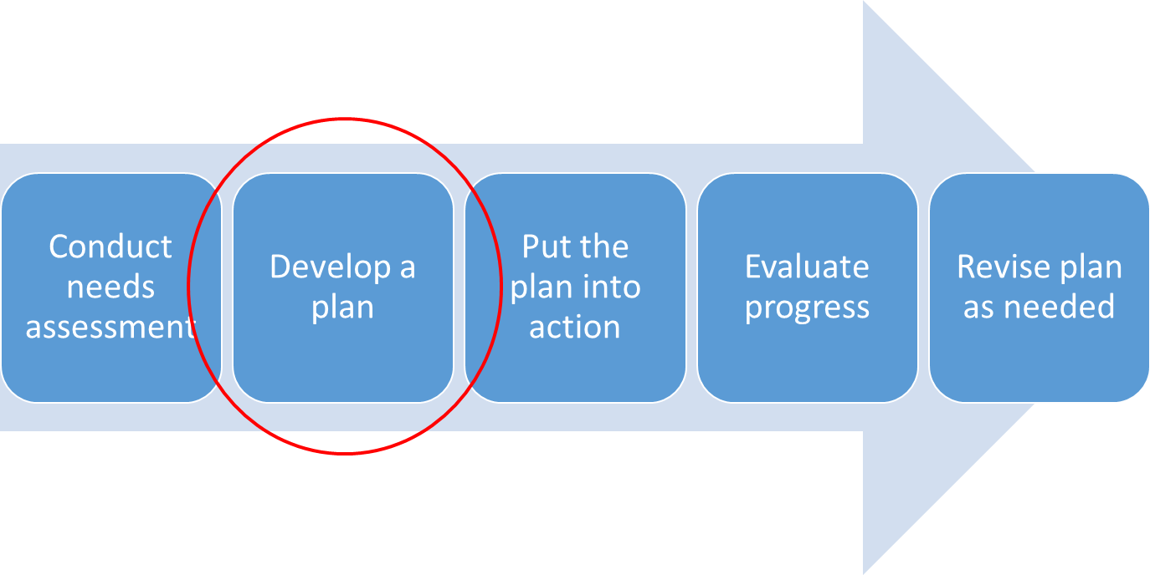
Process for increasing access to drinking water in schools
Notes:
NARRATIVE
Once the assessment of the school’s water policies and practices has been completed, the next step is to develop a drinking water access plan.

Slide 20
Develop a Plan
1
2
Identify priority actions
3
4
Identify goals and objectives for each priority action
Identify person(s) responsible for each objective
Identify strengths and opportunities for improvement
Notes:
NARRATIVE
Once the assessment of the school’s water policies and practices has been completed, the next step is to develop a drinking water access plan.
The purpose of developing a plan is to
Identify strengths and opportunities for improvement in providing access to and consumption of drinking water;
Develop a list of recommended actions for providing access to and consumption of drinking water;
Identify goals and objectives for each priority action; and
Identify the individuals responsible for ensuring that each objective is carried out in the designated time frame.

Slide 21
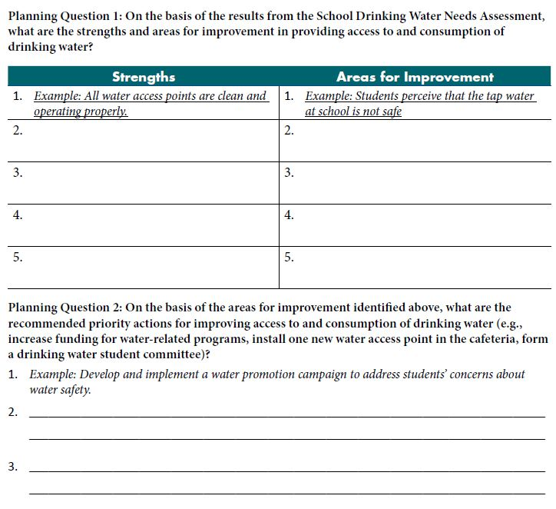
Identify Strengths, Opportunities, and Priority Actions
Notes:
NARRATIVE
First, based on the results of the needs assessment process, make a list of the strengths and weaknesses.
For, example one weakness could be that students perceive that the tap water at the school is not safe.
Next, based on the weaknesses identified in Planning Question 1, make a list of recommended actions to improve drinking water access, and select at least one priority action from the list.
Although the number of priority actions will vary for each school, it is recommended to identify between one and three priority actions.
Examples could include the following: Form a student committee to help implement a drinking water campaign at school.

Slide 22
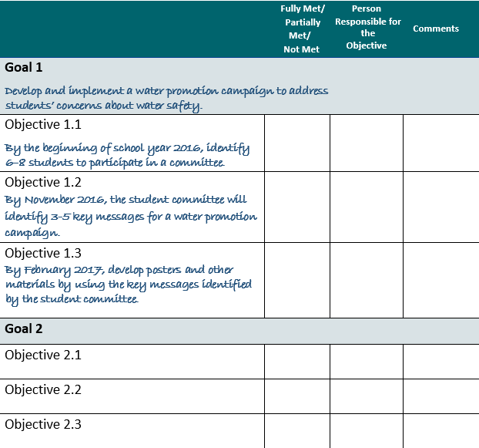
Identify goals and objectives for priority actions
Notes:
NARRATIVE
Next, use the Goals and Objectives Template provided to identify goals and objectives for each of the priority actions that were identified. Another way to think about this are what are the steps that are needed to meet the priority actions.
Remember to develop objectives that are specific, measurable, achievable, realistic, include the timeframe by when they will be completed. Also, it is important to identify an individual or group of individuals who will be responsible for helping to implement each of the objectives.
For the example goal to develop and implement a water promotion campaign to address students’ concerns about water safety, some objectives might be:
By the beginning of school year 2014, identify 6-8 students to participate in a committee to develop the campaign.
By November 2016, the student committee will identify 3-5 key message for a water promotion campaign.
By February 2017, the committee will develop posters and other materials using the key messages.

Slide 23
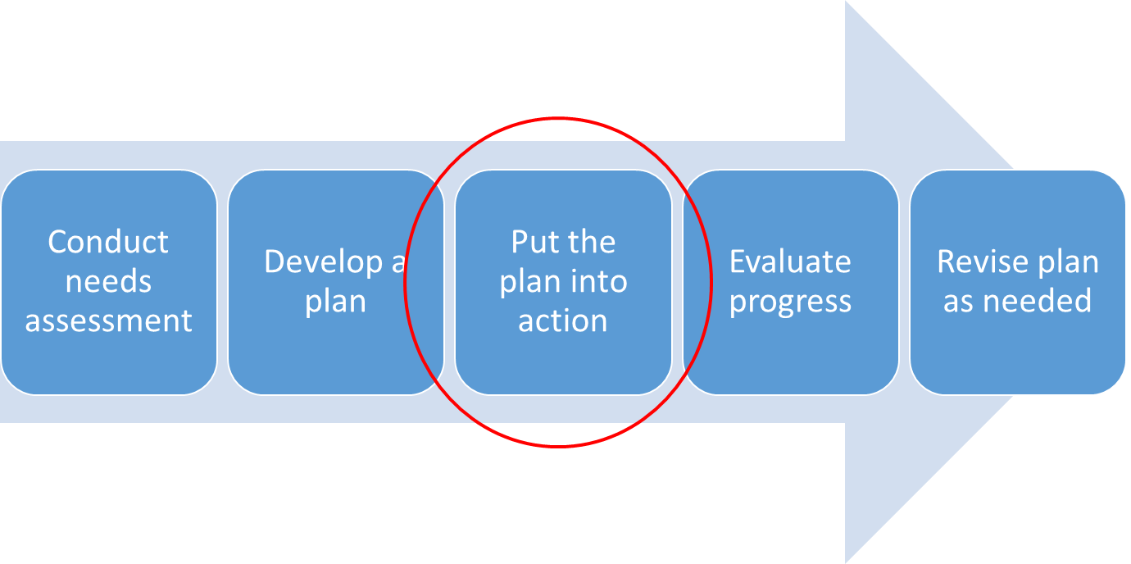
Process for increasing access to drinking water in schools
Notes:
Note for Sarah and Sarah: One option is to show this process slide again as a transition to the next step.
NARRATIVE
Once the plan has been developed, including goals and objectives, then the next step is begin to implement the water access plan.

Slide 24
Put the Plan into Action
1
Seek opportunities for funding
2
Gather partners to support the effort
3
5
Select a water delivery method
6
Address sustaining the water access plan long-term
Develop water promotion strategies
4
Identify personnel needs and training
Notes:
NARRATIVE
Depending on the goals and objectives that are identified, additional steps may be needed to implement the water access plan. The tool kit addresses the following implementation strategies to help schools achieve the goals and objectives including:
Opportunities for funding.
Additional partners to support the effort.
Selecting a water delivery method.
Identifying personnel needs and training.
Developing water promotion strategies.
Addressing sustaining the water access plan long-term.

Slide 25
Ideas for Funding
School food service funds
Federal, state, or municipal funding
Foundation grants
Partnership with private industry (e.g., reusable water bottle companies)
Parent Teacher Association (PTA) fundraiser
Notes:
NARRATIVE
Ideally, schools would incorporate certain costs involved with improving water access into their annual budgets.
Funding may be needed for installation of new water access points (e.g., water fountains, water dispensers, hydration stations), buying cups to be kept at water access points (unless the school has the students bringing their own containers), maintaining water access points (e.g., a water dispenser may require filter changes every few months), testing of drinking water, repair (e.g., old drinking water-related infrastructure), removing drinking water contaminants (e.g., filter certified to remove lead), and supporting labor costs to maintain water sources.
If the provision of drinking water in your school is beyond the district’s current means, consider including these improvements in the school’s long-term school modernization plans as a worthwhile investment.
Other options for funding school water-related programs include the following:
School food service funds, if the water access point is in the food service area
Federal, state, or municipal funding
Foundation grants
Partnership with private industry (e.g., reusable water bottle companies)
Parent Teacher Association (PTA) fundraiser

Slide 26
Gather Partners
Drinking water agencies and associations
Health professionals, agencies, and associations
Youth advocacy programs
Education associations
School facilities and custodial staff
State department of environmental
protection
Foundations that address health
Notes:
NARRATIVE
In addition to key stakeholders necessary to the entire planning and implementation process (e.g., school health councils, parents, community members), there are many people and organizations who share the common goal of promoting access to drinking water including:
Drinking Water Agencies and Associations
Association of State Drinking Water Administrators
Local water district or local water utility company
Health Professionals, Agencies, and Associations
Association of State and Territorial Health Officials
Dentists and other oral health professionals, physicians, and dieticians
Public health departments
Youth Advocacy Programs and Education Associations
Youth development programs (e.g., Girls and Boy Scouts, 4H)
Parent Teacher Associations (PTA)
Others
School facilities and custodial staff
State department of environmental protection
Foundations interested in health issues

Slide 27
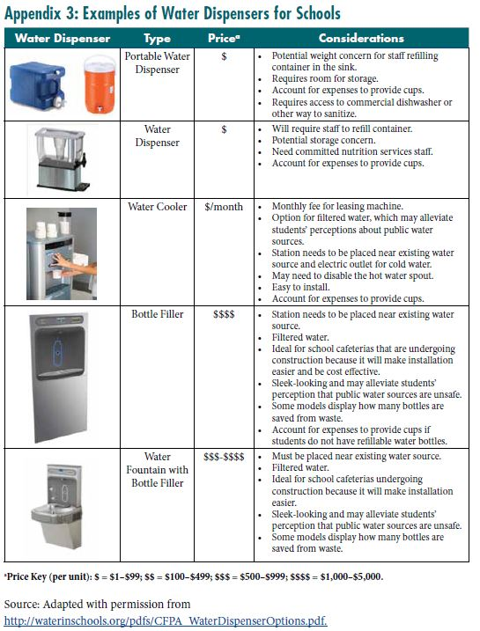
Water Delivery Methods
Know your budget
Decide where the water access point(s) will be located
Consider providing cups or allowing the use of reusable water bottles
Notes:
NARRATIVE
Once you know the current water environment at your school, one potential priority action might be to install new water access points in the school or to retrofit existing fountains. This decision will depend on where the water access points will be located and the available budget.
Appendix 3 provides examples of different methods for providing water, including general price points and key considerations such as where the water access points will be located. Knowing where water access points will be located will help to determine whether a plumbed access point or nonplumbed access point will be the most appropriate. Plumbed access points, such as water fountains and water bottle filling stations and some models of water coolers, require direct access to the building’s water pipes, whereas nonplumbed access points (e.g., pitchers) do not require direct access to the water pipes
Although all new water access options will require some initial funding to implement, there is evidence that water provision options that rely on tap water have lower long-term costs. In addition, cups (e.g., reusable, recyclable, or compostable) or reusable water bottles for students should be considered in the water access budget.

Slide 28

Identify Training Needs
Additional staff time
Labor contracts
Training for school staff
Notes:
NARRATIVE
Depending on how the school chooses to address water access, there are questions related to staffing that will need to be addressed.
Additional staff time may be needed to maintain existing and new water access points to ensure that they are functioning properly, regularly sanitized and cleaned, have adequate water pressure, and to clean up spills.
Labor contracts may include language related to lifting heavy containers and cleaning or maintaining water fountains.
School staff may require training on different aspects of providing drinking water in schools. School nutrition staff may require training on how to provide and maintain drinking water access points in the cafeteria in compliance with the sanitary code, including how to disassemble and sanitize new equipment. Principals and other staff (e.g., counselors, physical education teachers, and athletic coaches) may require training on how to promote drinking water among students throughout the school day and during physical activity. Teachers may require training on the health benefits of drinking water and how to promote drinking water among students, such as through inclusion of benefits of water consumption in health education and other subject area lesson plans. Custodial staff may require training on how to maintain and clean water fountains or water dispensers, as well as perform basic repairs, if needed. Further, local health inspectors may require or recommend additional training for school staff, such as water testing or flushing protocol, if needed.

Slide 29
Ideas to Promote Water
Place signs near water fountains and dispensers
Include messages about the benefits of water in school newsletters and communication materials
List water on the school meal menus
Include content about water into lesson plans
Engage students in water promotion activities
Notes:
NARRATIVE
It is important to promote water for overall health and as a healthy beverage option. Interventions that have improved drinking water access with concurrent education (e.g., by teachers) to change beverage preferences have been more effective at increasing water intake.
Example of promotion strategies include
Placing signs near water fountains and dispensers.
Including messages about the benefits of water in school newsletters and communication materials sent to parents and families.
Listing water as an available beverage on the school meals menu.
Including content about water into lesson plans.
Engaging students in water promotion activities.
Key messages could focus on:
The importance of water for overall health.
That fluoridated water prevents tooth decay in people of all ages.
Water as the optimal beverage to quench thirst.
The health benefits of replacing calorically sweetened beverages with water.
The quality and safety of tap water.
The environmental benefits of drinking tap water instead of bottled beverages, including bottled water.
The cost savings of drinking tap water compared with other beverages.

Slide 30

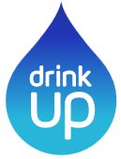

Examples of Water Promotion Campaigns
Drink Up
http://www.youarewhatyoudrink.org/
Potter the Otter
http://www.potterloveswater.com/
Rethink Your Drink
http://www.cdph.ca.gov/programs/wicworks/Pages/WICRethinkYourDrink.aspx
Louisville Pure Tap
http://www.louisvillepuretap.com/
Notes:
NARRATIVE
The tool kit also includes a list of promotional campaigns to help promote drinking water including those shown on the slide.

Slide 31
Address Sustainability
Budget for necessary supplies and repairs
Include language about water access to district policies
Ensure that district maintenance and food service policies specify who is responsible for maintaining water dispensers
Promote water access
Share success stories
Notes:
NARRATIVE
It is important to consider how water access efforts can be maintained once the water access plan has been implemented. Suggestions for sustaining water access in school include the following:
Budgeting for necessary supplies (e.g., cups) and repairs.
Adding language about water access to district policies. Examples of language that could be incorporated in a LWP include the following:
Provide all students and employees with access to clean, safe, palatable drinking water free of charge at every district facility, including cafeteria and eating areas, classrooms, hallways, play yards and athletic fields, and faculty lounges throughout the school day and at before- and after-school activities
Allow students to bring drinking water from home and to take water into the classroom, provided that the water is in a clear, capped container, such as a water bottle, to prevent spills.
Encourage school administrators, teachers, and building staff to model healthy behavior, including drinking tap water.
Require repairs to bring school buildings into compliance with state and local plumbing codes and relevant state laws.
Establish hygiene standards for water access points, including how often they should be cleaned.
Promote water through multiple methods, including providing cups at water access points.
Ensuring that district maintenance and food service policies specify who is responsible for maintaining the water access points, including the frequency of cleaning and maintaining water fountains or other water sources, the frequency of testing water for contaminants, as well as flushing water outlets after periods of no use, such as weekends or school vacations, and spot checks to ensure implementation of policies.
Promoting water access by using posters, signs, newsletters, and announcements will encourage students and school staff to continue to use water access points.
Sharing success stories in the local newspaper, school Web site and social media, newsletters, and school board meetings can help other schools in their efforts to improve access to drinking water.

Slide 32
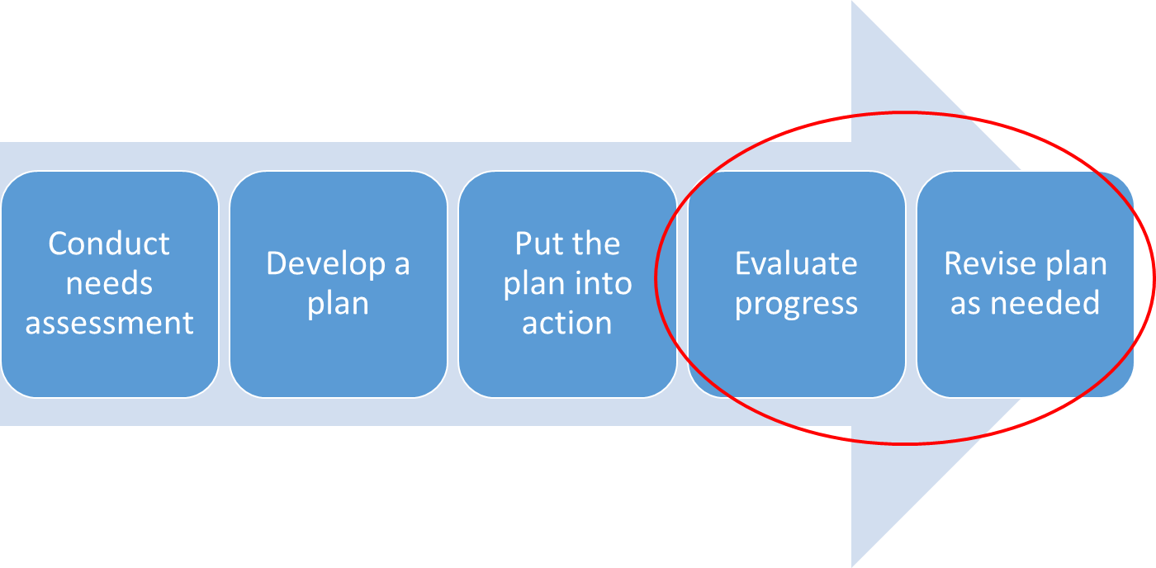
Process for increasing access to drinking water in schools
Notes:
NARRATIVE
Evaluation can help access to drinking water policies and practices by identifying strengths and weakness, developing plans for improvement, improving the implementation of policies and practices, and measuring changes in the school environment, as well as the dietary habits of students and staff.

Slide 33
Evaluate Progress
1
Process evaluation
2
Outcome evaluation
3
Use results to inform program or policy improvements
Notes:
NARRATIVE
There are two main types of evaluation: process and outcome. Process evaluation aims to assess the extent to which a policy, program, or practice has been implemented as intended, and can help identify ways to improve implementation in the future.
Outcome evaluation is used to assess if specific changes occurred as a result of implementing policies or practices.
It is important to plan an evaluation that can be used to further improve policies and practices. The goals and objectives that have been developed as part of the water access implementation plan will guide the evaluation design, including what information should be collected.

Slide 34
Example Process Evaluation Questions
  Were water access points added in the school setting? If so, how many?
  Are cups provided at water access points? If so, how many cups were used? What was the cost of providing the cups?
  Has language on water access been added to the local school wellness policy or other school policy?
Notes:
NARRATIVE
Example process evaluation questions include
Were water access points added in the school setting? If so, how many?
Are cups provided at water access points? If so, how many cups were used? What was the cost of providing the cups?
Has language on water access been added to the local school wellness policy or other school policy?

Slide 35
Example Outcome Evaluation Questions
  Have students’ perceptions of access to water among school settings changed?
  Have students’ attitudes and preferences related to water changed?
  Have students’ consumption of water and other beverages changed?
Notes:
NARRATIVE
Example outcome evaluation questions include
Have students’ perceptions of access to water among school settings changed?
Have students’ attitudes and preferences related to water changed?
Have students’ consumption of water and other beverages changed?
More guidance on evaluation is included in the Evaluation section of the tool kit.

Slide 36
Appendices
Notes:
NARRATIVE
The water tool kit also includes several appendices that can help with your work in this area.

Slide 37
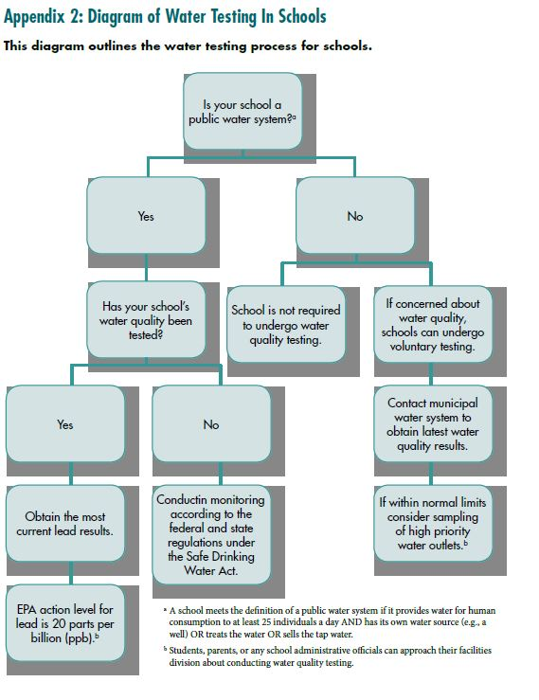
Appendix 2:
Notes:
NARRATIVE
Appendix 2 provides an overview of how to get started on testing water in schools.
This scheme reflects federal guidance therefore the final box at the bottom left hand corner of the slide states that action should be taken if the water sample has ≥20 parts per billion (ppb) of lead. However, states may establish standards that are stricter than federal standards. Please check with your state regulations on this issue.

Slide 38
Appendix 3
Notes:
NARRATIVE
Appendix 3 provides examples of different types of water dispensers including price ranges and key considerations for each example.

Slide 39
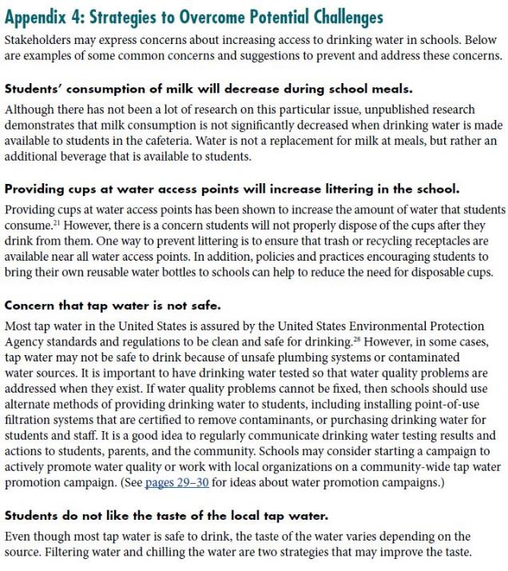
Strategies to Overcome Potential Challenges
Key topics addressed
Milk consumption
Providing cups
Water safety
Tap water taste
Water bottles
Notes:
NARRATIVE
Appendix 4 includes responses to common concerns about increasing access to drinking water in schools including concerns about
milk consumption decreasing during school meals
Proving cups will increase lettering in the school
Safety of tap water
Students do not liking the taste of tap water
Potential misuse of water bottles.

Slide 40
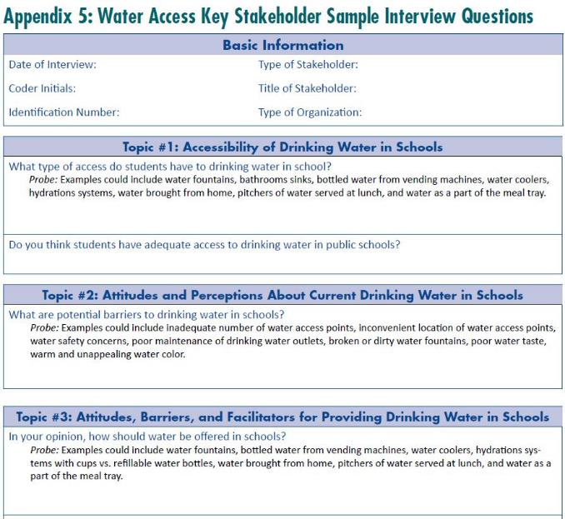
Key Stakeholder Sample Interview Questions
Interview Questions Address
Availability of water
Attitudes and perceptions
Barriers and facilitators
Notes:
NARRATIVE
Appendix 5 provides examples of stakeholder interview questionnaire that can be adapted and used to find out more about students’ attitudes and perceptions about drinking water access at schools.

Slide 41
Success Stories
Notes:
NARRATIVE
The tool kit includes examples of success stories related to different water access activities including policy changes, securing funding for new water dispensers, and promoting water.

Slide 42

Successful Water Access Wellness Policies
Earlimart School District (CA)
Provides students and employees with drinking water free of charge
Allows students to bring drinking water from home and into the classrooms
Encourages school administrators, teachers, and other staff to model drinking water.
District performs maintenance and testing of all water fountains regularly
Makes test results available in an easily accessible format.
http://www.californiaprojectlean.org/docuserfiles/Case%20Studies_Earlimart-Final.pdf
Notes:
NARRATIVE
Schools throughout the country have adopted a variety of policies and practices to improve access to drinking water on campus. The following example illustrates a district that includes language on access to drinking water in the district wellness policy:
Earlimart School District in California adopted a wellness policy that requires water to be accessible throughout the school day, as well as during before-school and after-school activities. It allows students to take water into the classroom in capped containers, and it also includes provisions on periodic maintenance of water fountains and testing of water sources. http://www.californiaprojectlean.org/docuserfiles/Case%20Studies_Earlimart-Final.pdf

Slide 43
Successful Funding for Water Access and Promotion in Schools
Water jets in NYC schools funded by city departments of health and education
Photos courtesy of Dr. Brian Elbel, NYU School of Medicine
Notes:
NARRATIVE
New York City public schools received funding and technical support from the city departments of health and education to purchase and install new water dispensers called water jets in school cafeterias.
As a result of this work, there was a significant increase in the number of students taking water during the meal periods.
Reference: Elbel B, Mijanovich T, Abrams C, Cantor J, Dunn L, Nonas C, Cappola K, Onufrak S, Park S. A Water Availability Intervention in New York City Public Schools: Influence on Youths’ Water and Milk Behaviors. AmJPublicHealth. 2015;105: 365–372.

Slide 44
Successful Partnerships
Photos courtesy of Louisville Water Company
http://www.louisvillepuretap.com
Notes:
NARRATIVE
Louisville Water and Jefferson County Public Schools in Louisville, Kentucky, worked together to create Louisville Pure Tap drinking water filling stations in schools including signage promoting water above the fill stations (produced by Louisville Water).

Slide 45
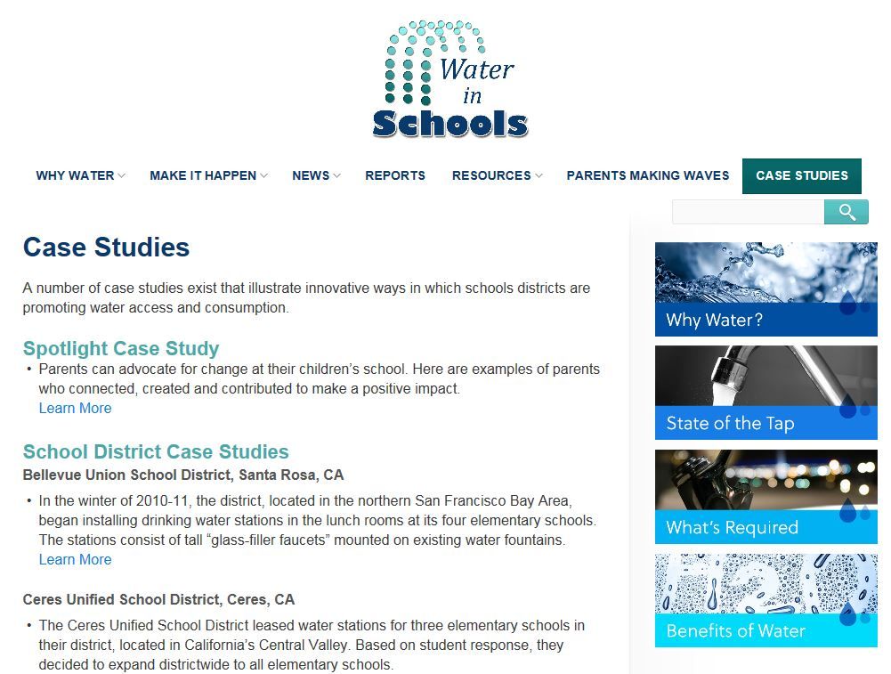
Water in Schools: Case Studies
www.waterinschools.org
Notes:
NARRATIVE
The waterinschools.org web site is a great resource that includes more case studies and resources to help guide your work in this area.

Slide 46
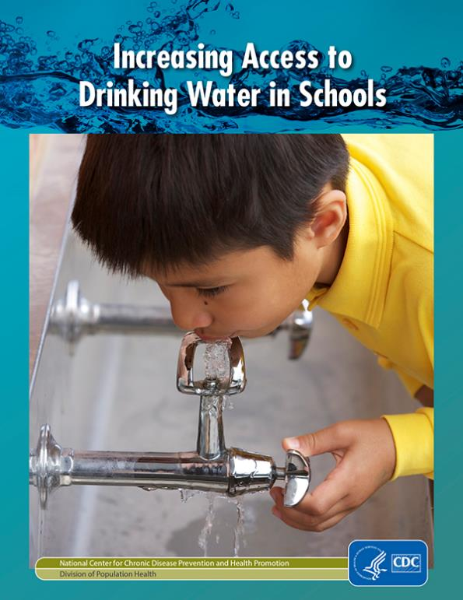
Download the Tool Kit!
https://www.cdc.gov/healthyschools/npao/pdf/water_access_in_schools_508.pdf
Notes:
NARRATIVE
You can download the tool kit at http://www.cdc.gov/healthyschools/npao/pdf/water_access_in_schools_508.pdf.

Slide 47
For more information please contact:
Centers for Disease Control and Prevention
National Center for Chronic Disease Prevention and Health Promotion
Division of Population Health
School Health Branch
1600 Clifton Road NE
Atlanta, GA 30333
1-800-CDC-INFO (232-4636)
TTY: 1-888-232-6348
cdcinfo@cdc.gov
http://www.cdc.gov/healthyschools/
www.cdc.gov/bam
Notes:
Thank you for reviewing this presentation.
If you have additional questions, please contact CDC by phone or by email.

