Slide 1
Acute Flaccid Myelitis (AFM): Clinical Overview
Division of Viral Diseases
Last Updated: 7/1/2022

Slide 2
Objective and Audience
The objective this slide set is to provide an overview of:
Clinical presentation of patients with AFM
Initial evaluation and management
Medical treatment considerations
Reporting suspected AFM cases to public health
The primary audience is:
Clinicians, especially those in the urgent care, emergency medicine, and primary care settings, and those seeing primarily pediatric patients
Many patients initially present to urgent care or the emergency room for acute onset of limb weakness, so it is important for clinicians in these settings to be aware of AFM.

Slide 3
Acute Flaccid Myelitis (AFM)
The term was coined in fall 2014 to describe patients with onset of acute flaccid limb weakness without a known cause
Clinical presentation is similar to poliomyelitis
Gray matter (neurons) of the spinal cord is affected
Most cases are in children
Viral causes:
non-polio enteroviruses (EV-D68, EV-A71)
flaviviruses (West Nile virus, Japanese encephalitis virus)
herpesviruses
adenoviruses
Caption: Cross-section of the spinal cord showing the gray matter and lower motor neurons affected in AFM.

Slide 4
How to Recognize AFM
What clinical characteristics would make you suspect AFM?

Slide 5
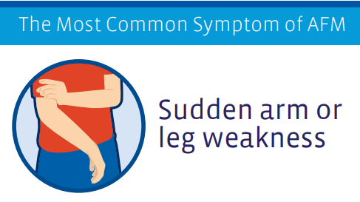
AFM Clinical Presentation
Most patients had preceding febrile illness 1-2 weeks before onset of acute flaccid limb weakness
Frequently respiratory or gastrointestinal illness (GI) with symptoms of fever, rhinorrhea, cough, vomiting or diarrhea
Onset of weakness is rapid
Within hours to a few days
Weakness is in one or more limbs
More proximal than distal
Loss of muscle tone and reflexes
https://www.cdc.gov/acute-flaccid-myelitis/symptoms.html

Slide 6
AFM Clinical Presentation (2)
Cranial nerve abnormalities may be present
Facial or eyelid droop
Difficulty swallowing or speaking
Hoarse or weak cry
Some patients may complain about stiff neck, headache, or pain in the affected limb(s)
In uncommon cases, people may also:
Have numbness or tingling
https://www.cdc.gov/acute-flaccid-myelitis/symptoms.html

Slide 7
AFM Clinical Presentation (3)
The most severe symptoms of AFM are:
Respiratory failure, requiring mechanical ventilation
Serious neurologic complications such as body temperature changes and blood pressure instability that could be life threatening
Clinicians should immediately admit patients to the hospital because AFM can progress rapidly and require urgent medical intervention, like assistance with breathing.
https://www.cdc.gov/acute-flaccid-myelitis/symptoms.html

Slide 8
Differential Diagnosis of Flaccid Limb Weakness
AFM may resemble:
Synovitis
Neuritis
Limb injury
Guillain-Barre syndrome (GBS)
Transverse myelitis
Stroke, including spinal stroke
Tumor
Acute cord compression
Conversion disorder
AFM must be high on differential diagnosis in late summer or early fall, especially in patients with preceding viral symptoms.
Careful neurological examination, laboratory testing, and MRI of the spine and brain can help guide diagnosis
Murphy O, Pardo C. AFM: A Clinical Review. Semin Neurology. 2020 April; 40(2): 211-218.; Hardy D, Hopkins SE. Update on AFM: Recognition, reporting, aetiology, and outcomes. Arch Dis Child. 2020 Feb 10. DOI: 10.1136/archdischild-2019-316817; Hopkins SE, Elrick MJ, Messacar K. Acute Flaccid Myelitis – Keys to Diagnosis, Questions About Treatment, and Future Directions.
JAMA Pediatrics. 2018. Nov 30. DOI: 10.1001/jamapediatrics.2018.4896

Slide 9
Initial Evaluation
What should you look for and ask patients who present with acute flaccid limb weakness?

Slide 10
Medical History
Collect information on any illness in the past 4 weeks
Note respiratory and GI symptoms, with or without fever
Ask about hand, foot, and mouth lesions (possible EV-A71 or similar viral infection)
https://www.cdc.gov/acute-flaccid-myelitis/hcp/clinicians-health-departments/evaluation.html

Slide 11
Focused, Age-appropriate Assessment and Questions to Evaluate Limb Function Impairment(s)
Young children or their parents may not describe their limb function impairment as “weakness”
New inability or difficulty | Example questions to ask about limb function
To use arm(s)/hand(s) | Can they feed themselves? Are they suddenly using one limb less or refusing to use one limb?
To raise arm(s) above the head | Can they put on or take off a T-shirt? Can they throw a ball overhead?
To walk | Are they limping or dragging a leg? Are they falling often while walking?
To get up unassisted from sitting or squat | Can they put on or take off pants? Can they get out of bathtub unassisted?
https://www.cdc.gov/acute-flaccid-myelitis/hcp/clinicians-health-departments/evaluation-weakness.html

Slide 12
Examining Proximal Muscle Weakness in Children
When examining patients with sudden limb, neck, or trunk weakness, remember to check both proximal and distal muscle strength, as impairment in proximal strength can be easily missed during exams.
https://www.cdc.gov/acute-flaccid-myelitis/downloads/examining-proximal-muscle-weakness-508.pdf

Slide 13
Additional Signs and Symptoms
Ask about additional signs and symptoms, including:
Difficulty holding their head up
Decreased appetite or difficulty swallowing
Increased sleepiness or inactivity
Headache or neck, shoulder, or back pain
Patients often complain of this prior or concurrent to weakness
Pain in extremities
Bowel or bladder changes, particularly constipation

Slide 14
Physical and Age-appropriate Neurological Exam
Neurological examination should include documentation of:
Muscle tone (flaccid/loose vs spastic/tight and firm)
Muscle strength (full strength, move against gravity with some resistance/pressure, move against gravity but with no resistance/pressure, or little limb movement but not against gravity, no muscle movement at all)
Reflexes in each extremity (hypo-, hyper, or absent)
Any cranial nerve deficiencies such as for facial, palatal and shoulder asymmetry, hoarseness or hypophonia and dysphagia (if possible)
Note: Sensory exam is often normal in patients with AFM
https://www.cdc.gov/acute-flaccid-myelitis/hcp/clinicians-health-departments/evaluation.html

Slide 15
Physical Exam (cont.)
Assess the patient’s ability to protect their airway
Document respiratory sufficiency
Negative inspiratory force may be used if the child is old enough and able to cooperate
Check for autonomic manifestations
Blood pressure lability
Body temperature instability

Slide 16
Diagnostic Studies
What specimens and tests are needed for the initial AFM work-up?

Slide 17
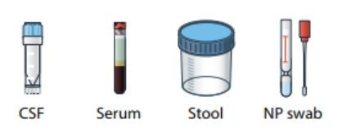
Initial Neurodiagnostic Studies
Laboratory Tests
Cerebrospinal fluid (CSF)
cell count with differential, protein and glucose; oligoclonal bands; meningitis/encephalitis PCR panel
Serum
EV PCR, anti-MOG (myelin oligodendrocyte glycoprotein) and anti-aquaporin antibodies, HSV, EBV, WNV
Stool for EV PCR
Nasopharyngeal (NP) and/or oropharyngeal (OP) swabs
respiratory multiplex testing and enterovirus (EV) PCR
Neuroimaging
MRI of the spine and brain
Consider additional pathogen-specific testing (e.g., Lyme) based on seasonality, exposures, and geography
Note: Some of these studies may require sedation, depending on child’s age
Coordinate the procedures to avoid repetitive sedation if possible
Monitor respiratory status continuously
Hardy D, Hopkins SE. Update on AFM: Recognition, reporting, aetiology, and outcomes. Arch Dis Child. 2020 Feb 10. DOI:: 10.1136/archdischild-2019-316817;
https://www.cdc.gov/acute-flaccid-myelitis/hcp/clinicians-health-departments/testing.html

Slide 18
Laboratory Specimen Collection
Rapid specimen collection increases the chance of pathogen detection
Specific testing for AFM should be done in consultation with a neurologist and infectious disease specialists
CSF, respiratory (NP/OP), serum, and stool specimens should be also sent to CDC for surveillance testing*
Consider additional pathogen-specific testing based on seasonality, exposures, and geography and clinical presentation
*Contact your health department to coordinate sending of specimens to CDC for testing: https://www.cdc.gov/acute-flaccid-myelitis/hcp/contact-info.html
https://www.cdc.gov/acute-flaccid-myelitis/hcp/specimen-collection.html

Slide 19
MRI Imaging
Order MRI of the spine and brain with and without contrast
Use the highest tesla scanner available (ideally 3T)
Imaging within the first 72 hours of limb weakness may be normal and should be repeated if clinically indicated
Axial and sagittal images are most helpful in identifying lesions
Multiple levels of the spinal cord are often involved, consider imaging entire spinal cord
In patients with cranial nerve deficits, high cuts of brainstem or total brain MRI should be considered
Although lesions are predominantly gray matter, some patients with AFM may also have some white matter involvement

Slide 20
Characteristic MRI Findings in AFM
A, B. Sagittal and axial images demonstrating hyperintensity of the entire central gray matter of the thoracic spinal cord; on axial imaging, demonstrating characteristic ‘H’ shape pattern.
D, E. Sagittal and axial images demonstrating T2 hyperintensity confined to the left anterior horn cells (best demonstrated in E)
Maloney JA et al. Am J Neuroradiol 2015;36(2):245-50.

Slide 21
Clinical Management of AFM
What treatment can be considered for patients with AFM?

Slide 22
Hospitalize when AFM is suspected
Assess the patient’s ability to protect airway
Manage patient in hospital equipped with ventilator
Consult with neurology and infectious disease experts to guide treatment and clinical management decisions
Siegel Rare Neuroimmune Association (SRNA) providers a portal for clinicians to contact AFM experts with any question: https://wearesrna.org/living-with-myelitis/resources/afm-physician-support-portal/
Review the clinical guidance available on the CDC AFM website at:
https://www.cdc.gov/acute-flaccid-myelitis/hcp/clinical-management.html
This document will be updated regularly as new evidence becomes available

Slide 23
Medical Treatments for AFM
Treatments commonly used for AFM in the acute phase include:
Intravenous immunoglobulin (IVIG)
Corticosteroids
Therapeutic Plasma Exchange (TPE)
There is not enough human evidence to indicate a preference or an avoidance for their use at this time
Treatment decisions should be made in conjunction with neurology and infectious disease experts
Potential benefits of using corticosteroids for spinal cord edema or white matter involvement must be balanced by potential harm due to immunosuppression in the setting of a possible viral infection
There is no indication for the use of fluoxetine, antiviral, and/or other immunosuppressive agents for AFM

Slide 24
Reporting of AFM
How to report suspected AFM cases to the health department?

Slide 25
Report suspected AFM patients who meet the AFM clinical criteria to public health
Reporting of cases should not delay a patient’s diagnosis and/or treatment and management plan
A case classification by CDC is not meant to override a clinician’s diagnosis of a patient’s illness, or their treatment and rehabilitation plan
Sharing information through reporting is vital for a better understanding of AFM and its pathogenesis to inform treatment and prevention strategies
For more information on reporting, see CDC’s webpage for clinicians and health departments: https://www.cdc.gov/acute-flaccid-myelitis/hcp/clinicians-health-departments.html
AFM Clinical Criteria for Reporting:
Acute onset of flaccid limb weakness
(even if lab/MRI results are still pending)

Slide 26
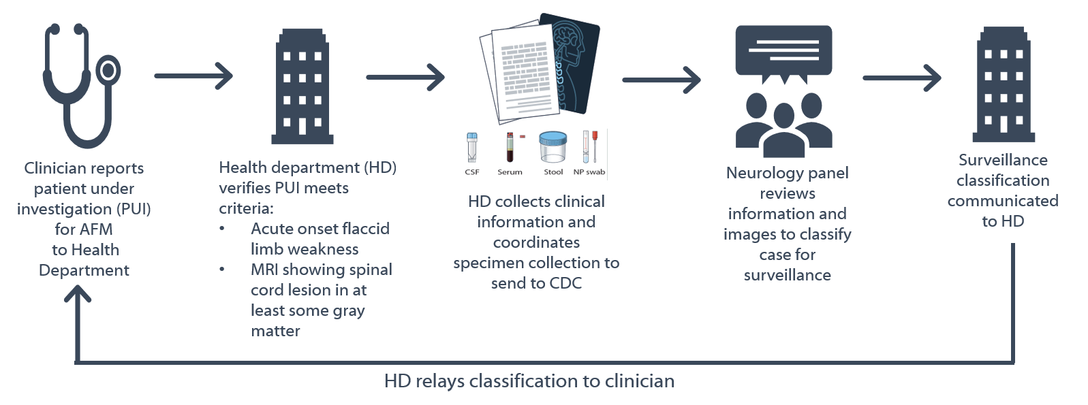
AFM Surveillance Processes
Notes:
The source of CDC surveillance data for AFM is via health departments from the reporting clinician. Once a clinician recognizes that a patient may have AFM, they alert the health department who assists in the collection of pertinent medical information, magnetic resonance images, and biological specimens to send to CDC. CDC works with an expert panel of neurologists to review the medical information and images and provide a case classification. The surveillance case classification is communicated back to the health department and then to the clinician and family.

Slide 27
Summary
Recognize, Hospitalize, and Report

Slide 28
AFM patients can deteriorate quickly and rapidly progress to respiratory failure
Most patients have a preceding febrile illness 1-2 weeks before onset of acute flaccid limb weakness
Perform and document a thorough neurologic exam
Hospitalize when AFM is suspected
Assess the patient’s ability to protect airway
Manage patient in hospital equipped with ventilator
Obtain specimens early to optimize yield for detecting a pathogen, including CSF through lumbar puncture
Order MRI of the full spine and brain (sedation may be required)
Consult with neurology and infectious disease experts to guide treatment and clinical management decisions

Slide 29
For more information
Visit www.cdc.gov/afm
Contact CDC AFM program at AFMinfo@cdc.gov
Contact other AFM specialists via the AFM Physician Consult and Support Portal: https://wearesrna.org/living-with-myelitis/resources/afm-physician-support-portal/

